Slide 1
Informatics and Informaticists
Jay Greenfield, PhD
Member of the Data Documentation Initiative (DDI) Data Description Moving Forward Project

Slide 2
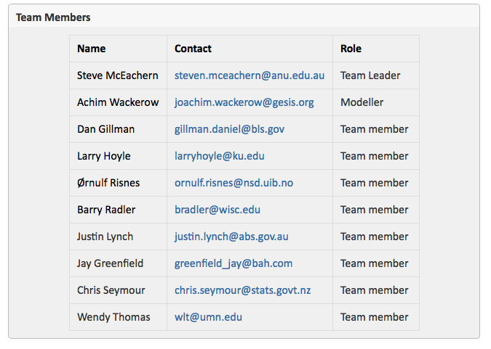
Acknowledgements
The DDI Moving Forward Data Description Team began working on the structure of a simple data description to cover archival data storage formats and to provide an extension base for describing more complex data description (i.e. databases)
A shift occurred during the Minneapolis Sprint (2015-05-25)
There it seemed within reach that at long last we might be able to account for and relate many different types of databases in a single model
Currently the team is working to prove the Minneapolis vision by using the model presented here to describe several data management solutions

Slide 3
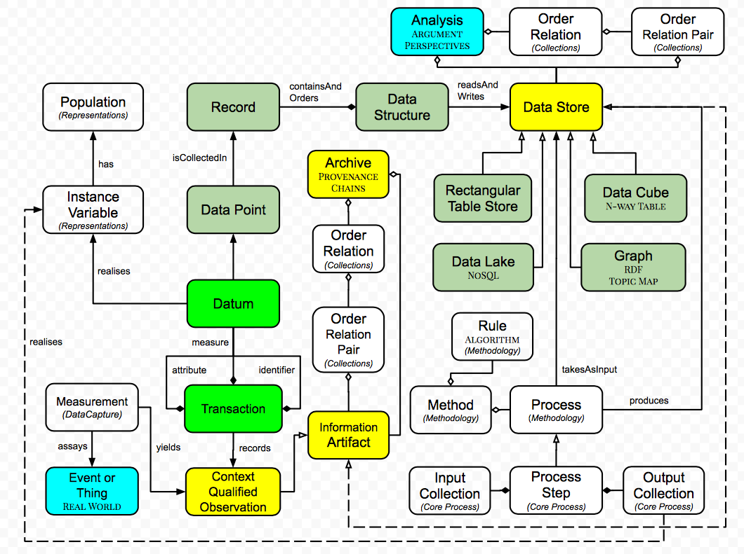
A data store is an information object in a chain of information objects that begins with real world events and things
In this chain events and things are observed and observation yields information
Data stores are used to understand this information
Information and information objects like data stores are not new
Books have been around for a while
So have documents and tables
However, as a consequence of computers, new types of information objects like dimensional stores in the late twentieth century and now data lakes in the twenty-first century have sprung into being
As a consequence, we now find ourselves in the position of having a new story to tell about information
This story is called informatics and the storytellers are called informaticists
One surprise in this story are transactions. Transactions preserve context and enable us to think about and understand events and things as a whole
Context might include metadata like a question asked or the kind of cuff used to take a blood measure
Context might include paradata like how long it took to answer a question or the condition of a person during a blood pressure reading

Slide 4
Another surprise is that with the emergence of new types of data models, informaticists can now look at events and things from many perspectives
Graphs (RDF) and topic maps (Google) are also data stores
Today, to gain perspective, we don’t limit ourselves to a single model
Instead we build models and stores as needed
Today, increasingly, we build models downstream
Also, one model like a data lake can lead to others like tables and graphs and vice versa.
Data exploration – again facilitated by computers – leads us to tweak data structures and build new data stores
Finally, data stores themselves become nodes in a data analysis that we traverse, making arguments and seeing events and things from multiple connected perspectives
One product of the stores that we build are papers in which we chain together tables to make arguments and gain perspective on real world events and things
A second product is an archive
The archive contains information artifacts such as the data we first captured and any data we derive from other data

Slide 5
Additionally, the archive captures the method, algorithms and processes we use as we create data from data
These derivations take the form of a chain called the provenance chain
Provenance chains need to describe the derivation process in enough detail so that other scientists can reproduce first the data stores and then the tables that are used to analyze, understand and report results
Given enough detail, provenance chains are not just historical in nature. They can be used by a software agent both to repeat and perform new analyses
Through the myriad of data stores, informaticists turn information into knowledge
We are approaching a time when anyone who is curious can be an informaticist because of the emergence of computers and tools
The informaticist need not be technical
Instead, as time goes forward and with the benefit of tools, it is both essential and enough that we be SMEs

