Slide 1
When DDI 4 is complete…. (Using an archive as an analogy)

Slide 2
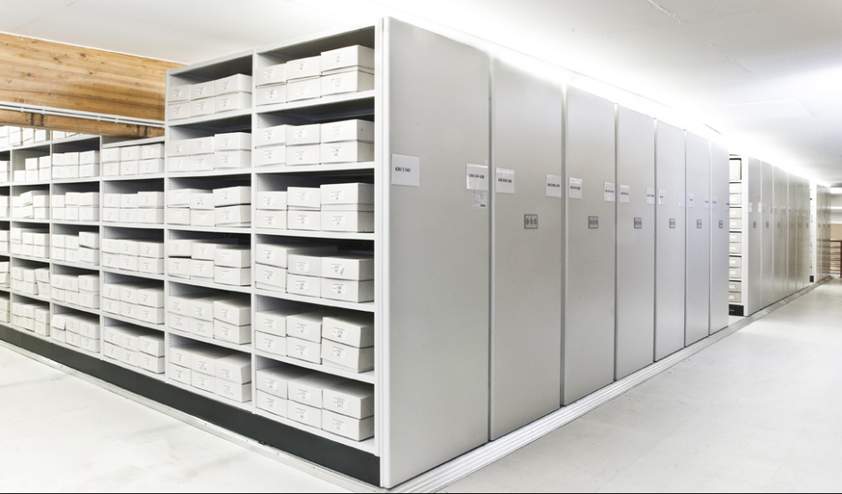
Imagine the DDI4 is like an archive. There is a room full of the information that DDI 4 covers. This information in is nicely organised into rows and shelves and boxes.
Data sets
Constructs
Physical data structures
Study
Glue
Data file
Data
Logical data structures
Record layout

Slide 3
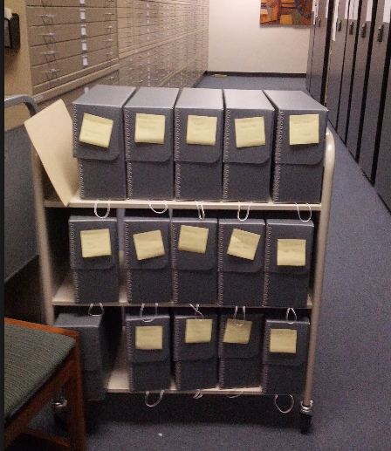
Typical users will come to the archive with a particular use case in mind. The archivist will give them the subset of information that is most useful to them.

Slide 4
Sophisticated users will be able to go into the actual archive to find the set of information that is most useful to them.
Most people never see the way the information is sorted into rows, shelves and boxes.

Slide 5
IN DDI 4 terms..
Library
Package
Data sets
Constructs
Physical data structures
Study
Glue
Data file
Logical data structures
Record layout

Slide 6
IN DDI 4 terms..
View

Slide 7
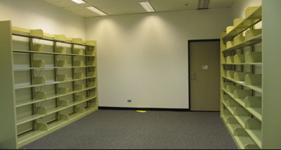
Creating DDI 4
At the moment our library is empty ☹

Slide 8
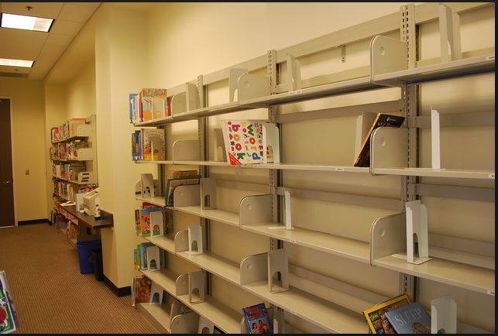
Creating DDI 4
We have to build the library.
The plan is to put in the information that we think the most people will need first
Process
Agent
Core
Concepts
Process
Discovery
Concept
Agent

Slide 9
Creating DDI 4
We know this is not complete and don’t know exactly how best to organise the information yet.
Release 1:
Information about:
Agent
Core
Concepts
Process
Use case:
Discovery
Process
Process
Concept
Concept
Agent
Agent

Slide 10
Creating DDI 4
We will start to work with people who have particular use cases (eg describing a simple instrument). We will have some of the information that is important to them and they will help us find the bit we are missing…and so the library get more things in it.
Release 2:
Information about:
Agent
Core
Concepts
Process
Use case:
Discovery
Simple Data Description
Simple Instrument
Classifications

Slide 11
Creating DDI 4
The further we go through the process, the less new things should have to be added to the library. For example, there should already be a lot of information in the library for complex instrument, because we already have the information for simple instrument.
Each release builds on the information already in the library.
Release 3:
Information about:
Agent
Core
Concepts
Process
Use case:
Discovery
Simple Data Description
Simple Instrument
Classifications
Simple Codebook
Comparison/ Harmonisation
Methodology
Complex Instrument
Complex Data Description

