Slide 1
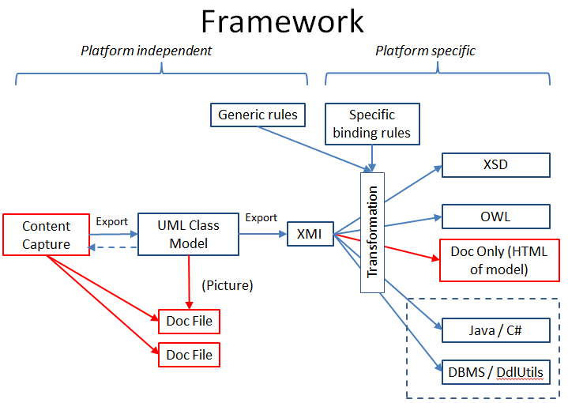
Content modelers define
Requirements for views,
And create needed new
objects.
After approval by
modelers, content
teams define views
from approved
library objects.

