Slide 1
Metadata Needs and Solution Possibilities
CODATA Pilots

Slide 2
Metadata Needs
The Pilot Data Stories
The Metadata these Stories Require
Current Challenges in Meeting these Requirements

Slide 3
Pilot Metadata Needs (1 of 2)
Speaking somewhat impressionistically, what I saw across all three pilots is a similar story unfolding:
There are disparate data sources — both quantitative and perhaps qualitative
They undergo data processing
The result is linked data sources that comes in a variety of data structures
The linked data is used to produce aggregates or, again, n-dimensional data cubes
In terms of standards perhaps what seems to be required is:
A single framework for representing microdata — both qualitative and quantitative, both “raw” and “linked” — regardless of the source(s)
A framework for representing data processing through which you can assure that on the way to the production of aggregates your processes are repeatable both within and between organizations
A framework for describing n-dimensional data cubes

Slide 4
Pilot Metadata Needs (2 of 2)
With regard to the state of knowledge representation within the pilots:
Aggregate definitions are often well known
Microdata definitions are variable, bedeviling and something we will need to get very smart about (i.e., "metadata infusion”). Note that metadata infusion sometimes involves “classification” and data science
Like most folks, we are all pretty clueless when it comes to creating repeatable processes

Slide 5
Solution Possibilities
Microdata
Aggregates
Linked Data and Data Linkages
Repeatable Processes

Slide 6
Microdata Metadata Discovery Tools
There are several tools available that read microdata as input and generate standard metadata as output at various levels of specificity
See the DDI website for descriptions of several transformation tools including Sledgehammer and Colectica for Excel
Additionally, there are components in the Splunk data pipeline that support automatic and interactive source typing once data is ingested
Automatic source typing relies on artificial intelligence (AI)
Interactive source typing makes a researcher a partner with an AI
Splunk has a special interest in growing its health data offerings and entering into partnerships with organizations that perform health data research

Slide 7
Aggregates (1 of 4)
There are three candidate standards that CODATA might consider for describing tabular data that report aggregates across dimensions:
DDI 3.2
SDMX 1.3
The RDF Data Cube Vocabulary
DDI 3.2 supports NCubes. SDMX 1.3 supports Data Structure Definitions. And the RDF Data Cube Vocabulary supports observations and slices
With all three standards, datasets are sources of aggregates, aggregates are constructed along dimensions and the dimensions may include time…

Slide 8
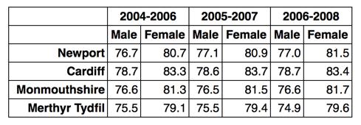
Aggregates (2 of 4)
In this example we can see that there are three dimensions - time period (rolling averages over three year timespans), region and sex. Each observation [aggregate] represents the life expectancy for that population (the measure) and we will need an attribute to define the units (years) of the measured values. An example of slicing the data would be to define slices in which the time and sex are fixed for each slice. Such slices then show the variation in life expectancy across the different regions, i.e. corresponding to the columns in the above tabular layout… (from The RDF Data Cube Vocabulary)

Slide 9
Aggregates (3 of 4)
The selection of one standard or another for describing aggregates depends on the CODATA reporting requirements
We are fortunate at Dagstuhl 2018 to have three participants who have been deeply involved in the development of one or more of these three standards: Dan Gillman, Arofan Gregory and Wendy Thomas
All three participants have opined on and compared the three standards so, if CODATA is interested in producing a standards-based description of the aggregates it builds, perhaps having a session with all three of these folks together would have value

Slide 10
Aggregates (4 of 4)
Note that the Generic Statistical Information Model (GSIM) was not included as a standards candidate here because, while it may be an “ancestor” of one or more of the three standards, GSIM is not an implementation model

Slide 11
Linked Data and Data Linkages (1 of 2)
Tabular data standards layer aggregates and dimensions on top of one or more datasets
In this process, disparate data sources are connected using data linkages
Data linkages are typically record relations based on keys
What falls out of these data linkages across datasets are various record structures like relational databases, hierarchical databases, star schemas, extremely indexed skinny key/value tables and the like
SDMX, DDI and the RDF Data Cube Vocabulary all support the description of these record structures and the data linkages and datasets they grow out of
Linked data, on the other hand, is a horse of a different color…

Slide 12
Linked Data and Data Linkages (2 of 2)
Linked data is something CODATA might want to consider apart from data linkages and the construction of aggregates
Linked data is another output alongside tabular data
DDI 4 supports the description of non-rectangular datasets
This, in turn, allows users to imagine and structure data graphically as mind maps
Mind maps can be used in support of discovery, search and persisting a series of subject matter insights
from Mind Map Gallery by Tony Buzan

Slide 13
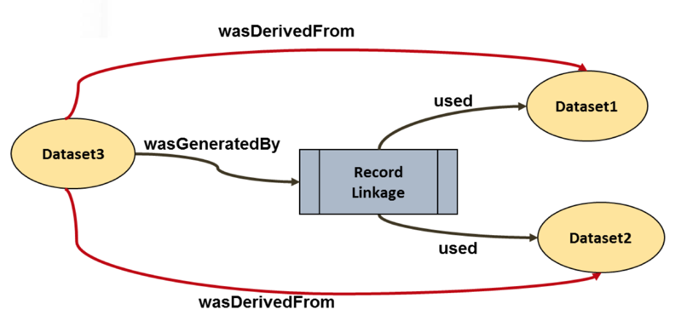
Repeatable Processes (1 of 4)
There are at least a couple of standards that can provide end-to-end descriptions of the provenance of data objects – PROV-O and the DDI 4 Data Management View
PROV-O is perhaps the gold standard, especially when it comes to describing the provenance of entities like datasets at a high level
This is not to say that PROV-O cannot be extended to describe transformations at, for example, the variable level of granularity
from Modeling Provenance in GSIM/CSPA-LIM by Francine Kalonji, Statistics Canada

Slide 14
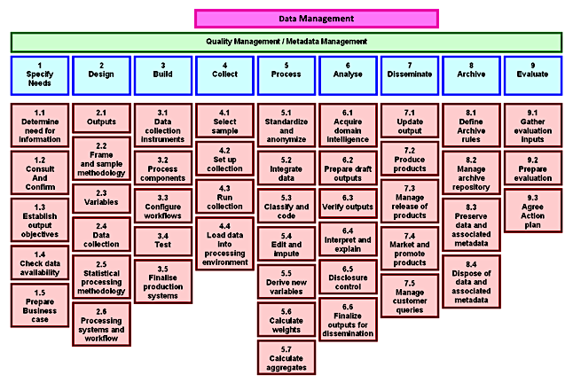
Repeatable Processes (2 of 4)
That being said, DDI 4 tracks provenance at two levels of granularity
By way of introduction, the Data Management View is a proposed Generic Statistical Business Process Model (GSBPM) overarching service whose scope includes the sub-processes (blocks) for GSBPM Phases 4 through 7

Slide 15
Repeatable Processes (3 of 4)
Data Management orchestrates the flow between blocks and the flow within blocks
The flow between blocks is the Data Pipeline of the GSBPM
The flow within each block consists of data transformation services, where the output(s) of one service are the input(s) of other services

Slide 16
Repeatable Processes (4 of 4)
Depending on the platform, services may be web services, BPMS activities or ETL transformations
Note that at the topmost level, the Data Management View is able to specialize the blocks and sub-blocks so they become a system of domain specific activities

Slide 17
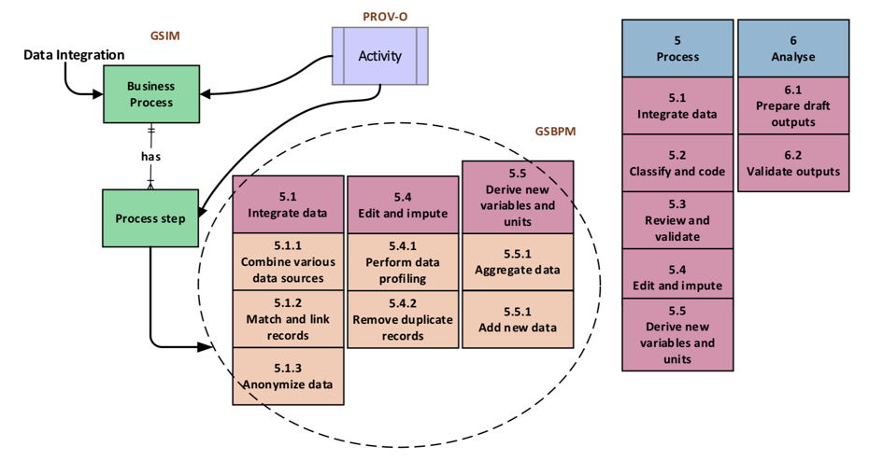
Adopting Standards: One or Many? (1 of 2)
In a case study Francine Kalonji at Statistics Canada considered the process of putting PROV-O, the GSBPM and GSIM together
The challenge she identified was mapping objects from one standard to another. In this case:
PROV-O: activity => GSIM: business process, process step and then
GSIM: process step => GSBPM: sub-process or sub-sub-process etc.

Slide 18
Adopting Standards: One or Many? (2 of 2)
In practice, when we map objects from one standard to another, it helps to have a common coin or, again, lingua franca such as UML
Nevertheless, it is a heavy lift conceptually because in the process Francine notes that we have to reconcile:
Similar terms and their definitions
Different terms with the same definition
In other words, it is necessary to build a common vocabulary or, again, an ontology across standards
Again, at Dagstuhl 2018 we are fortunate to have a number of participants with significant experience reconciling terms and building vocabularies including Dan Gillman, Eric Prud’hommeaux, Harold Solbrig and others

