Slide 1
DDI URN Resolution
Scientific Board 2021-07-13
Joachim Wackerow

Slide 2
High-Level Goals
Identifiable DDI objects can be used and re-used in many contexts
Core examples are concepts, questions, and variables
The intention of the DDI URN is to be a globally unique, persistent identifier for any DDI objects
The goal is to achieve a Globally Unique, Persistent and Resolvable Identifier (GUPRI) in the sense of the FAIR principle F1 “(Meta) data are assigned globally unique and persistent identifiers“
DDI objects with a GUPRI support the idea of DDI repositories and registries as well as the vision of a distributed DDI object network

Slide 3
DDI URN Resolution - High-Level View
A program requests a DDI object which is identified by a DDI URN and receives a copy of this object.
The main question are now:
Which solution can support efficiently the vision of a distributed DDI object network based on DDI repositories and registries?
How does this really work?
Related questions are:
Who has the responsibility to provide the basis for this?
What are the required resources (one-time and maintenance)?
The Scientific Board should create a proposal for a related policy
This is basically a strategic decision and would possibly require some resources.
With this background, a decision of the Executive Board might be necessary.

Slide 4
DDI URN as Resolvable Identifier (GUPRI)
A user (software program or human) is interested to get the object identified by a DDI URN.
A Uniform Resource Name (URN) is a Uniform Resource Identifier (URI). „URNs are globally unique persistent identifiers assigned within defined namespaces so they will be available for a long period of time, ... URNs cannot be used to directly locate an item …“
‘ddi’ is the URN namespace of DDI URNs.
A DDI URN needs a resolution to a physical location, Uniform Resource Locator (URL), which can be used to request the DDI object.
DDI agencies are responsible for the assignment of DDI URNs to their DDI objects. They are approved and listed in the DDI Alliance agency registry.

Slide 5
DDI URN Structure
urn:ddi:rai:di:vi
International Registration Data Identifier
Persistent, globally unique object identifier aligned with ISO/IEC 11179-6:2015, Information technology - Metadata registries (MDR) - Part 6: Registration, Annex A, Identifiers based on ISO/IEC 6523
rai – registration authority identifier
Identifier assigned to a Registration Authority, hereafter called Registration Authority Identifier (RAI). The RAI is called 'agency' in DDI-Codebook and DDI-Lifecycle.
di – data identifier
Identifier assigned to an Administered Item within a Registration Authority, hereafter called Data Identifier (DI). The DI is called 'id' in DDI-Codebook and DDI-Lifecycle.
vi – version identifier
Identifier assigned to a version under which an Administered Item registration is submitted or updated hereafter called Version Identifier (VI). The VI is called "version" in DDI-Codebook and DDI-Lifecycle.
Document “A Uniform Resource Name (URN) Namespace for the Data Documentation Initiative (DDI)”, https://datatracker.ietf.org/doc/draft-urn-ddi/. The details of the resolution approach is described in the appendices A and B.

Slide 6
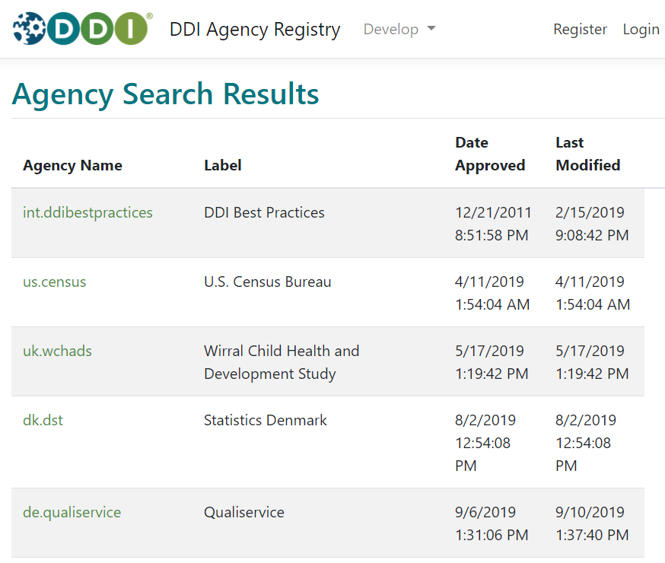
Registry of DDI Agencies

Slide 7
DNS-Based DDI URN Resolution
Conceivable: HTTP Resolution service
based on the entire structure
DNS - Domain Name System
ddi.urn.arpa
Option 1
registry.ddialliance.org
List of central
DDI URN services
Central resolution service
from URN to URL
DDI agency DNS server
Option 2
DDI agency DNS server
DDI agency DNS server
List of DDI URN services
per DDI agency
Resolution service per DDI agency
from URN to URL

Slide 8
Background on DDI URN and DNS
A DNS query on a DDI URN is delegated to the DDI Alliance server (registry.ddialliance.org). The server could answer two-fold:
Delegation of the query to a DNS server of a registered DDI agency. The DNS server of the DDI agency provides a list of available DDI services like resolution of DDI URNs to URLs. Prerequisite: resolution service per DDI agency
The DNS server of the DDI Alliance provides a list of available DDI services like resolution of DDI URNs to URLs. Prerequisite: central resolution service

