Slide 1
DDI Marketing and Partnerships Group
Activities Plan - 2021
Team:
Barry Radler
Jared Lyle
Steve McEachern
Ron Nakao
Dan Smith
Wendy Thomas

Slide 2
Mission Statement
Coordinate marketing activities, establish DDI brand, ensure consistent messaging about DDI and the Alliance
Goal: Promote DDI
Increase size of the DDI user community
Increase DDI Alliance membership (30 full, 15 associate)

Slide 3
Activities next 12 months
Promoting releases/reviews
Rebranding DDI Product Suite (FAIR)
Lifecycle 3.3, CDI, SDTL, etc.

Slide 4
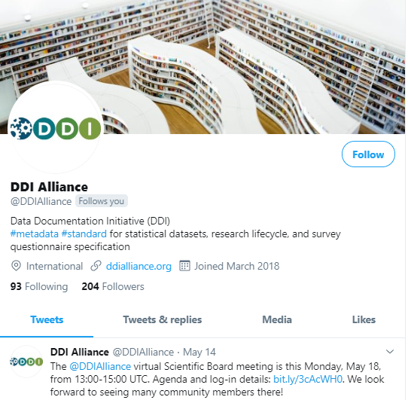
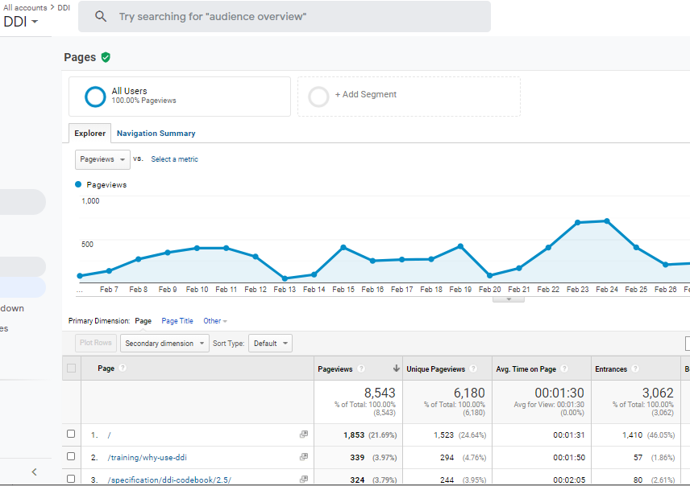
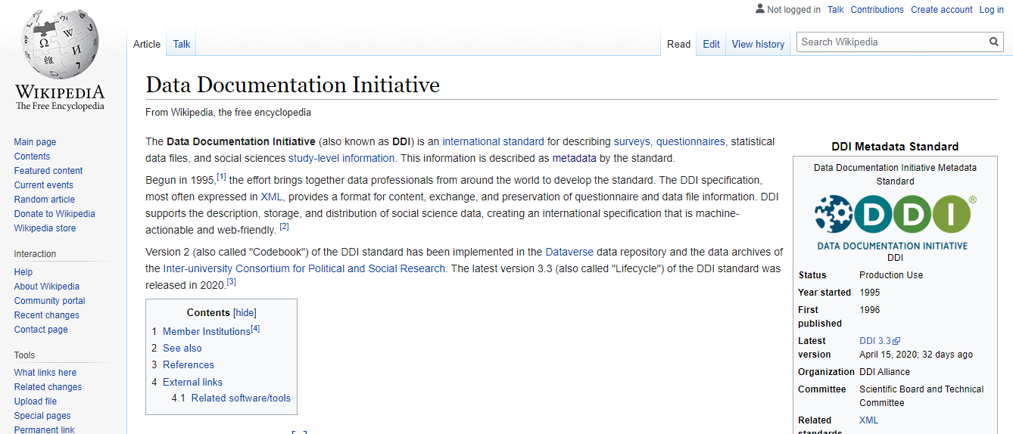
Activities next 12 months
Reorganizing website, manage media
Interfacing with working groups
Monitor website use (Analytics)

Slide 5
Activities next 12 months
Email communication: new member, retaining members
Template to welcome new DDI members.
Also for current members, annual refresh.
Updates about Scientific Board, bylaw changes, reminders of benefits and obligations.
Clarify process for joining working groups.
Managing mailing lists
Currently use MailMan to mange different email lists
Need opt-out opt-in to address privacy issues.
Discuss alternatives at annual meeting.
Manage list of email addresses
Create Slack channel

Slide 6
Longer term DDI Alliance goals
Conference attendance and active outreach
Revisit conference relationships
Coordination with Training and Technical Committees
Training Resources (aka Training Library)
Promotional videos
Webinars/tutorials
Dissemination of DDI stakeholder research
Recent in-depth interviews
Future web-based assessments

Slide 7
Longer term DDI Alliance goals
Develop a formal marketing strategy
Address the “Partnerships” aspect of the Marketing and Partnerships
Add to and/or refresh the Marketing and Partnership group's membership

