Slide 1
Documentation WG Outcomes
Friday October 28th 2016

Slide 2
Documentation Gaps & Improvements
Identify missing documentation (create “burndown” lists)
Improve granularity of documentation
Identify fields for export in the model
Review of usability
Graphics improvement
Capture additional fields at the class-level
Controlled vocabularies (DDI & External)
Quality of mappings (e.g. DDI 3.2)

Slide 3
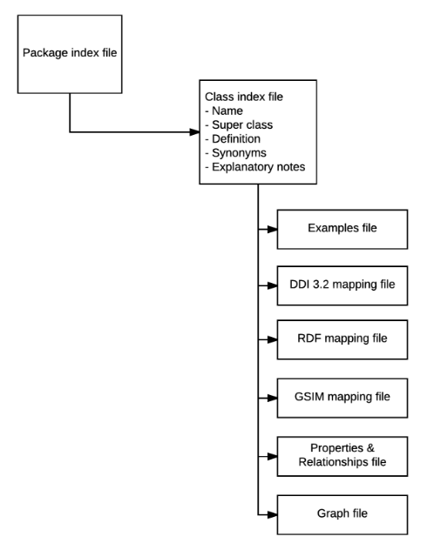
Documentation exporting & model inclusion

Slide 4
Topical mappings for documentation slicing
Identified a mechanism to incorporate topical mappings to class-level documentation to support slicing by different audiences
M – Mandatory
T - Technical
TL - Technical Lite
Audience | Types
Ourselves (Moving Forward) | everything
Deciders | M – High level
Developers | M + Technical
Documenters | M + T Lite
Researchers | M

Slide 5
Use Cases Builder
Currently no structured consistent way to build use cases, for different purposes (developers, modelling, end-users, etc.)
Proposal to build a mechanism to allow people to select classes and document use case workflows:
Validate against the schema
Testing of the model
Feedback loop built-in
Visualization of the workflow
Publish for reuse

Slide 6
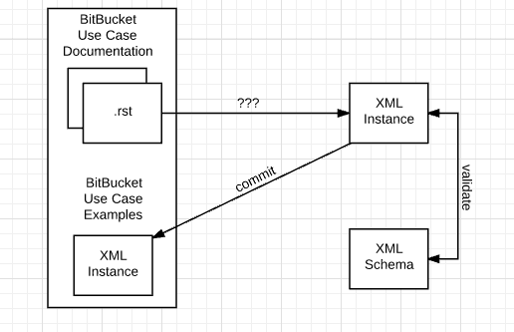
Use Case workflow example

Slide 7
RST output (data capture example)
https://ddi-alliance.atlassian.net/wiki/download/attachments/54493207/usecasepage.png?api=v2

Slide 8
Thanks!

