Slide 2
A brief Introduction to CDISC Foundational Standards

Slide 3
Standards &
Regulated Clinical Research
End-to-end standardization of study data
Protocol CRF CTDB Edit checks SDTM SAP Standard TFLs Define.xml
Datasets ADaM Data
Controlled terminology
Standardization
Collaboration
Communication

Slide 4
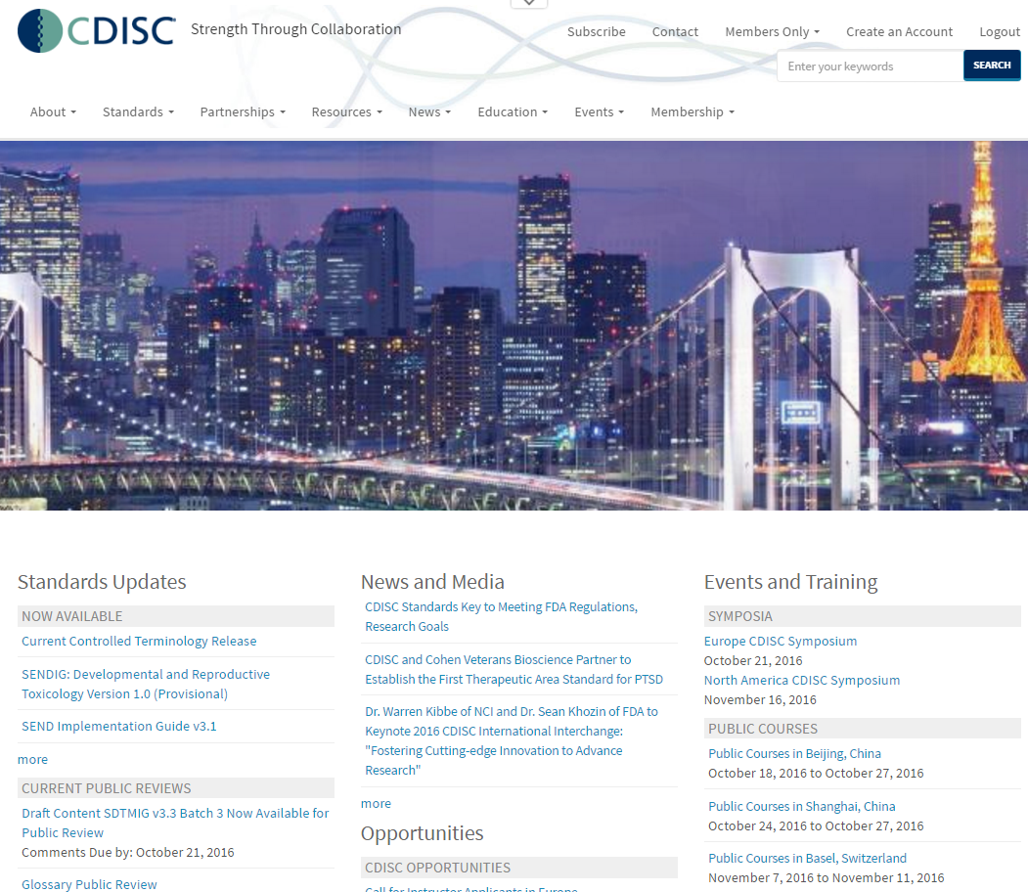
The CDISC Vision: Informing patient care and safety through higher quality medical research
Mission: To develop and support global, platform-independent data standards that enable information system interoperability to improve medical research and related areas of healthcare
Standards bring order to complexity

Slide 5
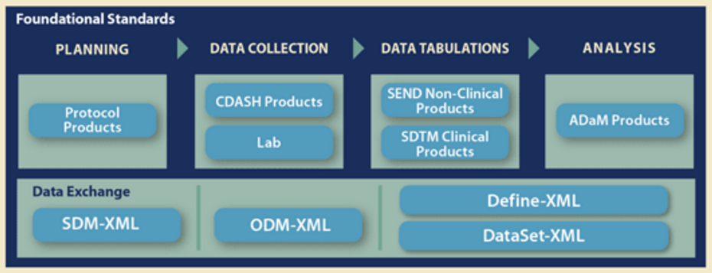
CDISC Foundational Standards

Slide 6





Clinical Research Process
Notes:
This is a picture of the clinical research process that we will use in this presentation to look at the standards that are used at each step. Notice at the top we have the high level process steps of Planning, Data Collection, Data Tabulations, Analysis and Reporting. Underneath those we see some more details beginning with Pre-clinical work, then moving into clinical with Protocol, Case Report Form, Data Capture, Data Management, Analysis, Submission/Reporting and Archiving and finally Review. [ANIM] I would like to show you how the CDISC standards support this process from end to end.

Slide 7
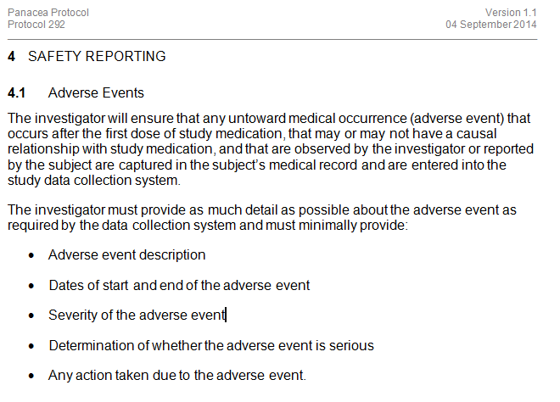

Slide 8
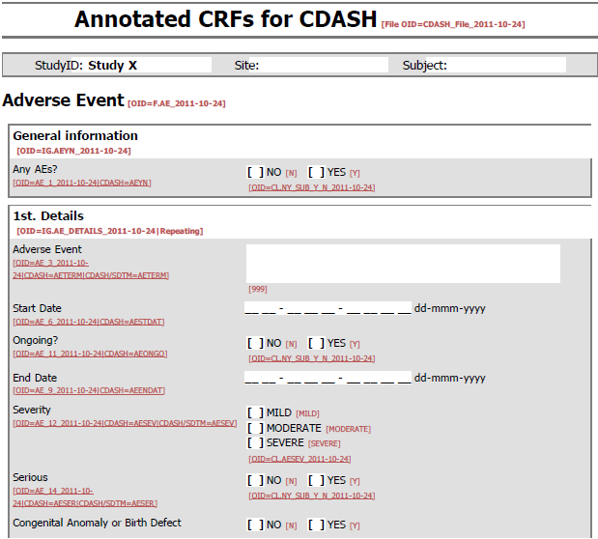

Slide 9
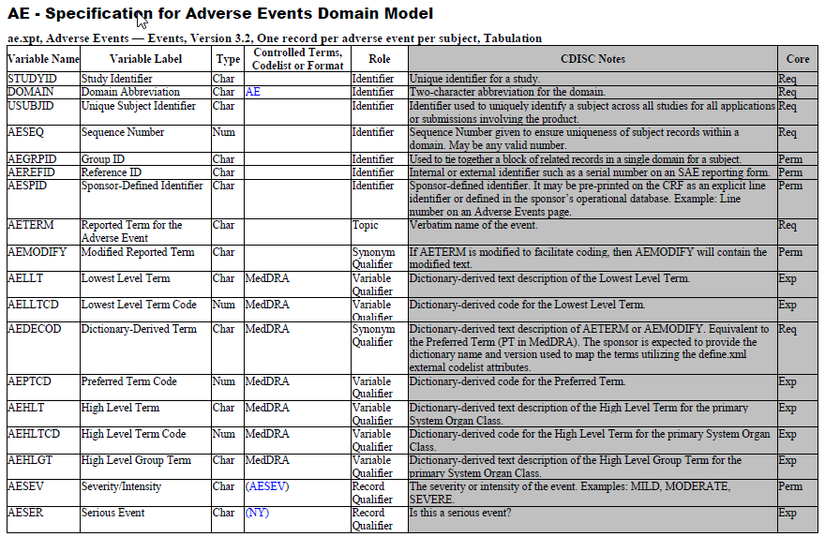

Slide 10
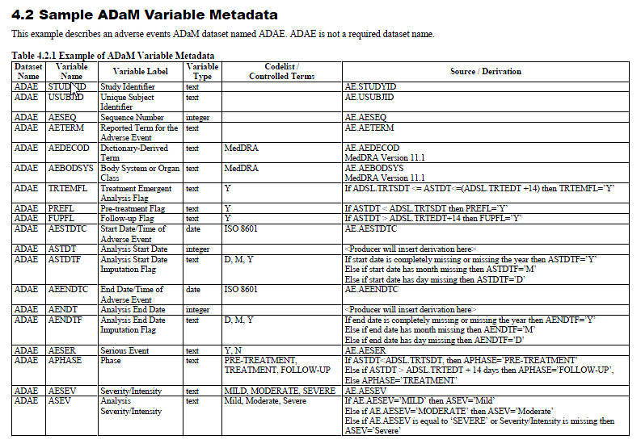

Slide 11
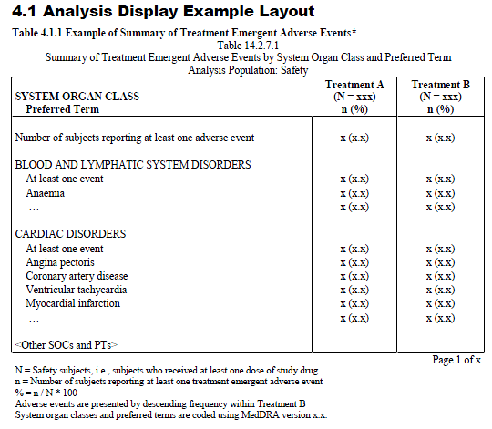

Slide 12
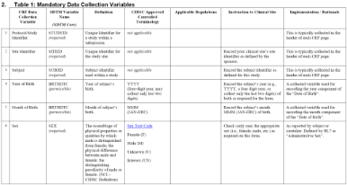
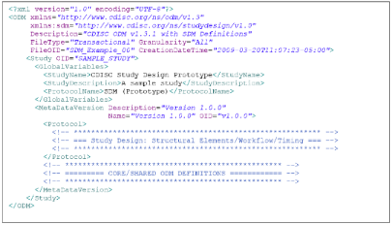

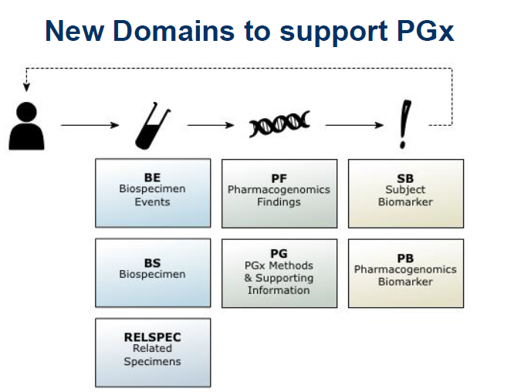
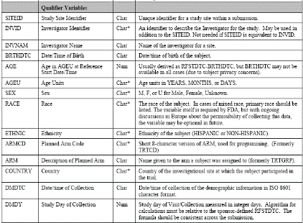

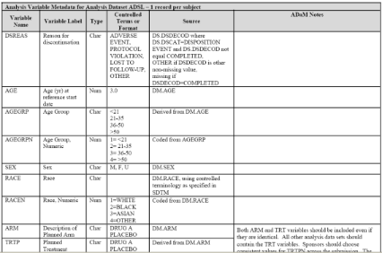
CDISC – End to End
OMICS
Protocol
CDASH
eCRFs
ODM
SDTM
SDTMIG-PGx
Data Capture
ODM
Analysis
ADaM
Database
Notes:
CDISC standards are [ANIM] intended to support an efficient, high quality, [ANIM] traceable and repeatable process [ANIM] from the beginning of your clinical study [ANIM] all the way through [ANIM] to your analysis and reporting. [ANIM] In the next section, we will learn more about the standards you see here.
12

Slide 13
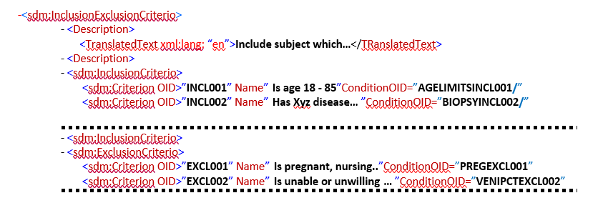
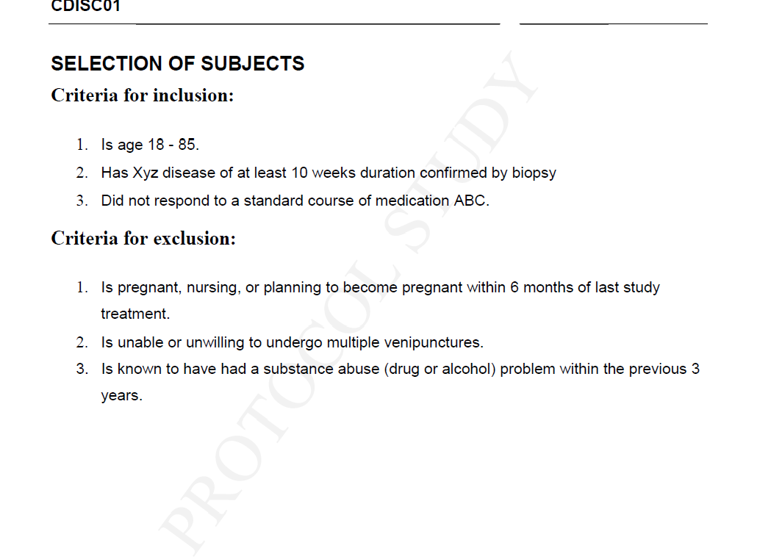
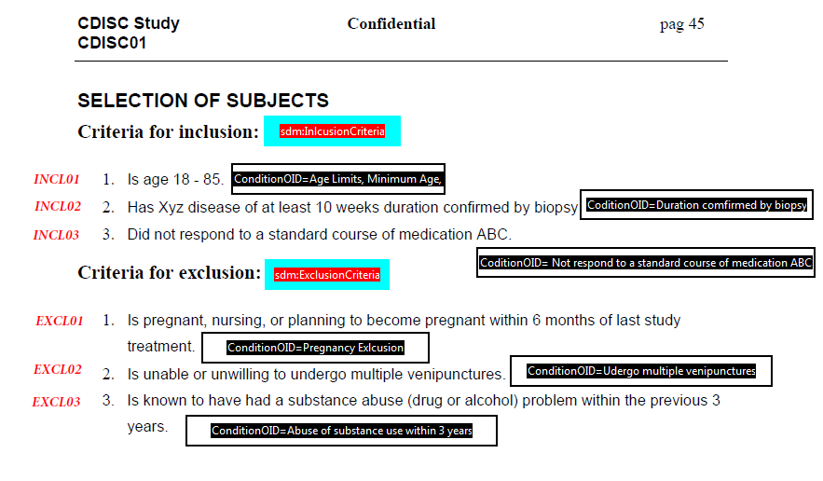
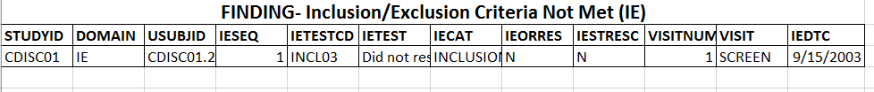
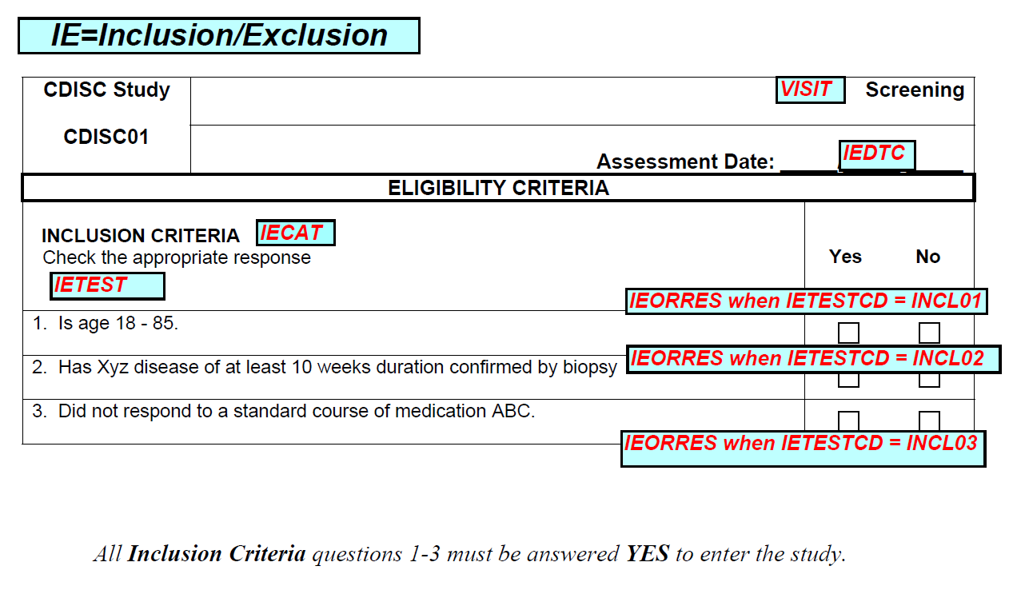
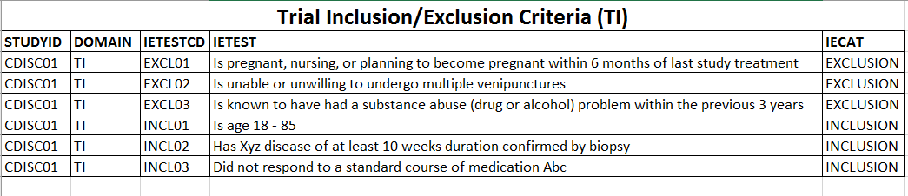
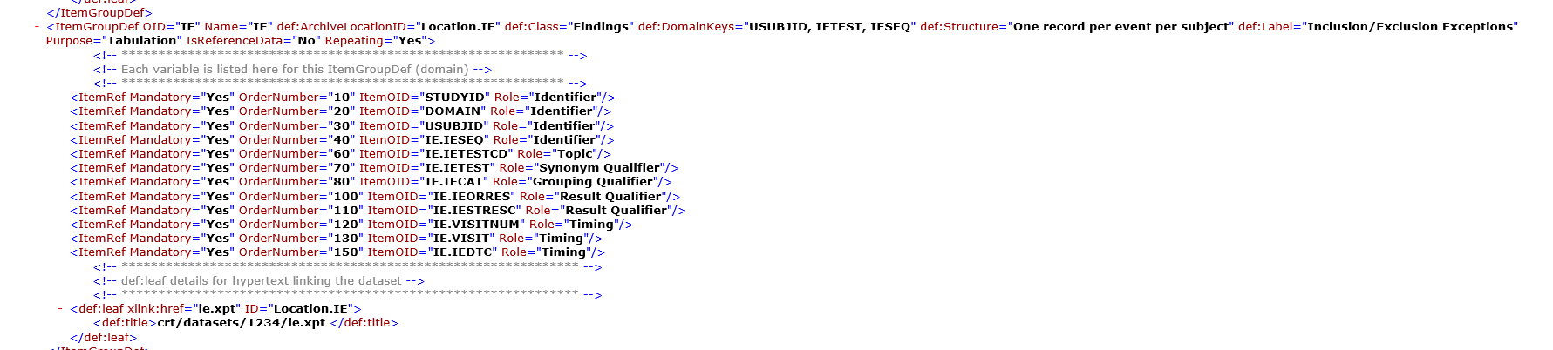
CDISC - Modelling the Migration
(use case: Inclusion Exclusion criteria - IE)
ODM SDM
(data collection)
STUDY PROTOCOL
(data annotation)
Data Collection
Planning
PRM
Data tabulation
XML define files
(data tabulation )
eCRFs
(SDTM data annotation)
Notes:
CDISC standards are [ANIM] intended to support an efficient, high quality, [ANIM] traceable and repeatable process [ANIM] from the beginning of your clinical study [ANIM] all the way through [ANIM] to your analysis and reporting. [ANIM] In the next section, we will learn more about the standards you see here.
13

Slide 14
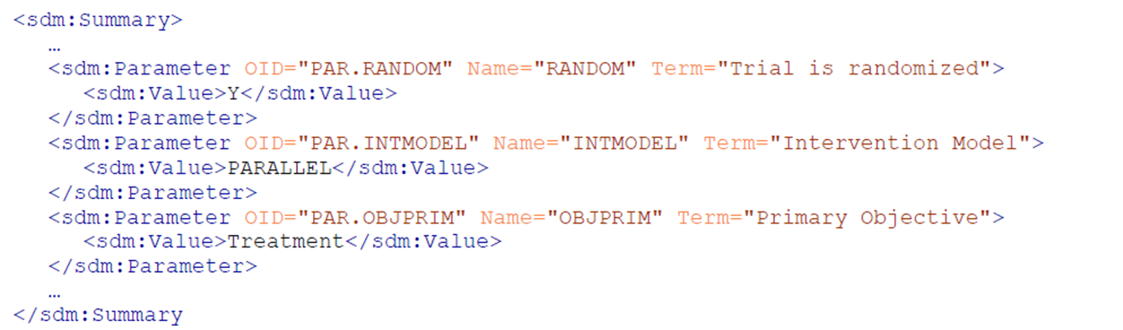
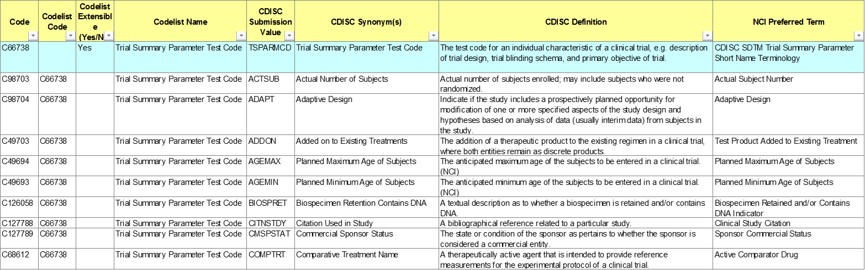
CDISC - Modelling the Migration
(use case: Trial Summary Information - TS)
ODM-SDM mechanism
SDTM Tabulate - TS domain
XML- TS domain
NCI EVS Terminology Resources

Slide 15
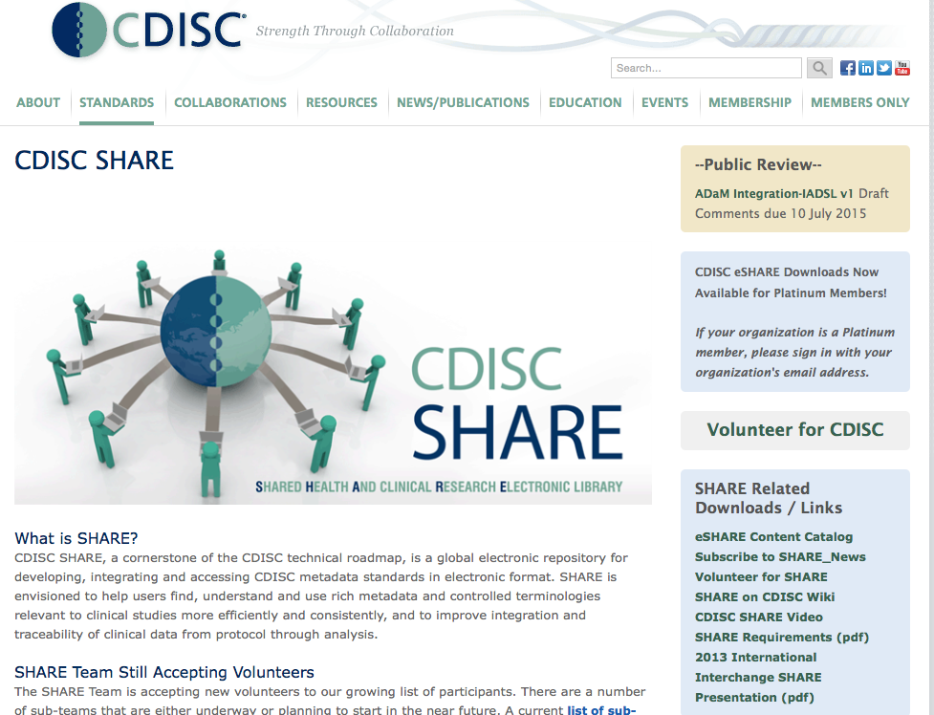

Slide 16

What is SHARE?
A global, accessible electronic library, which through advanced technology, enables precise and standardised data element definitions that can be used
in applications and studies
to improve biomedical research
and its link with healthcare
http://www.youtube.com/watch?v=gCyVdvgVpY8&feature=youtu.be

Slide 17





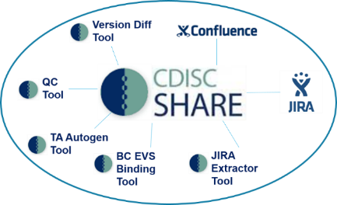
CDISC Shared Health and Research Electronic Library
End
Users-
Apps
Clinical Research Apps
Clinical Care Apps
  SHARE provides immediate access to curated, computable CDISC Standards to:
  Implement standards in real time and/or as ‘packages’
  Enable exchange of health research data
  Reduce costs through increased automation
  Comply with eSubmission requirements for FDA, PMDA
External MDRs
IT/Stats
Other Systems
SHARE &
Ecosystem
Tools
Controlled Terms
Versioned CDISC Standards
Therapeutic Areas, Questionnaires, Labs, …
Foundational Standards

Slide 19
Back-up
Notes:
XRBDVDYS

Slide 20
What is CDISC?

Slide 21

What is CDISC?
Clinical Data Interchange Standards Consortium
  Founded in 1997 (all volunteers); incorporated in 2000 as a non-profit charitable organization
  Today ~ 400 member organizations of all types
  Global Standards Development Organization (SDO) developing global consensus-based standards focusing on Clinical Research
  Collaborate with other SDOs (e.g. ISO, HL7, IHE)
  To be required by U.S. FDA and Japan’s PMDA
  CDISC Standards
    Enable innovation
    Support all types of research from protocol through analysis and reporting
    Significantly streamline research processes and enable data sharing/aggregation
    Include links to healthcare through EHRs/eSource

Slide 22

CDISC has established worldwide industry standards to support the electronic acquisition, exchange, submission and archiving of clinical research data and metadata to improve data quality and streamline medical and biopharmaceutical product development and research processes
Consensus-based development
Standards are freely availably at www.cdisc.org
IP Policy ensures open standards

Slide 23
CDISC
CDISC
Board of
Directors
CDISC
Coordinating Committees
CDISC
Advisory
Council
CDISC
Operations
CDISC
Teams
CDISC
User Networks
Members, Supporters,
Volunteers, Stakeholders,
Adopters

Slide 25


Slide 26
Benefits of CDISC Standards

Slide 27
Gartner-PhRMA-CDISC Project
Business Case for using CDISC standards
Summary:
  Using CDISC standards can save significant time and cost, especially when implemented in the early stages of the study (case report form, protocol)
  Opportunities for an additional impact on clinical research
    Increased data quality
    Data integration / enhanced re-usability
    Facilitate data exchange with partners
    Enable software tools
    Improve team communication
    Facilitate regulatory reviews and audits

Slide 28
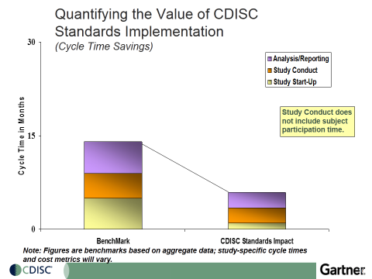

Value of Using Standards Even Greater Now!
2014 Business Case
Current Landscape
2014
Study Complexity
# Datapoints
Data Management
Time/Resources
Cost of Research
2007 CDISC Business Case

Slide 29

ADAS-Cog Variability
Across Organizations
Coalition Against Major Diseases (CAMD)
Nine sponsors with failed Alzheimer’s studies of 100-200 patients each
Data standardized and aggregated (CDISC Alzheimer’s disease TA)
Now over 6,000 patients worth of data available for researchers worldwide
CDISC Alzheimer’s Disease Standard Now Available!
“It is all about the data and how you can gain maximum utility and insight from data. In a world where many data are being shared, but in differing formats, CDISC standards provide a faster path to gaining those insights.” -Enrique Aviles, CTO, C-Path
 | ADNI | J&J | Wyeth | sanofi-aventis | Pfizer | AstraZeneca | Abbott
Item 1 | Word Recall | Word Recall | Word Recall | Word Recall | Word Recall | Word Recall | Word Recall
Item 2 | Commands | Name Obj/fing. | Name Obj/fing. | Commands | Name Obj/fing. | Name Obj/fing. | Name Obj/fing.
Item 3 | Constr. Praxis | Delayed recall | Commands | Constr. Praxis | Commands | Commands | Commands
Item 4 | Delayed recall | Commands | Constr. Praxis | Delayed recall | Delayed recall | Constr. Praxis | Constr. Praxis
Item 5 | Naming Obj/fing. | Constr. Praxis | Idea Praxis | Name Obj/fing. | Constr. Praxis | Idea. Praxis | Idea. Praxis
Item 6 | Idea. Praxis | Idea Praxis | Orientation | Idea. Praxis | Idea. Praxis | Orientation | Orientation
Item 7 | Orientation | Orientation | Word Recog | Orientation | Orientation | Word Recog | Word Recog
Item 8 | Word Recog. | Word Recog. | Remem. Instr. | Word Recog | Word Recog | Remem. Instr. | Spoken Lang Abil.
Item 9 | Remem Instr. | Remem Instr. | Spoken Lang. Abil. | Remem. Instr. | Remem. Instr. | Spoken Lang. Abil. | Comprehension
Item 10 | Comprehension | Spoken Lang. Abil. | Word Finding Dif. | Spoken Lang Abil. | Spoken Lang Abil. | Word Finding Dif. | Word Finding Dif.
Item 11 | Word Finding Dif. | Word Finding Dif. | Comprehension | Diff. Spont. Speech | Word Finding Dif. | Comprehension | Remem. Instr.
Item 12 | Spoken Lang. Abil. | Comprehension | Concentration | Comprehension | Comprehension | Concentration
Item 13 | Number cancel. | Concentration |  | Concentration | Concentration

Slide 30

Biomedical Research Integrated Domain Group (BRIDG)
Healthcare
Stakeholders:
CDISC, US FDA, US NCI, HL7 RCRIM, ISO

Slide 31
Basics of BRIDG
BRIDG is an information model
A way to express the processes and data concepts of clinical research consistently across all stakeholders
Domain Analysis Model (DAM)
Represented using Unified Modeling Language (UML)
Bridges clinical research to healthcare data (HL7)
Harmonizes the CDISC standards to each other at the data element level
ISO Standard
Notes:
Representation of “what’s important”
Emphasizes concepts and relationships
Hides “unnecessary” details
Can usually be viewed from a variety of perspectives
Covers an entire domain of interest
E.g., R&D
Can be expressed as a taxonomy/ontology

Slide 32
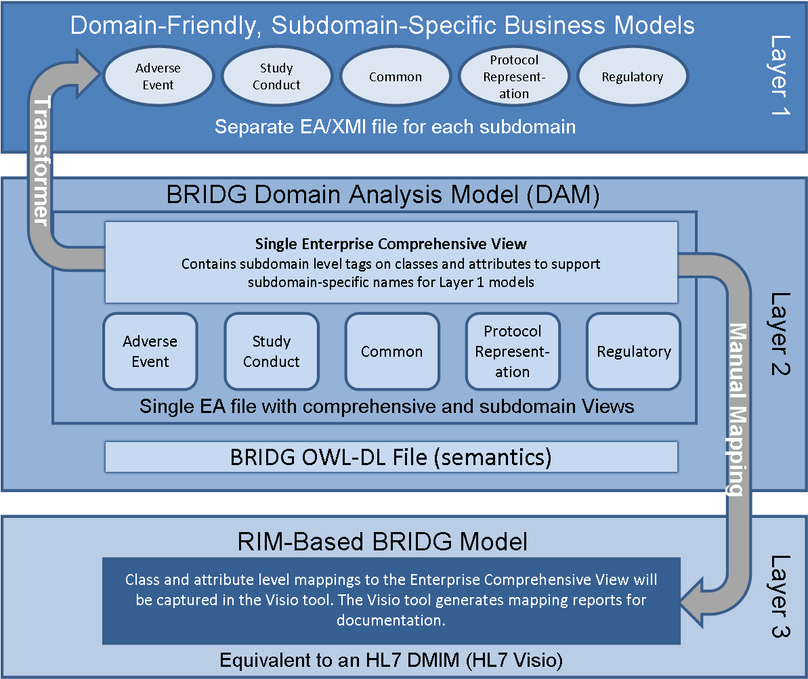
3 Layer Architecture
Future
Future
32
Notes:
Talking Points:
Areas covered include but are not limited to: protocols, studies, study sites, organization and org roles, people and people roles, study subjects, study activities (e.g. subject enrollment, specimen collection, lab work, etc.) , products, study design, documents, regulatory artifacts

Slide 33
Layer 2: UML-Based BRIDG Model
Documents
Study Subjects
Studies
Study Design
People and their Roles
Study Activities, Observations and Results
Adverse Events
Organizations and their Roles
Regulatory
Specimens
Products and Study Agents
Specimen Collection

Slide 34
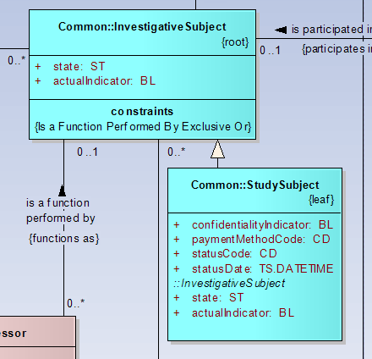
Layer 1: AE Sub-Domain UML Model
Notes:
AdverseEvent Subdomain Model

