Slide 1

The CSPA Logical Information Model
– An Introduction –
Flavio Rizzolo
October 17, 2016 - Schloss Dagstuhl, Leibniz Center for Informatics

Slide 2
What is CSPA?
The Common Statistical Production Architecture (CSPA) is a reference architecture for the official statistics industry.
CSPA:
  provides a practical link between the Generic Statistical Information Model (GSIM), the Generic Statistical Business Process Model (GSBPM), and the actual statistical production as implemented by statistical organizations;
  includes multiple architectures and associated principles for the delivery of statistical services;
  does not prescribe technology environments of statistical organizations.

Slide 3
What is CSPA LIM?
GSIM provides a common language for statistical production that help people communicate. However, it does not provide enough detail for service implementation.
A logical information model (LIM) is being developed within CSPA. LIM:
  bridges the gap between GSIM and the needs of CSPA services to describe physical information models for data exchange;
  maps to SDMX and DDI as much as possible.

Slide 4
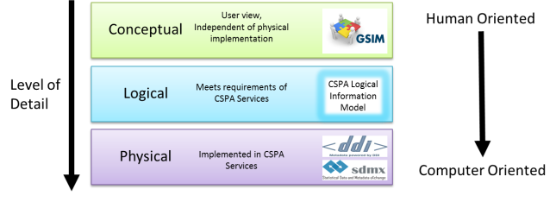
Representation layers

Slide 5
Service design layers

Slide 6
Why not using the standards directly?
A service builder has multiple choices for physical models, e.g. SDMX-ML (XML), SDMX-JSON, DDI 3.2 XML, DDI-Views XML and RDF (soon), SKOS/XKOS, others.
Despite many choices being “equal”, some are more “equal” than others:
  E.g. code lists have different representations in SDMX ML and DDI 3.2; exchanging data between a service with a SDMX ML interface and another one with a DDI 3.2 interface requires a mapping and a data transformation.
In addition, as these standards have evolved independently, the objects and attributes they use are similar but not always compatible, and can be implemented in many different ways.

Slide 7
Why a logical model?
LIM provides the “missing link” for translating GSIM objects to consistent, standards-aligned, physical inputs and outputs for the CSPA services that need them.
The CSPA LIM will:
  complement, and be founded upon, the existing GSIM conceptual model;
  support consistent use of SDMX, DDI and other implementation standards in reusable CPSA services;
  make it easier for organisations that do not currently use SDMX or DDI to implement reusable CSPA services, and
  be a useful way for users to precisely document the inputs and outputs of their business processes.

Slide 8
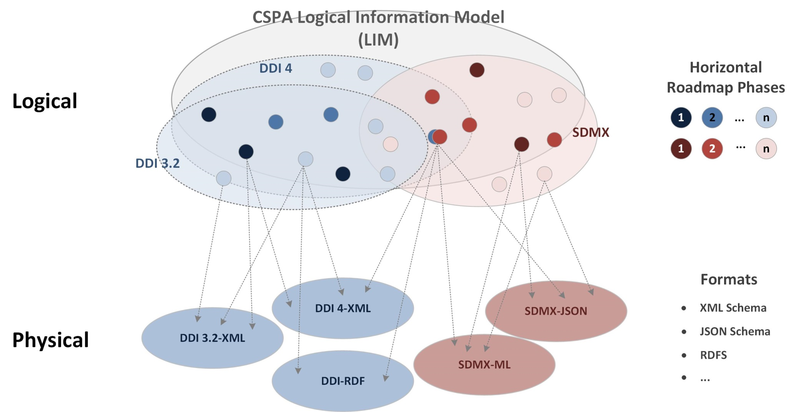
LIM-to-Physical mapping

Slide 9
LIM development criteria
CSPA services development roadmap
  LIM objects will be developed based on CSPA service implementation needs;
Statistical agencies internal service development roadmap
  LIM object will be developed based on participant agencies’ service implementation needs;
Reusability factor
  LIM objects required by multiple services will have higher priority;
Coverage provided by existing standards
  LIM objects that can be mapped to DDI and SDMX will have higher priority.

Slide 10
Service-driven development
Stage 1:
  Determine the information inputs and outputs (GSIM objects)
  Check if the inputs/outputs are covered by LIM
    If yes, service builder uses relevant part of the LIM, as well as a recommended physical representation
    If no, contact CSPA implementation group for guidance, possible LIM development
  Look at which standards are in scope of the request
Stage 2:
  LIM development team consults more broadly on needs
  On acceptance of development, make it CSPA mandated

Slide 11
Example: Extending GSIM
A Process Control defines the flow within Process Steps and between different Process Steps. In particular, it can describe the flow within a service and also between different services.
Process Input and Process Output are used to identify the information objects to be passed across the service boundary.
There are three types of Process Input in LIM: Transformable Inputs, Process Support Inputs, and Parameter Inputs.
And three types of Process Output: Transformed Output, Process Execution Log and Process Metric.
These six classes are additions to GSIM 1.1.
Notes:
There are three types of Process Input in LIM:
Transformable Inputs, which is any object passed into a service that will be manipulated by the execution of the service, e.g. Data Sets and structural metadata.
Process Support Inputs, which is a resource that is referenced or used to guide the service in completing its execution, e.g. code lists, background data, auxiliary data sets, or classifiers used as part of the service
Parameter Inputs: Inputs used to specify which configuration should be used for a specific Process Step, which has been designed to be configurable.
There are three types of Process Output in LIM:
Transformed Output, which is the product of the actions that were executed by the Service, e.g. the updated ("value added") version of one or more Transformable Inputs supplied to the Service (Data Set where values that were missing previously have been imputed).
Process Execution Log captures, which captures the output of a Process Step not directly related to the Transformed Output it produced, e.g. data that was recorded during the real time execution of the Process Step.
Process Metric, which records the quality or methodological measurements about the execution of a service. One purpose for a Process Metric may be to provide a quality measure related to the Transformed Output, e.g. measure of how many records were imputed, and a measure of how much difference, statistically, the imputed values make to the Data Set overall

Slide 12
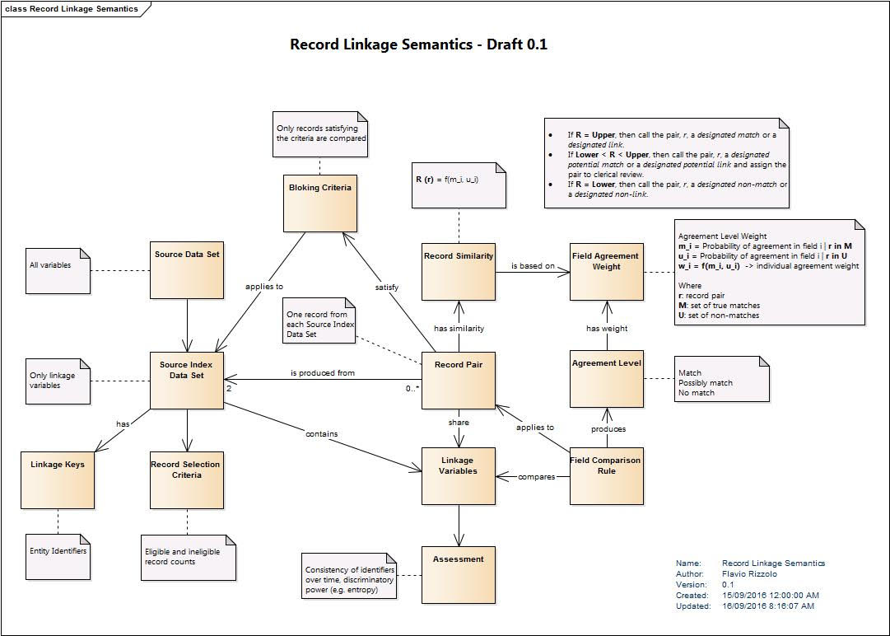
Example: Expanding GSIM

Slide 13
Further development of LIM
CSPA Implemention group
Subgroup LIM
Variables identified as high priority
  Help avoid risk of implementors using different Variable incorrectly -> easier to share services
  Neuchâtel Model definitions

Slide 14
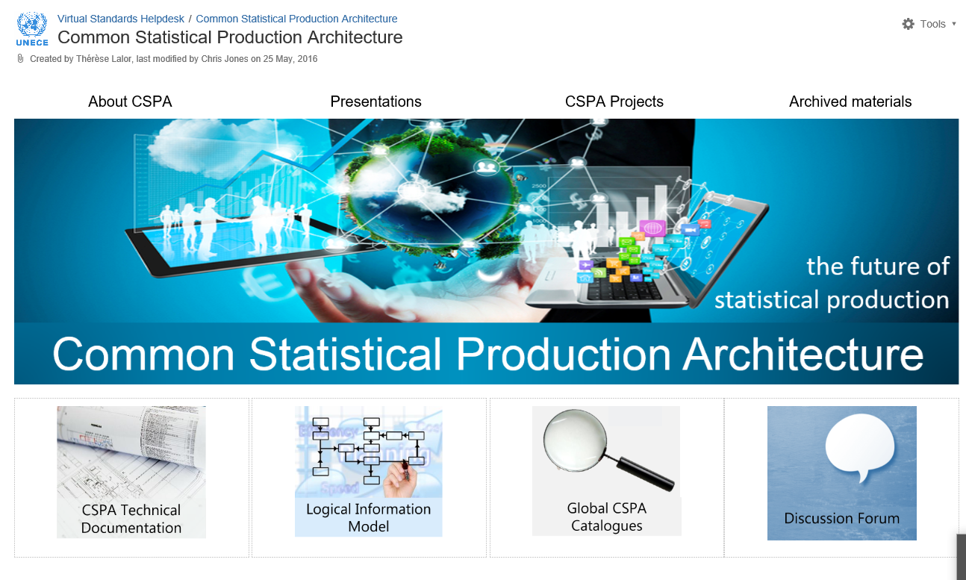
Where to find information
http://www1.unece.org/stat/platform/display/CSPA/Common+Statistical+Production+Architecture

