Slide 1
MarkLogic and the Marketplace
An Interoperability Use Case
Jay Greenfield, Ph.D.
Booz | Allen | Hamilton
10/14/2016

Slide 2
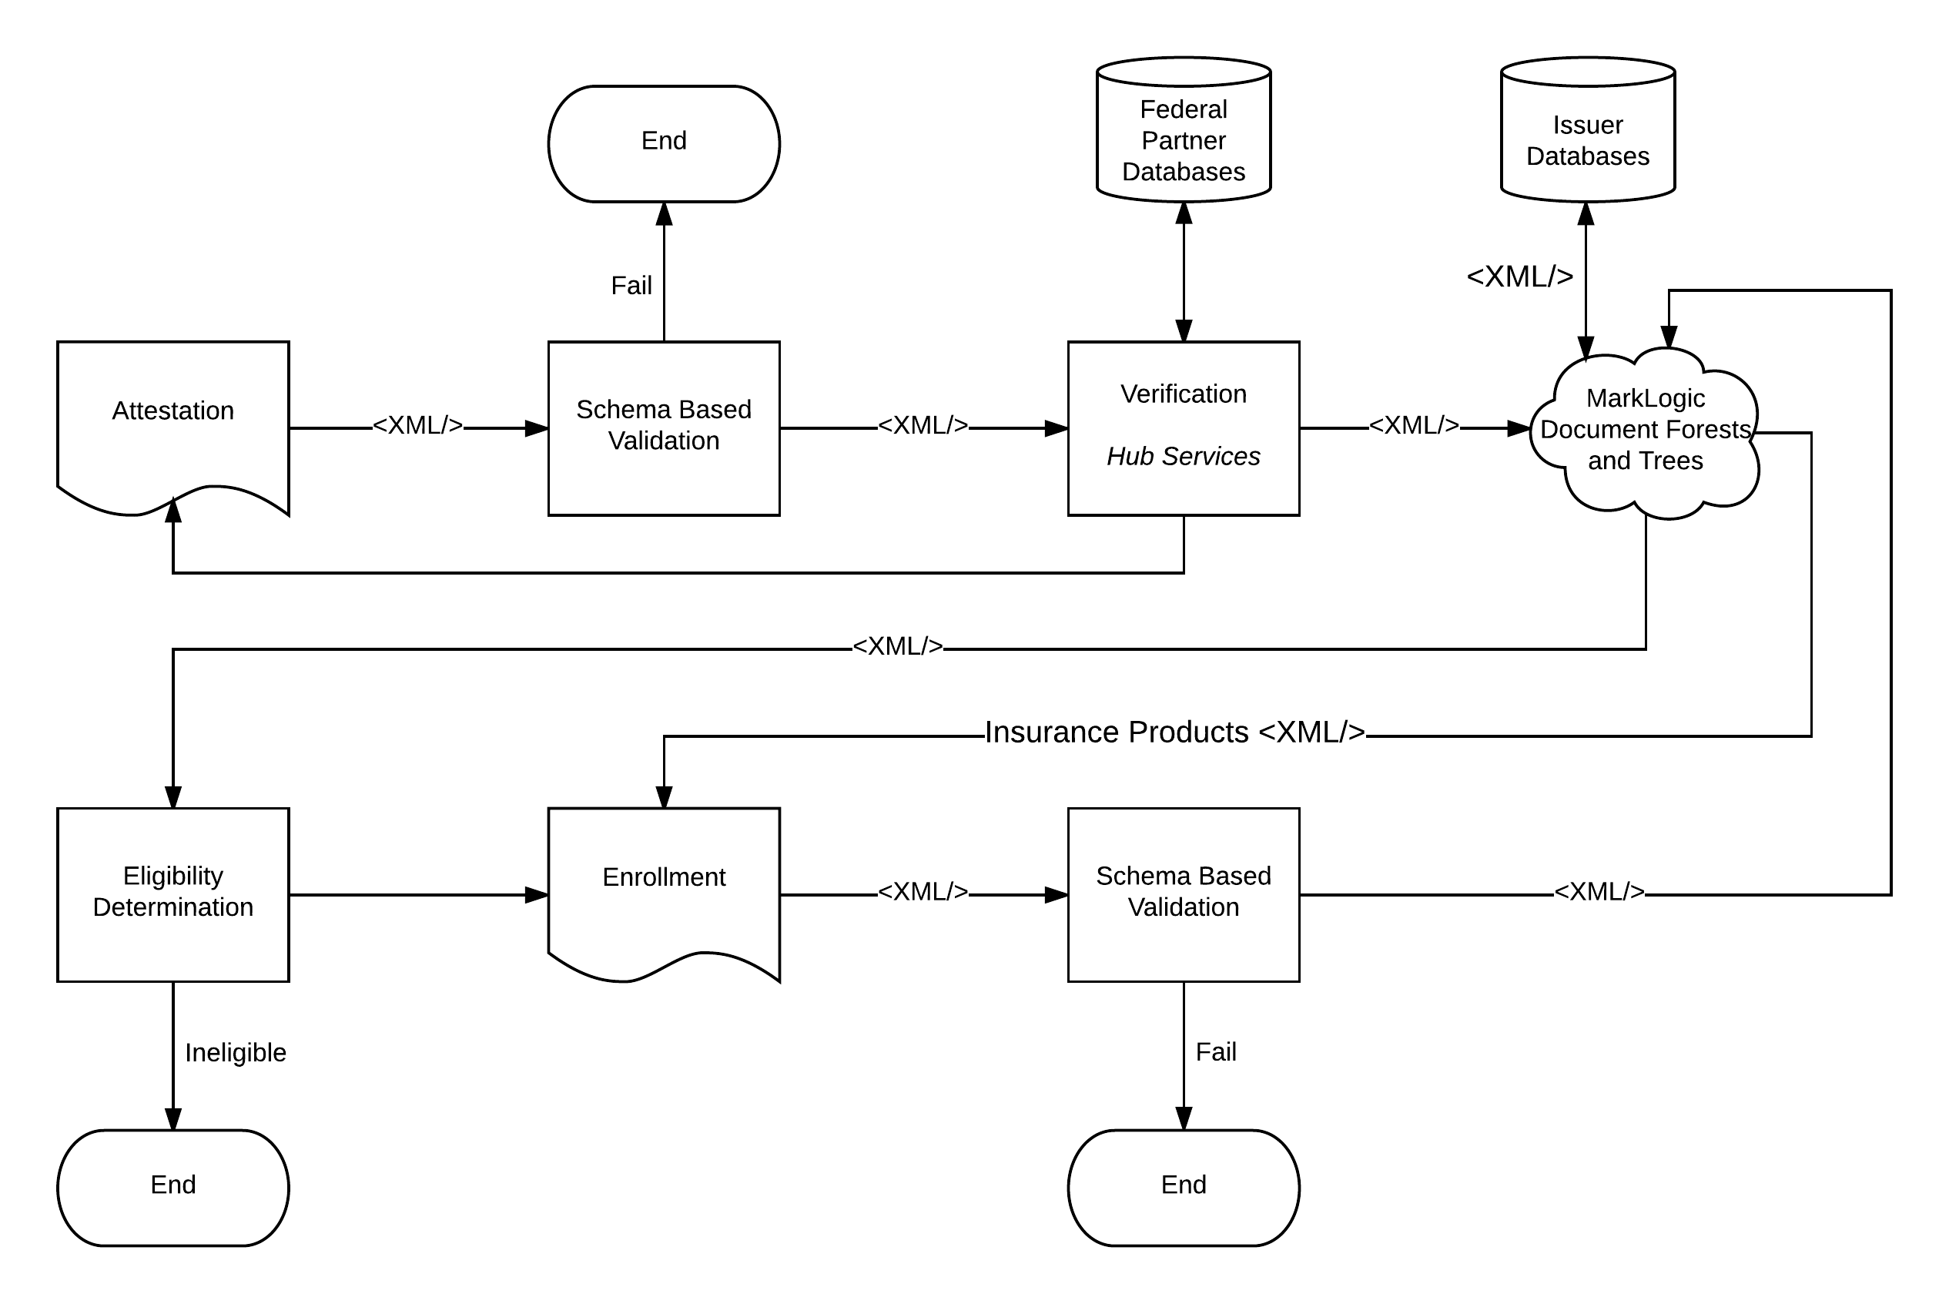
MarkLogic and the Marketplace

Slide 3
Interoperability Design
MarkLogic is indifferent to the format of the document trees that it stores
But don’t be fooled by big data
Even if MarkLogic doesn’t think schemas, any system in which MarkLogic participates does
Indeed, this is the case with big data in general
There is a new division of labor
Let’s look at this new division of labor in the case of the Marketplace to see what the costs and benefits are in terms of interoperability design

Slide 4
Marketplace Interoperability Design Under MarkLogic
Benefits: Information acquisition is local
Costs: Governance is local
Employers, insurers and the Marketplace itself each provide attestation products (questionnaires or, again, insurance applications)
Products need to vary by state because of Medicaid rules. Attestation can be state specific
Besides attestation a second source of information that figures into eligibility are insurance products
Across attestations and insurance products there are a myriad of value sets with no central authority
Instead there is a document oriented eligibility engine that pages through a series of sections
Correspondences are established between attestations, insurance products and these sections
It is up to the various “partners” and sometimes the Marketplace itself to establish these correspondences
The correspondences need to be at once syntactic and semantic
Particular attention has to be paid to sentinel or, again, missing values.
Sections of the document are one size and one size doesn’t fit all so inevitably there are sentinel values

Slide 5
Marketplace Interoperability Design Under MarkLogic (continued)
Benefits: Attestation can change based on changes in federal and state regulations
Costs: As forests and trees become more varied in their structures, processing becomes more expensive
The description of insurance products can grow
Additional questions can be added to attestations
New sections can be added to MarkLogic insurance application documents with ease
Trees and forests become more complicated
A tree may be a collection of applications. Forests might correspond to insurers
Reports search forests and shred trees.
Reporting requires MarkLogic to make use of schemas
This type of “understanding” increases the amount of processing
MarkLogic doesn’t scale up. MarkLogic scales out
As time grows and there are hundreds of millions of applications in the forest, the cloud and cloud vendors like Amazon become a MarkLogic necessity

