Slide 1
DDI 2016 Pragmatic Perspectives
Metadata Standards For Interoperability Between Research and Delivery

Slide 2
Overview
Data & Metadata “Standards” in Learning Health Systems
HL7 & Other Works in Progress 2015-2016
Data Access Framework 3
Structured Data Capture Initiative
Data Quality Collaborative
Clinical Quality Framework
Generic Longitudinal Business Process Model

Slide 3
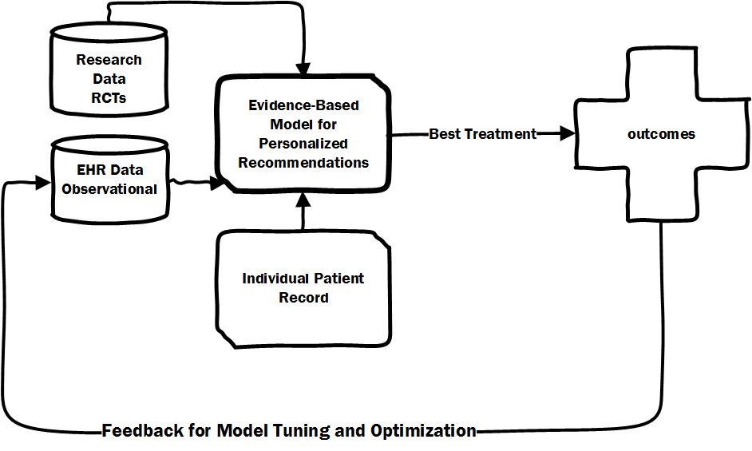
CDISC
custom
HL7
custom

Slide 4
DAF Phase 3

Slide 5
Statistical priors based on experiments/analysis (e.g. of clinical trials
Transactions
Aka “Data Processing” “Computable Phenotype” specification “Cohort”
Data Set
Extraction Program
Extracted Data Set
(“Flat File”)
Analysis Program
e.g. OMOP
Reference
Data Model
Estimated Model
Publish
(as resource?)
research
Publish (in Model Archive?)
care
HL7
Record Processing Program
Standardized
Extracted Record
Model Computation
Patient Centered Prediction
Patient Record

Slide 6
Data Integration & Interoperability
“far out hopeful stuff”
Data from Controlled Experiments
Transactions
e.g. OMOP
PCORnet
Analytic Model
Analytic Models
PCORnet
e.g. minisentinel
Predictive Models
Predictive Models
Transactions

Slide 7
DRN Standards for Analysis Workflow Modeling
Process we need to represent | Standard | Rationale
Data processing rules | HQMF-> CQL->PMML | CMS, ONC, HL7 endorsed Part of EHR certification process New standards in trial use
Cohort definition rules | HQMF->CQL | 100’s of established data sets 1000s of cohort criteria
Data set description | QRDA PMML | QRDA – Quality Measurement EHR Certification & CMS PMML – Data analysis model (“Data Set”)
Data Analysis Methods | PMML | UCSD Data Mining Group Extensible to support model specifications
Data Analysis Results (Estimated Models) | PMML | Developed to represent results Adopted by most stats packages
Process Workflow | BPML? FHIR “Tasks” | TBD
Notes:
Comparable to LIM in Flavio’s presentation.

Slide 8
Alignment Needs
http://hl7.org/fhir/2015May/qicore.html
2.15.4.4 Relationship to Other Initiatives
QICore has been harmonized with certain other FHIR-based initiatives, in particular, the Data Access Framework (DAF). DAF is a U.S. Realm Implementation Guide that maps Meaningful Use data elements to FHIR resources.
QICore's extensions have also been reviewed by HL7 Work Groups and other initiatives to validate that QICore extensions will not create future conflicts. One initiative that provided reviews and feedback was the Clinical Information Modeling Initiative (CIMI) through the Healthcare Services Platform Consortium (HSPC).
Biomedical Data & Metadata Standards
Clinical Data Standards
Outcomes Research Standards
Graveyard: BRIDG, QueryHealth

Slide 9
Relevant Activity in 2015-2016
Structured Data Capture Initiative
Goal is to create a framework where data capture instruments (e.g. forms) can be accessed. Take a “role” based model
Data Access Framework 3
Goal is to create an API standard that enables distributed health databases to be queried in networks
Data Quality Collaborative
Goal is to create a standard for communicating the quality of data in health databases

Slide 10
“Structured Data Capture” Standards “Role”-Based Metadata for things like eCRFs
Patient Personal Device
(SDC Form Filler Role)
Cerner EHR
(SDC Form Filler Role, SDC Form Receiver Role)
Browser
PROMIS App
PROMIS Result Display [SMART and/or Cerner mPage]
Cerner Millennium API
Cerner DB
FHIR
HL7*
FHIR SDC Server
SDC Staging Platform
Identity Management
Messaging (HC)
Logic (HC)
Data
Consent Metadata
Vis/Report
(SDC Form Manager Role)
DAF3
(SDC Form Receiver Role)
Research Data Warehouse
PCOR & eCQM Information System
Assessment Center API
Assessment Center PROMIS
(Part of SDC Form Manger Role & Data Element Repository)
Survey Logic and Form Item
Scoring
Feedback
DAF metadata here
PCORNet
QDM
https://www.assessmentcenter.net/ac_api
Notes:
https://www.assessmentcenter.net/ac_api

Slide 11
FHIR Data Access Framework Phase 3 API standard that enables distributed health databases to be queried in networks
Focused on minimum necessary metadata to query and operate on* networked data
Provenance and FHIR “tasks” that have been completed
Data Model or Data Dictionary
Computing environment for executing query logic (e.g. derived variables)
Data Quality/Characteristics
* DAF is distinct from simple information retrieval - it often requires data manipulation and transformation before transfer/retrieval

Slide 12
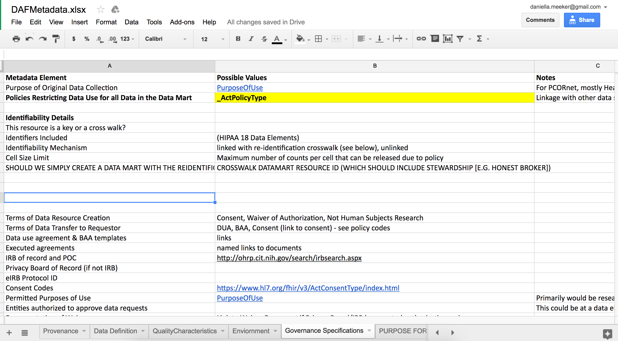

Slide 13
Data Quality Collaborative
Multiple iterations attempting to harmonize semantics of different data quality models
Concluding on a set of metrics based on two categories
Conformance to standards and metadata
Deviation from valid values or distributions from underlying conceptual model
Statistical variance
Violation of rules

Slide 14
Data Quality as Psychophysics
Data is a partial representation of ground truth
Constructs are the way we operationalize concepts corresponding to models of the real world
Data capture instruments (eCRFs, SDC Forms)
Secondary use of data from transactional systems
Use of data from purposful collection tools
Data processing algorithms
Interpretation implicitly or explicitly includes model(s) of the real world
Data can violate both intended

Slide 15
End Here fro Questions

Slide 16
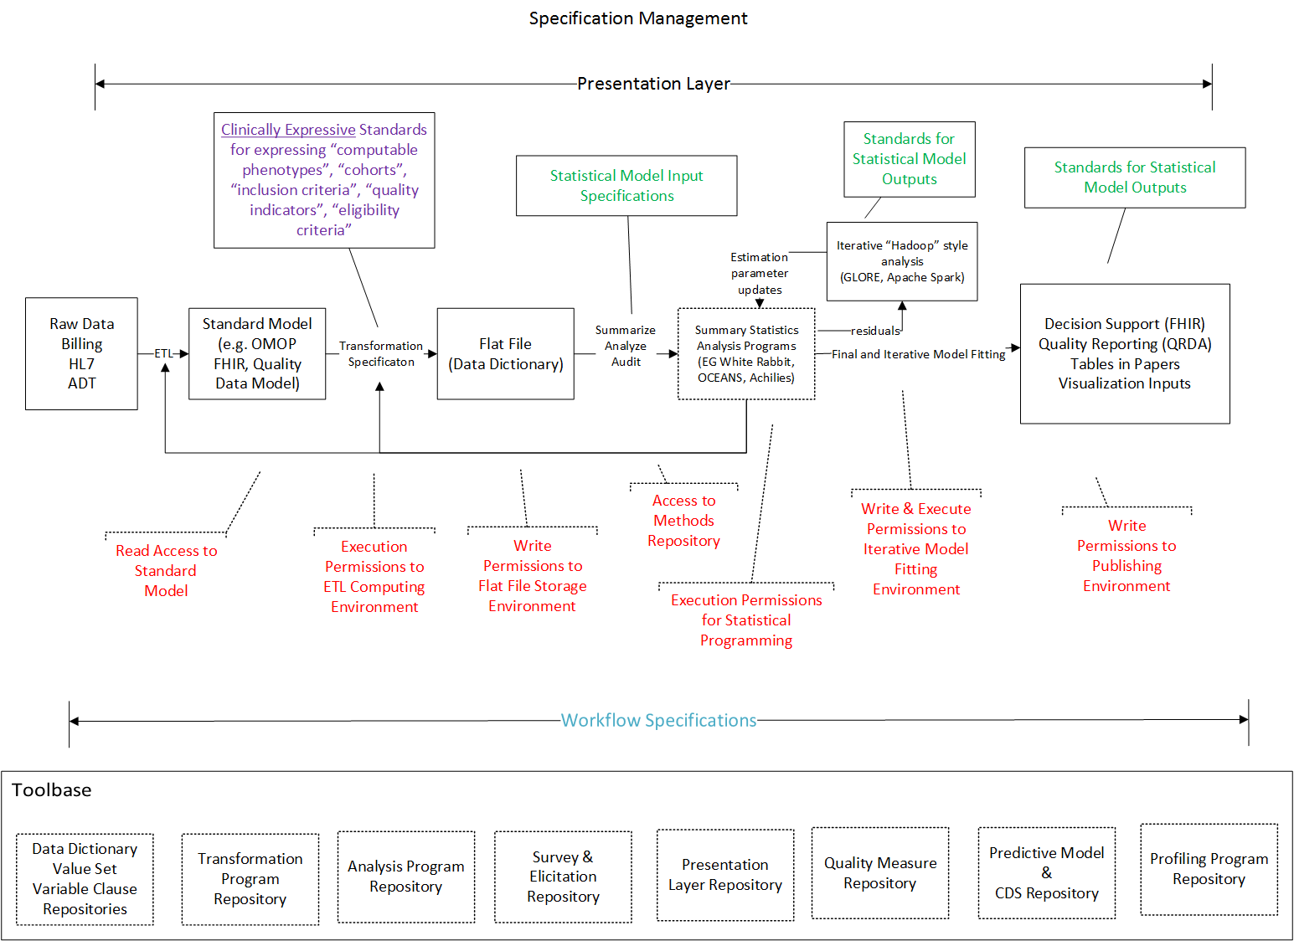

Slide 17
Obtain and Document Necessary Regulatory and Ethical Approvals

Slide 18
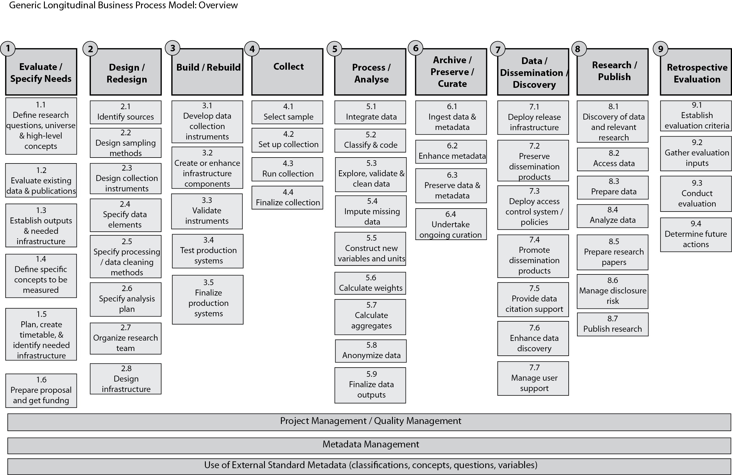
Public Registration of Design and Research Intent in Registries
4.1 Instantiate Sample from which data will be collected
Feasibility Assessment
Power Analysis
Needs more attention and comparison
Limited Uptake
CANDIDATE FOR REMOVAL
measurements
* Material vs. information samples require more detail
This is where there is a lot of valuable metadata in clinical trials is captured
Obtain and Document Necessary Regulatory and Ethical Approvals

Slide 19
Ontologies for Research
http://obi-ontology.org/page/Main_Page
Ontology for Biomedical Investigations
Study Types
Interventional
Randomized
Non-randomized
Observational
Purposful (Prospective)
Opportunistic (often, not always retrospective, but no control over data capture)

Slide 20
Semantic/Terminology Resources
http://stats.oecd.org/glossary/detail.asp?ID=3717
RAMON http://ec.europa.eu/eurostat/ramon/nomenclatures/index.cfm?TargetUrl=LST_NOM&StrGroupCode=GLOSS&StrLanguageCode=EN

