Slide 1
MarkLogic and the Marketplace An Interoperability Use Case
Jay Greenfield, Ph.D.
Booz | Allen | Hamilton
10/18/2016

Slide 2
MarkLogic and the Marketplace

Slide 3
Interoperability Design
MarkLogic is indifferent to the format of the document trees that it stores
But don’t be fooled by big data
Even if MarkLogic doesn’t think schemas, any system in which MarkLogic participates does
Indeed, this is the case with big data in general
There is a new division of labor
Let’s look at this new division of labor in the case of the Marketplace to see what the costs and benefits are in terms of interoperability design

Slide 4
Marketplace Interoperability Design Under MarkLogic
Benefits: Information acquisition is local
Costs: Governance is local
Employers, insurers and the Marketplace itself each provide attestation products (questionnaires or, again, insurance applications)
Attestations need to vary by state because of Medicaid rules. Attestation can be state specific
Besides attestation a second source of information that figures into eligibility are insurance products. Think second lowest cost silver plan
Across attestations and insurance products there are a myriad of value sets with no central data element repository
Instead attestations, enrollments and insurance products take the form of documents with sections that present themselves to a schema authority
While content is centrally specified by a business authority, enforcement is local
ET rarely phones home to the application server and the application server and database server are ships passing in the night

Slide 5
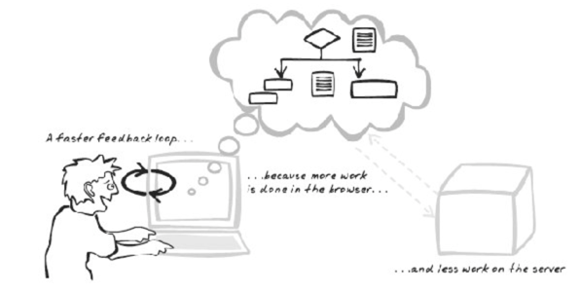
Marketplace Interoperability Design Under MarkLogic (2 of 4)
Fat Client
No worries, dear. The children love JavaScript!

Slide 6
Marketplace Interoperability Design Under MarkLogic (3 of 4)
Benefits: Attestation and Enrollment can change based on changes in federal and state regulations
Costs: As trees get bigger, forests grow, and the back end processing becomes more and more expensive
The description of insurance products can grow
Additional questions can be added to attestations
Enrollment can grow a decision support system
Fat clients can get fatter
Trees are added to stands over time, a forest is a collection of stands and a database consists of one or more forests
Upon ingest tree elements are the subject of one or more indexes
Reports search forests for trees and search trees for elements
Reporting requires MarkLogic to make use of schemas
This type of “understanding” increases the amount of processing
MarkLogic doesn’t scale up. MarkLogic scales out
As time grows and there are hundreds of millions of applications, enrollments and insurance products in the forest, the cloud and cloud vendors like Amazon become a MarkLogic necessity

Slide 7
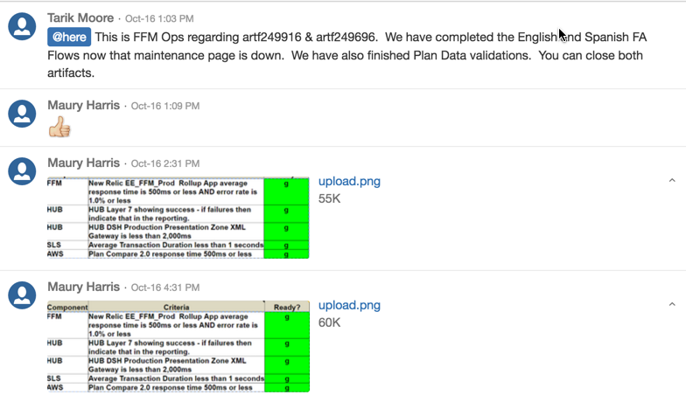
Marketplace Interoperability Design Under MarkLogic (4 of 4)

