Slide 1
UKDS Experiment with DDI-4
Deirdre Lungley
Data and Services Developer
Dagstuhl Sprint 2016, Week 1
17th October, 2016

Slide 2
BDNS: Big Data Network Support
UKDS uplift component:
Experiments in improving visibility of UKDS data:
BSA (British Social Attitudes Survey) – DDI-3.2
I-CeM – DDI-4
Methodology:
DDI-1.2.2 (Nesstar Publisher) + CSV to RDF using DDI-3.2/4 schema
Load triples (N-Triples) to HBase
Harth, Andreas, and Stefan Decker. "Optimized index structures for querying rdf from the web." Third Latin American Web Congress (LA-WEB'2005). IEEE, 2005.
Cudré-Mauroux, Philippe, et al. "Nosql databases for rdf: an empirical evaluation." International Semantic Web Conference. Springer Berlin Heidelberg, 2013.
Zeppelin notebook visualisation using SparQL + Spark

Slide 3
I-CeM: Integrated Census Microdata Project
Year | No. of records
1851 | 20.6m
1861 | 22.8m
1881 | 29.9m
1891 | 33.5m
1901 | 36.9m
1911 | 36.4m

Slide 4
I-CeM: Integrated Census Microdata Project
Variable Type | No. of variables | No. currently included
Enumeration/Iden. | 26 | 5
Household | 11
Institution | 5
Person | 5
Demographic | 12
Occupational | 10
Disability | 3
Birthplace | 11 | 2
Language | 2
Fertility | 6
Derived | 30+
Total | 120+

Slide 5
DDI4: Packages used
Logical Data Description
Record level data (year, recordId, countyOfEnum, countyOfBirth
Conceptual
InstanceVariable (the link)
Representations
Hierarchical data structures
Census enumeration geography – parish, district, county, country
Administrative geography – county, country

Slide 6
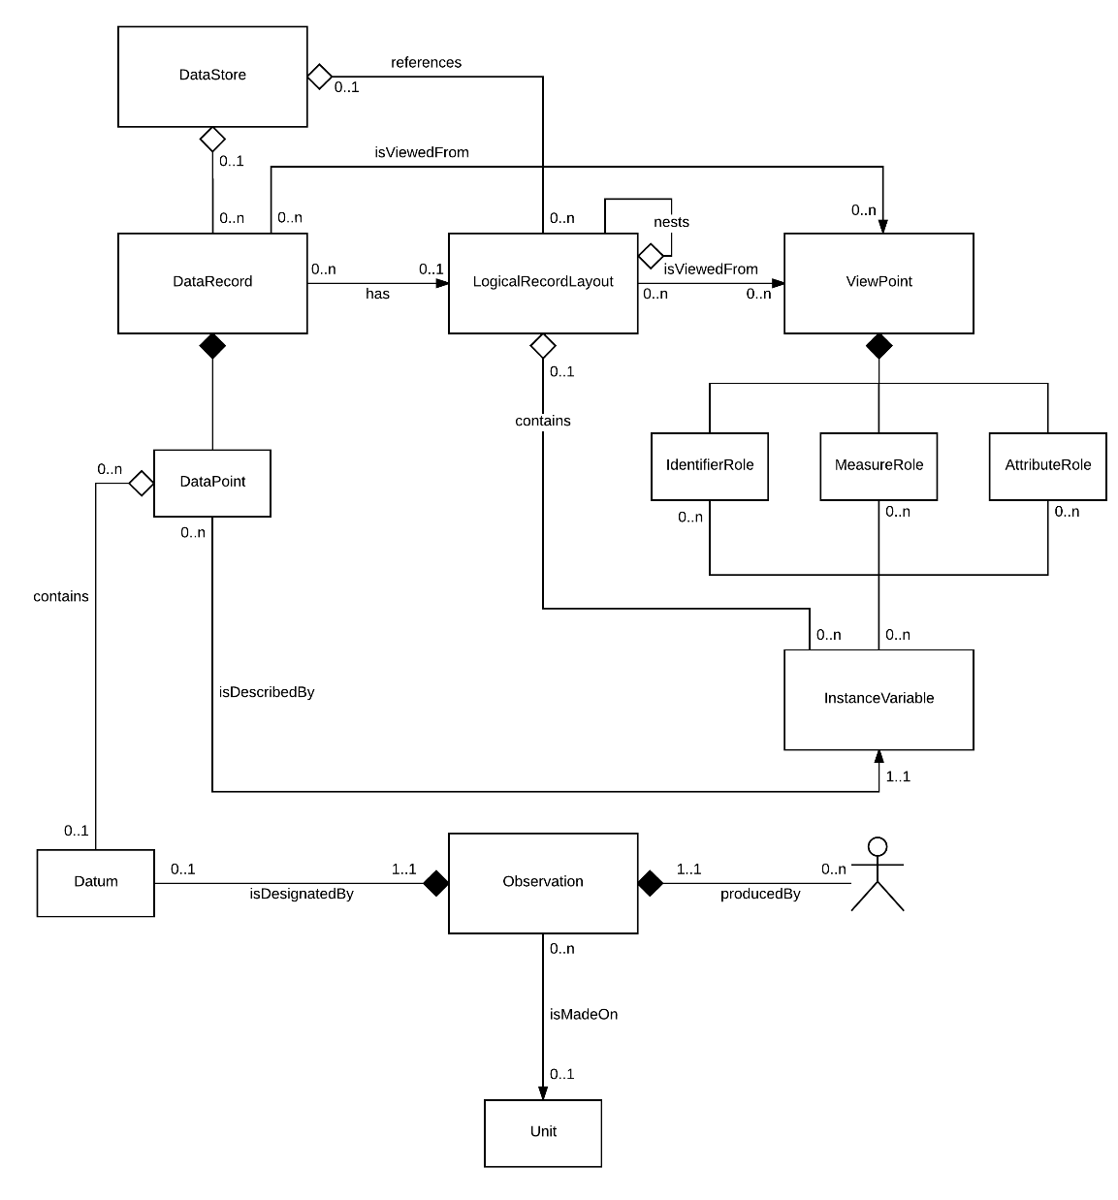
DDI4: Logical Data Description

Slide 7
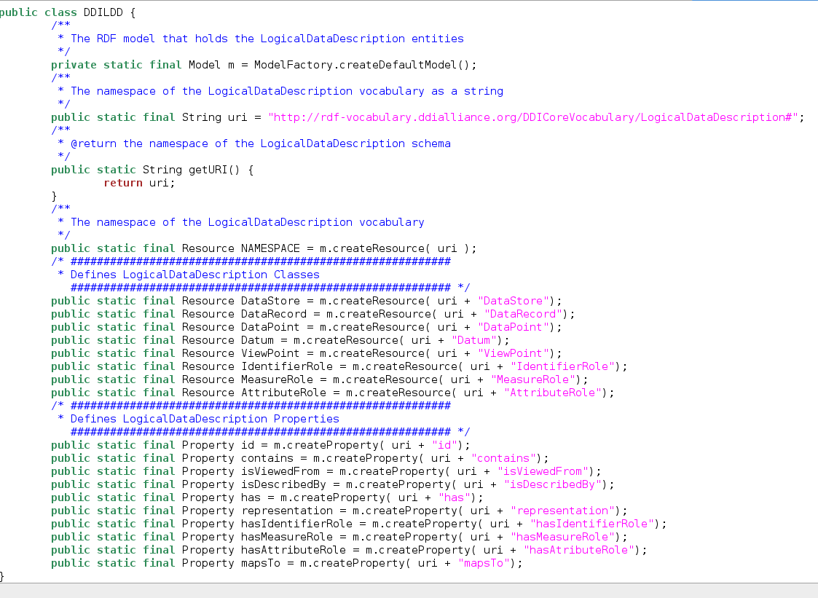
DDI4: LogicalDataDescription

Slide 8
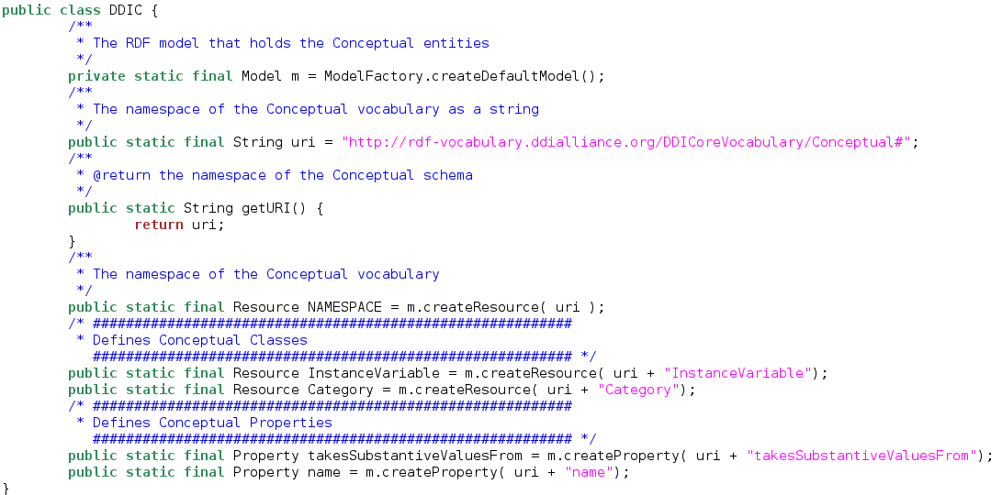
DDI4: Conceptual

Slide 9
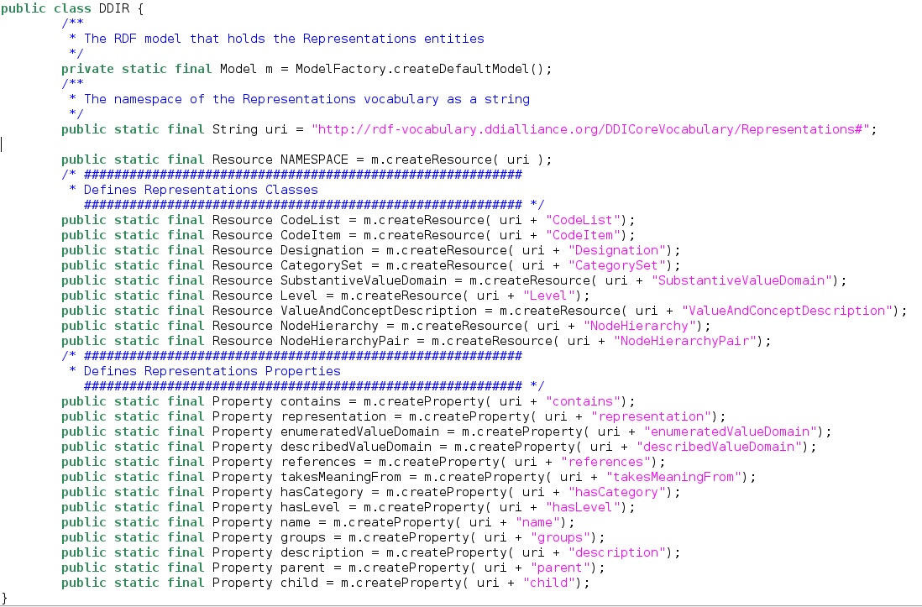
DDI4: Representations

Slide 10
DDI-Views: Observations / Questions
User moving from DDI-3.2 to DDI-4
Example mappings to help choose between multiple options:
Representations: CodeList / CategorySet / NodeSet / NodeHierarchy / NodeHierarchyPair
Conceptual: ConceptParentChild / ConceptPairChildPair
Use of Signification Pattern
Signifier
RDF Validation options: ShEx v SHACL
Keen to avail of open source and community developed tools

Slide 11
Deirdre Lungley
dmlung@essex.ac.uk

