Slide 1
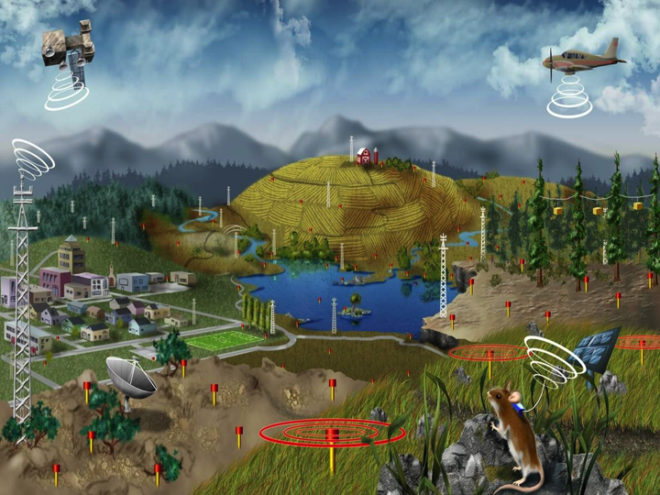
Ecological Metadata Language (EML)
Overview
To provide the ecological community with an extensible, flexible, metadata standard for use in data analysis and archiving that will allow automated machine processing, searching and retrieval.
NEON Inc. – Image: Nicolle Rager-Fuller, National Science Foundation

Slide 2
EML
Background
The Ecological Metadata Language (EML) is a metadata standard developed by the ecology discipline and for the ecology discipline.
It is based on prior work done by the Ecological Society of America and associated efforts (Michener et al., 1997, Ecological Applications).
EML is implemented as a series of XML document types that can by used in a modular and extensible manner to document ecological data.
Each EML module is designed to describe one logical part of the total metadata that should be included with any ecological dataset.

Slide 3
EML
Features
Modularity: EML was designed as a collection of modules rather than one large standard to facilitate future growth of the language in both breadth and depth.
Detailed Structure: enable advanced services in terms of processing data through the parsing of accompanied metadata.
Compatibility: Facilitates conversion of EML documents into other metadata languages (DwC, ISO 19115, GML, STMML, XSIL).
Strong Typing: EML is implemented in XML Schema which provides the ability to use strong data typing within elements.

Slide 4
EML
Modules
Root-level structure:
eml - A metadata container
eml-resource - Base information for all resources
Top-level resources:
eml-dataset - Dataset specific information
eml-literature - Citation specific information
eml-software - Software specific information
eml-protocol - Research protocol specific information

Slide 5
EML
Modules
Supporting Modules - Adding detail to top-level resources
eml-access - Access control rules for resources
eml-physical - Physical file format
eml-party - People and organization information
eml-coverage - Geographic, temporal, and taxonomic extents of resources
eml-project - Research context information for resources
eml-methods - Methodological information for resources
Data organization - Modules describing dataset structures
eml-entity - Entity level information within datasets
eml-attribute - Attribute level information within dataset entities
eml-constraint - Relationships among and within dataset entities

Slide 6
EML
Modules
Entity types - Detailed information for discipline specific entities
eml-dataTable - Logical information about data table entities
eml-spatialRaster - Logical information about regularly gridded geospatial image data
eml-spatialVector - Logical information about non-gridded geospatial image data
Schema for validating spatial referencing descriptions
eml-storedProcedure - Data tables resulting from procedures stored in a database
eml-view - Data tables resulting from a database query
Utility modules - Metadata documentation enhancements
eml-text - Text field formatting
Internationalization - Metadata in multiple languages

Slide 7
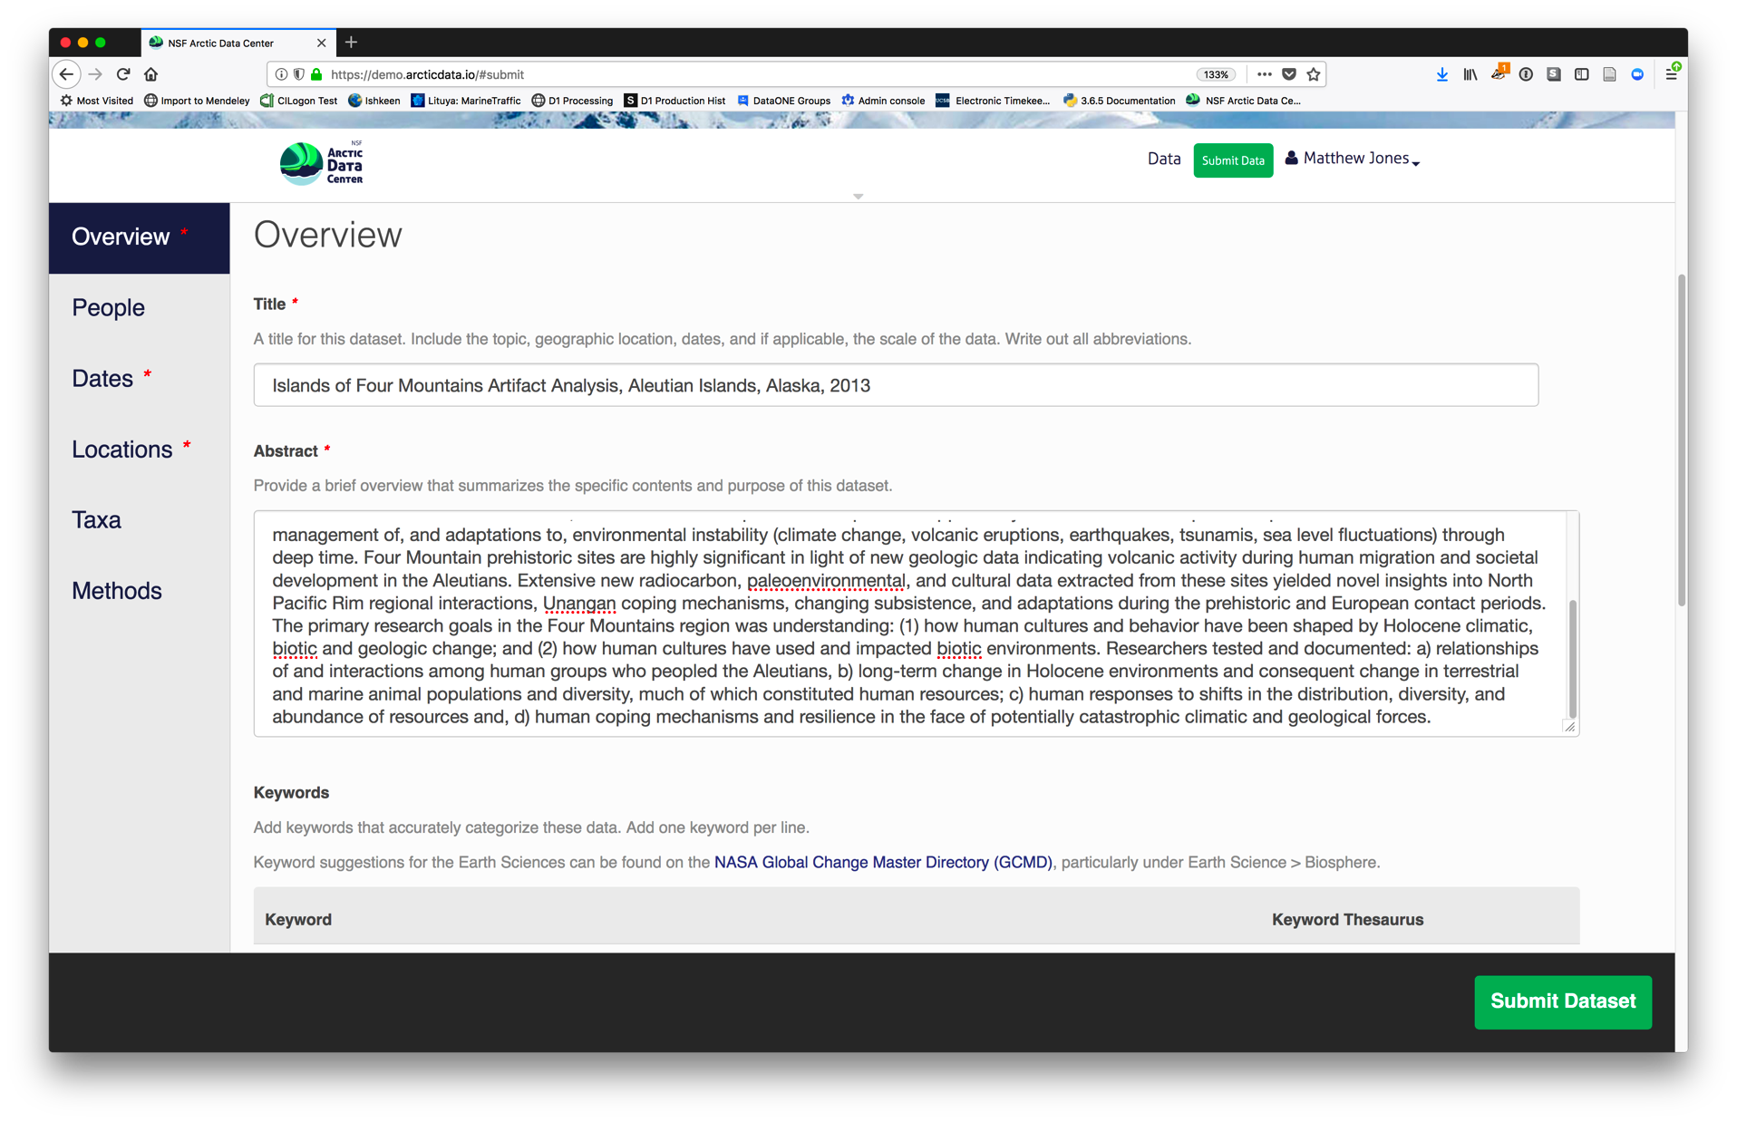
Metadata Entry via Arctic Data Center

Slide 8
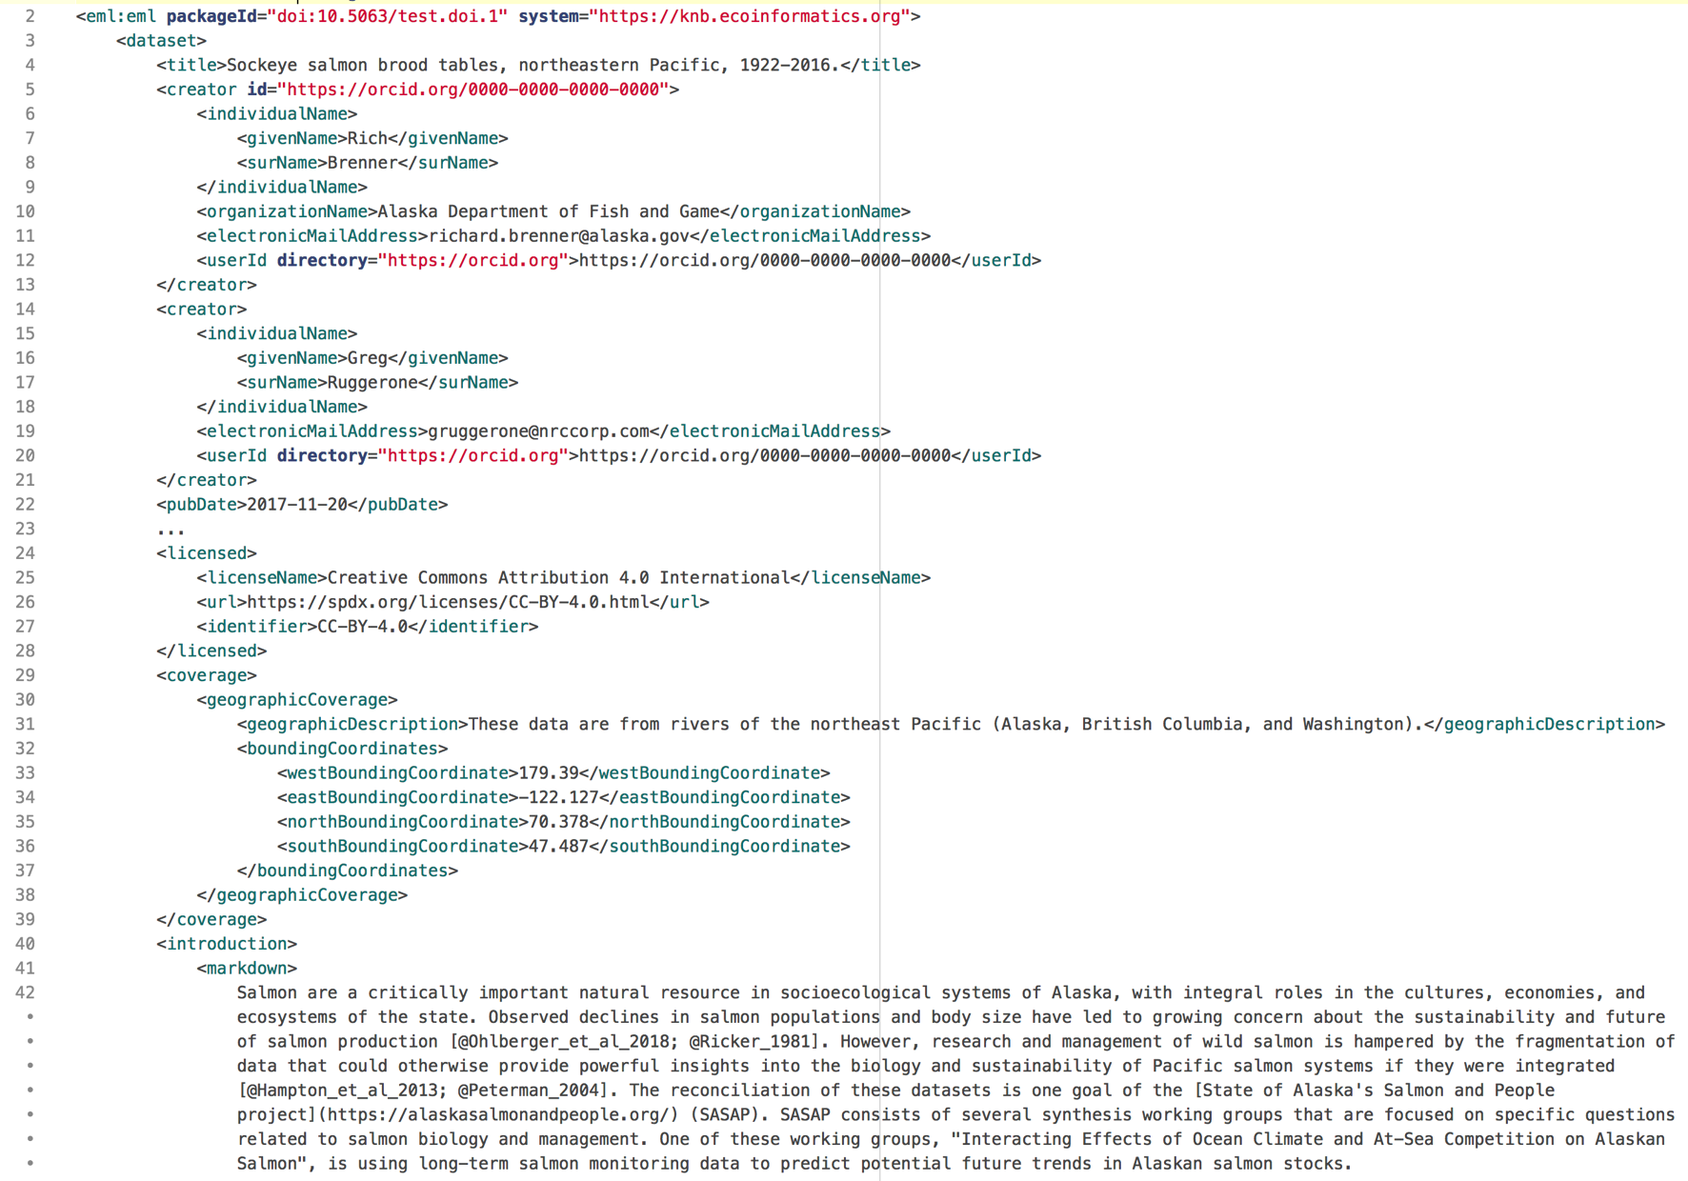
Ecological
Metadata
Language
2.2 release
ORCID
License
Location
Citations
Notes:
Added missing fields
Introduction, Getting Started, Data synopsis
Formalized license
Literature Cited
Added new capabilities
Markdown support
Inline images and equations
Bibtex references

Slide 9
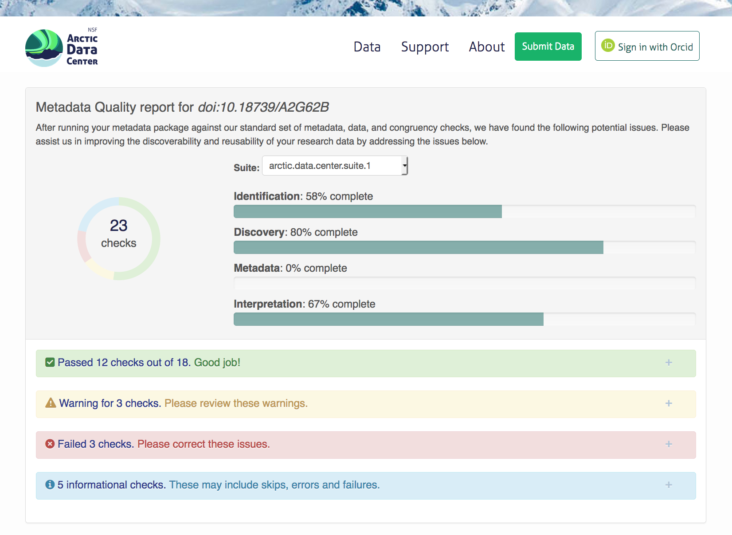
Metadata Improvement Service

Slide 10
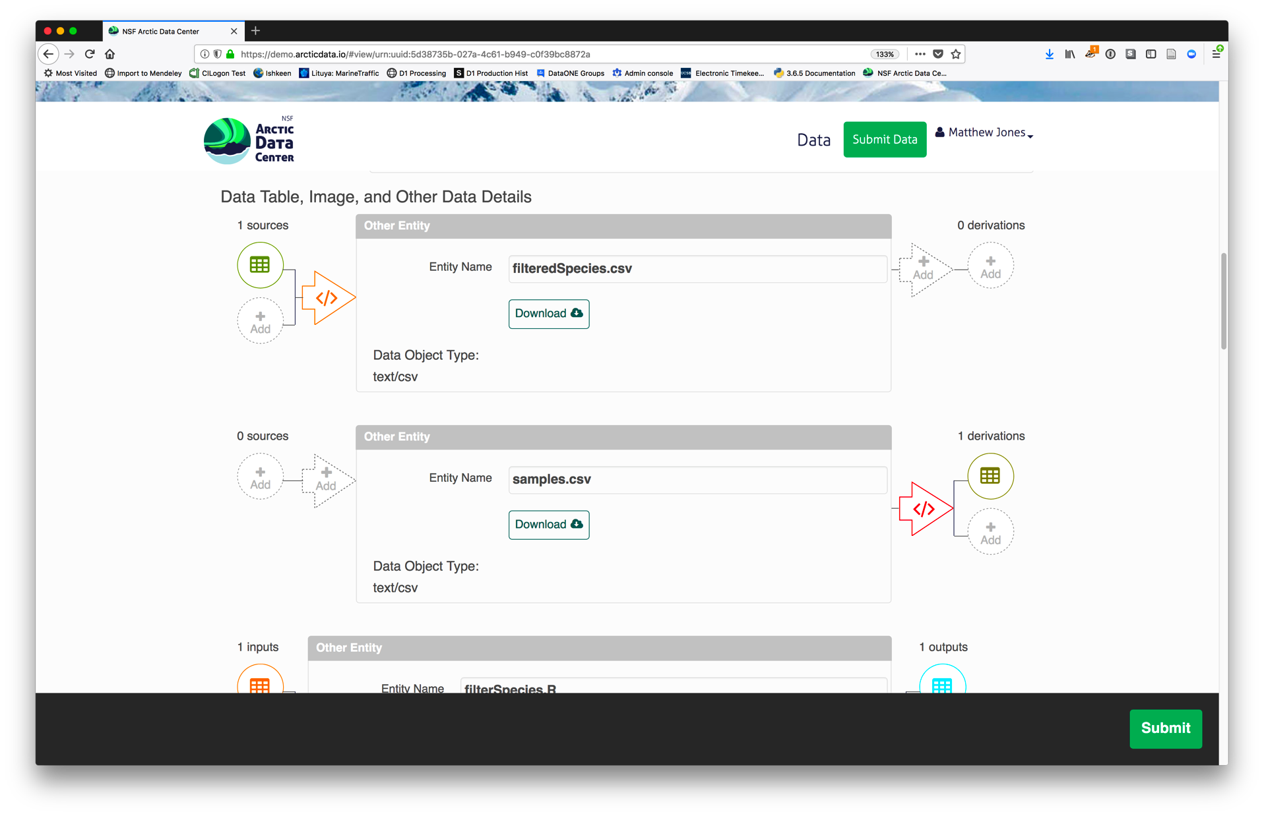
Computational Workflows
Provenance linking data, software, and papers

Slide 13


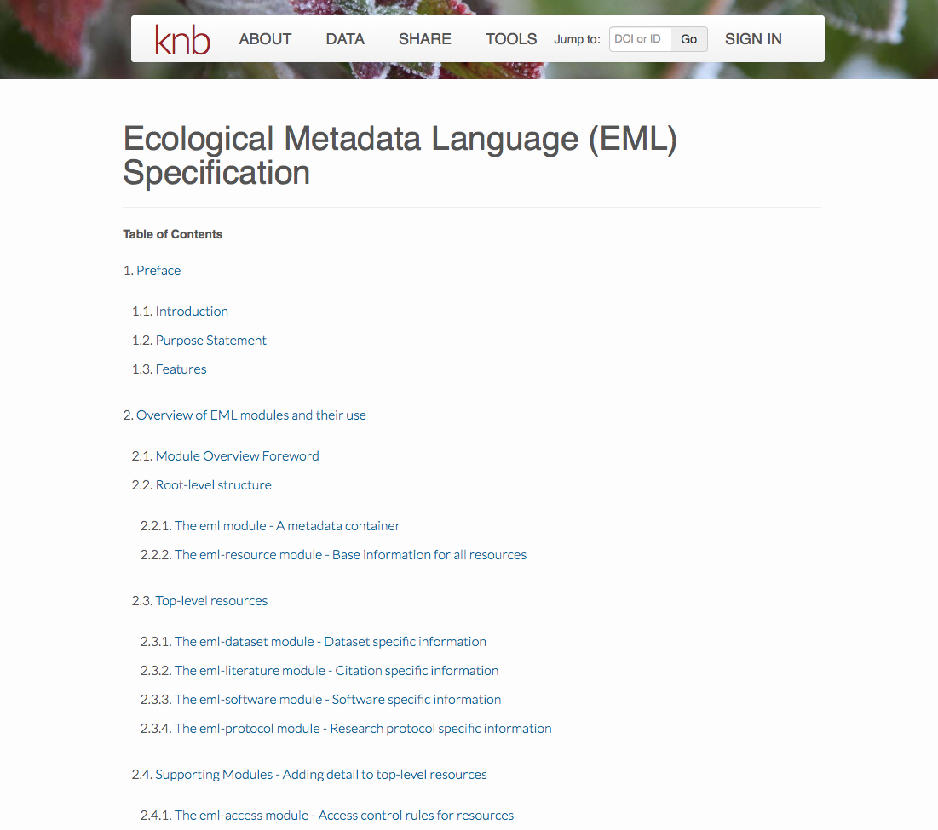
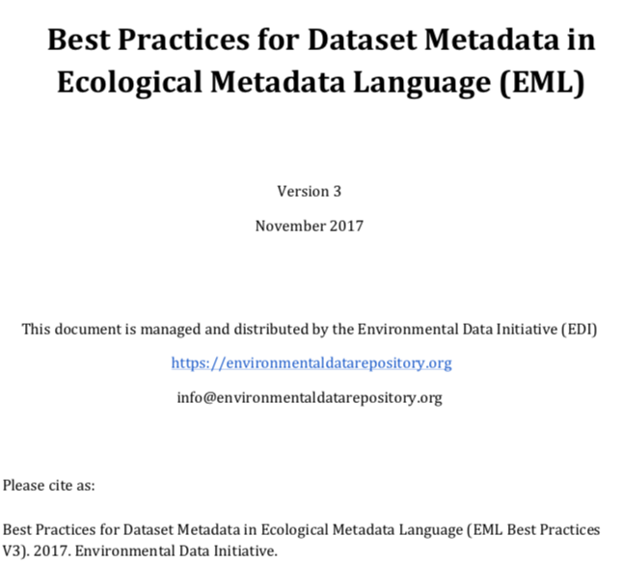
EML Resources
Knowledge Network for Biocomplexity. EML Specification.
Environmental Data Initiative. Best Practices.

