Slide 1
Why CERIF?
Keith G Jeffery Scientific Coordinator ERCIM
Anne Assserson euroCRIS
Keith G Jeffery
SDSVoc Workshop Amsterdam 20161130-1201

Slide 2
A brief history of Metadata
Problem: making programmatic data structures persistent, externalised and virtualised
Solution: database technology – schema - metadata
Problem: needed richer metadata
  Catalogues of data assets (library technology onwards)
  Catalogues of software assets (software engineering)
  Catalogues of computing resources (GRIDs then CLOUDs)
  Catalogues of persons as users (AAAI)
All digital representations of objects are data
The only difference between data and metadata is mode of use
Keith G Jeffery
SDSVoc Workshop Amsterdam 20161130-1201

Slide 3
The VRE4EIC Challenge
CERIF
Catalog
(metadata)
VRE4EIC (Virtual Research Environment)
e-RI
e.g.
ELIXIR
catalog
e-RI
e.g.
DARIAH
catalog
e-RI
e.g.
EPOS
catalog
e-RI
e.g.
ENVRI
catalog
e-RI
e.g.
SKA
catalog
e-I
e.g GEANT
e-I
e.g AARC2
e-I
e.g.
EUDAT
e-I
e.g
EGI
e-I
e.g
OpenAIRE
Keith G Jeffery
SDSVoc Workshop Amsterdam 20161130-1201
3

Slide 4
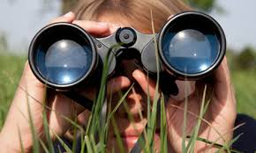
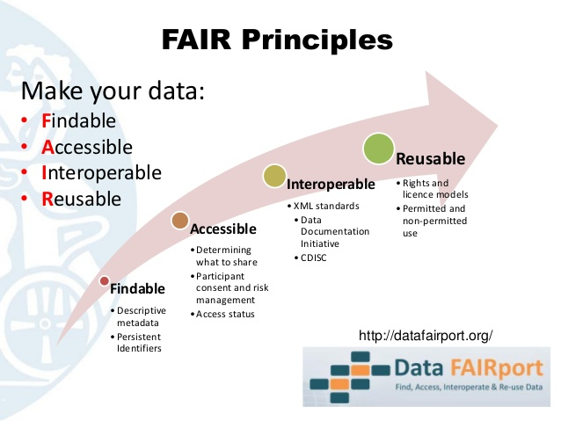
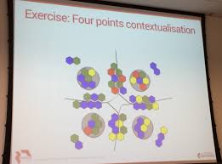

Need for Metadata
Discovery
Contextu
- alisation
Action
Keith G Jeffery
SDSVoc Workshop Amsterdam 20161130-1201
4

Slide 5
Metadata Desiderata
Formal syntax
  Referential integrity
  Functional integrity
Declared semantics
  Ontologies
  multilingual
To allow not only
  Discovery
  Contextualisation
    relevance
    quality
  Action
    Deployment
    Execution
    Interoperation
by HUMANS
but also by COMPUTERS
Keith G Jeffery
SDSVoc Workshop Amsterdam 20161130-1201
5

Slide 6
Metadata Desiderata: Example: Syntax
<ID><Title><Abstract><Author>
May be >1 author (referential integrity)
May be >1 title/abstract (multilinguality) (referential integrity)
Author is not uniquely dependent on ID which refers to the digital object (functional integrity)
This was a simple example; it can get much more complex hence need for formal syntax
Keith G Jeffery
SDSVoc Workshop Amsterdam 20161130-1201
6

Slide 7
Metadata Desiderata: Example: Semantics
To obtain consistency it is essential that terms are:
(a) restricted to an agreed list; (b) related to other terms; (c) defined.
Senior lecturer is an academic rank.^{[1]} In the United Kingdom, Republic of Ireland, New Zealand, Australia, and Switzerland, lecturer is a faculty position at a university or similar institution. The position is tenured and is roughly equivalent to an associate professor in the North American system. (Wikipedia)
<senior lecturer (UK)> <equivalence> <associate professor (US)> <equivalence> <maitre des conferences (FR)> ………
Particularly important for keywords and classification codes
e.g. Frascati ⬄ UDC ⬄ ………
Keith G Jeffery
SDSVoc Workshop Amsterdam 20161130-1201
7

Slide 8
Metadata Standards Need to Express example citation
P
<is cited by><datetimestart><datetimeend>
Q
Keith G Jeffery
SDSVoc Workshop Amsterdam 20161130-1201
8

Slide 9
Metadata Standards Need to Express example citation
P
<is cited by><datetimestart><datetimeend>
Q
Person A
Person B
<Author 100%>< datetimestart><datetimeend>
<Author 100%>< datetimestart><datetimeend>
Keith G Jeffery
SDSVoc Workshop Amsterdam 20161130-1201
9

Slide 10
Metadata Standards Need to Express example citation
P
<is cited by><datetimestart><datetimeend>
Q
Person A
Person B
<Author 100%>< datetimestart><datetimeend>
<Author 100%>< datetimestart><datetimeend>
<Employed 50% >< datetimestart><datetimeend>
Organisation M
<Employed 100% >< datetimestart><datetimeend>
<Employed 50% >< datetimestart><datetimeend>
Organisation N
Keith G Jeffery
SDSVoc Workshop Amsterdam 20161130-1201
10

Slide 11
Metadata Standards Need to Express example citation
P
<is cited by><datetimestart><datetimeend>
Q
Person A
Person B
<Author 100%>< datetimestart><datetimeend>
<Author 100%>< datetimestart><datetimeend>
<Employed 50% >< datetimestart><datetimeend>
Organisation M
<Employed 100% >< datetimestart><datetimeend>
<Employed 50% >< datetimestart><datetimeend>
Organisation N
<leader> <datetimestart><datetimeend>
Project P
<participant 50%>< datetimestart><datetimeend>
Organisation X
<funded 100%> <datetimestart><datetimeend>
Keith G Jeffery
11
SDSVoc Workshop Amsterdam 20161130-1201

Slide 12
Metadata Standards Need to Express example citation
<{part of} article P> <is cited {positively | negatively} {start date,time-end date,time} by> <{part of} article Q>
<article P> <{100%}authored {start date,time-end date,time} by> <person A>
<person A> <employed {50%} {start date,time-end date,time} by> <Organisation M>
<person A> <employed{50%} {start date,time-end date,time} by> <Organisation N>
<person A> <is {start date,time-end date,time} leader of> <Project P>
<article Q> <{100%}authored by {start date,time-end date,time} > <person B>
<person B> <employed {100%} {start date,time-end date,time} by> <Organisation M>
<person B> < {start date,time-end date,time} participates{50%} in> <Project P>
<Project P < {start date,time-end date,time} is funded 100%} by> <Organisation X>
Same is true for citation of datasets or software
Keith G Jeffery
SDSVoc Workshop Amsterdam 20161130-1201
12

Slide 13
Advantage of Formal Expression
This is essentially expressions in (decorated) first order logic – the elements in red are linking semantic relations
Therefore can do deduction (facts from rules) and induction (rules from facts): this
  reduces the effort of input,
  increases the quality by consistency validation
  and ensures actionable
Keith G Jeffery
SDSVoc Workshop Amsterdam 20161130-1201

Slide 14

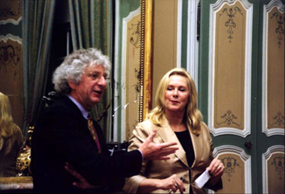

Metadata Standards: CERIF
Common European Research Information Format
  Data Model for exchange and storage of information about research
CERIF91 (1987-1990) quite like the later Dublin Core (late 1990s)
  Tested and found to be inadequate (as predicted by Jeffery)
CERIF2000 (1997-1999) used full E-E-R modelling (formalised by Jeffery & Asserson)
  Base entities
  Linking entities with role and temporal interval (i.e. decorated FOL)
2002 EC requested euroCRIS to maintain, develop and promote CERIF www.eurocris.org
  Now in use in 43 countries and national standard for research information in 10
  SMEs providing CERIF systems , 2 bought up by Elsevier and Thomson-Reuters
Keith G Jeffery
SDSVoc Workshop Amsterdam 20161130-1201

Slide 15
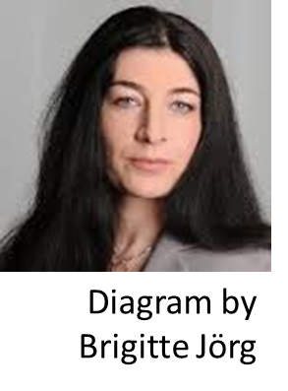
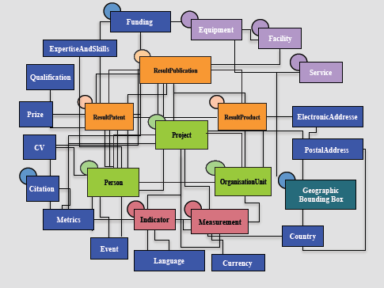
Contextual Metadata: CERIF
Keith G Jeffery
SDSVoc Workshop Amsterdam 20161130-1201

Slide 16

Characteristics of CERIF 1
(a) it separates clearly base entities from relationships between them and thus represents the more flexible fully-connected graph rather than a hierarchy;
(b) it has generalised base entities with instances specialised by role (for example <person> rather than <author>), the role specialisation is in the linking entities;
(c) it handles multilinguality by design (multiple language representations are linked with role (e.g. machine or human-translated) and temporal information (so representing versions of the translation) to the appropriate attribute treated as an entity – example <title> linked to <publication>;
(d) temporal information is in the link entities not the base entities (example employment between two dates is in the linking relation between <person> and <organisation> and not an attribute of either of the base entities;
Keith G Jeffery
SDSVoc Workshop Amsterdam 20161130-1201
16

Slide 17
Characteristics of CERIF 2
(e) the temporal information in linking entities provides provenance and versioning recording e.g. versions of datasets and – in the associated role attribute – the method of update or change;
(f) CERIF separates the semantics into a special ‘layer’ which is referenced from CERIF instances. The sematic layer includes permissible values for roles in any linking entity (e.g. <person> <author|editor|illustrator|reviewer…> <publication>) and also permissible values for controlled values of attributes in base entities e.g. ISO country codes). Thus semantic terms are stored once and referenced many times (preserving integrity). The semantic layer – like the syntactic layer - consists of base entities (e.g. the valid values for an attribute or valid roles for a linking entity) and linking entities thus allowing relationships between vocabularies and relationships between individual terms to be represented i.e. an ontology. Thus CERIF provides formal syntax and declared (multilingual) semantics.
(g) CERIF has a formal review and update process controlled by euroCRIS and so can evolve. However, it is designed to evolve by accretion (there is a method of adding additional entities and appropriate linking entities to existing base entities) so that the core of CERIF remains constant for interoperability among CERIF installations.
Keith G Jeffery
SDSVoc Workshop Amsterdam 20161130-1201
17

Slide 18



Use of CERIF
Originally intended for CRIS (Current Research Information Systems)
  Research institutions to manage their portfolios, publish their research information (web pages), offer services, interoperate with others
  Research funding institutions to manage their portfolios, assess funded research
  Industry to discover relevant research to be used for wealth creation
  Government to discover relevant research to be used for policymaking
  Publishers to check their own catalogs, to find new potential authors, to track emerging domains
  Media to publish research ‘stories’
Now used in large e-Research infrastructures e.g.
And in leading-edge CLOUD project PaaSage
Keith G Jeffery
SDSVoc Workshop Amsterdam 20161130-1201
18

Slide 19

The Challenge
Metadata Standards must be a good thing
  there are so many of them
  And commonly several dialects of each
So to do research we need to interoperate to gain access to/re-use of assets described by metadata such as:
  Datasets
  Software modules
  Services
  Workflows
  Instruments/detectors
  Computing resources
  Persons (experts)
  Publications
So we need to interoperate across metadata standards
Keith G Jeffery
SDSVoc Workshop Amsterdam 20161130-1201
19

Slide 20
But…
Metadata standards have different:
  Elements (attribute names, types)
  Syntax (structure within and between elements)
  Semantics (meaning of values of elements or of components of elements)
  Language
  (I used to also say character set but Unicode has more-or-less solved this)
Keith G Jeffery
SDSVoc Workshop Amsterdam 20161130-1201
20

Slide 21


The n squared problem
If we have n metadata standards
Then to interoperate we need n*(n-1) mappings/convertors (almost n**2)
➔ define a superset canonical metadata standard and use that as a kind of ‘switchboard’
Then have n mappings/convertors (a considerable saving!)
➔ clearly this canonical metadata standard has to be
  A superset of the elements from the n metadata standards to be interoperated
  Richer in syntax and semantics than any of the n metadata standards to be interoperated
  Interoperable with each of the n metadata standards to be interoperated
CERIF mappings exist⬄ DC, DCAT, eGMS, CKAN, INSPIRE…..
Keith G Jeffery
SDSVoc Workshop Amsterdam 20161130-1201
21

Slide 22

Research Data Alliance
Metadata Interest Group
  Metadata Standards Catalog Working Group
  Data in Context Interest Group
  Research data provenance interest group
Data Formats & Types Working Group
PIDs Working Group
Data Fabric Interest Group
(and many more)
Keith G Jeffery
SDSVoc Workshop Amsterdam 20161130-1201

Slide 23
RDA Element set
Collected use cases
  Across many domains
Analysed for commonality
Proposed element set (Jeffery & Koskela)
Minor changes suggested by RDA attendees
Now checking applicability across domains
Next detail the elements
Then decide representation
Unique Identifier (for later use including citation)
Location (URL)
Description
Keywords (terms)
Temporal coordinates
Spatial coordinates
Originator (organisation(s) / person(s))
Project
Facility / equipment
Quality
Availability (licence, persistence)
Provenance
Citations
Related publications (white or grey)
Related software
Schema
Medium / format
Keith G Jeffery
SDSVoc Workshop Amsterdam 20161130-1201
23

Slide 24
RDA Element set
Collected use cases
  Across many domains
Analysed for commonality
Proposed element set (Jeffery & Koskela)
Minor changes suggested by RDA attendees
Now checking applicability across domains
Next detail the elements
Then decide representation
Unique Identifier (for later use including citation)
Location (URL)
Description
Keywords (terms)
Temporal coordinates
Spatial coordinates
Originator (organisation(s) / person(s))
Project
Facility / equipment
Quality
Availability (licence, persistence)
Provenance
Citations
Related publications (white or grey)
Related software
Schema
Medium / format
Elements are NOT simple attributes
They have syntax (structures) and semantics
Keith G Jeffery
SDSVoc Workshop Amsterdam 20161130-1201
24

Slide 25
RDA Element Set : Considerations
The RDA element set is not unlike DDI
It is much richer than DC, DCAT, CKAN, INSPIRE
Its representation will be an interesting discussion
  Likely follow FAIR principles
  Formal syntax and declared semantics
Keith G Jeffery
SDSVoc Workshop Amsterdam 20161130-1201
25

Slide 26
Requirement: Researcher View
User Request to system
  Typing ➔ voice, static or mobile device
System interacts to ensure understood
  Clarification, improvement, disambiguate
  Medium/format of output required
System discovers relevant assets
  Location, rights management, (costs), security, privacy, performance considerations
System constructs workflow
  Presents to user for validation /correction
  Including all rights management, security, privacy, costs
  Distributed, parallel
System executes workflow
  User has monitoring screen
  Distributed, parallel
System returns results to end-user
  In appropriate medium/format
In essence same as requirement for G-EXEC 1968-71
Main difference then
  System did not interact to understand
  User constructed the workflow
  No user monitoring (batch processing)
Now possible thanks to virtualisation
  Metadata
    Datasets
    Software
    Publications
    Persons
    Organisations
    Equipment, facilities
    GRIDs, CLOUDs
Keith G Jeffery
SDSVoc Workshop Amsterdam 20161130-1201
26

Slide 27
Requirement: Researcher View
plus assistance with the rest of the research lifecycle
  Generating ideas
  Researching the literature
  Writing proposals
  Managing research projects
  Publicising research results
  Maintaining online CV
  Reviewing proposals and scholarly papers
  Cooperating with other researchers
  Evaluating against other researchers
  Working on editorial boards and conference programme committees
Keith G Jeffery
SDSVoc Workshop Amsterdam 20161130-1201
27

Slide 28
Requirement Metadata
Metadata to describe (virtualise)
  Datasets
  Software components
  Publications (white and grey)
  Equipment/facilities
  Computing resources
  Workflows
  Persons
  Organisations
  etc.
FAIR principles
Managed rights (ideally toll-free open access and utilisation)
Suitable for
  Discovery
  Contextualisation (relevance, quality)
  Action
Re-use for new research
Re-use for reproducibility
Formal syntax, declared semantics
Keith G Jeffery
SDSVoc Workshop Amsterdam 20161130-1201
28

Slide 29
VRE4EIC Architectural Positioning
CERIF
Catalog
(metadata)
VRE4EIC (Virtual Research Environment)
e-RI
e.g.
ELIXIR
catalog
e-RI
e.g.
DARIAH
catalog
e-RI
e.g.
EPOS
catalog
e-RI
e.g.
ENVRI
catalog
e-RI
e.g.
SKA
catalog
e-I
e.g GEANT
e-I
e.g AARC2
e-I
e.g.
EUDAT
e-I
e.g
EGI
e-I
e.g
OpenAIRE
Keith G Jeffery
SDSVoc Workshop Amsterdam 20161130-1201
29

Slide 30
Questions
?
Keith G Jeffery
SDSVoc Workshop Amsterdam 20161130-1201

Slide 31
Acknowledgment
The VRE4EIC project has received funding
from the European Union’s Horizon 2020 research and innovation programme under grant agreement No 676247
Keith G Jeffery
SDSVoc Workshop Amsterdam 20161130-1201

