Slide 1
Why CERIF?
Keith G Jeffery Scientific Coordinator ERCIM
Anne Assserson euroCRIS

Slide 2
Need for Metadata
Discovery
Contextualisation
Action
2

Slide 3
Metadata Desiderata
Formal syntax
Referential integrity
Functional integrity
Declared semantics
Ontologies
multilingual
To allow not only
Discovery
Contextualisation
relevance
quality
Action
Deployment
Execution
Interoperation
by HUMANS
but also by COMPUTERS

Slide 4
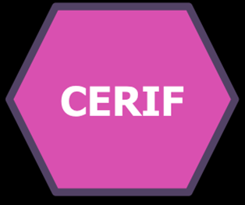
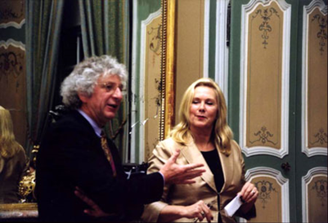
Metadata Standards: CERIF
Common European Research Information Format
Data Model for exchange and storage of information about research
CERIF91 (1987-1990) quite like the later Dublin Core (late 1990s)
Tested and found to be inadequate (as predicted by Jeffery)
CERIF2000 (1997-1999) used full E-E-R modelling (formalised by Jeffery & Asserson)
Base entities
Linking entities with role and temporal interval (i.e. decorated FOL)
2002 EC requested euroCRIS to maintain, develop and promote CERIF www.eurocris.org
Now in use in 43 countries and national standard for research information in 10
SMEs providing CERIF systems , 2 bought up by Elsevier and Thomson-Reuters

Slide 5
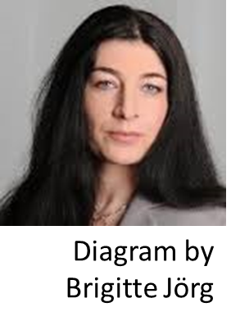
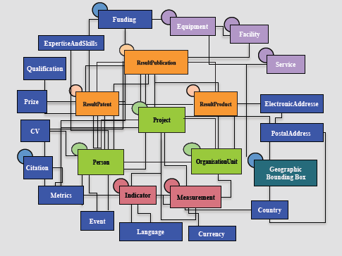
Contextual Metadata: CERIF

Slide 6
Characteristics of CERIF
(a) it separates clearly base entities from relationships between them and thus represents the more flexible fully-connected graph rather than a hierarchy;
(b) it has generalised base entities with instances specialised by role (for example <person> rather than <author>), the role specialisation is in the linking entities;
(c) it handles multilinguality by design (multiple language representations are linked with role (e.g. machine or human-translated) and temporal information (so representing versions of the translation) to the appropriate attribute treated as an entity – example <title> linked to <publication>;
(d) temporal information is in the link entities not the base entities (example employment between two dates is in the linking relation between <person> and <organisation> and not an attribute of either of the base entities;
6

Slide 7
Characteristics of CERIF
(e) the temporal information in linking entities provides provenance and versioning recording e.g. versions of datasets and – in the associated role attribute – the method of update or change;
(f) CERIF separates the semantics into a special ‘layer’ which is referenced from CERIF instances. The sematic layer includes permissible values for roles in any linking entity (e.g. <person> <author|editor|illustrator|reviewer…> <publication>) and also permissible values for controlled values of attributes in base entities e.g. ISO country codes). Thus semantic terms are stored once and referenced many times (preserving integrity). The semantic layer – like the syntactic layer - consists of base entities (e.g. the valid values for an attribute or valid roles for a linking entity) and linking entities thus allowing relationships between vocabularies and relationships between individual terms to be represented i.e. an ontology. Thus CERIF provides formal syntax and declared (multilingual) semantics.
(g) CERIF has a formal review and update process controlled by euroCRIS and so can evolve. However, it is designed to evolve by accretion (there is a method of adding additional entities and appropriate linking entities to existing base entities) so that the core of CERIF remains constant for interoperability among CERIF installations.
7

Slide 8
Use of CERIF
Originally intended for CRIS (Current Research Information Systems)
Research institutions to manage their portfolios, publish their research information (web pages), offer services, interoperate with others
Research funding institutions to manage their portfolios, assess funded research
Industry to discover relevant research to be used for wealth creation
Government to discover relevant research to be used for policymaking
Publishers to check their own catalogs, to find new potential authors, to track emerging domains
Media to publish research ‘stories’
Now used in large e-Research infrastructures e.g.
And in leading-edge CLOUD project PaaSage
8

Slide 9
The Challenge
Metadata Standards must be a good thing
there are so many of them
And commonly several dialects of each
So to do research we need to interoperate to gain access to/re-use of assets described by metadata such as:
Datasets
Software modules
Services
Workflows
Instruments/detectors
Computing resources
Persons (experts)
Publications
So we need to interoperate across metadata standards
9

Slide 10
But…
Metadata standards have different:
Elements (attribute names, types)
Syntax (structure within and between elements)
Semantics (meaning of values of elements or of components of elements)
Language
(I used to also say character set but Unicode has more-or-less solved this)
10

Slide 11
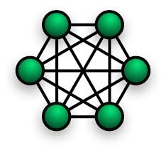
The n squared problem
If we have n metadata standards
Then to interoperate we need n*(n-1) mappings/convertors (almost n**2)
➔ define a superset canonical metadata standard and use that as a kind of ‘switchboard’
Then have n mappings/convertors (a considerable saving!)
➔ clearly this canonical metadata standard has to be
A superset of the elements from the n metadata standards to be interoperated
Richer in syntax and semantics than any of the n metadata standards to be interoperated
Interoperable with each of the n metadata standards to be interoperated
CERIF mappings exist⬄ DC, DCAT, eGMS, CKAN, INSPIRE…..
11

Slide 12
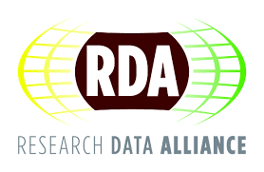
RDA Element set
Collected use cases
Across many domains
Analysed for commonality
Proposed element set (Jeffery & Koskela)
Minor changes suggested by RDA attendees
Now checking applicability across domains
Next detail the elements
Then decide representation
Unique Identifier (for later use including citation)
Location (URL)
Description
Keywords (terms)
Temporal coordinates
Spatial coordinates
Originator (organisation(s) / person(s))
Project
Facility / equipment
Quality
Availability (licence, persistence)
Provenance
Citations
Related publications (white or grey)
Related software
Schema
Medium / format
12

Slide 13
RDA Element set
Collected use cases
Across many domains
Analysed for commonality
Proposed element set (Jeffery & Koskela)
Minor changes suggested by RDA attendees
Now checking applicability across domains
Next detail the elements
Then decide representation
Unique Identifier (for later use including citation)
Location (URL)
Description
Keywords (terms)
Temporal coordinates
Spatial coordinates
Originator (organisation(s) / person(s))
Project
Facility / equipment
Quality
Availability (licence, persistence)
Provenance
Citations
Related publications (white or grey)
Related software
Schema
Medium / format
Elements are NOT simple attributes
They have syntax (structures) and semantics
13

Slide 14
RDA Element Set : Considerations
The RDA element set is not unlike DDI
It is much richer than DC, DCAT, CKAN, INSPIRE
Its representation will be an interesting discussion
Likely follow FAIR principles
Formal syntax and declared semantics
14

Slide 15
Requirement Metadata
Metadata to describe (virtualise)
Datasets
Software components
Publications (white and grey)
Equipment/facilities
Computing resources
Workflows
Persons
Organisations
etc.
FAIR principles
Managed rights (ideally toll-free open access and utilisation)
Suitable for
Discovery
Contextualisation (relevance, quality)
Action
Re-use for new research
Re-use for reproducibility
Formal syntax, declared semantics
15

