Slide 1

ALPHA network data lineage
Documentation of “after the fact” harmonised African longitudinal community-based demographic and HIV surveillance data
Chifundo Kanjala, Jay Greenfield, David Beckles and Basia Zaba

Slide 2
Overview
ALPHA network
  Background
  Data management
Motivation
Developing a business process model for ALPHA data management
Going the last mile: Mapping Pentaho transformations to Structured Data Transform Language (SDTL)
Where we are we now?
Where to next?

Slide 3












Slide 4
ALPHA partner studies and aims
Independent institutions
Located in six high prevalence countries of Eastern and Southern Africa
Managed by ten independent African research institutions
Surveillance studies pre-date the network formation
Facilitated by LSHTM secretariat
ALPHA network aims
Analyse community-based HIV surveillance data
Pool data to strengthen analytical conclusions
Present analyses to health policy makers
Build data analysis and data management capability of partner institutions
Notes:
The ALPHA network is not a multi-country study – the 10 partner studies pre-date the formation of the network each had established its own research aims and field protocols before joining together to form the network. Many of the partner studies had long-standing collaborations with North American and European research institutions amongst them LSHTM which now acts as the network secretariat.

Slide 5
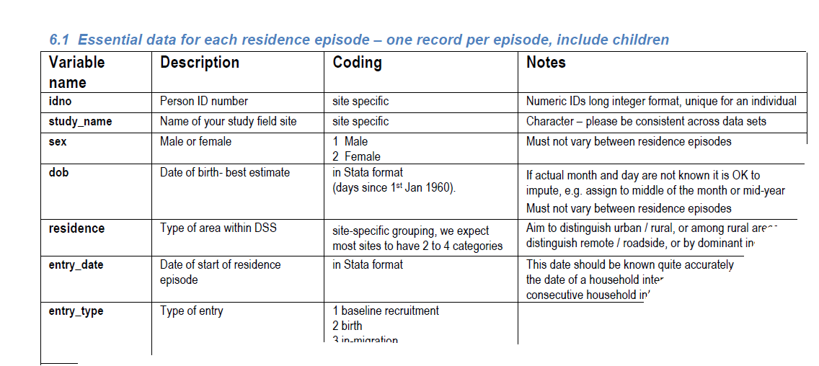
How are ALPHA datasets prepared?
Notes:
Very simplified overview of the processes surrounding ALPHA data processing and exchanges
-A picture of ALPHA specification an older version asking for episodes based spec 6.1 but okay for the purposes of this presentation
This presentation focusses on activities done in the Green box. We are applying business process modelling concepts and DDI 4 DataManagementView components to processes in the green box.

Slide 6
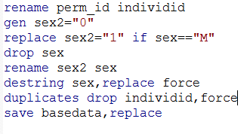
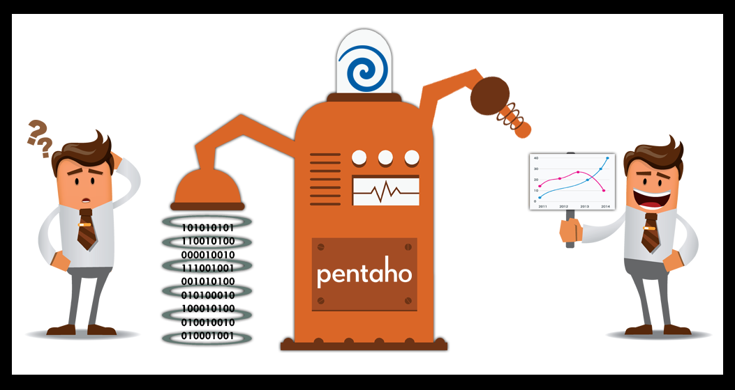
ALPHA data management over the years…
Traditionally done in Stata
  Complex transformations of longitudinal population data, repeated cross sectional surveys and health records
  Different data managers/ researchers producing the ALPHA data
  Source data for different sites are organised differently
  Do-files show how something was done NOT why
  New staff often start from scratch as they do not understand previously done work
Now Migrating to Pentaho Data Integration (PDI) funded by Wellcome Trust
Notes:
Traditionally partner studies data managers and researchers extracted snapshots of relevant data from their operational databases and transformed them in Stata to produce the ALPHA data
ALPHA got funding from WT to migrate the data management to Pentaho Data Integration
The use of Pentaho in ALPHA is within the Centre in a Box environment (Herbst et al. 2015) a self-contained controlled data management and curation system.

Slide 7

Motivation
Why is ALPHA considering structured documentation of its data management processes?

Slide 8
Primary motivation
Need to share data beyond ALPHA
Other drivers
Efficient multi-site data management and exchange among ALPHA members
Standardisation will improve the use of existing data
Funders’ policies requiring data sharing
Pooling and sharing data brings credit through data citation.

Slide 9
Issues…
There is limited domain-specific metadata in Pentaho Data Integration (PDI)
Need for domain specific framework to guide ALPHA data producers to design and document ETL processes
There is a metadata specificity gap between business process models and ALPHA ETL implementations.
  Need for a more concrete documentation of lower level data transformation details
Aims…
Enhance transparency maintainability and reuse of ALPHA ETL routines by:
  Developing a domain-specific business process model that specialises GLBPM
  Expressing transformations done in PDI using generic data transformation language (SDTL). SDTL is mapped to DDI
Notes:
Issues
Though ALPHA has made progress with the transition to PDI the documentation resulting from the ETLs is mainly in the form of Pentaho transformations and jobs diagrams and the accompanying Pentaho-specific XML. Two limitations are identified regarding documentation of the ALPHA ETLs. There is limited contextual metadata to describe the transformations using concepts entities and relationships within the domain of population-based longitudinal demographic and epidemiological surveillance. Contextual metadata is important for further improving maintainability and easy of reuse of the ETL scenarios developed in Pentaho within and across sites. In addition consumers of the outputs from ALPHA ETL in Pentaho will need to understand Pentaho semantics and concepts to follow what would have been done during the data harmonisation process. There is need therefore to have a standardised ETL tool agnostic documentation of the ALPHA ETL to address the two limitations.
Aims
The main Aim is to further improve maintainability and reuse of ALPHA ETL routines by (i) developing a demographic and epidemiological surveillance business process model for aiding designing and documentation of the ALPHA ETLs and (ii) to standardise the metadata produced during ALPHA ETL.

Slide 10
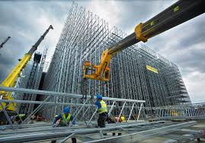
Developing a business process model for ALPHA data management
African population-based Demographic and Epidemiological Surveillance Business Process Model (ADESBPM)

Slide 11
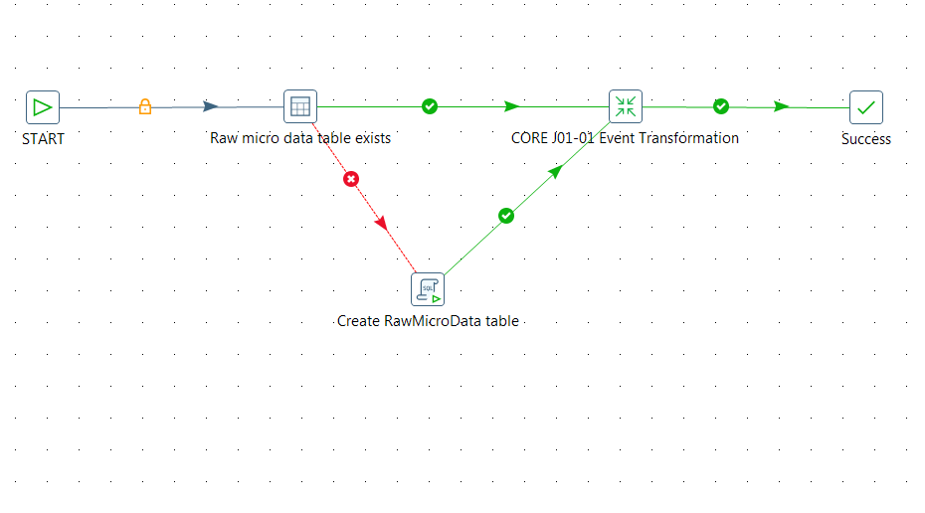
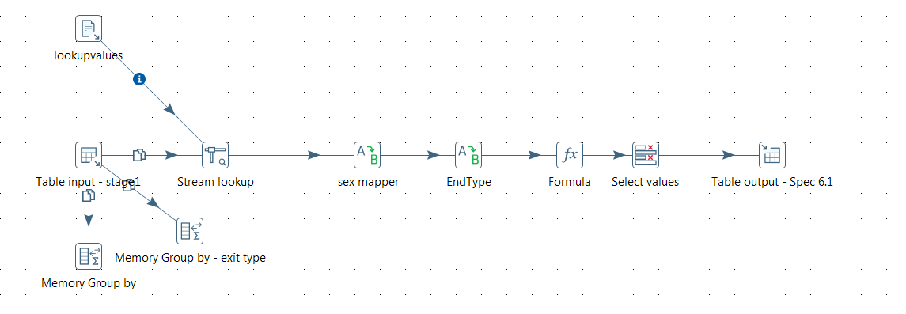
Building ADESBPM: Pentaho data integration
Overview
Terminology
Graphical Extract Transform and Load (ETL) designer
Rich library of pre-built components for data manipulations
Can implement ETLs at two levels (Job and Transformation)
Jobs are at a higher level showing sequence in which transformations are carried out
Transformation – a network of logical tasks called steps
Step – building blocks of a transformation
Hop – connections between steps allowing data to pass from one step to another
Job – a workflow like model for coordinating resources executions and dependencies
Notes:
Pentaho provides a graphical extract-transform-load (ETL) designer to simplify the creation of data pipelines. It has a rich library of pre-built components to access prepare and blend data from various sources. It has powerful orchestration capabilities to coordinate and combine transformations. It has two levels at which ETL scenarios can be implemented; these are the job and the transformation levels. The transformations represent the lower level which decomposes the transformation into a sequence of Pentaho steps. The steps are connected via connections or again “arcs” that Pentaho calls hops.
The Job level is the higher level. It shows the sequence in which transformations are carried out. PDI generates an XML document which records details of the ETL process as it gets developed.

Slide 12
Building ADESBPM: DDI 4
DDI 4 is built on earlier versions of DDI, the Generic Statistical Business Process Model (GSBPM) and the Generic Statistical Information Model (GSIM)
DDI 4 prototype comes in several use cases
Use cases stand on their own and are called views in DDI 4
The relevant view for ALPHA ETL is the DataManagementView
The DataManagementView aims to account for the ingestion and production of new data types (registry data, health data, big data, spell data, event data, etc.) and both legacy and new data management services that give shape to these data types in the course of the data lifecycle…

Slide 13
Building ADESBPM: DDI 4 DataManagementView
At one level DataManagementView has a DataPipeline which comprises a set of business processes traversing a business process model
Each business step in the pipeline decomposes into a collection of WorkflowStep in DDI 4. Thus, a BusinessProcess is a collection of WorkflowSteps.
BusinessProcesses and WorkflowStep map to GLBPM steps and sub-steps respectively
DataPipeline
BusinessProcess
BusinessProcess
Ad Infinitum
WorkflowStep
Collection
WorkflowStep
WorkflowStep
Collection
WorkflowStep

Slide 14
Building ADESBPM: PDI & DDI 4 Information models
ETL Information Model | DDI4 Information Model
Upper model Job Hops Transformation Lower model Transformation Hops Steps Input Output Transform Joins Flow Scripting More… | Upper Model DataPipeline List BusinessProcesses Lower Model BusinessProcess WorkflowStepSequence WorkflowSteps MetadataDrivenAction ComputationAction

Slide 15
Building ADESBPM
Use PDI ETLs to define a set of business activities required to produce ALPHA data
  Map jobs to GLBPM steps
  Specialise the GLBPM steps to demographic and epidemiological surveillance concepts, entities and relationships
GLBPM steps create reusable metadata using a generalised vocabulary.
  Facilitates communication with users outside ALPHA.
  Intended for a wide audience thus too broad for ALPHA
ADESBPM steps create reusable metadata using domain-specific vocabulary
  Provide a more concrete guide for ALPHA data managers and researchers during design and documentation of ALPHA ETLs

Slide 16

Going the last mile…
Mapping Pentaho transformations to Structured Data Transform Language (SDTL)

Slide 17
Going the last mile: Structured Data Transform Language (SDTL)
There is a specificity gap between GLBPM (and ADESBPM) and the ALPHA data production systems
  We are using DDI 4 to bridge that gap
PDI transformation steps details provide DDI 4 WorkflowStep descriptions.
Map PDI transformation steps to SDTL
SDTL maps to DDI 3/4
SDTL – a model for describing data transformations
Developed in the C²metadata project
http://c2metadata.gitlab.io/sdtl-docs/ & http://c2metadata.org/
The language aims to document data transformations carried out in common statistical packages (SPSS, Stata, R, SAS etc)

Slide 18
Composite type | Properties | Type | Cardinality
ExpressionBase | Name | String | 0..1
 | TypeName | String | 1..1
TransformBase | Command | String | 0..1
 | SourceInformation | SourceInformation | 0..1
Comment | CommentText | String | 0..1
Compute | Variable | String | 0..1
 | VariableRange | VariableRangeExpression | 0..1
 | Expression | ExpressionBase | 0..1
 | Condition | ExpressionBase | 0..1
Delete | Variables | String | 0..n
 | VariableRange | VariableRangeExpression | 0..n
FunctionCallExpression | Function | String | 1..1
 | ProprietaryOperator | String | 0..1
 | IsProprietary | Boolean | 0..1
 | Arguments | ExpressionBase | 0..n
Recode | RecodedVariables | RecodeVariable | 0..n
 | RecodedVariableRange | VariableRangeExpression | 0..1
 | Rules | RecodeRule | 0..n
RecodeRule | FromValue | string | 0..n
 | FromValueRange | ValueRange | 0..n
 | SpecialFromValue | string | 0..1
 | To | string | 0..1
 | SpecialToValue | string | 0..1
 | Label | string | 0..1
RecodeVariable | Source | string | 0..1
 | Target | string | 0..1
ReshapeLong | MakeItems | String | 0..n
 | IndexValues | Int | 0..n
 | IndexVarName | String | 0..1
ReshapeWide | KeepItems | string | 0..n
 | IdVar | string | 0..1
 | IndexVar | string | 0..1

Slide 19
The last mile: WorkflowStep decomposition
Identify the SDTL equivalents of the PDI steps used in ALPHA ETLs
Compile a list of PDI transformation steps that are not accounted for in SDTL (vice versa is unlikely…)
Suggest extensions to SDTL if needed
This will provide a way to document lower levels of PDI transformations in DDI

Slide 20

Where are we now?
Initial results on developing ADESBPM and mapping of Pentaho transformation steps to SDTL

Slide 21
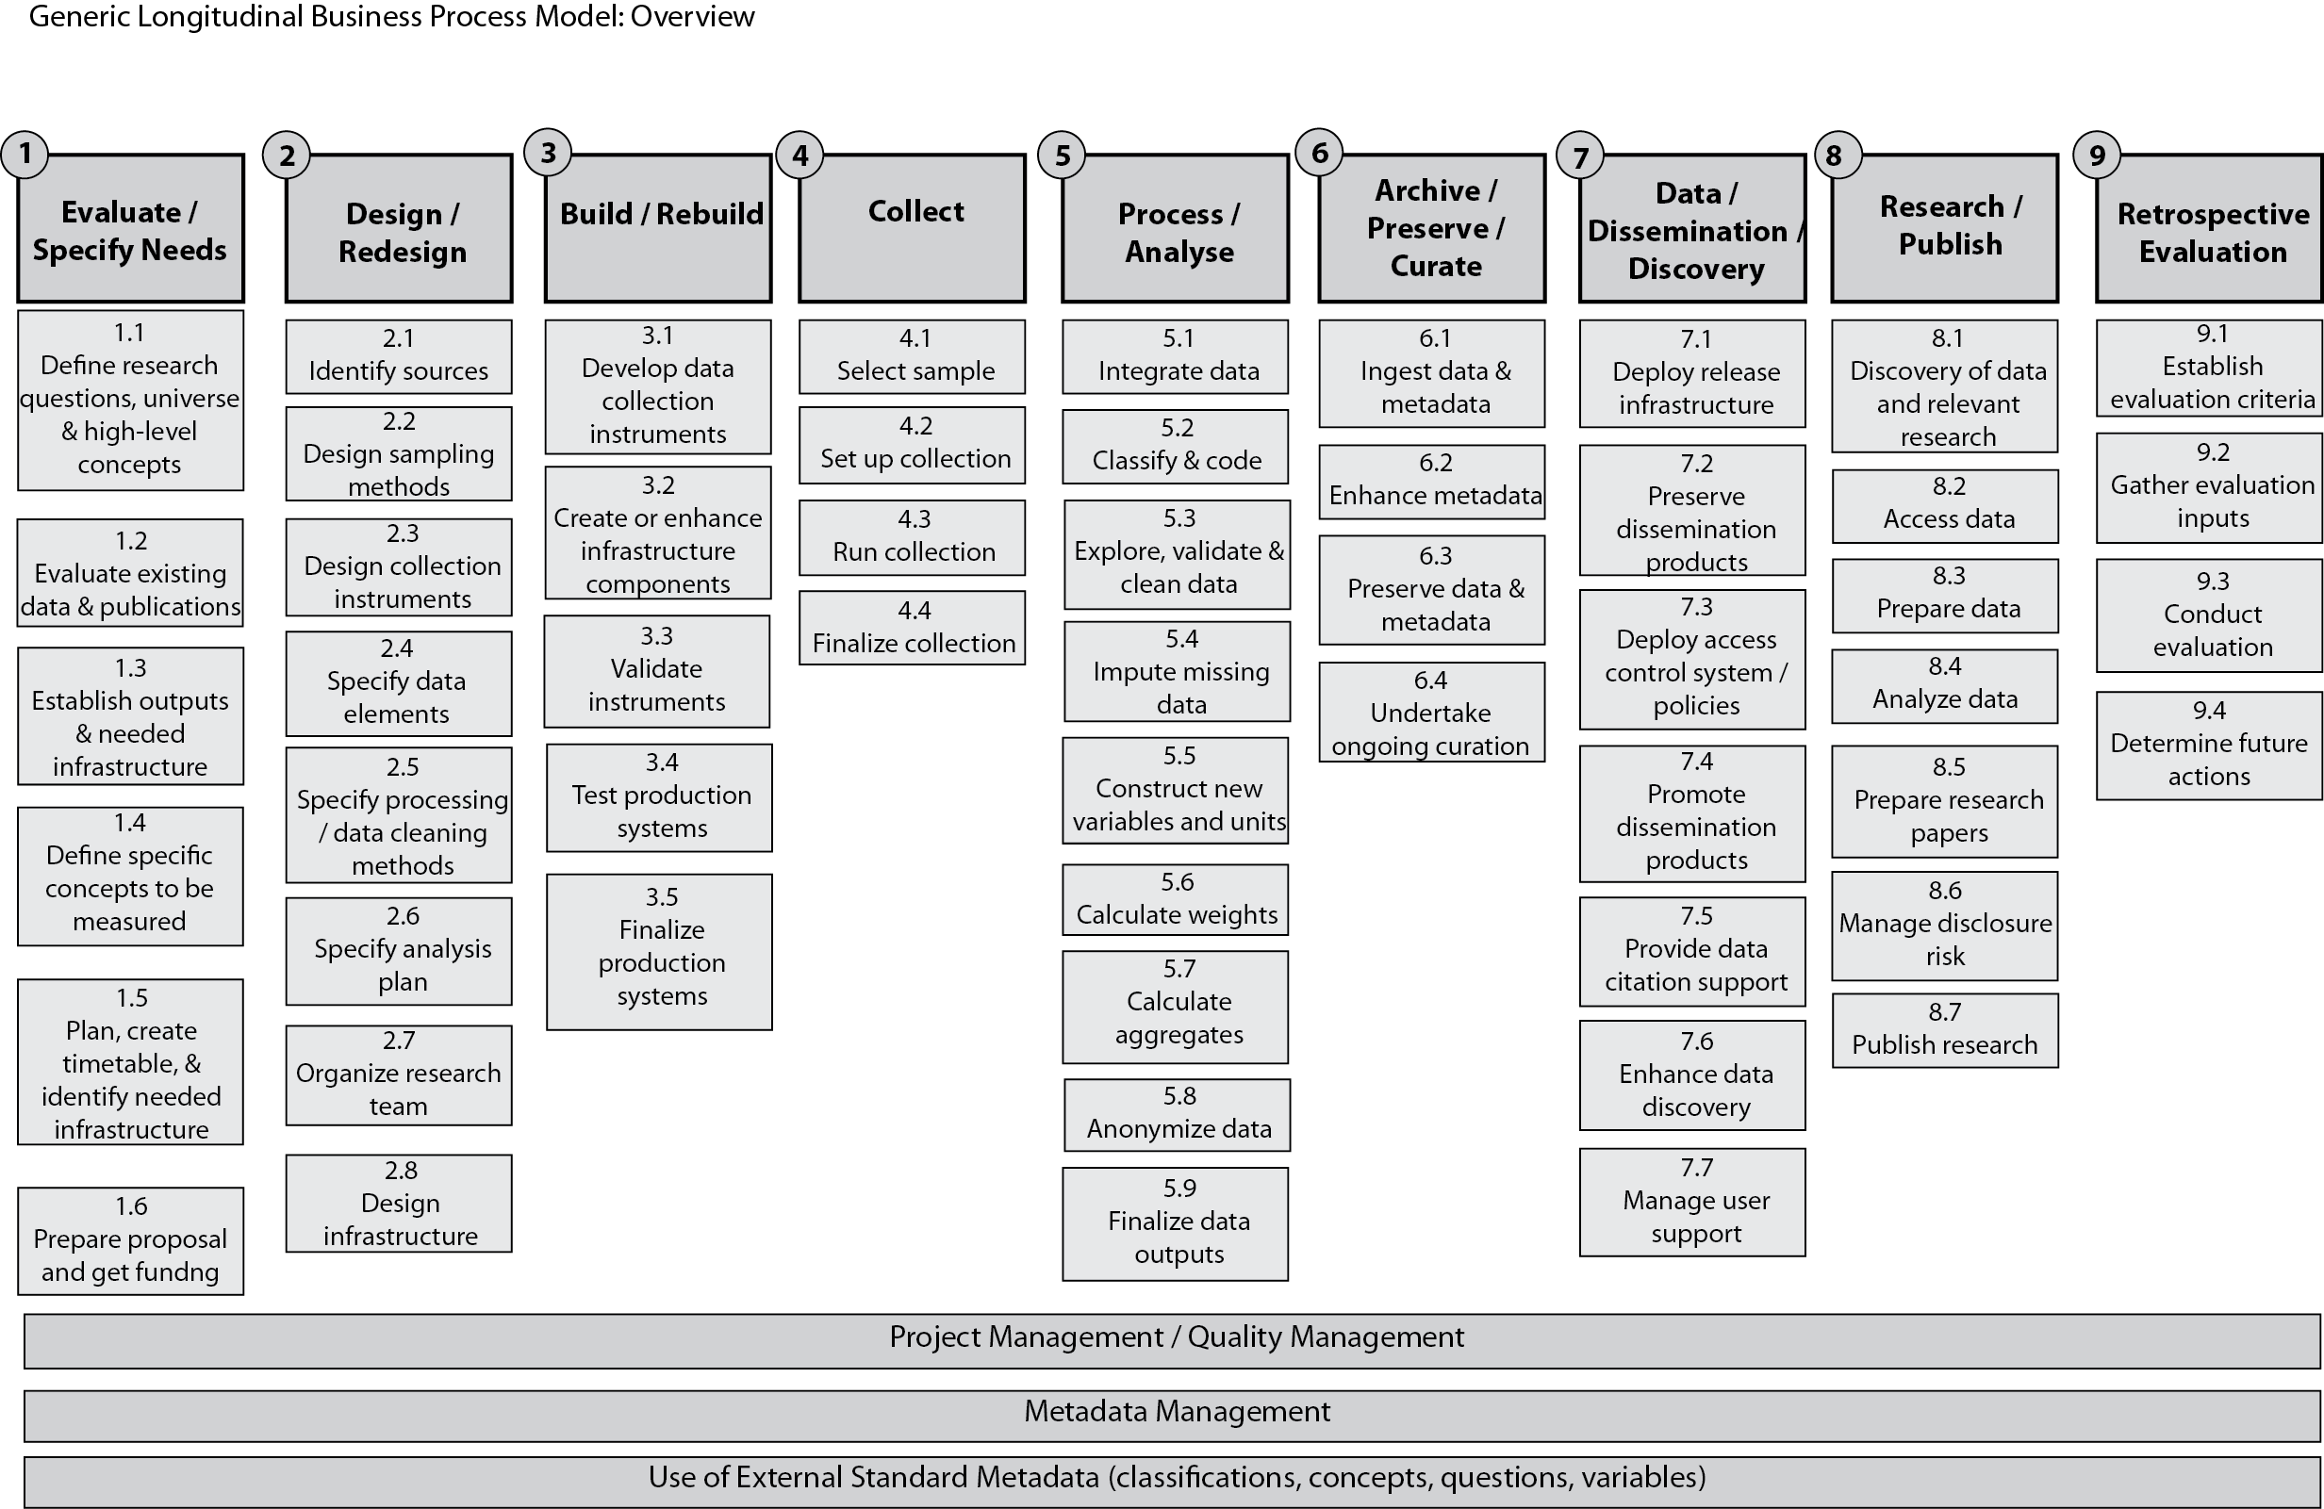
Where are we now? ADESBPM

Slide 22
Where are we now? ADESBPM
GLBPM | ADESBPM | AlgorithmOverview
5.1 Integrate data | Transform operational data into relevant entities of the HDSS reference data model | Create individual table Create events table Create delivery detail table Create delivery-mother-child link table Create cause of death table Populate individual table etc
 | Transform HDSS reference data model entities into harmonised data | Create raw harmonised data table Merge events table to individuals table Merge deliveries information to 1 and 2 Merge cause of death data Etc
5.3 Explore, validate and clean data | Validate sex, dob, events order and events dates | Create QualityMatrics table Create events consistency matrix table Create illegal transitions table Create starting events table Etc Compile illegal events ordering

Slide 23
Where are we now? Pentaho to SDTL mapping
We have started identifying SDTL equivalents of some PDI steps used in ALPHA
Some PDI steps could not be mapped to SDTL
SDTL Composite type | Pentaho step
Compute | calculator, formula
FunctionCallExpression | Sort,
Load | input
Recode | Value mapper
ReshapeLong | Row Normaliser
ReshapeWide | Row denormaliser
Save | output
Select | Select
? | String operations
? | Add value fields changing sequence

Slide 24

Where to next?
ADESBPM: Will review ALPHA PDI ETLs and
add detail to ADESBPM based on this review
Provide ADESBPM template that the ALPHA network management can use as a framework for designing and documenting ALPHA ETLs across member institutions
Complete Pentaho to SDTL mapping to find SDTL equivalents for all transformation steps in ALPHA PDI ETLs
Compile transformation steps not in SDTL to work as basis of extending SDTL on ETL platforms
Develop DDI tools on top of the ADESBPM and SDTL that present the data lineage of PDI data products in a graphical format

Slide 25
Acknowledgements
ALPHA network
Data Documentation Initiative Alliance
Research participants

Slide 26

Thankyou Merci Dankie Zikomo Ahsante Tatenda Ngiyabonga Danke dankje gracias enkosi tawonga wabeja 谢谢 धन्यवाद tack kealeboga shukrān Ndolivhuwa Tá Tsikomo Maraba Sikomo Tak Aitäh obrigado

