Slide 1
Fighting Infectious Diseases Outbreaks through Data Integration
Fernando Reis
1 October 2018

Slide 2
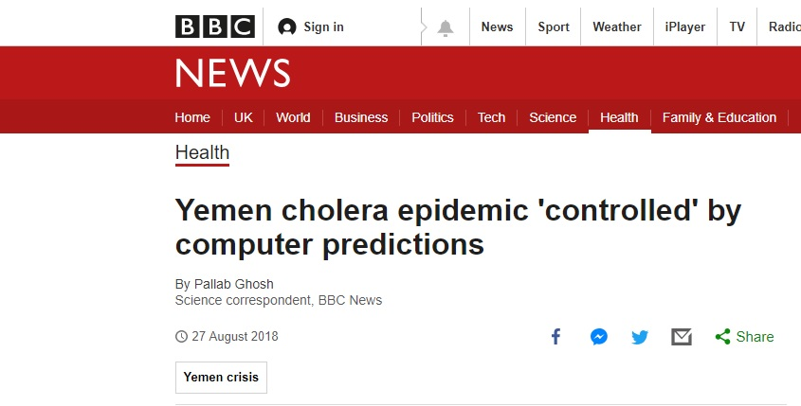
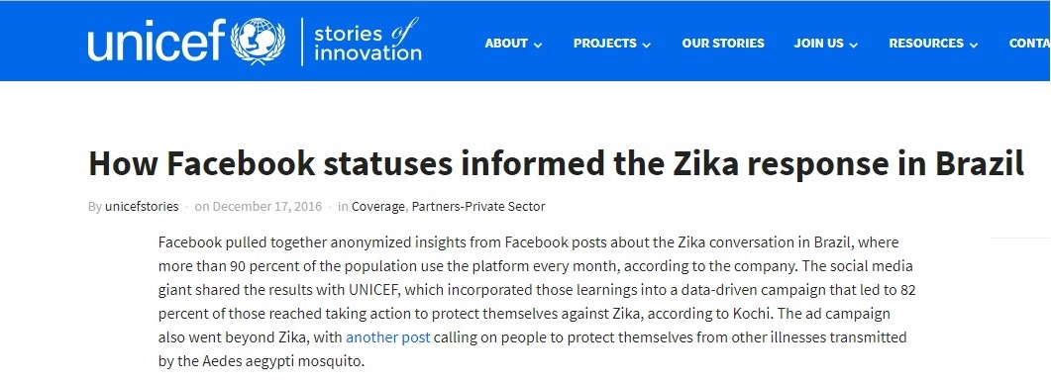
Use of data for the prevention and control of infectious diseases outbreaks
Notes:
The combination of different forms of data to prevent or respond to infectious diseases outbreaks already happens
Prevention: Cholera in Yemen
It draws on a variety of local information such as:
Rainfall forecast
population density
access to clean water
seasonal temperature
Control: Zika in Brazil

Slide 3
Background
Better prevent and control outbreaks of infectious diseases
Make data more useable & findable: Pool and standardise individual patient-level data
Make data available to the health, scientific & humanitarian communities
Notes:
The aim is to build on a multidisciplinary approach to identify and characterize datasets of different domains that contain information that can be used to better prevent and control outbreaks of infectious diseases.
Governed data access
improve accountability of data users
protect patients
ensure benefit to those who provide data

Slide 4
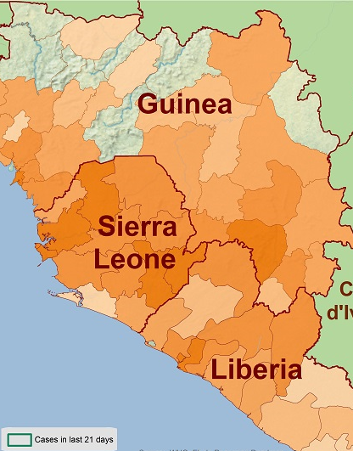
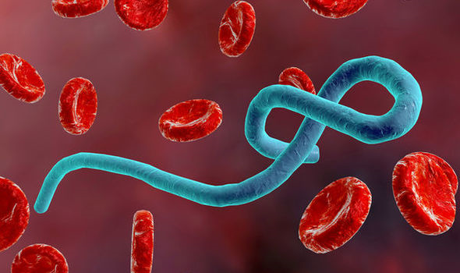
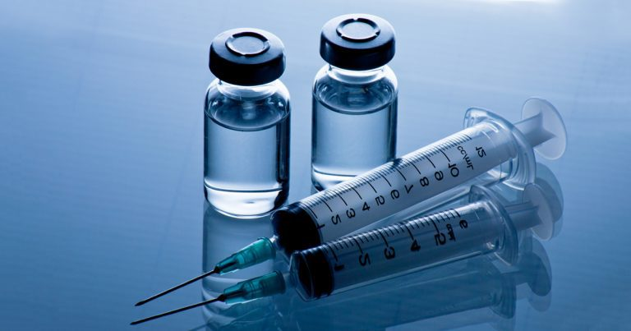

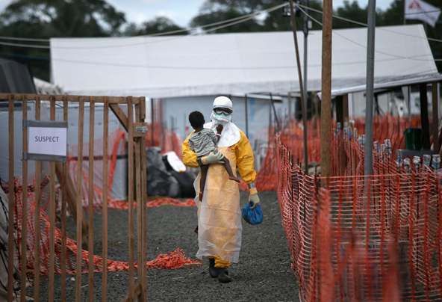
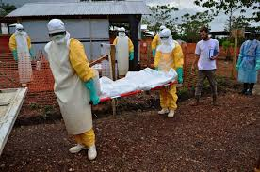
Viral hemorrhagic fevers - Ebola
Largest Ebola outbreak in West Africa in 2014
No licensed vaccine or treatment for Ebola as of yet
More than 28,000 confirmed cases
More than 11,000 deaths recorded as of 27 March 2016
US $ 7.4 billion GDP loss in 2014 in West Africa

Slide 5
Questions addressed : Ebola
What factors affected the spread of the 2014-2016 Ebola outbreak in West Africa?
Can we build a data integration model to support prediction and/or better respond to future outbreaks?
Datasets: Ebola patient data Operational response data; Census; Rumour datasets; internet coverage;

Slide 6
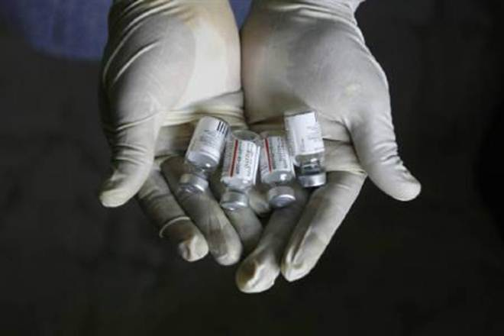
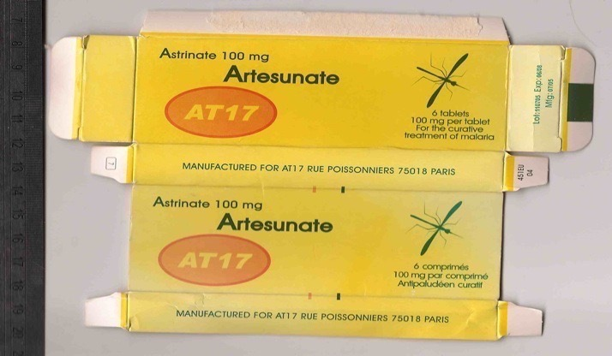
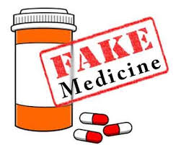
Poor Quality Medicine products
LMICs are the most susceptible market
600,000 doses of substandard diphtheria, tetanus and pertussis vaccines in China
US $ 30 billion economic impact
10% substandard /falsified medicines in LMICs

Slide 7
Questions addressed : Poor Quality Medicines
What is the global burden of poor-quality medicines?
How can global data be used to trace and quell the supply of falsified and substandard medicines?
Datasets: USP Medicines Quality Database, ProMED reports, Health Map studies, WHO Global Surveillance and Monitoring System Report

Slide 8
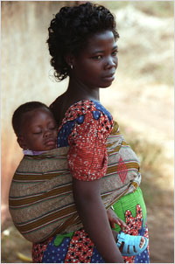
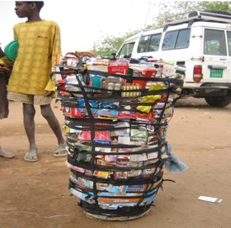
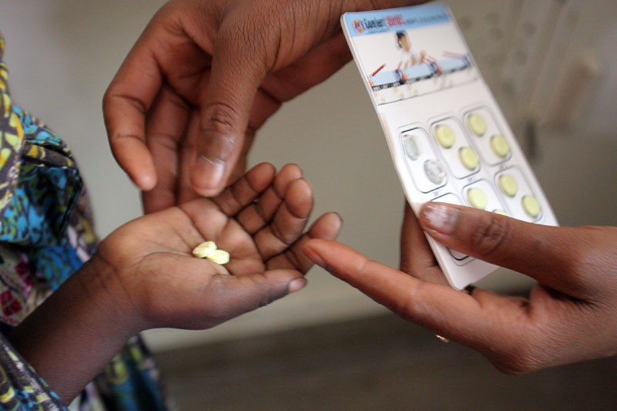
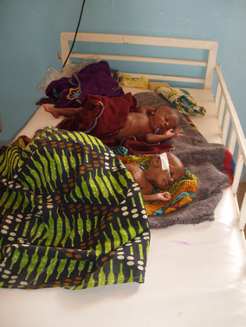

Sub-optimal Malaria treatment
Poor quality
medicines
Young children, pregnant women, malnourished, patients with comorbidities
420,000 people die every year from malaria, and 80% are under 5 years old
89.6 million malaria cases in 2015, and 24% of those occurred in sub-populations under risk of receiving sub-optimal treatment

Slide 9
Questions addressed : Sub-optimal Malaria treatment
What is the real proportion of the world population at risk of sub-optimal malaria treatment?
How they can be targeted? (Who are these patients, where they are, how to get to them.)
Datasets: Malaria patient data; Demography; Population health; Prevalence of substandard and falsified medicines

Slide 10
Challenges
Different format files (xls., pdf., texts, gbtablx, etc)
Lack of standards
Lack of data dictionaries
Where are all these datasets?
Restricted accessibility

Slide 11



How to integrate data to better predict and respond to emerging infections?
Notes:
IHR – reluctance due to travel & trade restrictions
HDX – waterways, roads/footpaths/transport networks, schools, health centers, population densities, census, settlements, administrative boundaries
SMS messages – rumours Ebola
Response – NGO, lab,
OWN biases and Whole new layers of challenges – ethics – privacy & EQUITY

Slide 12
https://docs.google.com/spreadsheets/d/1378GiYkOtk6-K0s94uN3AxWE4Tq2bDpVRgIz0x1stj8/edit#gid=0
https://docs.google.com/spreadsheets/d/1twjmiu0_3bk_zgwJQI8y4Jk1601UjF3IhpqpA4dsb_Q/edit#gid=720830404

