Slide 1
Questionnaire Generator
Based on the DDI standard
Insee – Guillaume Duffes

Slide 2
Contents
Context
Question bank
Parameters
Filters
Checks

Slide 3
Context
Two major projects involved in the implementation of DDI:
ColTranE (transverse data collection for business surveys)
RMéS (Statistical Metadata Repository)
RMéS
DDI
ColTranE
ODF, PDF, XFORMS
Questionnaire generator
XSLT/eXist/Orbeon

Slide 4
Context
February 2012: RMéS was a bit lost, too many metadata scattered all over, too many standards, didn’t know where to start.
ColTranE needed to put online its SBS survey questionnaires
Both projects jumped in. First DDI 3.1 into PDF fillable forms.
In 2014, move to DDI 3.2 to enhance the representation of grids (mainly). Output format: Xforms.

Slide 5
Guidelines
Guidelines (available in English) explaining the implementation of DDI in the RMéS/Coltrane system.
Various purposes of it:
Give details and illustration of the specific use of DDI (e.g. use of controlled vocabularies)
Make the clear cut between semantics and representation explicit, e.g. <QuestionGrid> and “table” as known by subject-matter experts are not equivalent (not all “tables” are <QuestionGrid> and vice-versa)

Slide 6
Statements
Generic term that designates a textual element from the questionnaire (other than
question text, modalities, etc.)
Although not well modelled in 3.2 (cf <TypeOfInstruction> in 3.3 ?), different types of statements created with dedicated representation:
Instruction: formal step to be completed by the interviewer/interviewee
Help: Enhances the understanding of the question and its responses
Tooltip: A message which appears when a cursor is positioned over an icon in the web form.
Comment: Introductory text preceding one or more questions

Slide 7
Statements
A conditional statement is any type of statement with a value determined by one or more questions from the instrument
<ConditionalText> contains a <Command> with the condition for displaying the text.
No way to link it to the text to be displayed (<LiteralText>), then assumption that it follows its condition

Slide 8
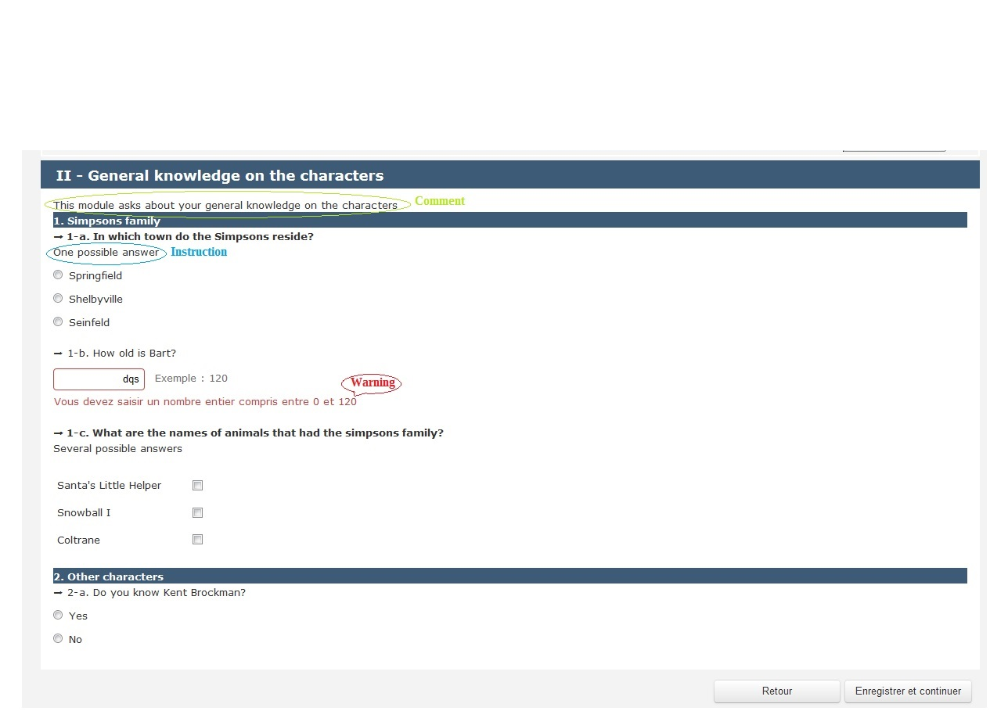
Statements

Slide 9
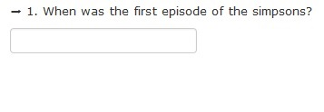
Question bank
Question with a single response domain
A text and only one response domain
Any response type (text, numeric, date, etc.)
DDI: <QuestionItem>

Slide 10
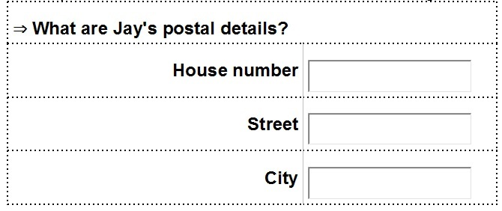
Question bank
Question with a multiple response domain
A text and several response domains
Response domains of any DDI type
Response fields preceded by a label
These labels do not constitute an information axis (i.e. a coherent set of concepts)
DDI: <QuestionItem> and several <ResponseDomainInMixed> in a single <StructuredMixedResponseDomain>

Slide 11
Question bank
Single choice question
A text and a single response domain typed as a codelist
The respondent can select one single response from a predefined list
DDI: <QuestionItem>
DDI: <ResponseCardinality> with a “1” fixed value
DDI: <GenericOutputFormat> takes value from:
“radio”
“dropdown”
“checkbox”

Slide 12
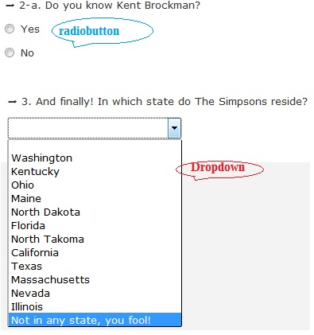
Question bank – Single choice

Slide 13
Question bank
Multiple choice question
Text is a the mutual part of several sub-questions that constitute a coherent whole i.e. an information axis.
Only one information axis (one dimension)
Each modality of the information axis peculiar to a specific response domain
Respondent can select the best answers out of predefined choices

Slide 14
Question bank
Multiple choice question
<QuestionGrid>
One <GridDimension> represented by a <CodeDomain>
Response domain: <StructuredMixedResponseDomain>/<GridResponseDomain>/<CodeDomain>
Design choice: a variable measured for each modality of the axis preferred to vector of variables for the whole axis

Slide 15
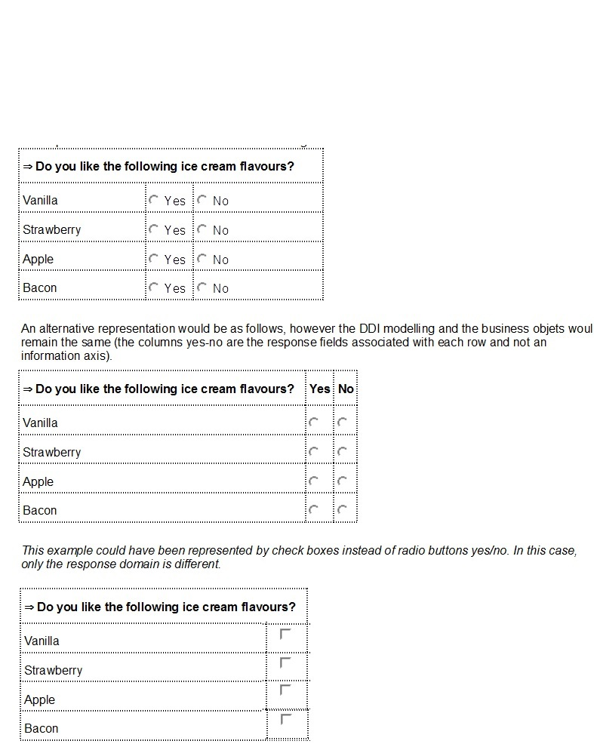
Question bank – Multiple choice
Various representations of the same object

Slide 16
Question bank
Table
A text and a response domain defined by two information axis (dimensions)
Response: intersection of a row and a column, i.e. a measured variable.
<QuestionGrid> with two <GridDimension>
A same two-dimension QuestionGrid can have varied representations
A same representation can either be a table (cf figure) or a mutiple choice question (cf figure)

Slide 17
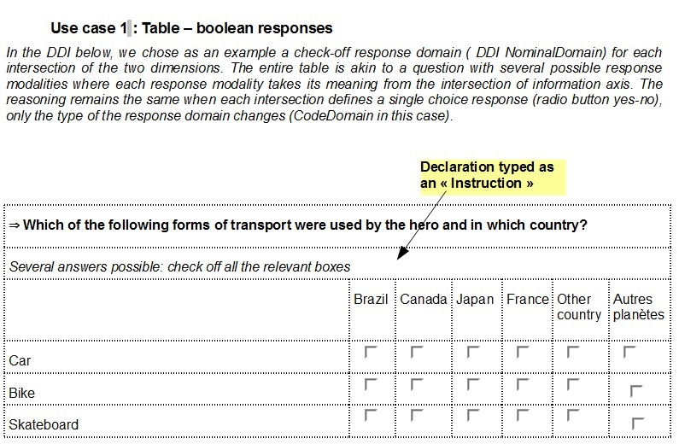
Question bank – Table (checkbox)

Slide 18
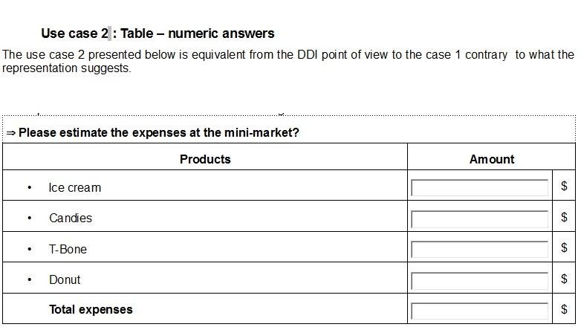
Question bank – Table (numeric)

Slide 19
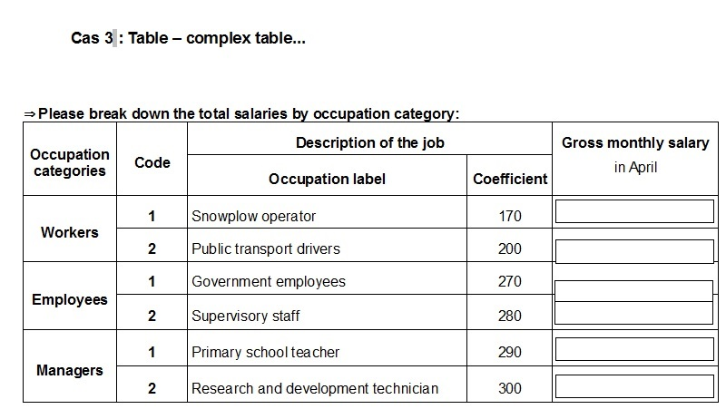
Question bank – Table (complex)

Slide 20
Question bank
Table with an implicit information axis
A two-way table where the modalities of one out of the two dimensions is not known a priori (e.g. individuals in a household)
<QuestionGrid> with a <Roster> dimension
@MinimumAllowed and @MaximumAllowed attributes used for restricting the number of rows

Slide 21
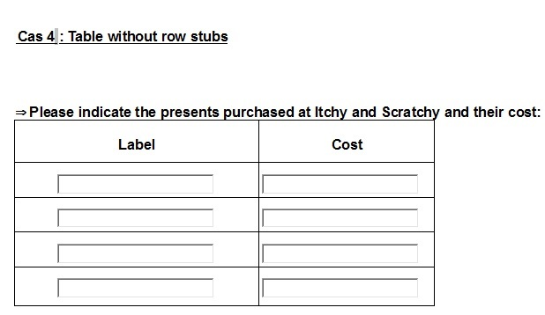
Question bank - Roster

Slide 22
Question bank
Response domains, two types are used:
Those added in-line
The ones reusable defined in various types of <Managed*Representation>, mainly:
ManagedDateTimeRepresentation
ManagedNumericRepresentation
ManagedTextRepresentation
The numeric representation can be subtyped using <NumericTypeCode> (controlled vocabulary)

Slide 23
Question bank
Conditional question: with a conditional text parameterised by the responses to one or more questions from the instrument
<ConditionalText> contains a <Command> with the condition for displaying the text.
No way to link it to the text to be displayed (<LiteralText>), then assumption that it follows its condition

Slide 24
Parameters
Parameter flow: Insee has adopted a simplified version (QI1 ->RD1 -> QI2) in comparison with 3.2 recommendation (see next picture). It is used in various contexts:
Filtering
Conditional text (instruction, question or categories)
Derived/calculated variables
Computation items

Slide 25
Parameters
Parameter flow as described in the 3.2 specification

Slide 26
Filters
Filter question: A means to target a segment of
the statistical population and drive it to specific branches of the questionnaire tree taking into account the previous response(s). Made of three parts:
<IfThenElse> construct contains the condition that defines the filter.
Targeted <Sequence> monitored by the filter. Two different types (CV defines the values of <TypeOfSequence>)
“Hideable”, i.e not displayed on the screen. Due to Xforms compliance and optimisation, an algorithmic choice was made: condition always validates the path to the next contiguous sequence, otherwise nothing happens.

Slide 27
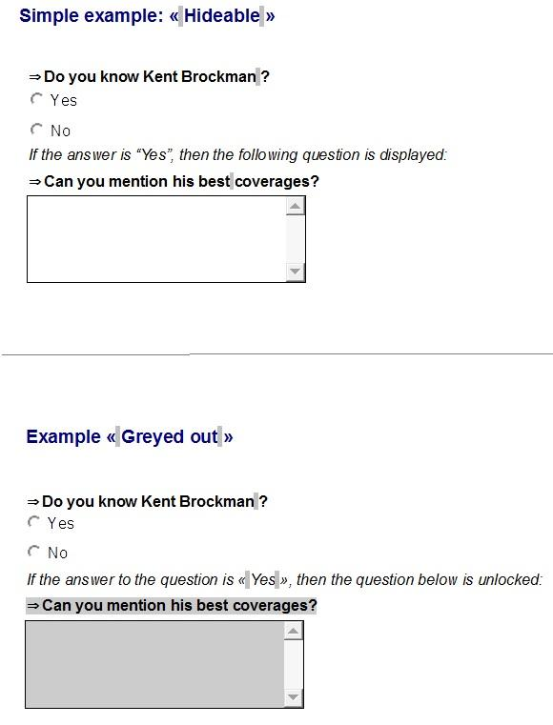
Filters
“Greyed out”, i.e. deactivated and greyed out.

Slide 28
Check
Web questionnaire operates online checks to raise the response quality. Two so-called types of checks:
Data entry checks
Micro-checks
Data Entry check: Input check linked to the response domain, e.g. check the data type of a response input
Not made explicit (except for the @regexp attribute)
Does not trigger DDI tailor-made error message
No level of criticality

Slide 29
Check
Micro-check: three types:
Internal coherence checks
Internal likelihood-ratio checks (comparison of a ratio with its distribution)
Temporal likelihood-ratio checks (ditto but using the ratio N/N-1)
A micro-check defined by:
A check condition
A DDI error message
A criticality level (e.g stumbling block)
<ComputationItem> construct. Future 3.3 <TypeOfComputationItem> to specify the criticality.
Checks in <Command>, xpath-based
Error message is an <Instruction> typed as a “Warning”

Slide 30
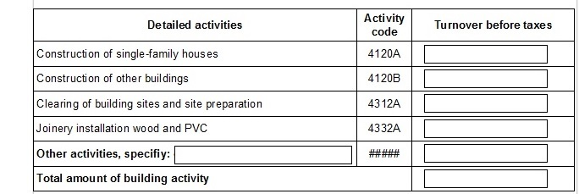
New 3.3 features
What we learn from implementation gets
Incorporated in the standard eventually.
ConditionalText:
Where to put the customisable part of a question text?
“In total, how long does (if RABS=2) this sick / (if RABS=5) maternity / (if RABS=6) unpaid leave / (if RABS=7) vocational training last?”
“Other, please specify” in QuestionGrid:
Same feature as for QuestionItem
ResponseDomainInMixed

Slide 31
New 3.3 features
. Boolean Attribute “displayCode”:
Add the same boolean attribute used in grids domain to the CodeDomain.
“Fixed values” in QuestionGrid:
Add option stating fixed value
Using extension base GridAttachmentType adding element value type=r:Value
“Total” in “QuestionGrid”:
Add to GridDimension complex element “CreateSummary”
CommandCode extended with Label “label for the summary type used”.

