Slide 1
Develop research concepts
Example questionnaire module topic:
Public Attitudes to Climate Change, Energy Security, and Energy Preferences
Top level concepts:
CLIMATE CHANGE BELIEFS
CLIMATE CHANGE SALIENCE
CLIMATE CONCERN
EFFICACY BELIEFS……
ENERGY DEMAND MEASURES
ENERGY SECURITY CONCERN…..
Sub-concepts:
CLIMATE CHANGE BELIEFS
CLIMATE CHANGE CAUSE
CLIMATE CHANGE IMPACT
CLIMATE CHANGE REALITY

Slide 2
Concept scheme – a list of concepts
Concept scheme example ‘ATTITUDES TO CLIMATE CHANGE’
Concepts in the scheme:
ENERGY SECURITY CONCERN
ENERGY DEPENDENCY
ENERGY AFFORDABILITY
ENERGY RELIABILITY
ENERGY SUPPLY
INTERNAL AND EXTERNAL VULNERABILITY
ENERGY SUPPLY SOURCES
PREFERENCE FOR ENERGY SUPPLY SOURCES
PRO-ENVIRONMENTAL PERSONAL NORMS
PUBLIC-SPHERE BEHAVIORS
CLIMATE CHANGE BELIEFS
CLIMATE CHANGE CAUSE
CLIMATE CHANGE IMPACT
CLIMATE CHANGE REALITY
CLIMATE CHANGE SALIENCE
CLIMATE CONCERN
EFFICACY BELIEFS
COLLECTIVE EFFICACY
COLLECTIVE OUTCOME EXPECTANCY
PERSONAL OUTCOME EXPECTANCY
SELF-EFFICACY
INSTITUTIONAL EFFICACY
ENERGY DEMAND MEASURES
ENERGY EFFICIENCY
ENERGY CURTAILMENT

Slide 3
Concept - example
Concept name ‘CLIMATE CHANGE BELIEF’
Description: The concept of Climate Change Beliefs refers to propositional cognitions about the nature of climate change, covering people’s views on the reality, cause(s), and impacts of climate change. The climate change belief concept is specifically aimed at capturing people’s mental representation of the climate change phenomenon that they accept as true and their evaluative beliefs about the impacts. The concept is not intended to capture affective responses to the phenomenon, for example whether people are concerned, excited or indifferent about climate change.

Slide 4
Operationalise concepts into questions
CLIMATE CHANGE BELIEFS
CLIMATE CHANGE CAUSE
CLIMATE CHANGE IMPACT
CLIMATE CHANGE REALITY
Description: Climate Change Cause refers to beliefs about the causes of climate change, that is, whether people think climate change is caused by human activity, natural processes, or a combination of the two
Question item – a reusable question
Question text
Do you think that climate change is caused by natural processes, human activity or both?
Response domain
Entirely by natural processes
Mainly by natural processes
About equally by natural processes and human activity
Mainly by human activity
Entirely by human activity
Missing/hidden categories
55 I don’t think climate change
is happening
77 Refusal
88 Don’t know

Slide 5
Operationalisation ctd.
CLIMATE CHANGE BELIEFS
CLIMATE CHANGE CAUSE
CLIMATE CHANGE IMPACT
CLIMATE CHANGE REALITY
Description: Climate Change Impact refers to evaluative beliefs about how positive or negative the impacts of climate change will be.
Question item
Question text
How good or bad do you think the impact of climate change will be on people across the world?
Response domain
Extremely bad Extremely good
0 1 2 3 4 5 6 7 8 9 10
Missing/hidden categories
77 Refusal
88 Don’t know

Slide 6
Operationalisation ctd.
CLIMATE CHANGE BELIEFS
CLIMATE CHANGE CAUSE
CLIMATE CHANGE IMPACT
CLIMATE CHANGE REALITY
Description: Climate Change Reality refers to beliefs about the reality of climate change, that is, whether people think the world’s climate is changing or not, irrespective of the possible perceived causes.
Question item
Question text
You may have heard the idea that the world’s climate is changing due to increases in temperature over the past 100 years. What is your personal opinion on this? Do you think the world’s climate is changing?
Response domain
Definitely changing
Probably changing
Probably not changing
Definitely not changing
Missing/hidden categories
5 I don’t think climate change is happening
7 Refusal
8 Don’t know

Slide 7
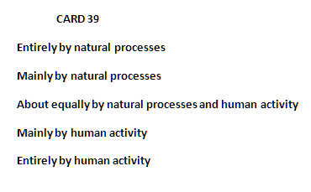
Add questionnaire specific details
Question construct
Question construct name: D22
Instruction: CARD 39
Question item
Question text
Do you think that climate change is caused by natural processes, human activity or both?
Response domain
Entirely by natural processes
Mainly by natural processes
About equally by natural processes and human activity
Mainly by human activity
Entirely by human activity
Missing/hidden categories
55 I don’t think climate change
is happening
77 Refusal
88 Don’t know
Concept CLIMATE CHANGE CAUSE

Slide 8
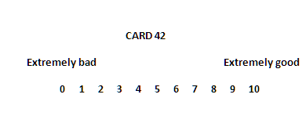
Add questionnaire specific details ctd.
Question construct
Question construct name: D25
Instruction: CARD 42
Question item
Question text
How good or bad do you think the impact of climate change will be on people across the world?
Instruction
[Please choose a number from 0 to 10, where 0 is extremely bad and 10 is extremely good]
Response domain
Extremely bad Extremely good
0 1 2 3 4 5 6 7 8 9 10
Missing/hidden categories
77 Refusal
88 Don’t know
Concept CLIMATE CHANGE IMPACT

Slide 9
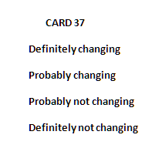
Add questionnaire specific details ctd.
Question construct
Question construct name: D19
Instruction: CARD 37
Question item
Question text
You may have heard the idea that the world’s climate is changing due to increases in temperature over the past 100 years. What is your personal opinion on this? Do you think the world’s climate is changing?
Question intent
‘world’s’ in the sense of ‘the Earth’s’. ‘due to’ in the sense of ‘as a result of’.
Response domain
Definitely changing
Probably changing
Probably not changing
Definitely not changing
Missing/hidden categories
5 I don’t think climate change is happening
7 Refusal
8 Don’t know
Concept CLIMATE CHANGE REALITY

Slide 10
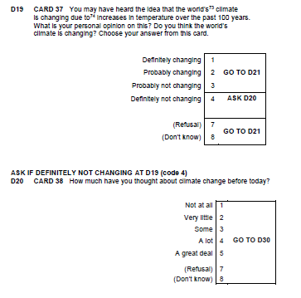
Add question constructs to instrument sequence; include flow logic

