Slide 1
OPEN ISSUES/QUESTIONS
Some issues/comments/questions are placed between “[ ]” brackets and CAPITALIZED
OVERALL ISSUES: CONSISTENCY
References/links to documentation – how best to do?
Modularity: some material (at end, material on classification maintenance is to be cut for non-official statistics audiences) – how best to indicate?
REVIEW COMMENTS:
(Comments from Dagstuhl Wednesday Review September 26, 2018)
Too much text
Add example of something common
How to deal with audience-specific terminology ("classification" vs. "codelist", etc.) - also, we should flag the terminology issues over time and across organizations
Knut: arrow on CodeList slide between Codelist box and CategoryScheme
Unit Type - this is a limited list in many cases, the Nordic Countries it is more open. Is there a problem with the way this slide presents Unit Types??
Should DDI CVs be based on some type of formalized concept system (Ontology, etc.)?

Slide 2
Foundational DDI Metadata: Concepts and Their Use
Schloss Dagstuhl, Wadern, Germany
September 26, 2018

Slide 3
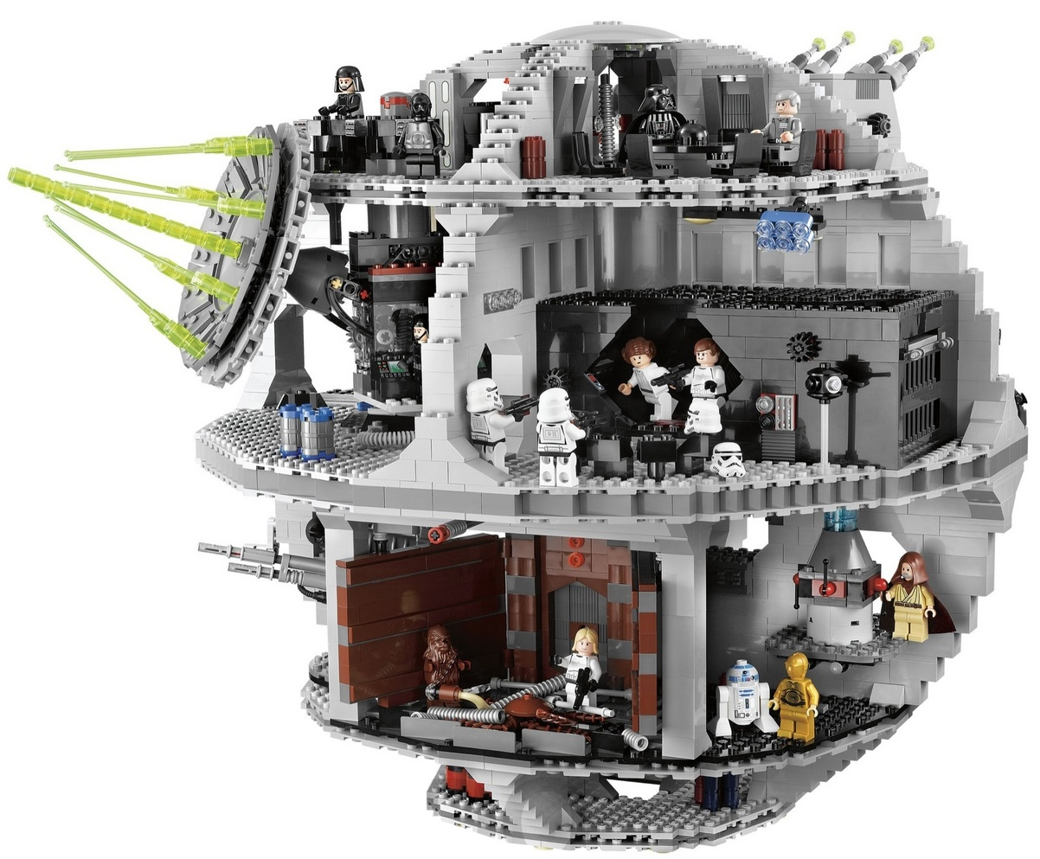
Thinking bigger with DDI!

Slide 4
A concept is an idea with a formal definition and a name.

Slide 5
Concepts are used in many places when collecting, producing, and describing data.
Examples are:
Variables
Categories
Unit Types
Universes

Slide 6
using
Study
Survey
Instruments
measures
made up of
about
Concepts
Questions
Universes
Copyright © GESIS – Leibniz Institute for the Social Sciences, 2010
Publshed under Creative Commons Attribute-ShareAlike 3.0 Unported

Slide 7
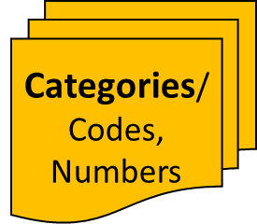
Categories/
Codes,
Numbers
with values of
Concepts
Questions
associated with
Variables
collect
made up of
with values of
Responses
Data Files
resulting in
Copyright © GESIS – Leibniz Institute for the Social Sciences, 2010
Published under Creative Commons Attribute-ShareAlike 3.0 Unported

Slide 8
Categories and Codes
A Category is the meaning associated with a Code – it is a specialized type of Concept.
When the Code appears in a data set (as a variable value) or questionnaire (as a response to a question), it is referring to the meaning supplied by the Category.
The Code is just the sign which refers to the Category – in and of itself, it has no meaning/definition. That is supplied by the Category.

Slide 9
CodeLists
A code is a sign paired with a meaning (a Category – the use of a concept).
A codelist is a set of codes used together for a specific purpose (the response to a question, the representation of the value of a variable, etc.)
Codelist
Category Scheme
Code 1
Category “Yes”
Code 2
Category “No”
Code 3
Category “Maybe”

Slide 10
Universe
”A defined class of people, entities, events, or objects, with no specification of time and geography.”
Example: All persons with a university degree
Example: All households
Example: All businesses
May also be defined by what it excludes
Example: All people except those with a university degree

Slide 11
Related Ideas: Unit Types, Units, and Populations
There are several ideas and terms which are related:
Population: “The total membership of a defined class of people, objects or events.”
Unit Type: “Class of objects of interest.”
Unit: “Object of interest in a business process.”
Unit Types and Populations are Concepts in DDI (they are a specialized form of Concept). Units are not.

Slide 12
Population
“A Population is used to describe the total membership of a group of people, objects or events based on characteristics, e.g. time and geographic boundaries.”
Examples of populations are:
Adult persons in the USA on 13 November 1956
Computer companies in the US at the end of 2012

Slide 13
Unit Types
“A Unit Type is used to describe a class or group of Units based on a single characteristic, but with no specification of time and geography. For example, the Unit Type of “Person” groups together a set of Units based on the characteristic that they are ‘Persons’.”
A common usage of unit types is describing the unit which you are analyzing and is measured using Variables.
Examples of unit types are:
Person
Business

Slide 14
Unit
Individual units that can be grouped together by a Unit Type.
Examples of units are:
The person Jannik V. Jensen
The company Microsoft
These could commonly be cases in a survey study.

Slide 15
Related Constructs
[ISSUE: SHOULD WE ALSO DISCUSS TAXONOMIES, OR ARE THEY COVERED BY GENERAL STATEMENTS?]
There are several ways of organizing, defining, and relating ideas:
Thesauri
Controlled Vocabularies (CVs)
Set of Keywords
Subjects
Ontologies
Classifications
Statistical Classifications (a specialized type of classification)
Some of these exist in DDI – others do not, depending on the version of the standard. It is important to understand which are used in DDI and how they are used.

Slide 16
Usage of Concept Systems
Concept System
May provide
basis for:
[CHECK SUB-BULLETS? SHOULD
THESE BE ABOUT USE OR
STRUCTURE? WHAT ABOUT
SUBJECTS?]
Controlled Vocabulary
Thesaurus
- Hierarchy/limited graph
Classification
- Levelled, complex
Keywords
Ontology
Graph/hierarchy, complex
Rich relationships
Codelist
Statistical Classification
Levelled (even), complex
Mutually exclusive, jointly exhaustive

Slide 17
Controlled Vocabularies, Subjects, and Keywords
[IMPROVE WORDING FOR FIRST BULLET – TOO CIRCULAR; MAKE MORE LIKE OTHERS]
Controlled Vocabularies (CVs) are lists of controlled terms. They exist in DDI, but are always developed/chosen by the user. DDI provides useful (but not required) CVs for some purposes.
CVs may be based on other Codelists, classifications, ontologies, thesauri, etc. but are not complete formalizations of these sources. (The CVs do not generally contain all structural and relationship information).
Keywords are terms used by DDI to support searches. This is their only function in the standard.
They are terms associated with studies and some other resources in DDI (they are a form of topical classification). They may be based on Codelists, classifications, CVs, ontologies, thesauri, taxonomies or other sources of useful terms, but are not formalizations of these.
“Subjects” exist in DDI to describe the topical coverage of studies/datasets. They provide support for the use of formal constructs and textual descriptions.

Slide 18
Concept Systems
Concepts can be organized into systems – sets of concepts with specific relationships between and among them.
There are several examples of this, including thesauri, classifications, ontologies, vocabularies, and other similar types of schemes.
Some of these are of particular interest because of their application to data. These are either directly supported within DDI, or are complementary to it.

Slide 19
Thesauri
[ISSUE: USE MESH HEADINGS AS AN EXAMPLE? THEY ARE DESCRIBED/PRESENTED AS A CV, A THESAURUS, AND AN ONTOLOGY IN DIFFERENT VERSIONS. SKIP? USE OTHER EXAMPLE?]
Thesauri are concept systems which are largely hierarchical, and in which the various subject headings (or similar concepts) are organized topically, and often with “narrower than,” “broader than,” and “related to” relationships. They function in this sense as non-hierarchical graphs.
ELSST is a common example within Social Science in Europe.
Some thesauri are more general in their intended use, being a structured set of concepts and their definitions within a particular field [cite GESIS thesaurus or other…]
They are not used to represent responses to questions or variable values in the way that formal ontologies and classifications are often used.
They can be represented in DDI as Concept Schemes.

Slide 20
Ontologies
Ontologies are concept systems which characterize and describe the complex relationships between and among entities within a domain.
Ontologies have become an extremely popular way of organizing concepts within many different domains, especially in combination with RDF/Linked Data technologies
Often contain complex structures (may be levelled or organized as graphs) with rich sets of specific relationships identified between the objects and concepts they describe
Often support logical inferencing
They are not explicitly supported within DDI, but have many applications when expressed as sets of keywords, CVs, or codelists (generally involving a reduction of the full set of relationships and other information).

Slide 21
Classifications
Classifications are concept systems used to classify items. They are often hierarchical, and may have organizing concepts associated with each level.
They are sometimes referred to as “hierarchical codelists”
Although not always explicit, DDI provides a structure for describing classifications of all types. (Statistical classifications are a special case, supported explicitly in some versions of DDI.)

Slide 22
Classification: Means of Transport
Organizing
Concepts
Level 1:
“Medium”
Air
Ground
Water
Boat
Car
Airplane
Submarine
Level 2:
“Vehicle
Type”
Helicopter
Train
Jet-ski
Truck
Zeppelin
Horse
Surfboard

Slide 23
Classifications (2)
[BULLETR ABOUT GEO CLASSIFICATIONS OK HERE? HOW BEST TO HANDLE?]
In DDI, the structure of a complex classification (more than a flat list of Codes and associated Categories) is described within the Codelist construct. (This may change in DDI 4).
Categories are referenced by each Code, but live in a separate, flat Category Scheme
Classifications are used exactly like Codelists in DDI
As value sets for variable representation
To populate responses to questions in a questionnaire
Geographical classifications (sometimes a type of Statistical Classification) may be described using a different set of constructs based on international standards (the ISO 19115 family).

Slide 24
Statistical Classifications
Statistical Classifications are a more constrained type of classification:
All lower-level Categories are sub-Categories of those at the next higher level (they are “even” hierarchies – all paths from root to leaf have the same length)
All Categories in a level are mutually exclusive
Categories at each level are jointly exhaustive
This means that any given item can be described by one and only one Category at any given level of the classification, and all possible items can be described
Statistical classifications may be very similar to ontologies in their application and function
Statistical Classifications are described with specific constructs in some versions of DDI (DDI 3.3 and later)
In DDI, Statistical Classifications – like other classifications – may be used in the same way as Codelists
Subsets of Statistical Classifications are often used as flat Codelists (eg, a single level of a hierarchical Statistical Classification)

Slide 25
Maintaining Statistical Classifications
Because Statistical Classifications are often used across long periods of time for many different streams of data, their evolution must be carefully tracked
To guarantee consistency within repeated waves of data collection
To support comparability between different data sets using the same classification
The Neuchatel Model* is a popular model for systems which maintain Statistical Classifications
To align with this model, DDI has adopted many of the constructs found in the Neuchatel classification model
* Neuchatel is now maintained as an appendix of the Generic Statistical Information Model (GSIM) produced by UN/ECE

Slide 26
Maintaining Statistical Classifications (2)
[QUERY: IS THIS TOO MUCH INFO? OK TO INCLUDE WITH IDEA IT OFTEN WILL BE CUT?]
There are a set of Neuchatel-aligned constructs in DDI for implementing the model needed for maintaining statistical classifications.
Important constructs include:
Classification Families: A group of Classification Series
Classification Series: A group of Statistical Classifications which are semantically related (reflecting changes across time)
Correspondence Tables: A description/mapping of the items within two Statistical Classifications:
Changes made to a variant classification can be described
Changes over time made within members of a Classification Series can be described (splits, joins, etc.)
Relationship between Classifications from two different Classification Series (semantic relationships) – example: mapping between classifications for activities and products

Slide 27
Versions of DDI and Foundational Metadata [TO DO: CHECK TO MAKE SURE MATRIX IS CORRECT FOR ALL MATERIAL]
Feature | DDI Codebook | DDI Lifecycle (3.2) | DDI Lifecycle (3.3) | DDI 4
Concepts |  | X | X | X
Universe | X | X | X | X
Population | X | X | X | X
Unit Type | X | X | X | X
Variables | X | X | X | X
Codelist/Category |  | X | X | X
Classification |  | X | X | X
Statistical Classification |  |  | X | X
Keywords/CVs/Subjects | X | X | X | X
Thesauri |  | X | X | X

