Slide 1
Overview - internal use
Modularized presentation, pick according to audience:
Module: Introduction to RDM
Module: Introduction exercise
Module: What is DDI?
Module: DDI for researchers and research data managers
Module: DDI for librarians and archivists
Module: DDI for developers
Module: DDI for project managers
Module: DDI for funders, lawyers
Training guidelines for users

Slide 2
DDI for researchers and data managers
Arofan Gregory, Chifundo Kanjala, Hayley Mills, Anja Perry
Output from the DDI Train-the-Trainer workshop
Dagstuhl, September 24-28, 2018
Notes:
Arofan Gregory, Chifundo Kanjala, Hayley Mills, Anja Perry.

Slide 3
Module:
Introduction to Research Data Management (RDM)

Slide 4
What is RDM?
Research Data Management is part of the research process, and aims to make the research process as efficient as possible. A method to...
Organize (structures, naming conventions and planning)
Store (keep it – make it secure and back it up)
Share (provide access, share with collaborators, publish and get cited)
Maintain (version data)
...your research data

Slide 5
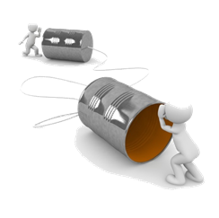
Benefits of Research Data Management
Saving resources
Correct results
Improved workflow
Proof of transparent & valid conduct
Facilitates re-use of own data
Communication within the project
Better access to data
Best use of public funds
Better science
Source: Pixabay CC0
Copyright © GESIS Leibniz Institute for the Social Sciences, 2016

Slide 6
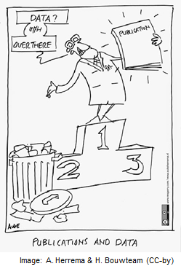
Research Data Management may be required by...
Your institute, e.g. by your working contract or project agreements
Funding agencies, e.g. to ensure reusability
Journals, claiming your data before publishing your article
Your supervisor…
→ check for such conditions
Copyright © GESIS Leibniz Institute for the Social Sciences, 2016
Notes:
Add current examples which may be relevant if possible. e.g. being audited.

Slide 7
Module:
What is data?
What is metadata?
Exercise

Slide 8
Introduction Exercise
When you are given a dataset, what information do you absolutely need to use it?
What information would you like to have, if it was available?
Notes:
Get researchers into the mindset of data documentation; let them think of their needs; eventually add to it when their knowledge of metadata is not sufficient.
Exercise could be implemented in pairs or individuals, followed by feedback to the group (on whiteboard). This should generate discussions and help identify differences or similarities in experience.

Slide 9
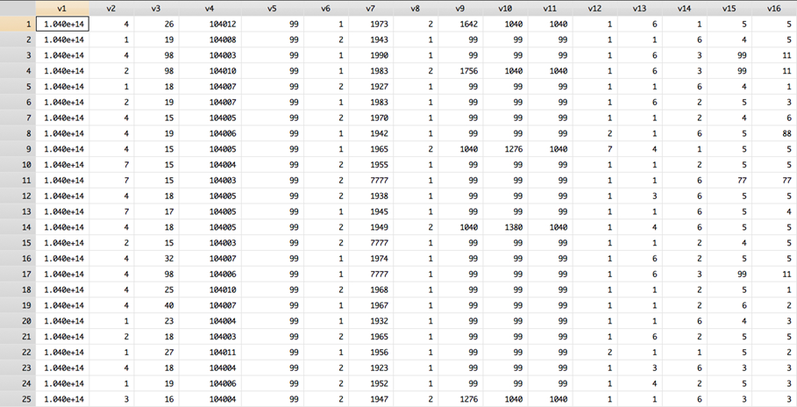
Copyright © GESIS Leibniz Institute for the Social Sciences, 2016
Notes:
Typically, we have a rectangular data file, lines specify individuals, columns the variables. Various types of codes in the cells represent the values. This is what we call data.

Slide 10
What is the study about? Who created it?
What do the variables mean?
Who funded it?
What was the intent/concept of the question?
What was the previous question?
What was the data capture? (the question)
Who was asked? What is the population?
Mode of collection?
What is the meaning of the codes?
Copyright © GESIS Leibniz Institute for the Social Sciences, 2016
Notes:
Animate bubbles, show one after the other.
Note the list is not exhaustive.
Goal: For the audience to know metadata is to them.
At the end you should emphasize that if you need this, then others will need this info too.
Example for “What was the previous question?”: When asked about life satisfaction it is often useful to ask about work satisfaction first. That way, the respondent doesn’t confuse general life satisfaction with work satisfaction.

Slide 11
Module:
What is DDI?

Slide 12
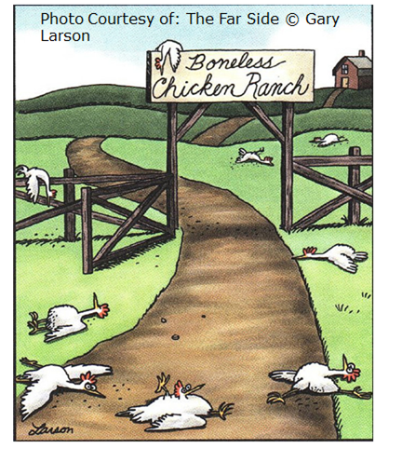
Structure and standardisation
“Skeletons give us vertebrates shape and structure, markup does the same for text” (Ray, 2003)
Data documentation contained in Word or PDFs are for human consumption only
Computers need structure to process documentation
DDI provides that structure
Notes:
•This cartoon is about an unusual chicken ranch of boneless chickens, they have no capacity to do what chickens usually do, strutting around etc. Documentation too, without a structure, is difficult to process…
•Though DDI can be presented in forms other than XML, the bottom line is that it provides structured documentation

Slide 13
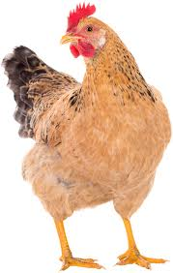
What is DDI?
Data Documentation Initiative
http://www.ddi-alliance.org/
A structure to consistently define data and it’s related metadata, for the purpose of supporting the intelligent use of the data over time.
Source: Pixabay CC0

Slide 14
Why computers?
A computer does it better, cheaper and faster.
Improves quality (less error prone)
Saves person time
Optimises use of human skills by automating, repetitive mindless tasks
Notes:
cheaper? yes, but with upfront investment - think long term!

Slide 15
DDI as a standard
DDI is a standard for metadata
The standard structure means that all computers, even if they are using different applications, can work on the same data and related information (metadata/documentation)
The formats are not proprietary to any specific system
Uses generic XML technology as the basis for cross-platform use

Slide 16
using
Study
Survey
Instruments
made up of
measures
about
Concepts
Questions
Universes
Copyright © GESIS – Leibniz Institute for the Social Sciences, 2010
Published under Creative Commons Attribute-ShareAlike 3.0 Unported

Slide 17
Categories/
Codes,
Numbers
with values of
Questions
Variables
collect
made up of
Responses
Data Files
resulting in
Copyright © GESIS – Leibniz Institute for the Social Sciences, 2010
Published under Creative Commons Attribute-ShareAlike 3.0 Unported

Slide 18
Levels of data documentation
Metadata on...
study level
variable level
Copyright © GESIS Leibniz Institute for the Social Sciences, 2016

Slide 19
Challenges
Involves initial investment but saves costs in the long-term
May involve changes to processes and systems
Investment in technology tools may be considerable
Legacy metadata may require updating
Consistency issues
Format transformations
Training is required

Slide 20
Module:
DDI for researchers and data managers
The following slides address different levels of DDI use so that the workshop can be tailored to specific needs of the group.Think about the scale, resources and current infrastructure if known for the audience.
If the trainer is aware of the current systems and infrastructure that the audience uses, then these should be incorporated into the appropriate medals using examples from their systems and the ways they can incorporate DDI into them.

Slide 21
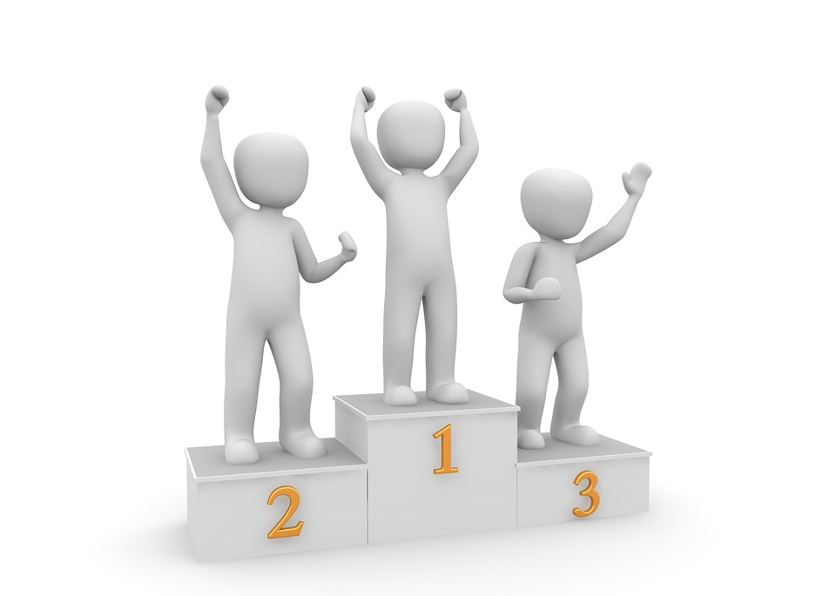
Climbing the podium
There are several levels of increasing sophistication, varying in costs and resources needed, in terms of culture/process change and tooling:
Bronze: Uses DDI as content guidelines (allows for future expansion)
Silver: Uses DDI to build on existing infrastructure (enhanced data dictionary in centralized database)
Gold: Centralized metadata management using dedicated DDI tools
Source: Pixabay CC0
Notes:
Note the medal system is not an officially recognized rating system from DDI.
Bronze Structured documentation is laying the groundwork (more adhoc) in a distributed way. They add metadata as they are working on it. Documenting in a standardised way. - when sharing with others they can understand.
Silver- Adds structure and centralisation. All communication is through the centre. Important for versioning.
Gold- starts with the metadata.- metadata driven. Design and capture at the same time so at the end it already exists and is correct.

Slide 22
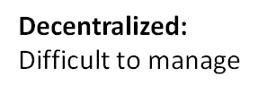
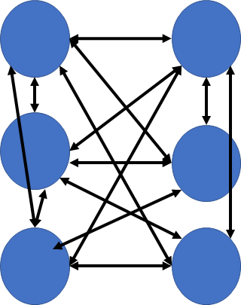
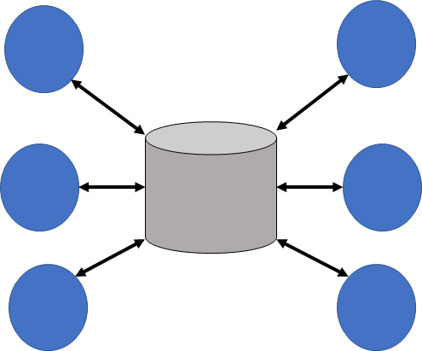
Management Patterns for Data and Metadata

Slide 23
“Upstream” vs. “downstream” metadata capture
“Downstream” Metadata Capture
METADATA
“Upstream” Metadata Capture

Slide 24
Bronze

Slide 25
Bronze: Structured Documentation
unstructured
Method reports
Questionnaires
Codebooks
...
structured
Controlled vocabulary
Coding schemes, f.ex. ISCED
Metadata standards, f.ex. DDI
...
Copyright © GESIS Leibniz Institute for the Social Sciences, 2016

Slide 26
Bronze: Structured Documentation
Support for data discovery systems (portals, catalogues) by extracting standard metadata from data files
Re-use metadata for outside or later use
Helps with communication within (and across) research projects
Including passing data between analysis packages
Creates institutional memory
Increase in data quality/usability
Notes:
Bronze: not centralized yet, still after the fact metadata. But still major benefits with DDI.

Slide 27
Bronze: Example tools
Use free Sledgehammer to:
Convert data into open ASCII text format to exchange data files across software packages
Generate setups for many different analysis packages and databases
Extract standard metadata (DDI) from your data files
Compute descriptive statistics at the variable and category levels for inclusion in DDI or for other purposes
Notes:
Reading data and extracting metadata from: Stata, SPSS, SAS, DDI+ASCII, Stat/Transfer+ASCII,SQL
Transforming data into ASCII text format (fixed, csv, delimited), with various optimizations
Producing standard metadata from input files. Supported specifications include DDI-Codebook (1.0-2.1 and 2.5), DDI LifeCycle (3.1-3.2), and Triple-SSS (1.1, 2.0)
Computing summary statistics at the variable and category levels for inclusion in DDI or for other purposes. Summary statistics include minimum, maximum, average, standard deviation, count of missing values, weighted and unweighted frequencies
Generating scripts for reading ASCII data into R, SAS, SPSS, Stata, Mathematica Notebook, Berkeley SDA, and various flavors of SQL (MS-SQL, MySql, MonetDB,PostgreSQL,Oracle, Vertica, HSQLDB). The database scripts support the creation of database schemas along with bulk loading of the ASCII data.

Slide 28
Bronze: Example tools
Use free NESSTAR Publisher* to:
Author and edit DDI metadata
Extract metadata from statistical packages
Validate metadata and variables
Publish your data to various dissemination platforms (portals, databases, etc.)
* The IHSN metadata management tools use NESSTAR for authoring and editing.

Slide 29
Bronze: Example tools
Use Colectica for Excel to:
Import data files from SPSS, Stata, or SAS for documentation in Excel
Publish your documentation
Export metadata in DDI

Slide 30
Silver

Slide 31
Silver: Single source of truth
Centralizes management of your research metadata
Leverages existing (Bronze) documentation tools and processes for authoring, editing etc (after the fact)
May leverage centralized data management infrastructure
Notes:
Second and third bullet point can be changed in order depending on the audience
databases used for management of data could be enhanced to handle metadata (enhanced data dictionaries)

Slide 32
Silver: Single source of truth
Having a centralized “official” copy of each piece of metadata avoids errors and unintended variation
Different versions can be stored as they change over time
Management becomes easier, because of improved organization and visibility
Notes:
Find data more easily?

Slide 33
Silver: Tools and systems
Infrastructure for data is often implemented using database platforms
The same platforms are often useful for managing metadata
Dedicated XML repositories may also be used
Authoring and editing tools are the same as for Bronze
Notes:
Find data more easily?

Slide 34
Gold

Slide 35
Gold: Active DDI Metadata Management
Uses the same centralized metadata management approach as Silver
After-the-fact becomes “upstream” approach to metadata
The production process begins with design captured as DDI metadata (eg., questions, concepts, codelists)
Metadata collection continues throughout the lifecycle
Requires upfront investment to realize long-term gains
Notes:
You don’t necessarily need to have the whole process but having some can lead to others.
Also you don’t need to have the data and metadata necessarily managed in the same place.

Slide 36
Gold: Dedicated DDI Metadata Management
Easier to share your data/metadata with other organisations
Reuse metadata in repeated data collections saving resources
Leverage the richness of the data to automating processes e.g. question banks, concordances, and data dictionaries
Automate the data request process (variable shopping basket)??
Additional consistency and quality as reuse produces more comparable data
Facilitates harmonization across datasets (over time or study)
Increase the interest in your study by making your data discoverable

Slide 37
Gold: Example tools
Colectica Designer / Repository
Rogatus
Notes:
Versions if needed:
Colectica repository 3.1, 3.2
CED2AR 2.5
DBKfree 1.x, 2.0, 2.1
DDI Index 2.1

Slide 38
Notes

Slide 39
Notes: motivation
- Introduce the trends within research toward funding of larger collaborative projects
- Introduce requirements for data-sharing as a condition for publication (eg, Nature)
- Emergence of data citation as a way of enhancing researcher reputation
Notes:
Once these ideas have been presented, the reasons for doing each type of metadata management can be presented.

Slide 40
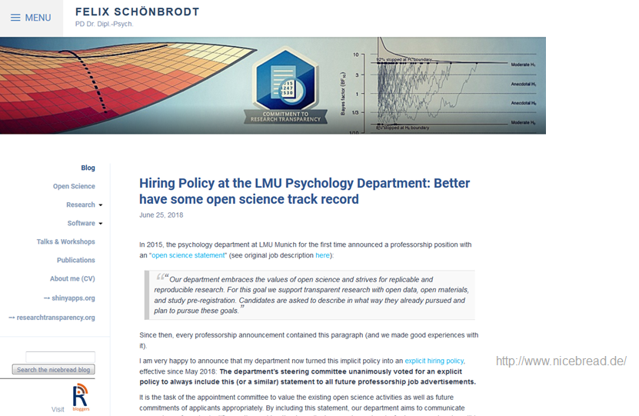
Notes:
Notes: motivation

Slide 41
Why DDI?
Data citation & data journals provide career credit
Publishers require citation of data sources (DOIs) making your data more visible
Funders require data sharing and reuse (data management plans)
Notes:
These should be additional to the what DDI module includes.
Data sharing is internal as well as external.

Slide 42
Gold: Dedicated DDI Metadata Management Tools
Add examples?
CLOSER
MIDUS
Notes:
The number of publications using MIDUS data continues to increase year on year; more than 600 publications from the study now appear in over 150 scientific journals. - this may be an argument for the funders?!

Slide 43
Overview - internal use
Chain of arguments:
Structure is good
Computers need structure
Cheaper, better, faster
DDI provides structure in a standard way for all computers

