Slide 1
DDI Codebook & DDI Lifecycle
Use cases and objectives

Slide 2
Notes:
When addressing to non-specialists, preferable to begin by asking some questions. Important to evaluate their needs, their expertise regarding data, metadata, data sharing etc

Slide 3
Please ask yourself the following questions:
What are you doing with your data?
What are the origins of your data?
How about metadata?
Do you have the resources to do technical development?
Notes:
Other questions to ask in fonction of your audience or of their answers to :
Are you sharing your data?
Are you required to archive your data?

Slide 4
What is <DDI>?
A structure for describing data and its related information
A open standard designed for data sharing and reuse
A mechanism for creating consistent, machine-actionable documentation for data
Notes:
•A structure to consistently define data and its related metadata for the purpose of supporting the intelligent use of the data over time
Lifecycle
•It provides clear information on the relationship between objects
•The CodeList (Object A) providing a codification of the Classification (Object B) which is maintained by an Organization (Object C) and is used by Variable (Object D) which is found in a set of data (Object E) within a study (Object F)

Slide 5
Historical approach of <DDI> Versions
Evolving, non-linear standard
DDI Codebook (DDI-C)
DDI Lifecycle (DDI-L)
DDI 4 (future standard)
Designed for different purposes
DDI Codebook is intended for documenting a single study
DDI Lifecycle is intended for documenting relationships between data objects
Preparation phase of both standards is different
Notes:
non-linear highlights that the DDI - Lifecycle is a evolution of DDI - Codebook with different purposes and extensions which are not obligatory compatible to each other (different approaches in structure) and Lifecycle offers more functionalities
Preparation Phase of both standards is different-> means that Lifecycle needs more time in preparation because a good conceptualization of the data is obligatory Why? is explained in the following slides

Slide 6
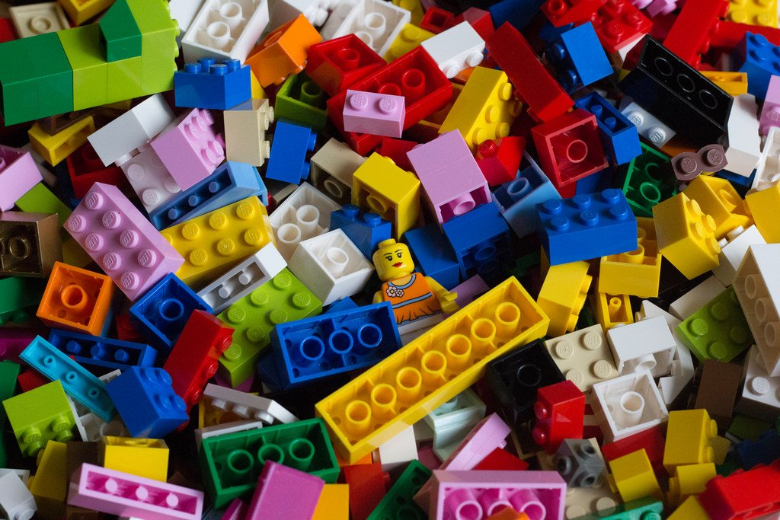
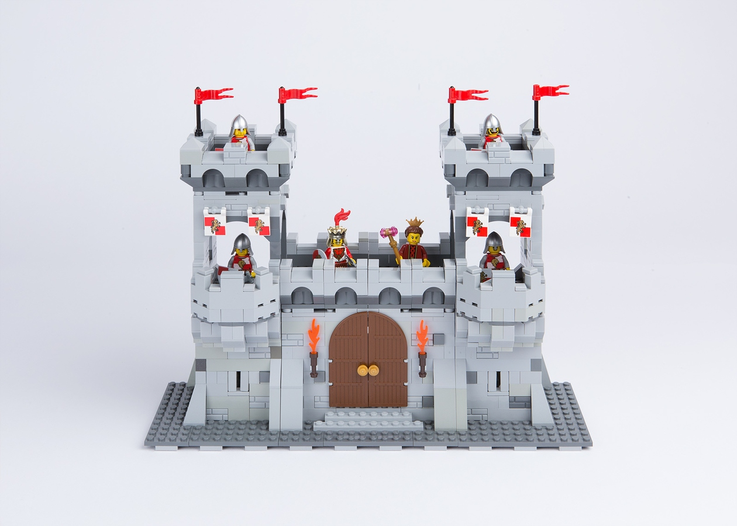
<DDI> Codebook
Metadata structured by DDI Codebook standard
Metadata not structured
DDI Codebook Structuration
Lost metadata manager
Notes:
Left: data manager is lost: how to manage all this data?
Right: Use DDI to put order in your data !! Give definition of DDI C

Slide 7
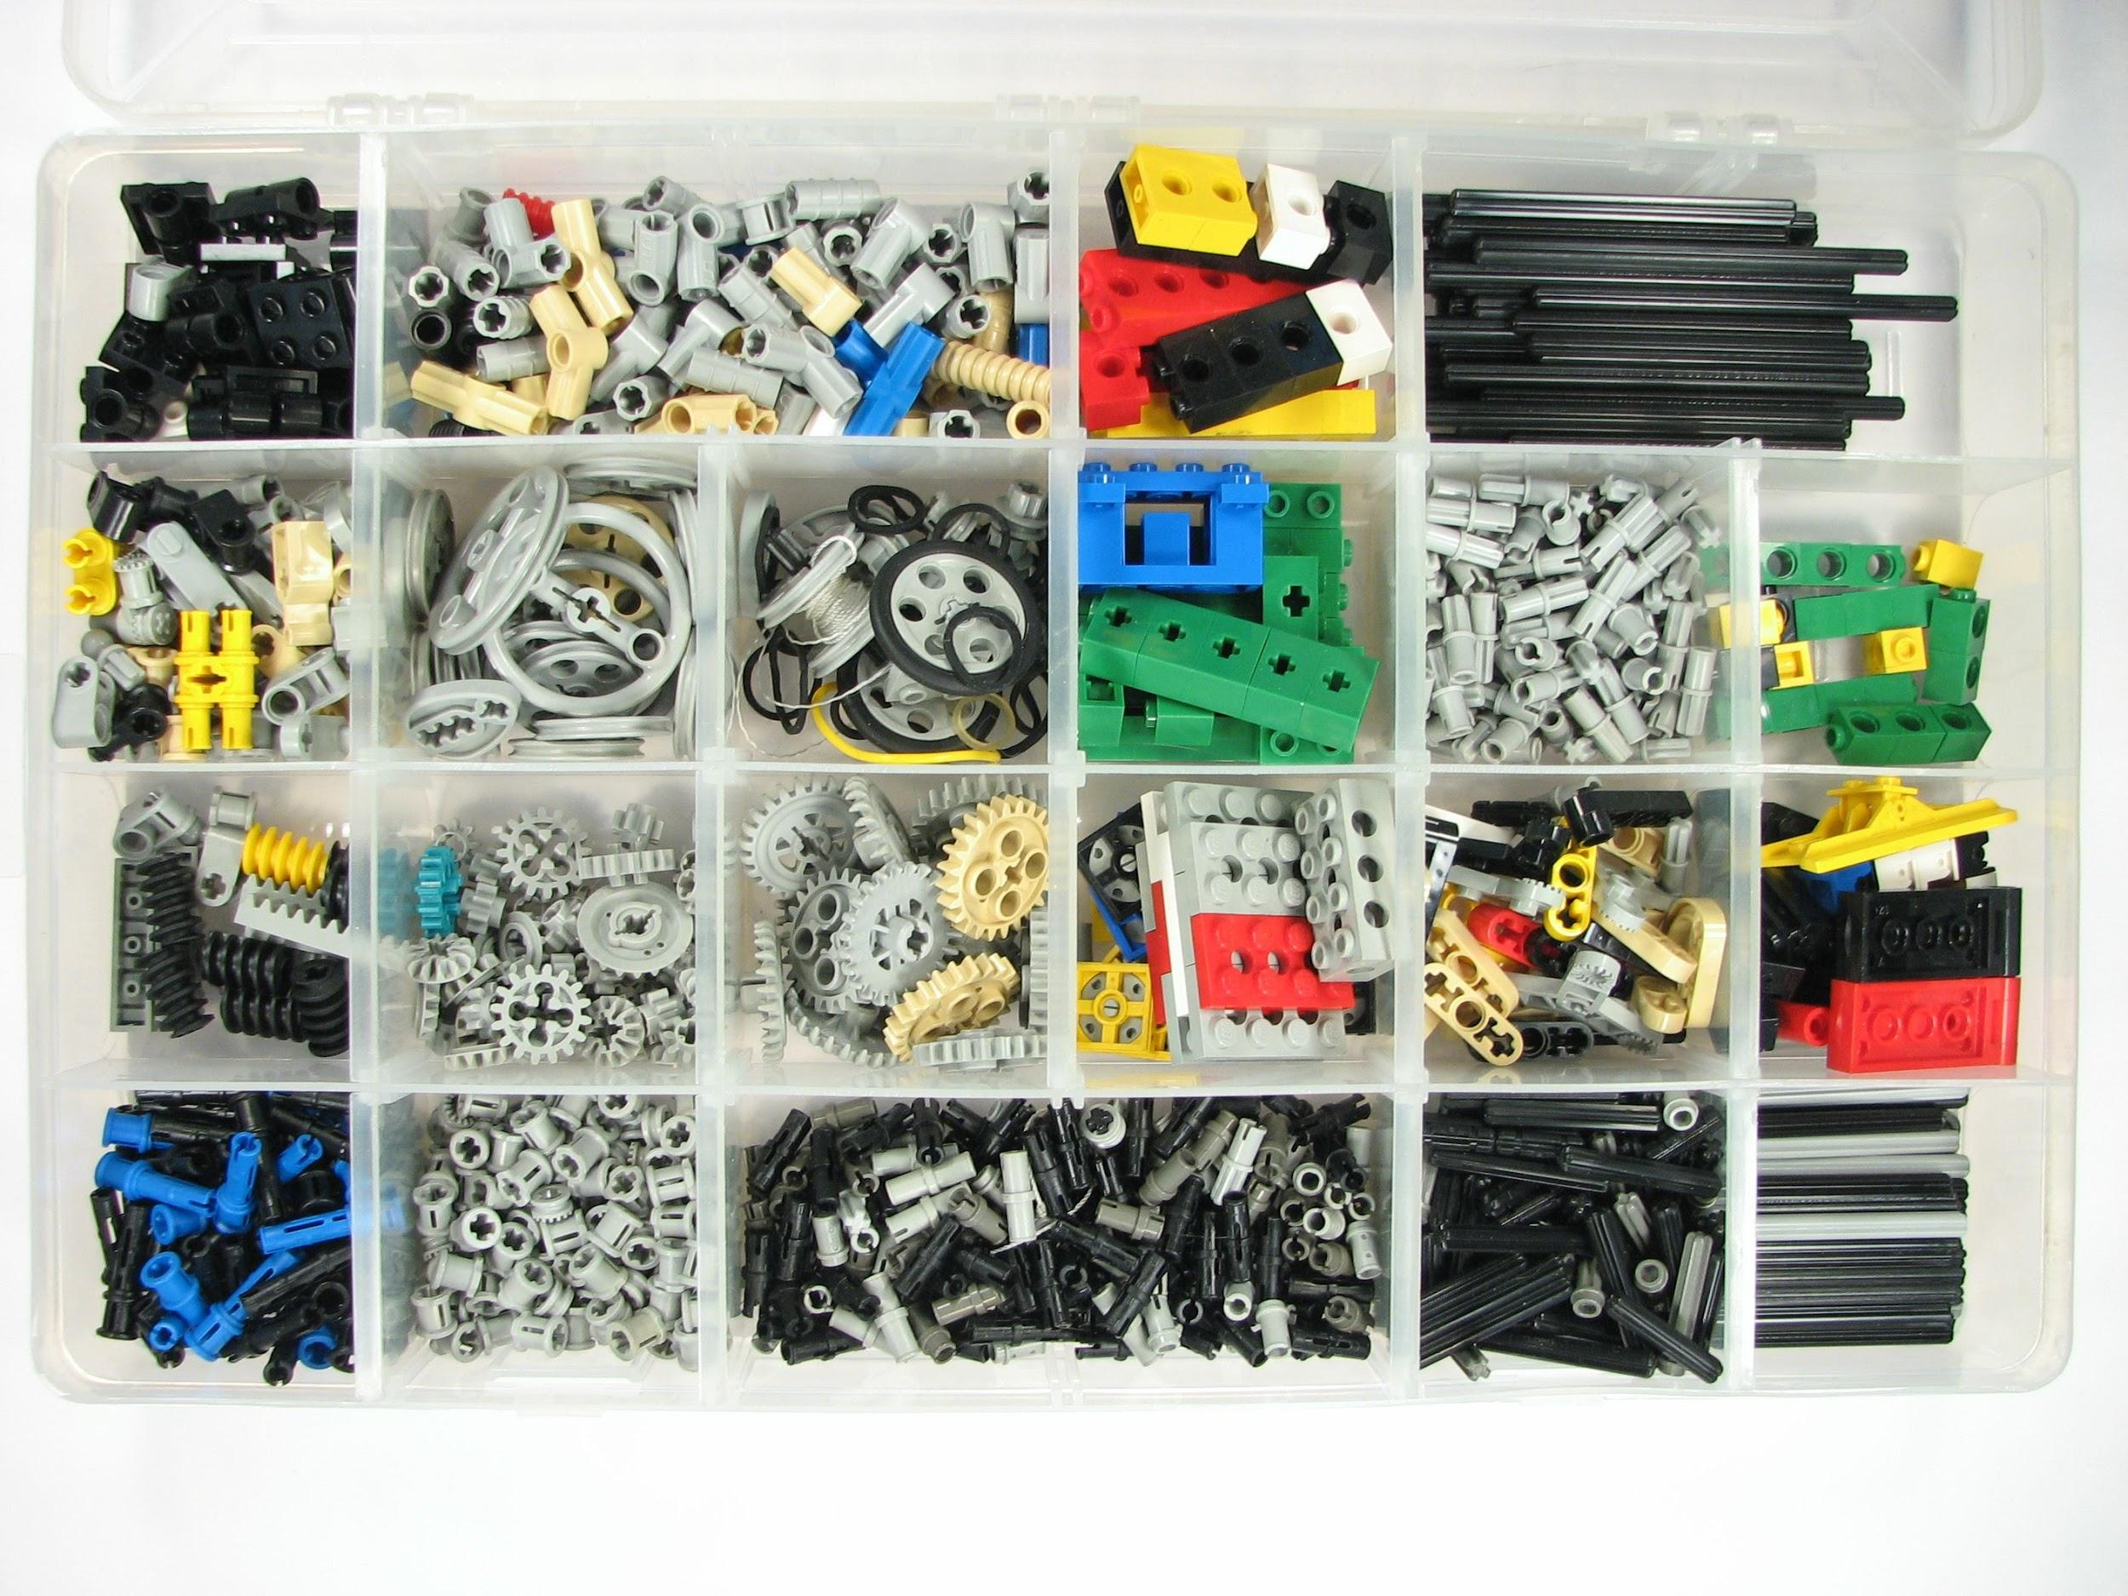
<DDI> Lifecycle
Metadata not structured
Metadata structured by DDI Lifecycle standard
DDI Lifecycle Structuration
Universe Scheme
Instrument Scheme
Notes:
Illustration of what you can do with DDI-L :use maintainable Schema to build what you need
A good idea for the trainer would be to give some examples or define these terms. You should probably adapt the examples in function of your audience
Definitions: http://www.ddialliance.org/resources/ddi-glossary

Slide 8
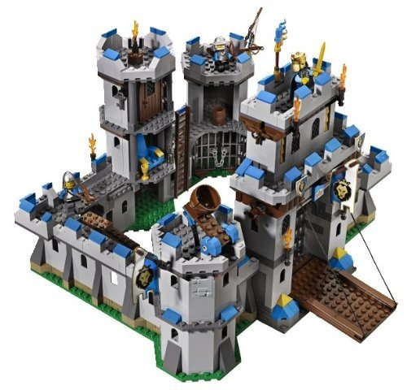
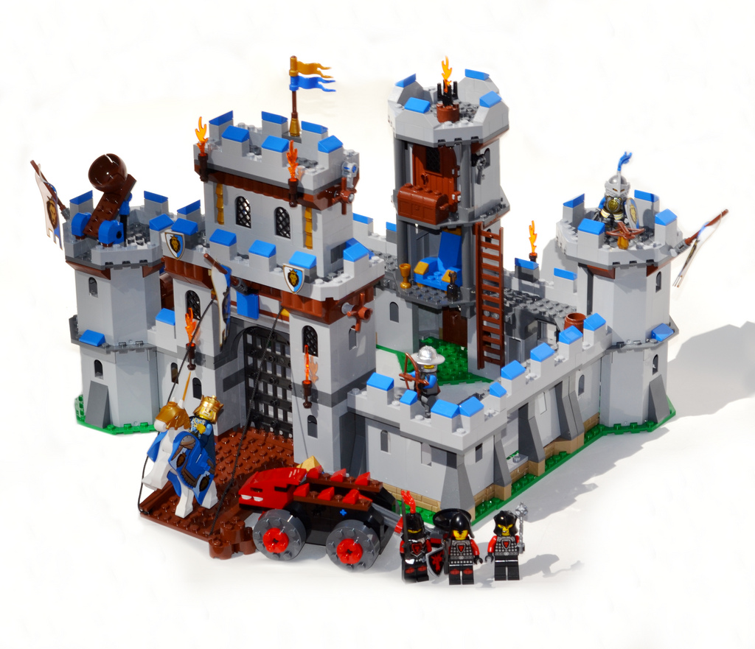
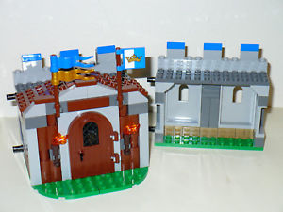
Reusable items
Metadata specified by DDI Lifecycle standard
Metadata structured by DDI Lifecycle standard
DDI Lifecycle Production
Notes:
So now, besides a castle, you can have many kind of castles

Slide 9
Purposes of <DDI> Versions
DDI Codebook
Find previous studies
Build a data repository
Catalogue record
Variable lists
Data analysis
DDI Lifecycle
Find previous studies
Build a data repository
Catalogue record
Variable lists
Data analysis
Data harmonisation and comparison
Questionnaire design
Manage data processes and workflows
Question banks
universal compounds
specific compounds

Slide 10
How to use <DDI>?
?
Use existing tools
Develop in-house tools
Comercial
Conceptualisation
Open source
Guidance for Backend

Slide 11
Some <DDI> Tools
Tools | Version supported
 | DDI Codebook | DDI Lifecycle
Colectica | Yes | Yes
Nesstar | Yes | No
DDIEditor | No | Yes
Questionnaire crosswalks (redCap, LimeSurvey, Blaise) | No | Yes
Statistical packages (StatTransfer, Sledgehammer) | Yes | Yes
More informations : https://www.ddialliance.org/resources/tools

Slide 12
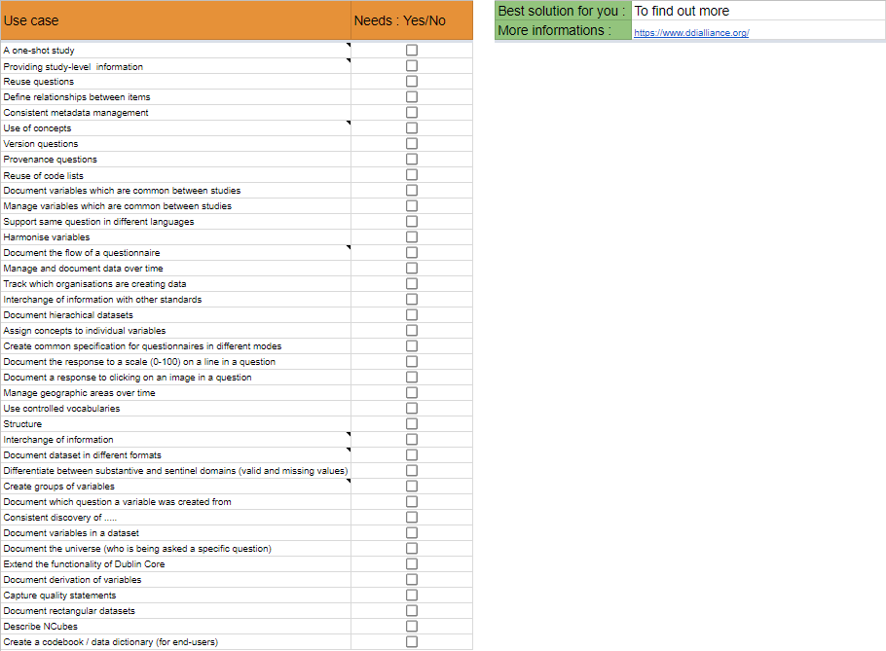
Find YOUR DDI
Notes:
We should add some instructions on how “to do” the exercise and what is its purpose

