Slide 1
DDI Codebook & Lifecycle
Use cases and objectives

Slide 2
What are you doing with your data?
What are the origins of your data?
Do you have metadata already?
Do you have the resources to do technical development?
Please ask yourself the following questions:
Notes:
Other questions to ask:
Are you sharing your data?
Are you required to archive your data?

Slide 3
What is DDI?
A structure for describing data and its related information
An open standard designed for data sharing and reuse
A mechanism for creating consistent, machine-actionable documentation for data
Notes:
•A structure to consistently define data and its related metadata for the purpose of supporting the intelligent use of the data over time
Lifecycle
•It provides clear information on the relationship between objects
•The CodeList (Object A) providing a codification of the Classification (Object B) which is maintained by an Organization (Object C) and is used by Variable (Object D) which is found in a set of data (Object E) within a study (Object F)

Slide 4
DDI Versions (history)
Evolving, non-linear standard
DDI Codebook
DDI Lifecycle
DDI Views (future standard)
Designed for different purposes
DDI-C is intended for documenting a single study
DDI-L is intended for documenting relationships between data objects

Slide 5
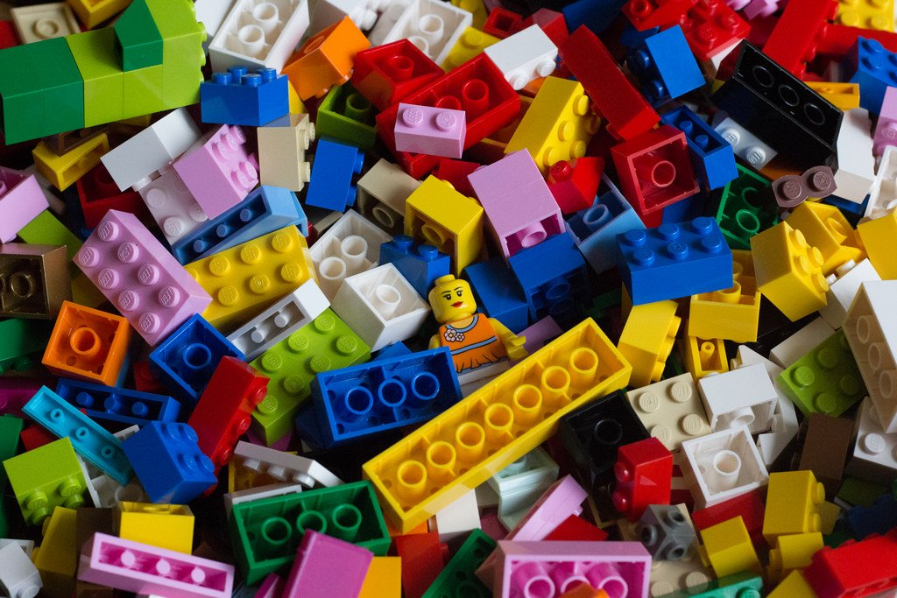
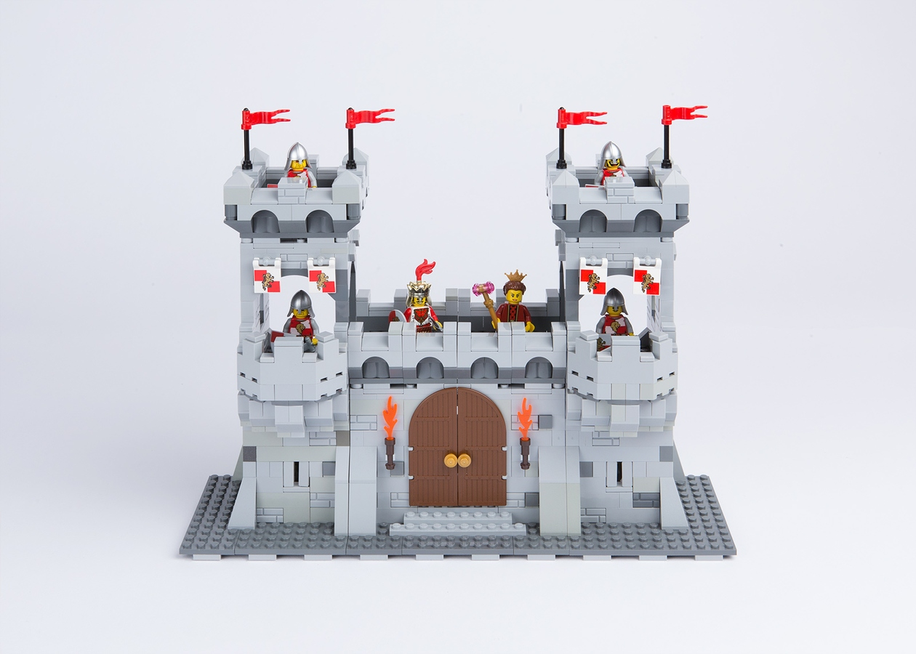
DDI Codebook
Lost metadata manager
Notes:
Left: without DDI
Right: With DDI-C

Slide 6
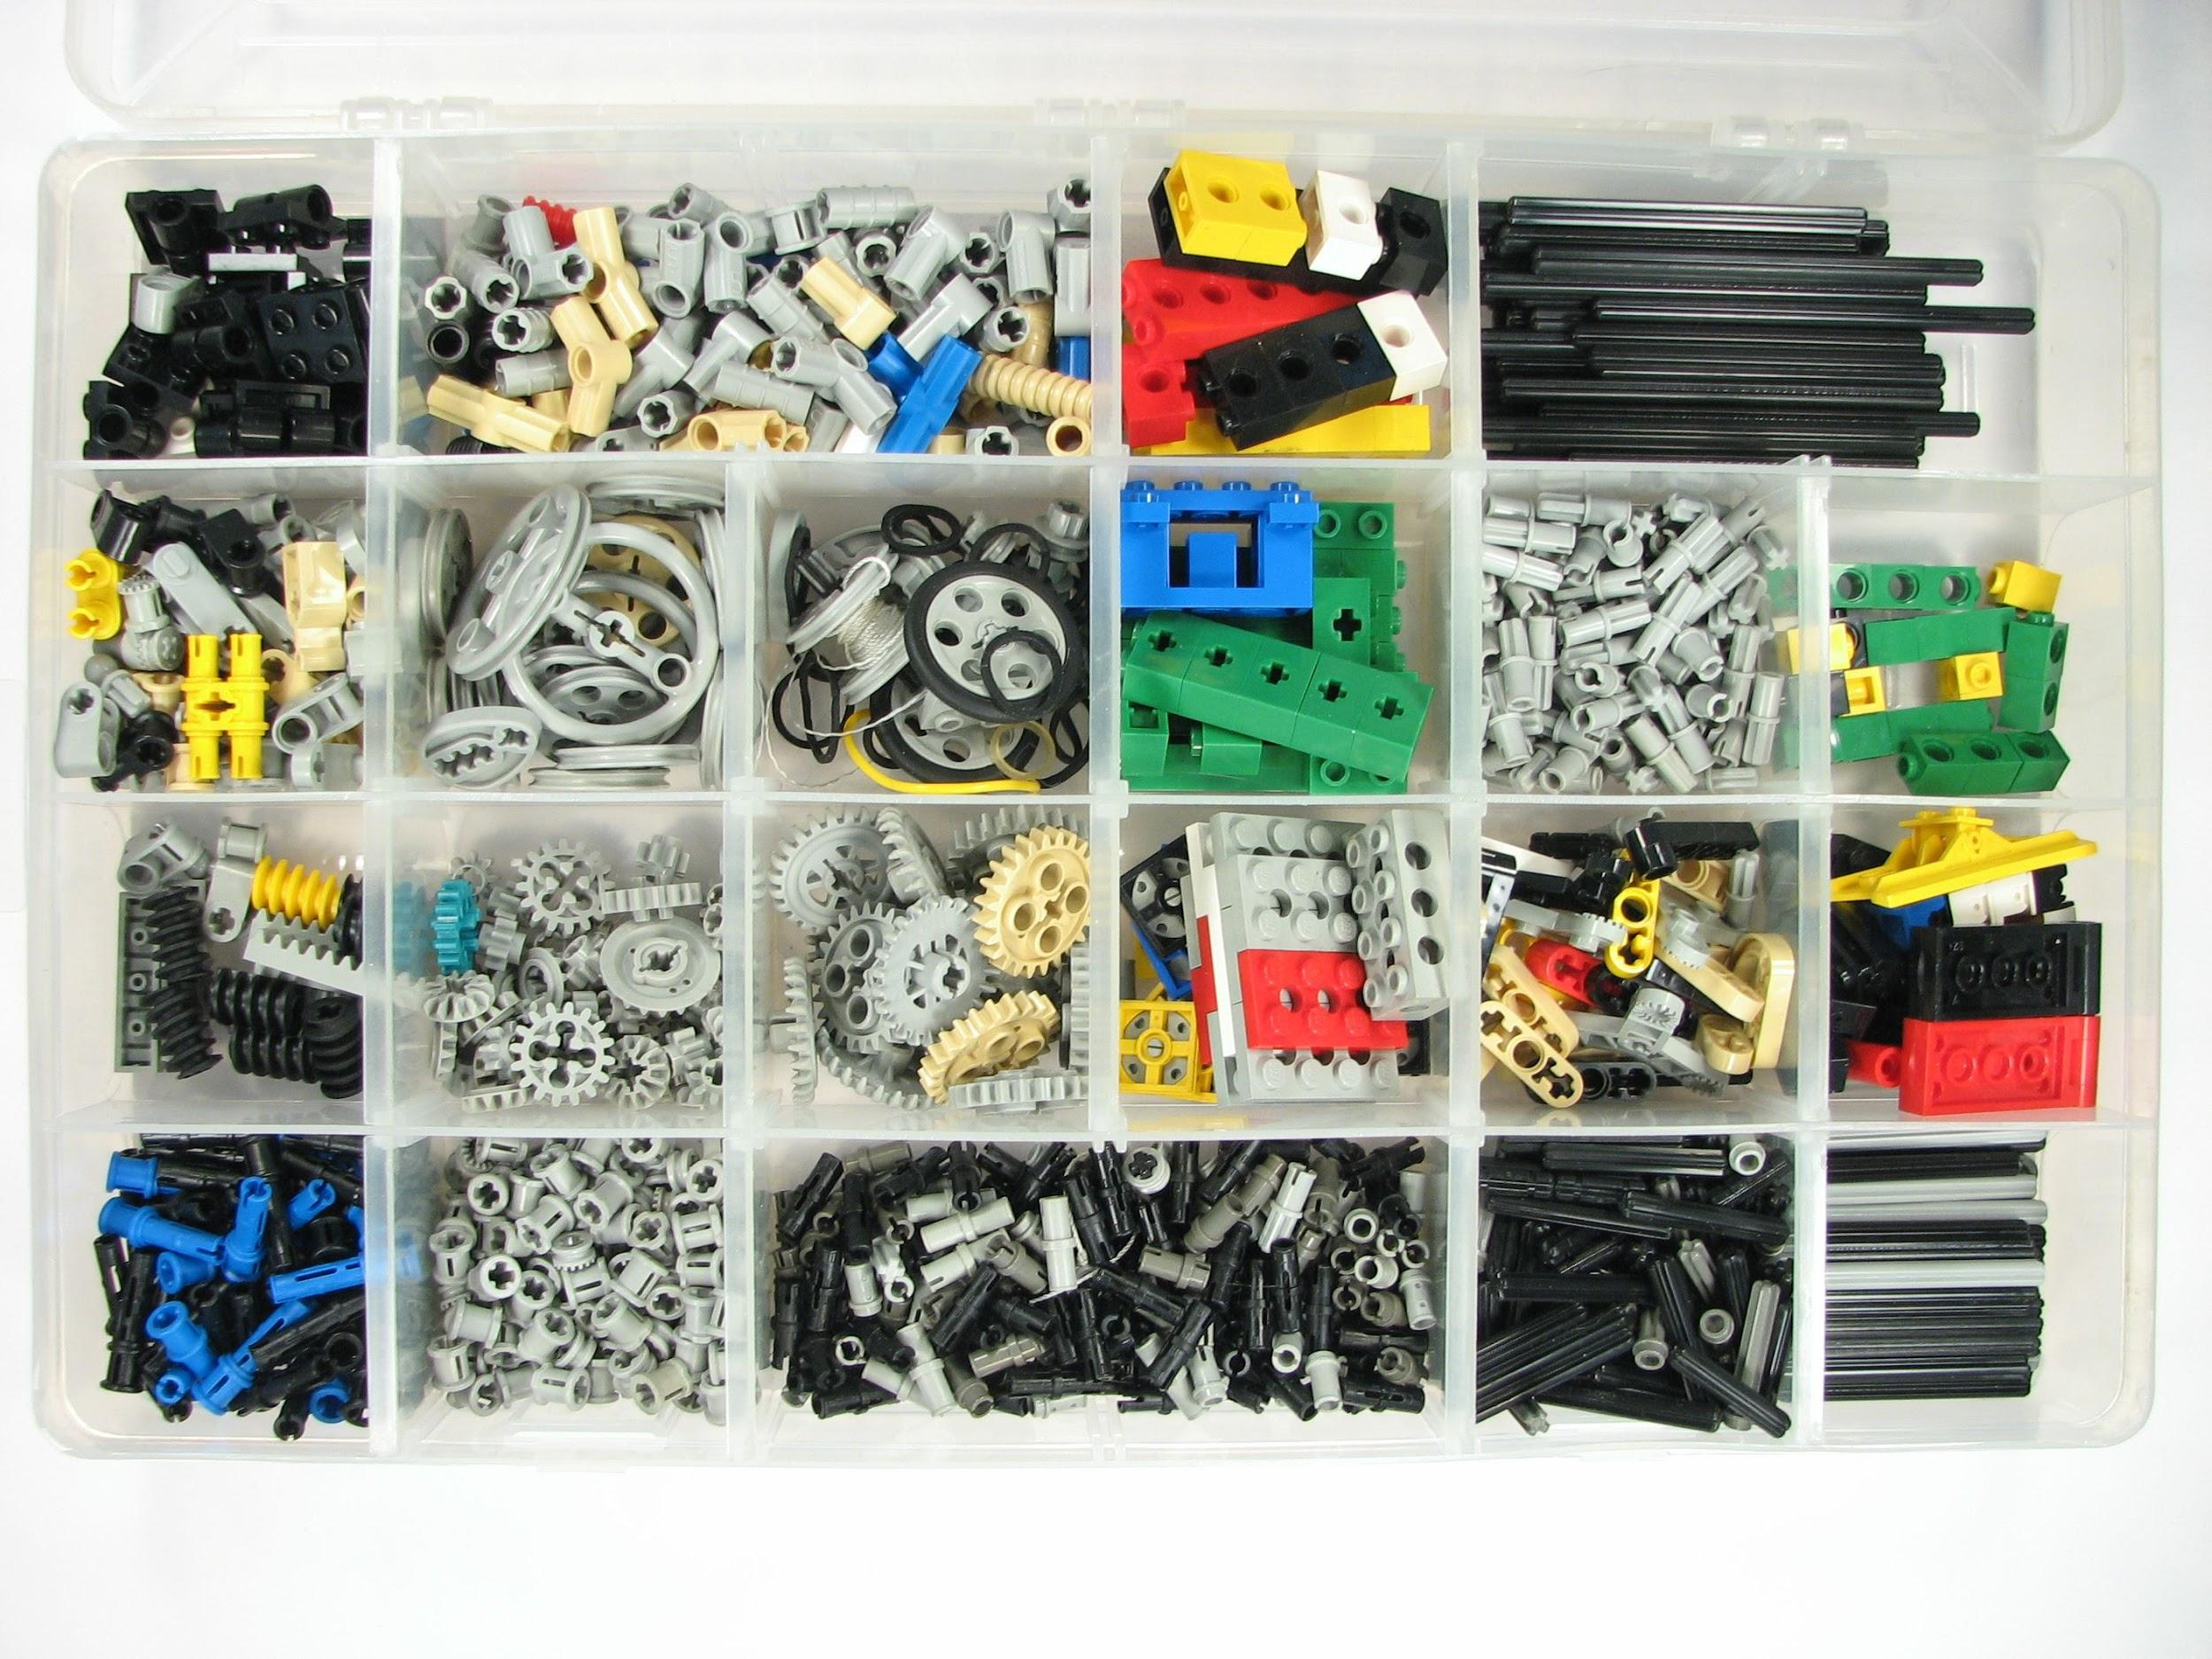
DDI Lifecycle
Universe Scheme
CodeList Scheme
Instrument Scheme

Slide 7
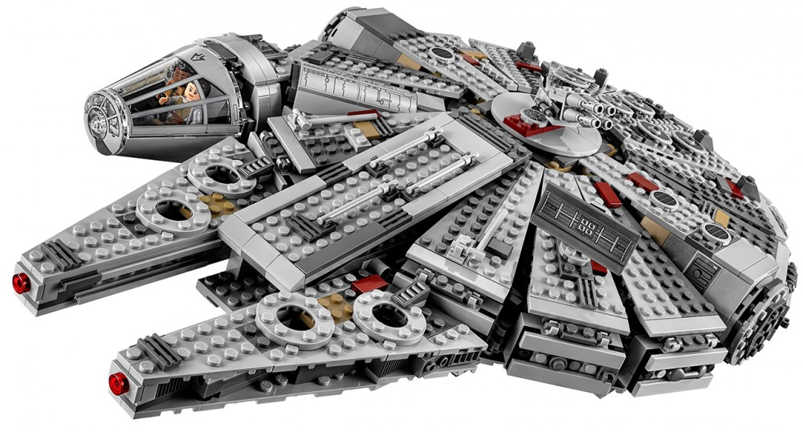
Reusable items

Slide 8
DDI Versions (purposes)
DDI-C & DDi-L | DDI-L only
Find previous studies | Data harmonisation and comparison
Build a data repository | Questionnaire design
Catalogue record | Manage data processes and workflows
Variable lists | Question banks
Data analysis

Slide 9
DDI Tools (examples)
 | Lifecycle | Codebook
Colectica | X | X
Nesstar Publisher |  | X
DDIEditor | X
Questionnaire crosswalks (redCap, LimeSurvey, Blaise) | X
StatTransfer, Sledgehammer (statistical packages) | X | X
https://www.ddialliance.org/resources/tools

Slide 10
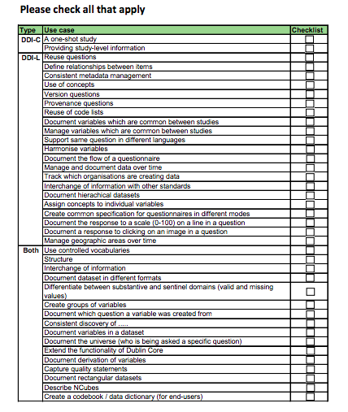
Checklist Exercise
https://drive.google.com/open?id=1z3XYkCmdB6KrZxTz5sgBYTL-EkAi_F2V

