Slide 1
ISO Metadata
Stephen M. Richard
US Geoscience Information Network
Editor ISO19115-3

Slide 2
Origins
Precursors:
NASA Directory Interchange format "DIF’" 1988.
U.S. FGDC CSDGM 1994
The Spatial Information Council of Australia and New Zealand (ANZLIC) 1996
ISO Technical committee TC211: Standardization in the field of digital geographic information.
International group, remote sensing concentration (initially)
First edition 2003, Update 2013

Slide 3
Components
Base standard: 19115-1
Extensions for Imagery and gridded data (19115-2)
XML implementation (19115-3)
Data Quality (19157)
Feature Catalogue (19110)
Foundation standards for time and space representation (19108 temporal, 19136 GML, 19111 spatial reference systems)

Slide 4
Design pattern
Entities with properties
Property has a data type- another entity or a base type (string, date, number, term)
String values can be language localized
Controlled vocabularies for term values.
Conceptual model is distinct from implementation (XML)
Modularized implementation

Slide 5
Packages
Metadata about metadata
Maintenance information
Constraints
Resource Information
Base information (DC)
Lineage
Distribution
Content Information
Spatial representation
Acquisition
Quality
Linked information
Portrayal scheme
Application schema
Spatial reference system
Extensions

Slide 6
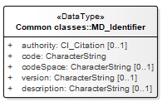
Interoperability challenges
Flexibility to encode information in different ways
Related resources
Distribution
Entity/Attribute
Binding format with distribution
Identifiers
Xlink, MD_Identifier
Geometry other than bounding box

Slide 7
Tools
Various catalog and search systems
ESRI geoportal, Geonetwork OpenSource, Deegree, …
Many editors
Various profiles
North American
INSPIRE
Blue Nast
Energistics

Slide 8
UML diagrams for reference

Slide 9
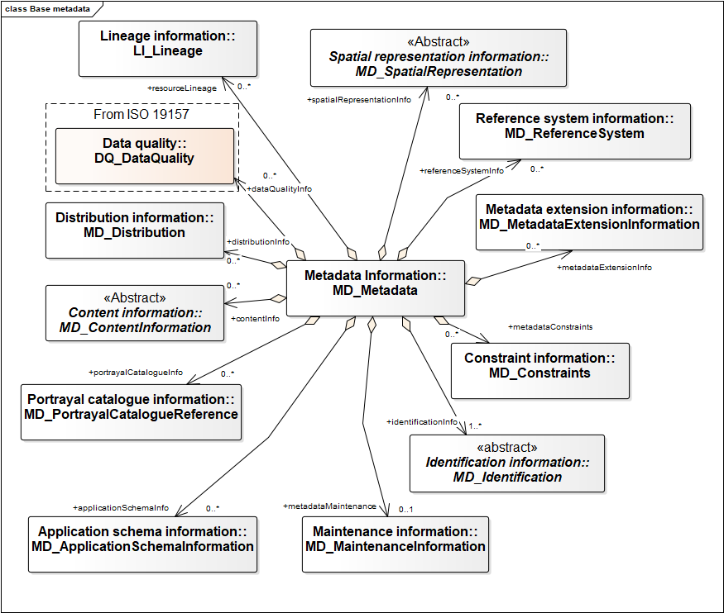
Metadata packages * Each is implemented in a separate XML namespace

Slide 10
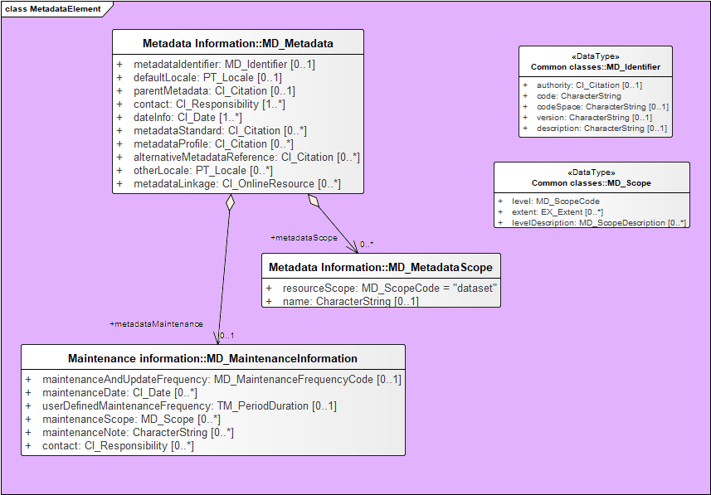
Base metadata class

Slide 11
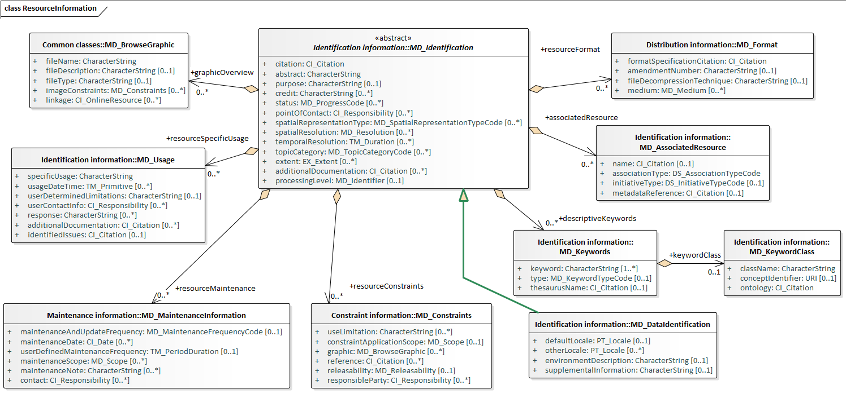
Resource description

Slide 12
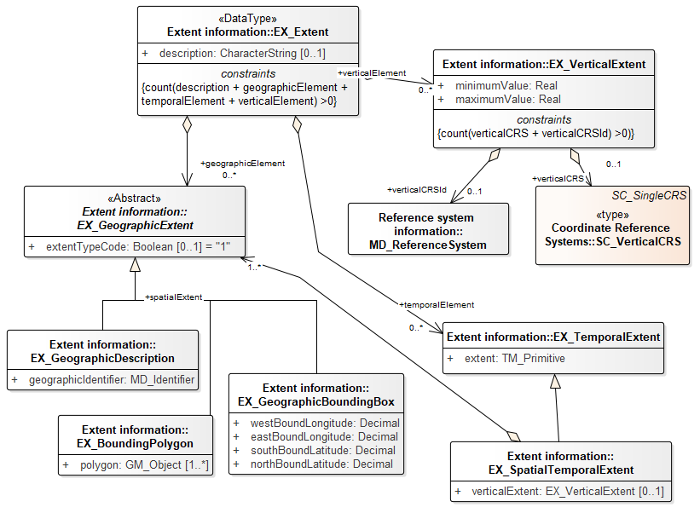
Extent—spatial and temporal

Slide 13
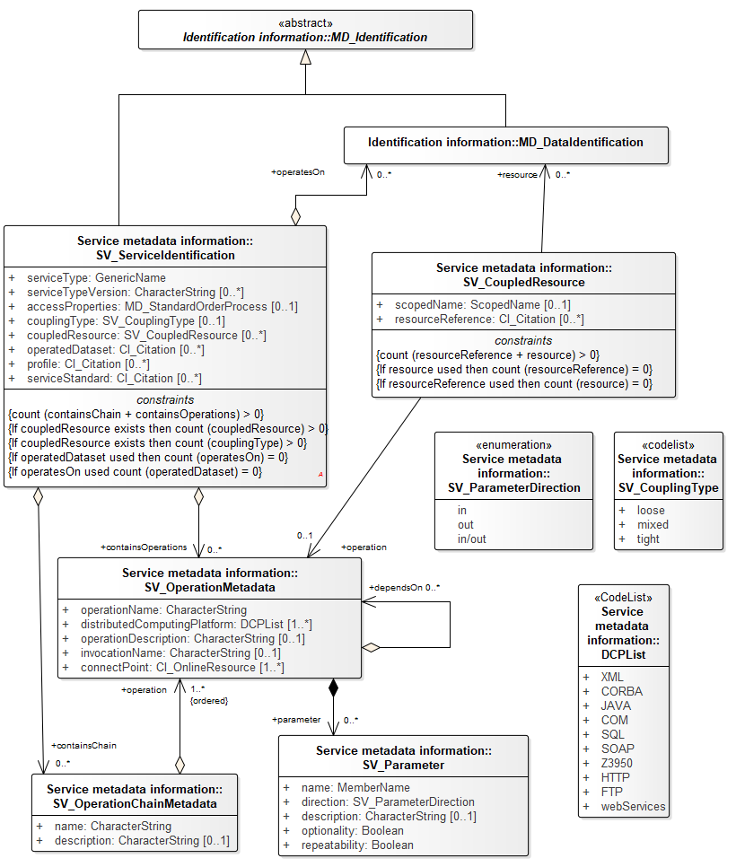
Identification, services

Slide 14
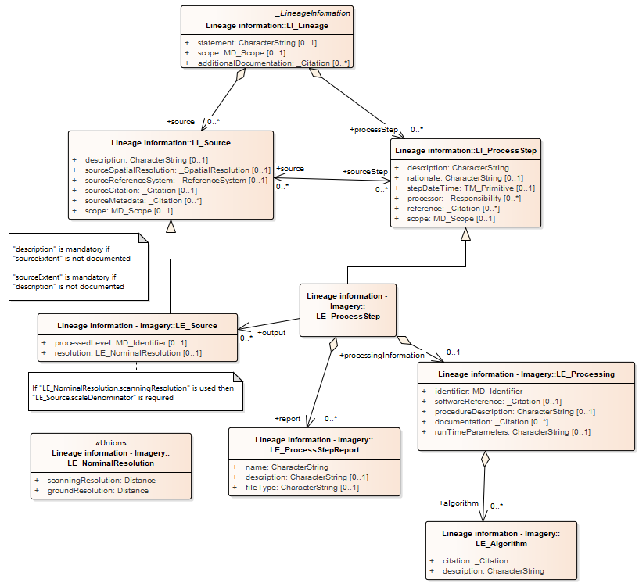
Lineage (provenance)

Slide 15
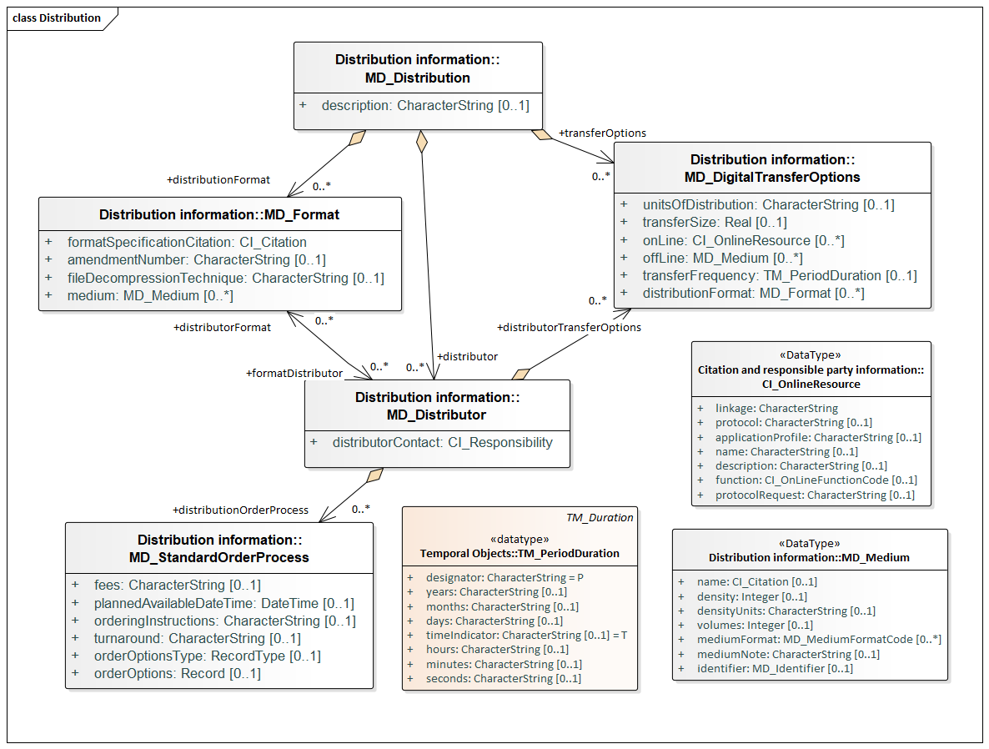
Distribution

Slide 16
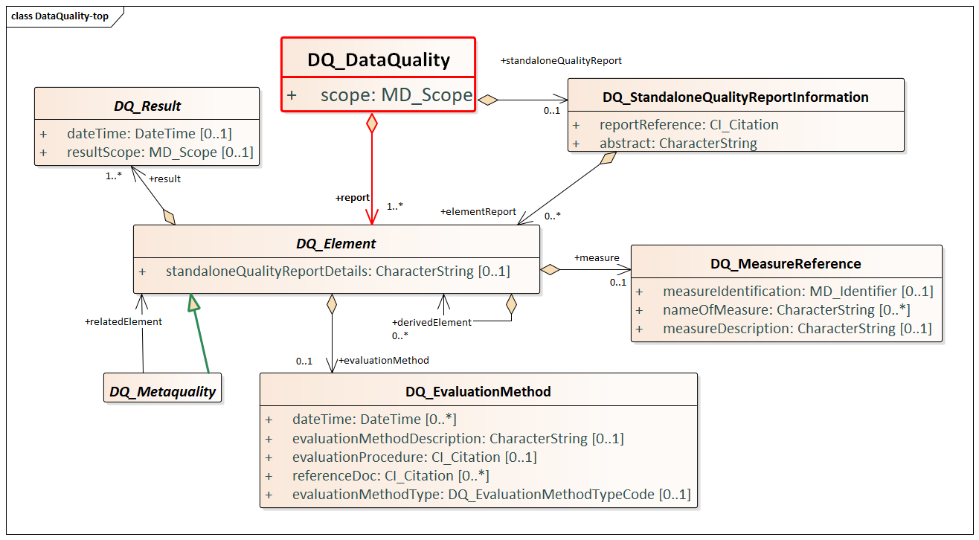
Data Quality ISO19157

Slide 17
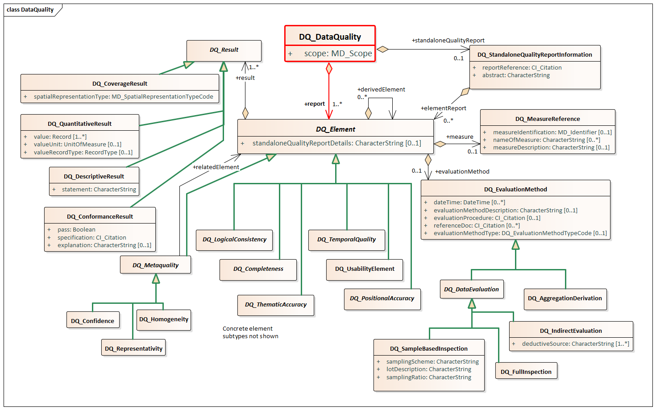
Data Quality Detail

Slide 18
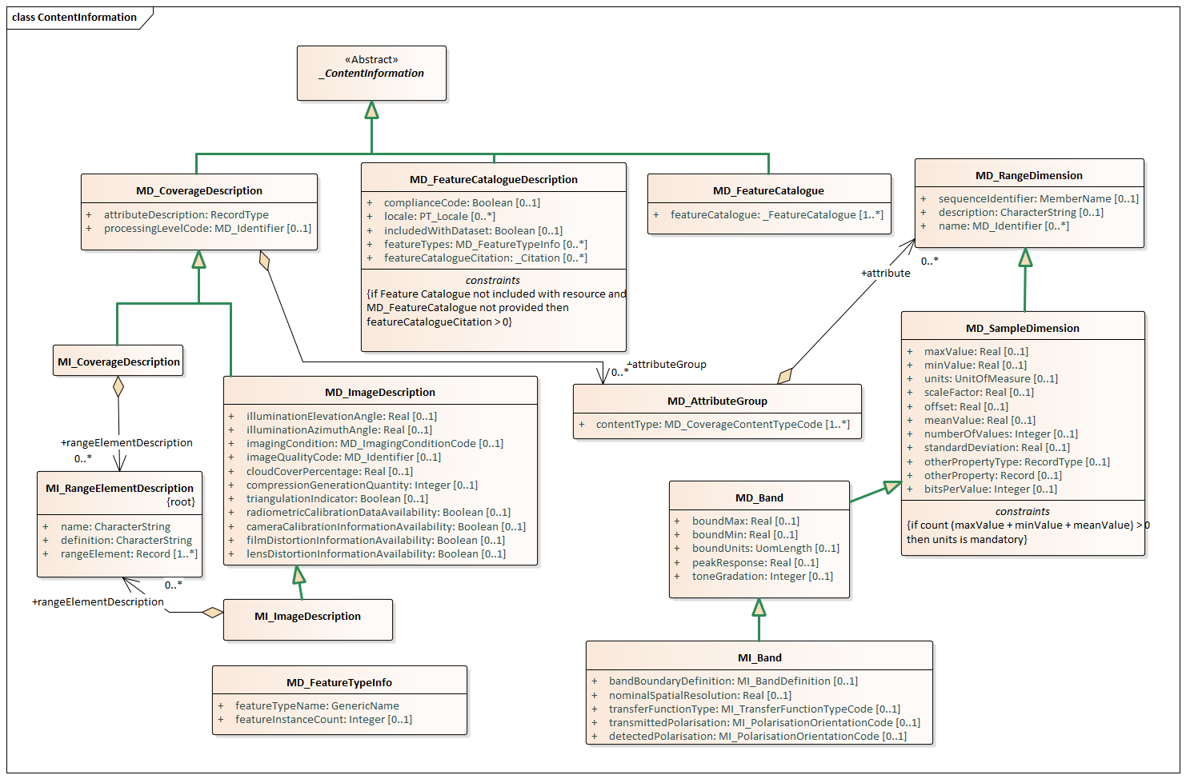
Content Information

Slide 19
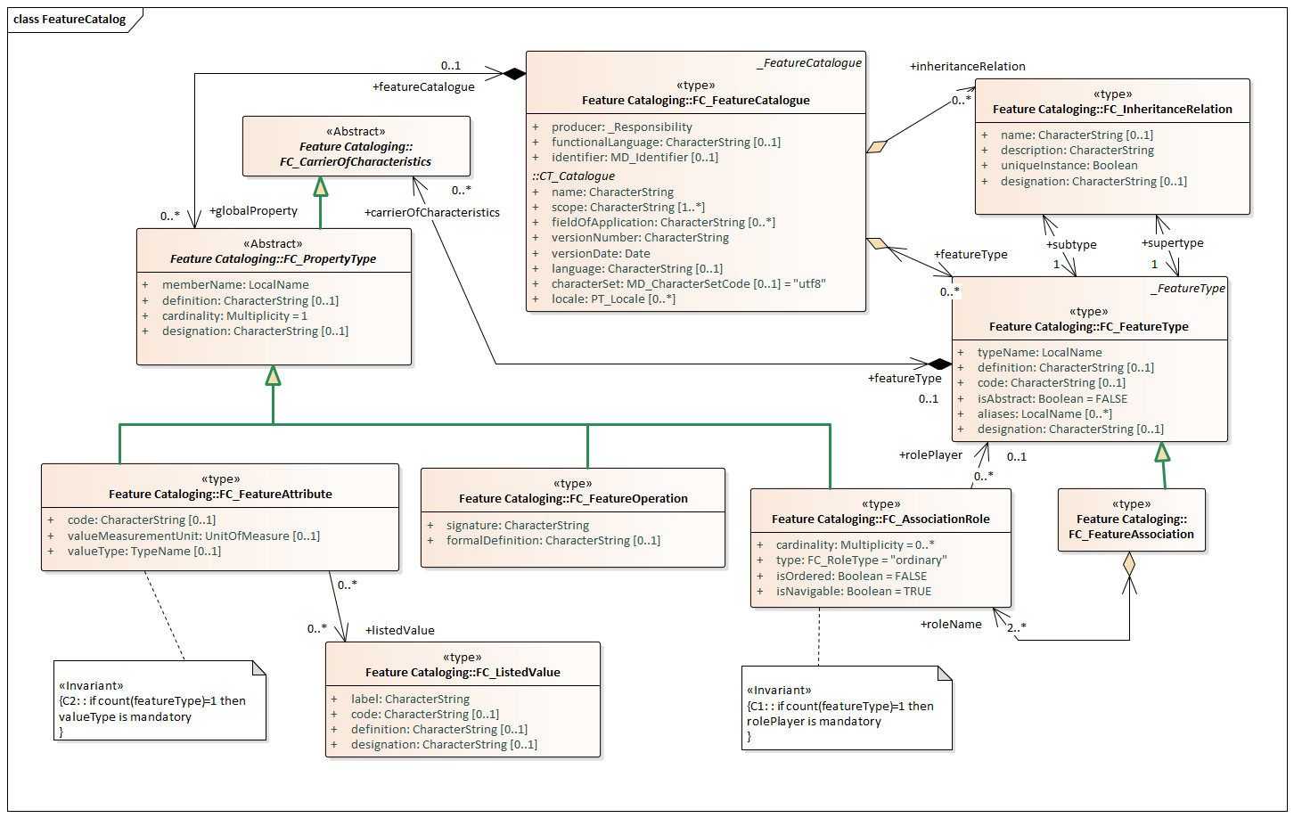
Feature Catalogue ISO19110

