Slide 1
MRT Data Description
A DataCube Worked Example
11-Apr-19

Slide 2
An MRT model for rectangular (wide and tall), non-rectangular and data cube data definitions and the workflows that spawn them from each other

Slide 3
Example¹ Unit Data Table: Wide
MyWide
PersonID | Sex | Born | Died | RefArea | Longevity
Marie | Female | 3.3.1932 | 12.1.2005 | Newport | 73.7
Henry | Male | 8.1.1929 | 6.2.2008 | Cardiff | 78.8
etc.
¹This example comes from the W3C RDF Data Cube Vocabulary recommendation

Slide 4
mrt:UnitDataRecordDefinition (patterned after CollectionOrderDefinition)
MyWide
InstanceVariableID | IndexValue | Role
PersonID | 1 | Identifier
Sex | 2 | Measure
Born | 3 | Measure
Died | 4 | Measure
RefArea | 5 | Measure
Longevity | 6 | Measure

Slide 5
mrt:DataCubeDefinition (patterned after CollectionOrderDefinition)
MyDataCube
InstanceVariableID | Role | IndexValue
RefArea | Dimension | 1
RefPeriod | Dimension | 2
Sex | Dimension | 3
LifeExpectancy | Measure | na
UnitMeasure | Attribute | na

Slide 6
Observations from the MyDataCube DataSet
The MyDataCube DataSet
RefArea | RefPeriod | Sex | LifeExpectancy
Newport | 2004-2006 | Male | 76.7
Newport | 2004-2006 | Female | 80.7
Newport | 2005-2007 | Male | 77.1
Newport | 2005-2007 | Female | 80.9
Cardiff | 2004-2006 | Male | 78.7
Cardiff | 2004-2006 | Female | 83.3
Cardiff | 2005-2007 | Male | 78.6
Cardiff | 2005-2007 | Female | 83.7

Slide 7
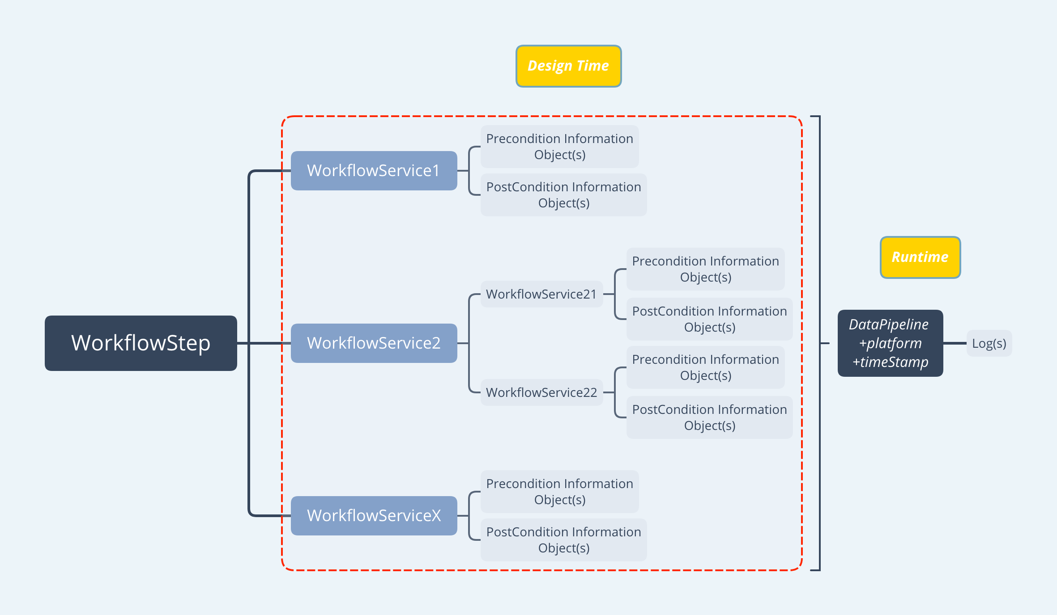
MyDataCube Incubator: mrt:DataPipeline (1 of 2)

Slide 8
MyDataCube Incubator: mrt:DataPipeline (2 of 2)
This template is what we might instantiate to specify the workflow that produces MyDataCube from MyWide
The template encompasses different levels of detail. Not all levels are required
At the topmost level WorkflowSteps describe the Process Design
WorkflowSteps are implemented by WorkflowServices that may in turn be implemented by WorkflowServices
Post-conditions of one WorkflowService may be the pre-conditions of other WorkflowServices
A DataPipeline orchestrates the flow minding post-conditions and pre-conditions

