Slide 1
Preparatory Meeting I: Interoperability of Metadata Standards in Cross-Domain Science, Health, and Social Science Applications
30 September – 5 October 2019
Schloss Dagstuhl
Wadern, Germany

Slide 2
Overview
What is Dagstuhl Like?
Goals/Outputs of the Workshop
The Problem Space: Cross-Domain Conceptual Framework
The 2018 Pilots

Slide 3
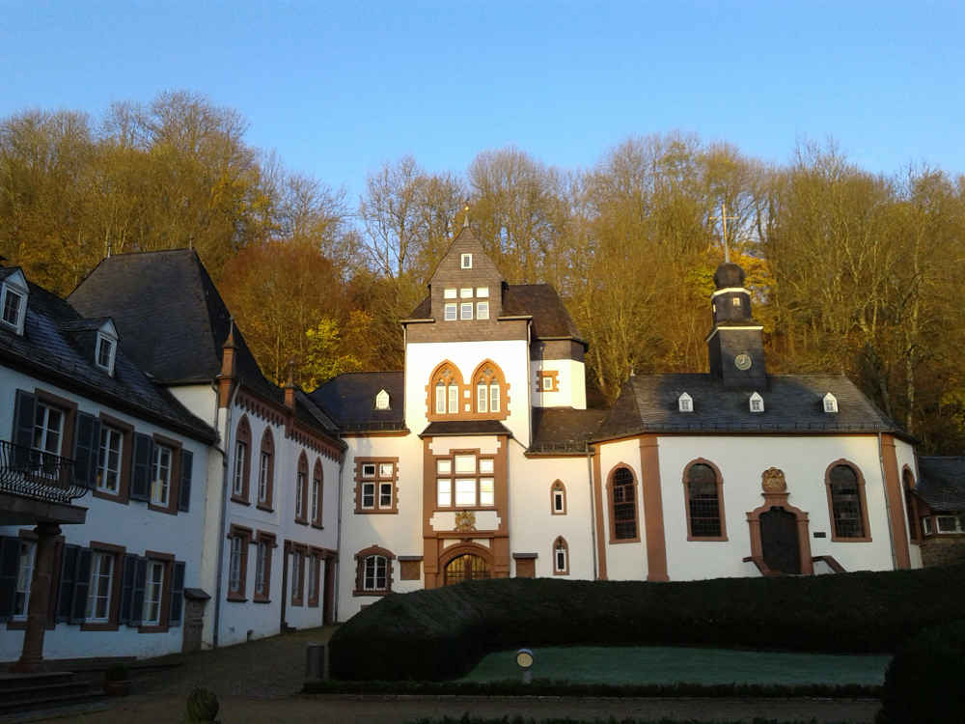
What is Schloss Dagstuhl Like?
In one sentence:
Schloss Dagstuhl is a beautiful, isolated place designed to make intelligent people work together productively.

Slide 4
Goals/Outputs of the Workshop
This is the second workshop in a series
Last year’s workshop was exploratory, investigating the challenges of cross-domain data sharing
This year’s workshop is meant to be more focused, and to produce outputs meaningful to the real world
Both workshops were/are based on real-world “pilot projects”
The same in both workshops

Slide 5
What We Won’t Deliver…
Ending World Hunger
Achieving World Peace
Realizing
Personal Enlightenment

Slide 6
What We Will (Try To) Deliver…
Meaningful, practical guidelines for people looking to make their data sharable and reusable across domains

Slide 7
Some Considerations
This is an ambitious goal!
We will not try to solve all of the problems
We will address some important ones
The specific focus will be determined by the workshop
We will provide ideas and templates, but…
The work is “self-organizing” (in Agile terms)
The participants determine what is possible, achievable, and useful
The organizers will provide a platform for promoting the work
The outputs of the workshop are intended to be the basis of further developments

Slide 8
Conceptual Framework
In order to ensure effective communication, we provide a way of thinking about the problem space based on three “dimensions”:
FAIR Principles
Stages of data sharing and reuse
Stakeholder perspective
This is not a complete or finalized conceptual model!
It is a way of approaching how we think and talk about the work, to ensure that we avoid needless miscommunication

Slide 9
The FAIR Principles
Findability
Access
Interoperability
Reuse

Slide 10
Stages of Data Reuse

Slide 11
Stakeholders
Data Discovery
Users
Providers
Harmonization and transformation
Users
Provider of classifications, codelists, harmonization approaches
Provider of harmonized data
Use
Analysts
Provider of cross-domain data
Others (Funders, etc.)

Slide 12
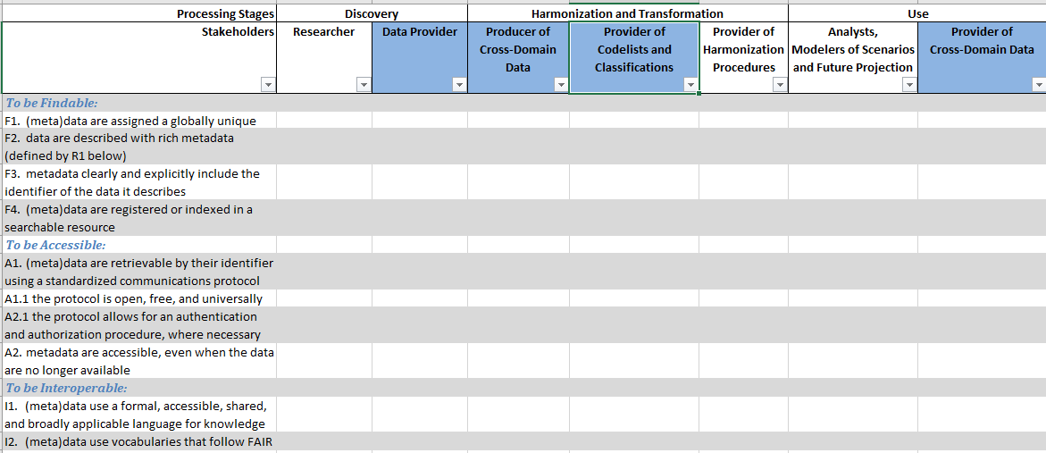
Conceptual Framework as a Table

Slide 13
Terminology: Examples of Confusion
“User” – one person’s user is another’s provider. Be clear when talking about “users”!
“Data”/”Metadata” – the term “data” means different things in different domains (ie, geo-spatial information is “data” in the GIS world and “metadata” for the social sciences, etc.) Do you mean quantitative data? W3C-type “data” (basically any parseable, digital content)? Be precise!
“Raw”/”Input”/”Source” – terms which are used in reference to a position in the production flow can easily cause confusion. Be specific!

Slide 14
The 2018 Pilot Projects
Sendai Framework – Disaster Risk Reduction
Resilient Cities (Medellin, Columbia)
Infectious Disease (IDDO, Oxford University)
We have pilots for 2019 in the same focus areas, but the projects themselves are slightly different.
The pilots serve to
Keep the work grounded/focused on real problems and solutions
Act as powerful illustrative examples

