Slide 1
Modes and Moods of the MethodologyPattern
Version 5
25 April 2017

Slide 2
Two Dimensions of Methodology
The MethodologyPattern contains / references three classes: design, algorithm and process
Arguably these classes and their relationships are not unlike the three concepts of Model Driven Architecture (MDA): the Conceptual Independent Model (CIM), the Platform Independent Model (PIM) and the Platform Specific Model (PSM)
Together the three classes of the MethodologyPattern form a mode of description that goes to increasing levels of specificity
There is a second dimension of methodology that unfortunately sometimes get conflated with the first
After HL7 we will call it mood…

Slide 3
Mood and Mode (1)
This is how HL7 thinks of mood
Mood seems to chronicle the lifecycle of an occurrence
In HL7 mood is represented as an attribute of an act
And the lifecycle of an occurrence consists of many acts – one for each mood
So in HL7 a mood is NOT a status code
Thus, an act in “order” mood that orders an act in definition mood and results in an Act in ‘event’ mood are three different acts, related through the act relationship.
The next slide is instructive in this regard

Slide 4
Mood and Mode (2)
Observation is a type of act and both the act and its observation are abstract
An observation is realized through a series of concrete acts that here includes an ObservationDefinition, and ObservationRequest and an ObservationEvent where the request instantiates the definition and the event fulfills the request
We need to keep in mind that “act” relationships in the context of healthcare have steps / moments that are different from the steps / moments that make up a study act.
That is why the BRIDG model is instructive

Slide 5
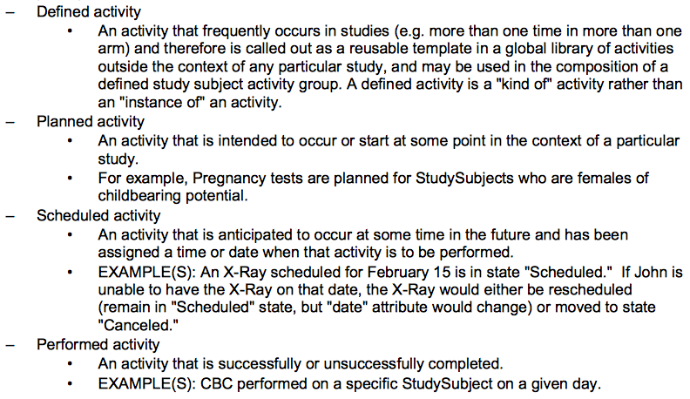
Mood and Mode (3)
BRIDG is the Biomedical Research Integrated Domain Group Model
Like DDI it is meant to describe the lifecycle of a study only not in general but specifically in the biomedical research domain
That being said, BRIDG takes a slightly different approach from HL7 and healthcare acts on mood
BRIDG identifies four activity subtypes through which study activities move. See the inset.
Each inherits and specializes the core activity class

Slide 6
Mood in DDI (1)
In DDI the MethodologyPattern is an abstraction like an act in HL7 or the core Activity in BRIDG
Just like acts and activities, the MethodologyPattern is content neutral: it can apply anywhere across the data lifecycle – both upstream during study conduct and downstream during data processing
In consequence it is often the case, just like in the HL7 example presented here, that the MethodologyPattern will be specialized for a specific activity in the data lifecycle
And this specialization might also be abstract
Alternatively this specialization might be domain-specific and, in terms of mood, form a definition for which there are many specific subtypes
For example, SamplingMethodology is a realization of the MethodologyPattern and there are many subtypes of SamplingMethodology

Slide 7
Mood in DDI (2)
So perhaps the first mood and model/view of Methodology on the way to fulfillment is to create a realization that is repeatable across many subtypes
Not that constructing this model/view – a model/view that is in effect a design pattern – requires both domain knowledge and experience
The skill set for defining design patterns is unique
Then the next mood and model/view might be to create a methodology that is an instantiation of the repeatable one
Less synthetic understanding and more domain knowledge is needed here
A process model in which inputs and outputs are specified across one or more workflows might come into play here
Alternatively, the mode of description might be less process and more algorithm
Not all instantiations need to become executable…

Slide 8
Mood in DDI (3)
Continuing, the next mood and model/view might be to further define a methodology so that it is useful during execution by a human and/or a software agent. This is the in progress mood
In this model/view parameters are bound to objects as needed. Until now (before runtime) they were unbound.
A final mood and model/view is after the fact. It considers the performance of the methodology
Nowadays we can glean performance by analyzing machine data (automatic logs)
Machine data can inform us about data matching issues during binding as well as issues like timeouts that may be a function of the scalability of the model/view
There are many tools available for analyzing machine data

Slide 9
Methodology Mood and Mode Crossings
 |  | Mood
Mode of Description |  | Repeatable | Instantiated | In Progress | Performed
 | Design | Conceptual Model (Mind map) | Design pattern if available | Back of the envelope / napkin | Applicability assessment
 | Algorithm | Formula | Instantiated Formula (Human readable) | Executable with human assistance (Platform independent) | Delta
 | Process | Workflow Schematic | Instantiated Workflow Schematic (Machine readable) | Executable with the assistance of a software agent (Platform specific) | Delta with performance metrics from machine data (logs)

Slide 10
Example
Consider the SegmentDefinitionWorkflow in DDI
It consists of a SegmentDefinitionDesign, a SegmentDefinitionAlgorithm and a SegmentDefinitionProcess in large part
As currently represented, it is the initial step in performing the segmentation of a media object: it applies the MethodologyPattern to a domain – media segmentation – and at first blush describes a generic methodology for media segmentation
So the mood of the SegmentDefinitionWorkflow in DDI might be “Repeatable”
The next step on the way to performing the segmentation is to identify the target object – instantiation
One way or another the SegmentDefinitionWorkflow would have to grow. Either the algorithm would have to grow to manage a specific media and/or the process would have to grow perhaps to support a specific layout
Upon instantiation the mood of the specialized SegmentDefinitionWorkflow would progress to “Instantiated”
Note that the mood does not determine whether on the way to performance we define on object-specific algorithm or workflow or both, i.e. the specificity of the description and its moods are independent

Slide 11
Design Patterns

Slide 12
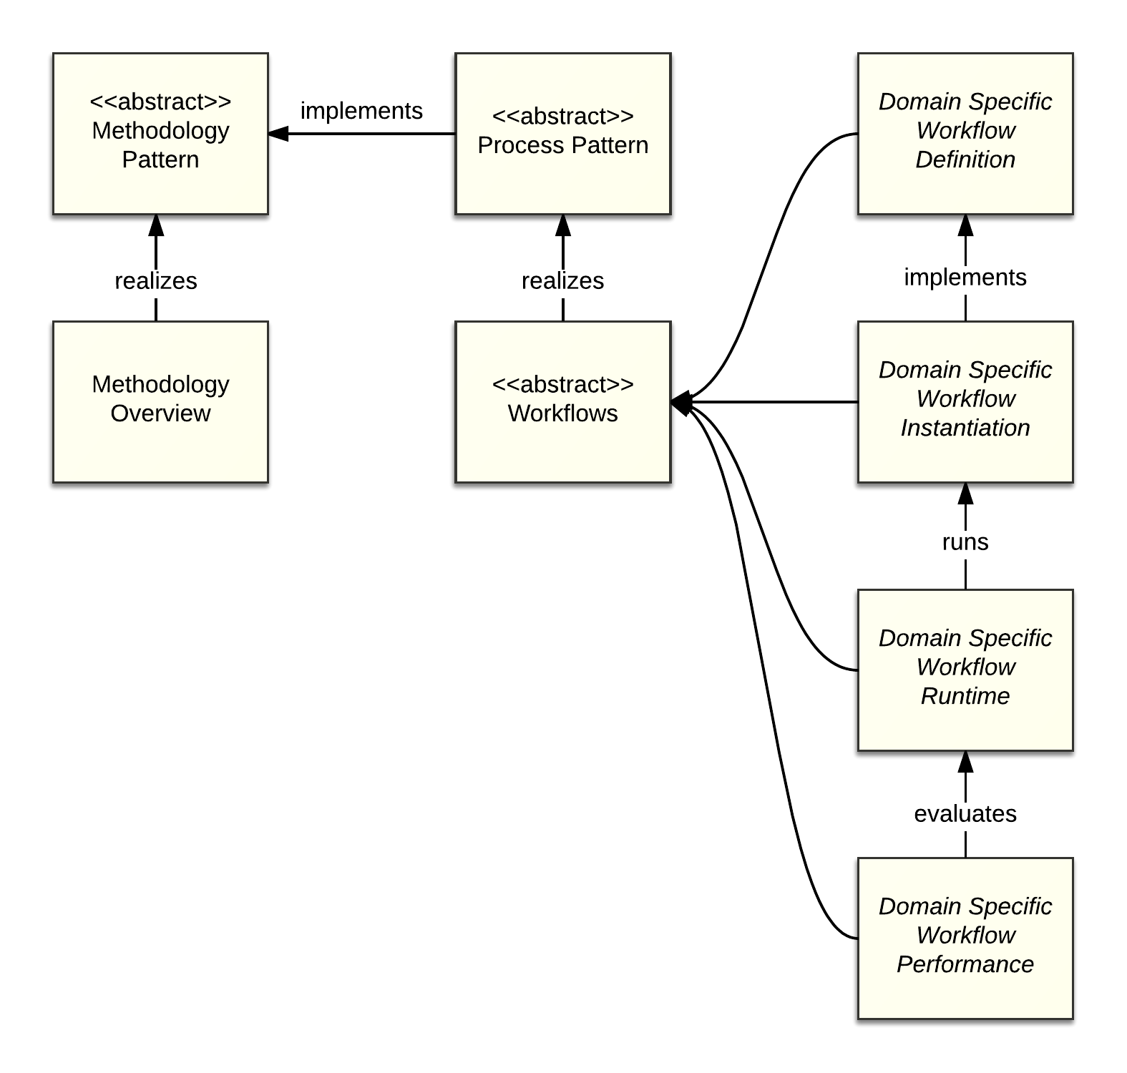
Methodology Light Process Heavy (1)
In this pattern not much is said/known about methodology
Perhaps the process has to be understood in detail first
Maybe a particular domain is not well defined and research is going bottom up
Recall that the realization of a methodology beyond an overview requires the specification of a methodology pattern that is “repeatable across many subtypes”
Understanding might not have progressed to this point yet

Slide 13
Methodology Light Process Heavy (2)
Imagine if we were doing data capture documentation and we began with an ImplementedInstrument
ImplementedInstruments are mode and unit specific
Let’s say we wanted to go longitudinal and add a successive round
Order of questions in the successive round might be the same with certain differences
This would require us to think more abstractly about a ConceptualInstrument on which we were now basing successive ImplementedInstruments

Slide 14
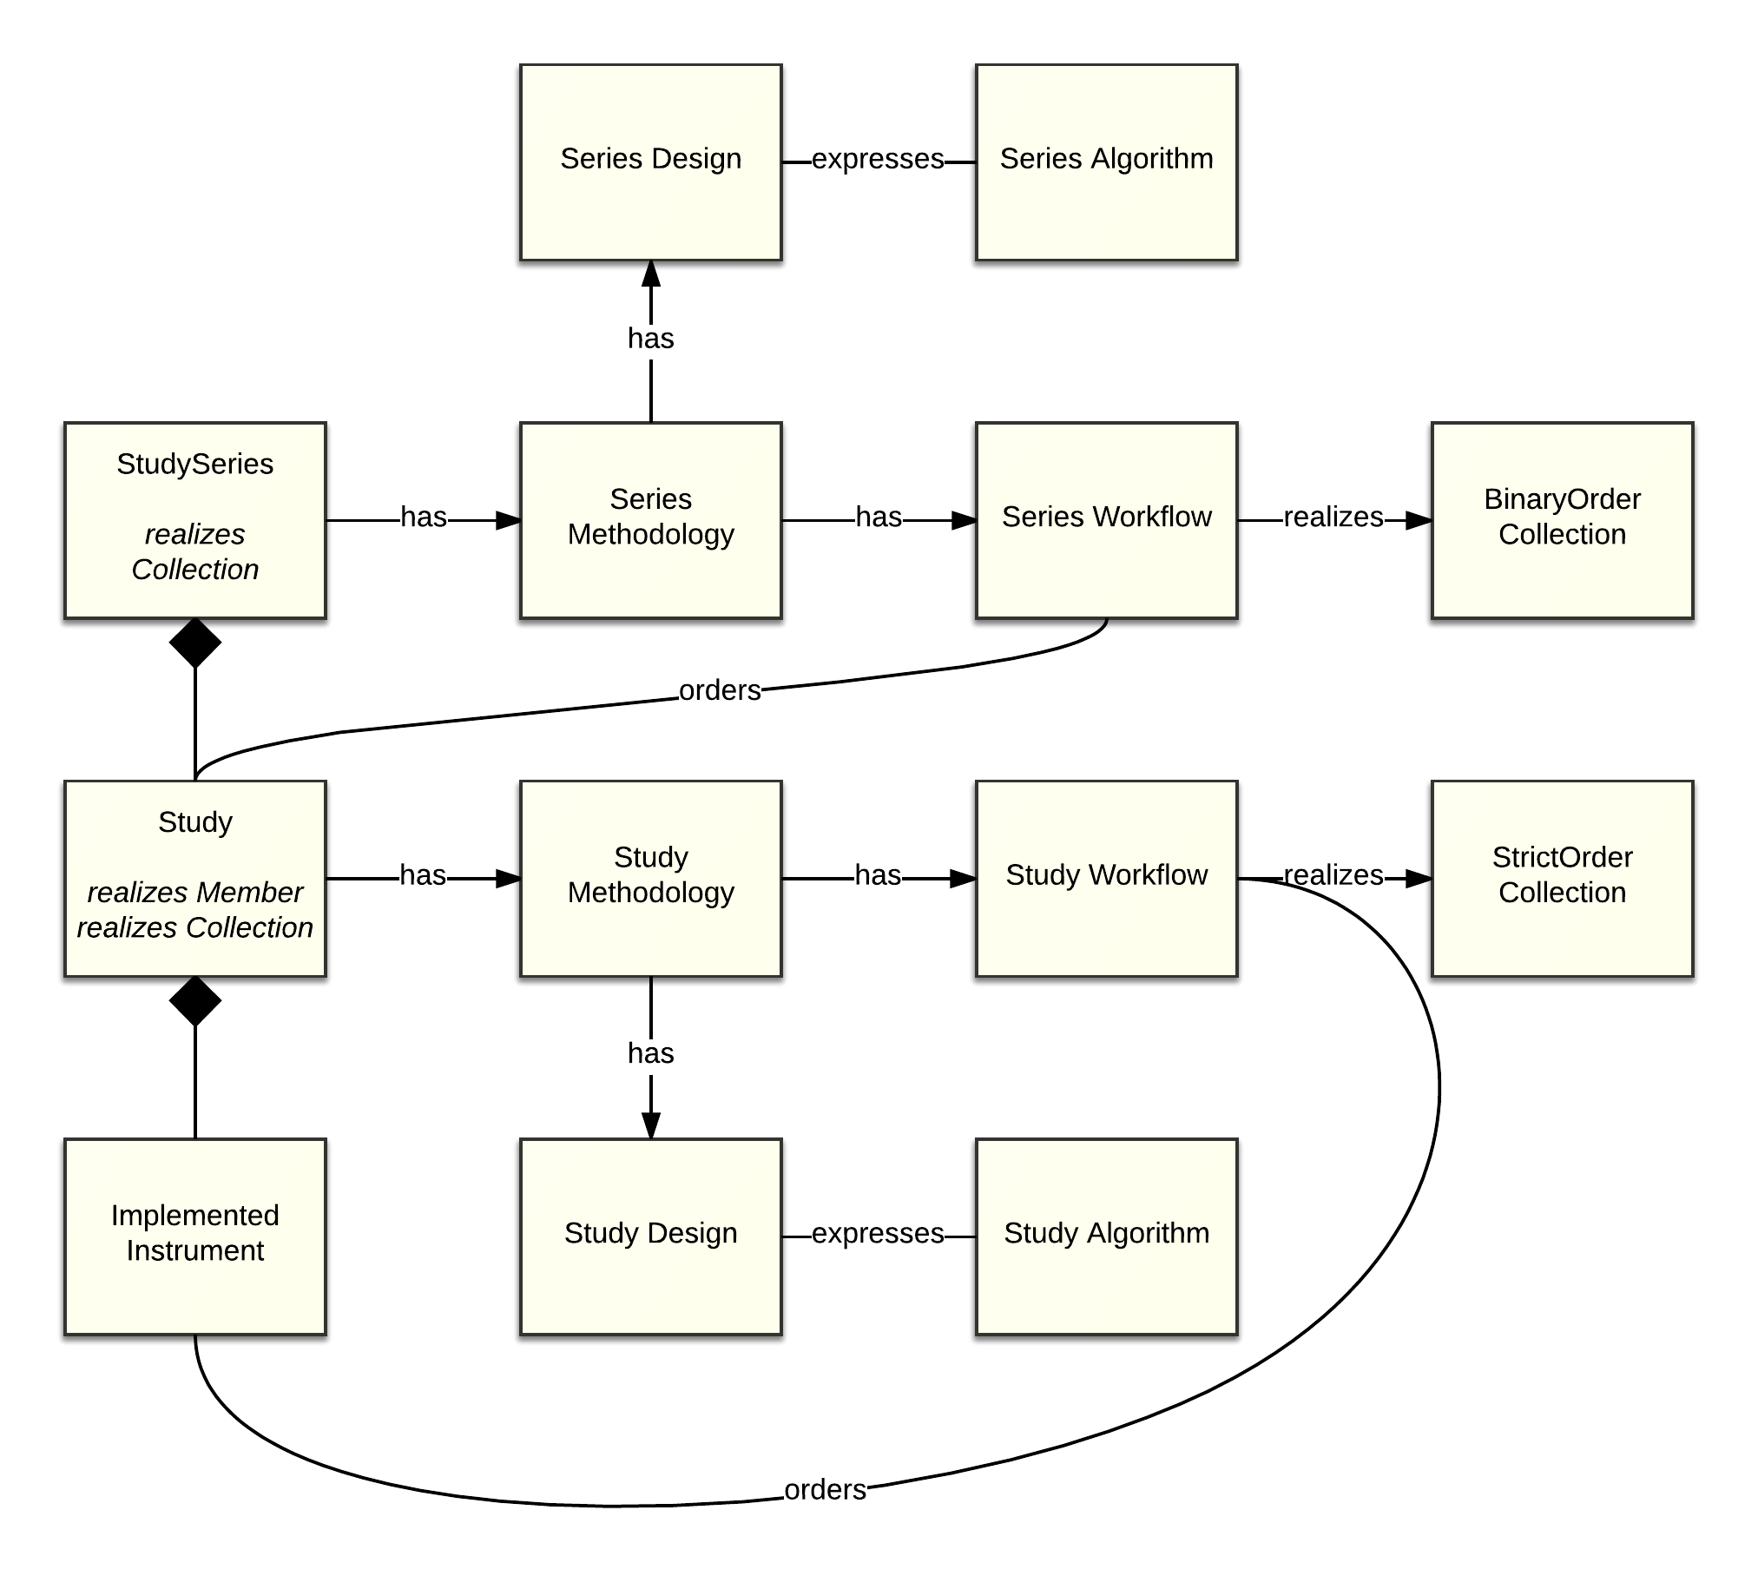
Methodology Light Process Heavy No More (3)
This development willy nilly forces to have a study methodology
In this methodology there might be one or more ImplementedInstruments in a round and several rounds in the longitudinal study
Within a round (Study) multiple ImplementedInstruments may be asked in a specific order
Within the series of rounds (StudySeries) the rounds follow each other at certain intervals defined using Allen’s interval algebra

Slide 15
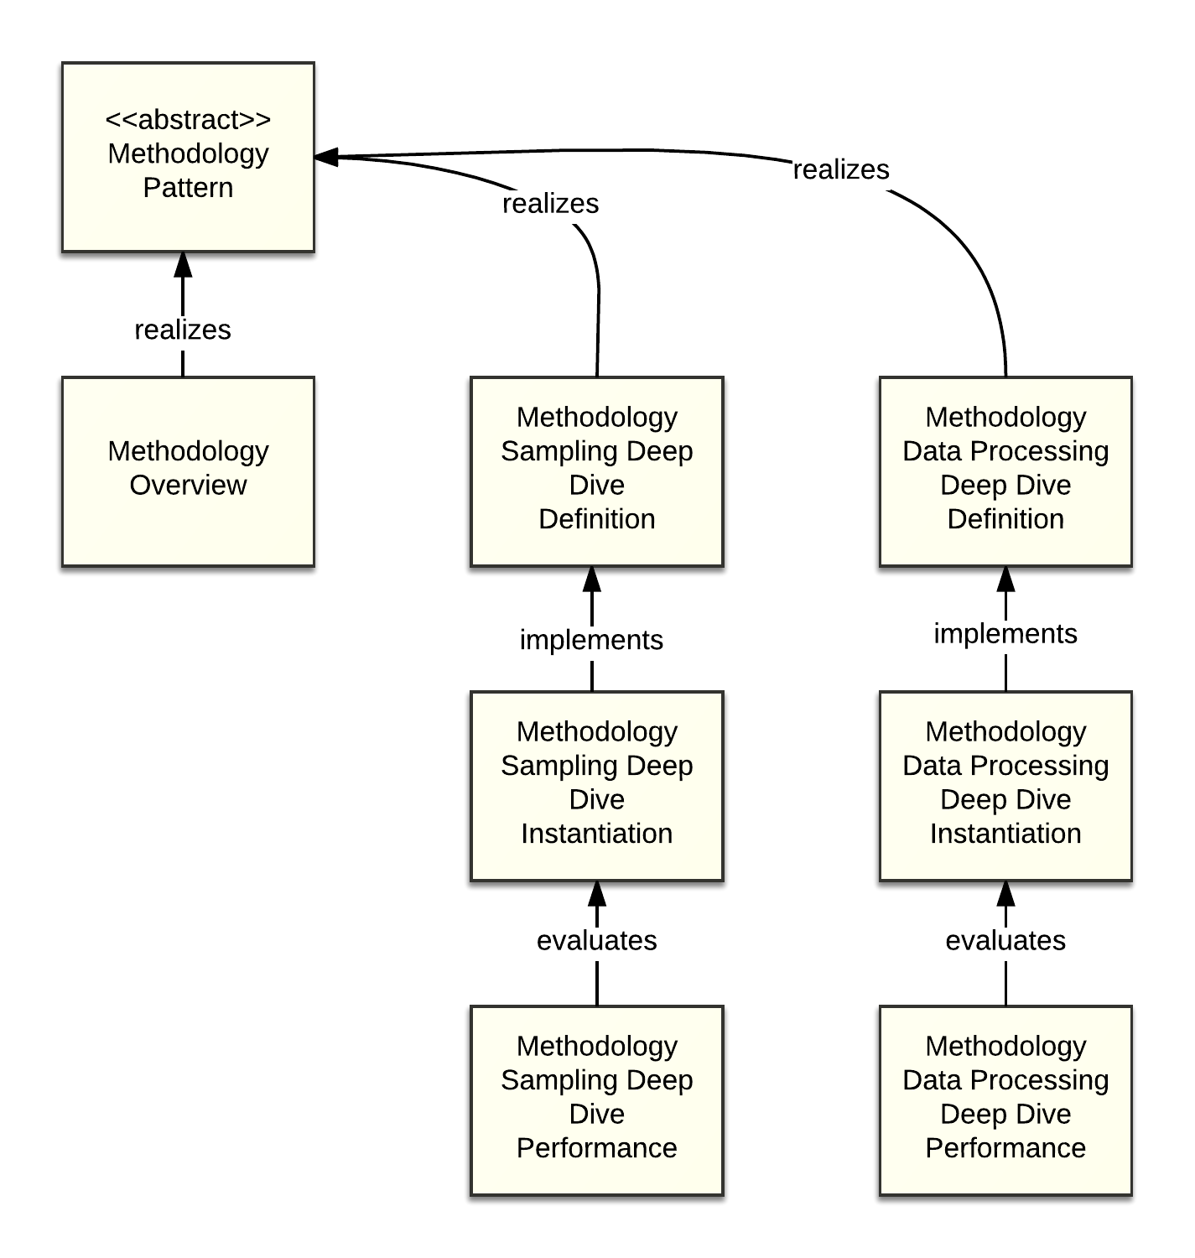
Research Paper Methodology Section (1)
The methodology section provides enough information for other researchers to replicate the research
It is preceded by an abstract (Methodology Overview)
The section need not describe all the component methodologies – just the out of the ordinary ones with the overview sufficing for “ordinary” components in this context
A “complete” methodology section might have deep dives for each of the sections of the GLBPM.
See DDI on Rails GLBPM for a pretty picture of the GLBPM

Slide 16
Research Paper Methodology Section (2)
This design pattern is human readable, not machine readable
It describes methods using algorithms
It may convey process at a very high level using flow diagrams, not sequence diagrams
As such, it doesn’t describe the actual event(s) in which a methodology is executed because this would entail a description of interfaces, messages and bindings between process steps
This design pattern does discuss what went right and wrong during execution
Because it doesn’t describe execution, this design pattern is arguably platform independent

