Slide 1
DDI Views
The User’s Perspective

Slide 2
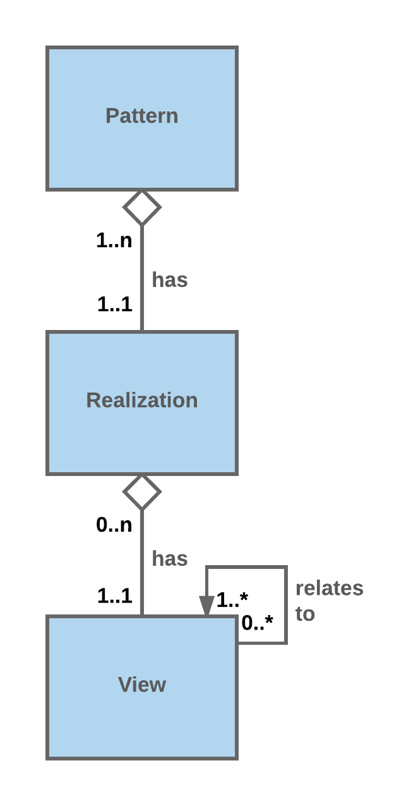
Introduction: DDI Views and the DDI User
DDI 3 is like a very large house where the user occupies and decorates only certain rooms
The user may know several “traversals” of the house but may care less about the house as a whole.
The house as a whole is “overhead” that remains for the user to negotiate as she occupies, decorates and find her way between a useful subset of the rooms
From a user’s point of view DDI Views is just the rooms and the pathways between them. The house as a whole falls away
DDI Views achieves this through a model that consists of patterns, pattern realizations, views and view relationships

Slide 3
The Model: Patterns
The DDI user never sees a pattern
A pattern is set of classes and relationships with very little “decoration” in the way of attributes
A pattern never shows up in XML or other bindings that DDI Views will support in the future (RDF, JSON)
To show up, a pattern needs a “realization” at a minimum
Note that a pattern may have more than one realization
Although invisible, patterns form the guiding principles of DDI Views – the so-called “invisible hand”
Each pattern forms a minimum model for a data description domain
Currently DDI Views includes four patterns: Collections, Signification, Methodology and Process
The reader will find descriptions of each pattern together with its realization(s) in the appendix

Slide 4
The Model: Realizations (1)
When it comes to realizations, we begin to encounter certain rules within the model that, in then end, enable the overhead to fall away, leaving a user with a minimum set of elements and their relationships in the XML now and in RDF and perhaps JSON later
The First Rule of Realization: You do not have to realize the whole pattern
Case A: Starting at the root, you can realize a single subtype of a class. For example, with the Collections pattern we might just realize a specific path that gives us the ability to order observations using Allen’s interval algebra
Case B: You can start a pattern in the middle. For example with the Methodology Pattern, we might realize just the Design or, alternatively, just Design and Algorithm, leaving out the Process

Slide 5
The Model: Realizations (2)
Case C: You can realize certain classes of the pattern giving them their own names. These classes in turn can continue to point back to unrealized classes in the original pattern in effect creating placeholders in the XML that go unfulfilled until a decision is made to realize additional classes
Comments on the First Rule of Realization:
Let’s say that a pattern is a minimally viable set of classes and their relationships needed in a description of a specific moment in the data lifecycle
Seemingly, slicing and dicing breaks a minimally viable set.
However, this is not the case if we use the mechanism described in Case C to create placeholders for classes and relationships we won’t use in a realization for now
Alternatively, we can simply leave these classes and relationships out all the while implying Case C
The implication preserves a minimally viable set

Slide 6
The Model: Views

Slide 7
The Model: View Relationships

Slide 8
Appendix

Slide 9
Methodology Pattern and its Realization(s)

Slide 10
Process Pattern and its Realizations

Slide 11
Collection Pattern and its Realizations

Slide 12
Signifier Pattern and its Realizations

