Slide 1
Data for the Planet: designing an ISC CODATA Decadal Programme on interoperability for global cross-domain research
Simon Hodson
Executive Director
CODATA
www.codata.org
DDI-CODATA Workshop on Interoperability of
Metadata Standards in Cross-Domain Science,
Health, and Social Science Applications II
Schloss Dagstuhl
7 October 2019

Slide 2
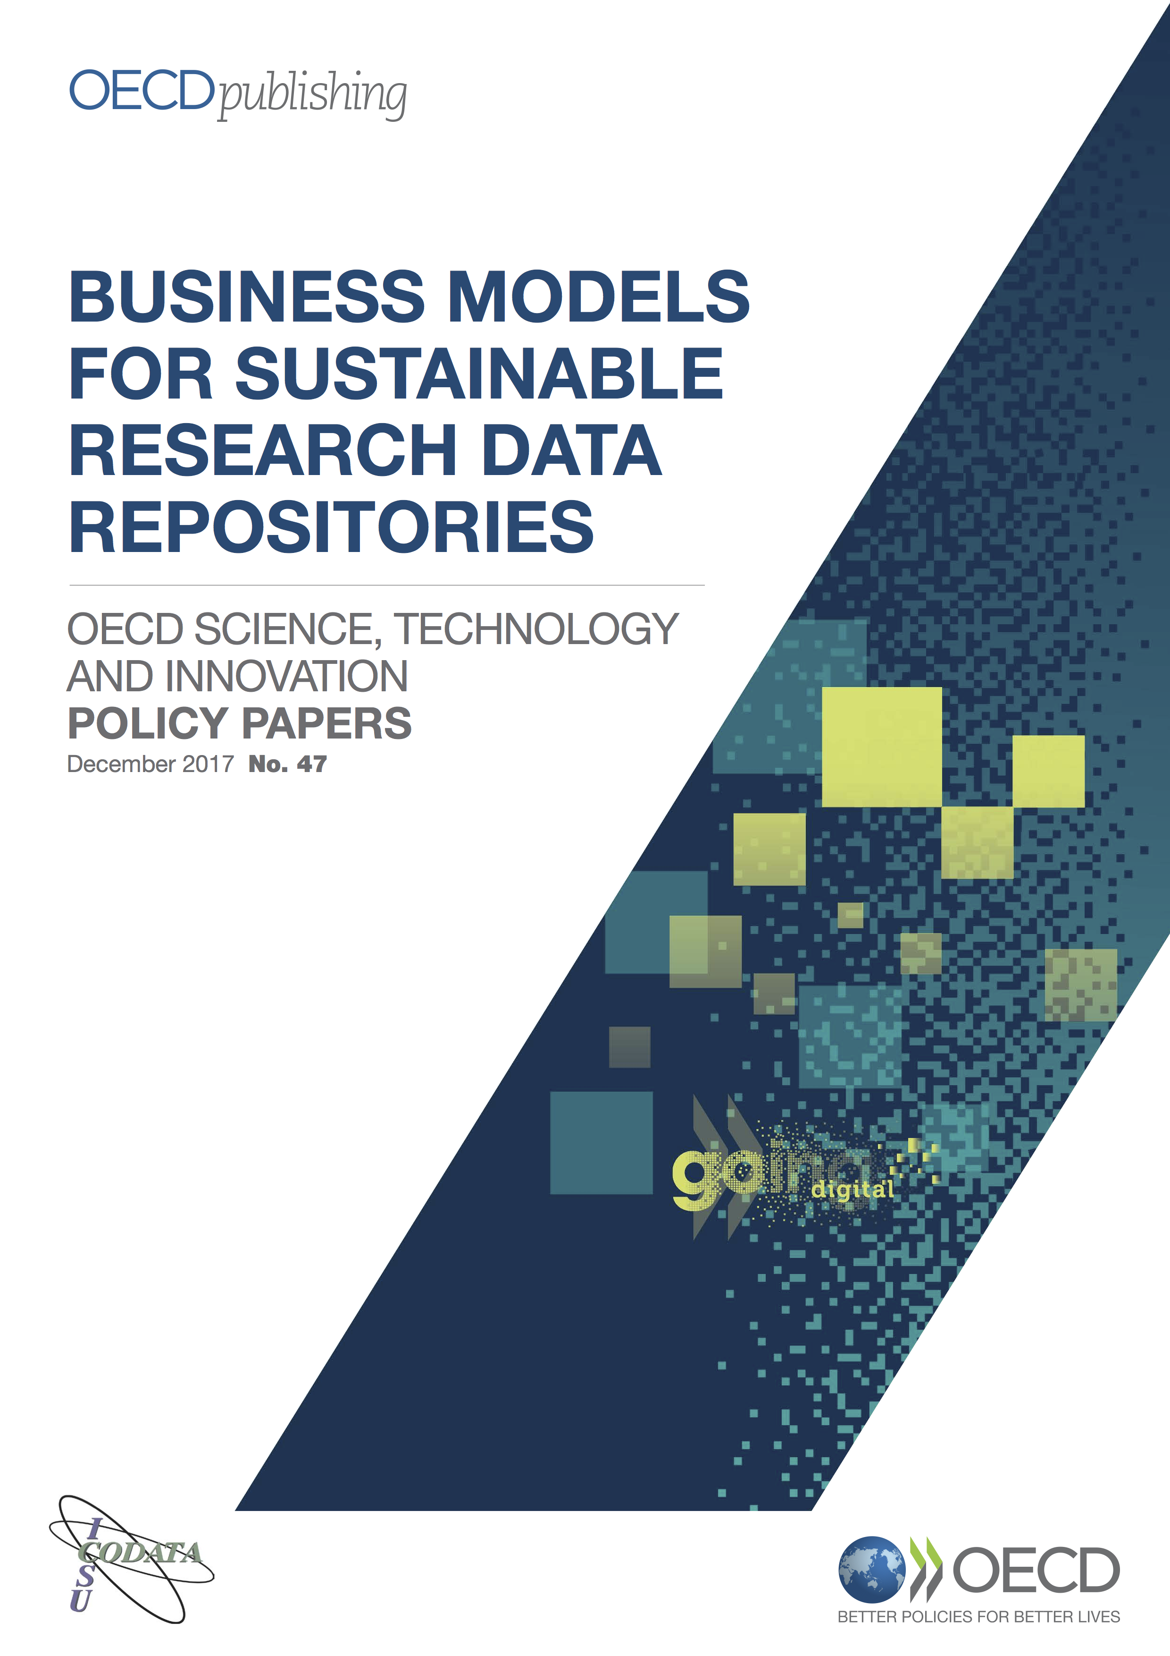
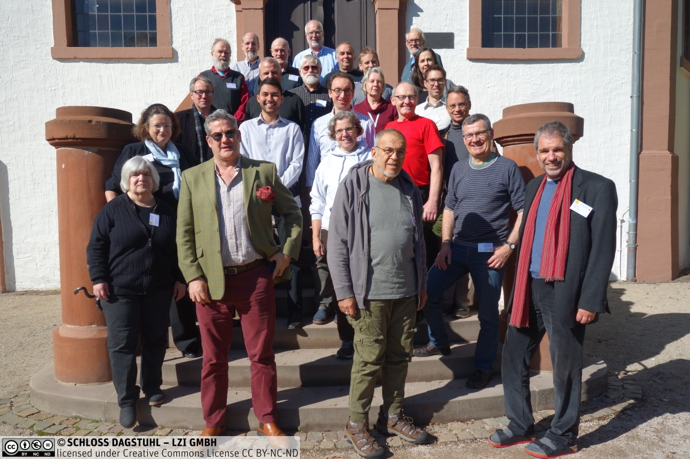
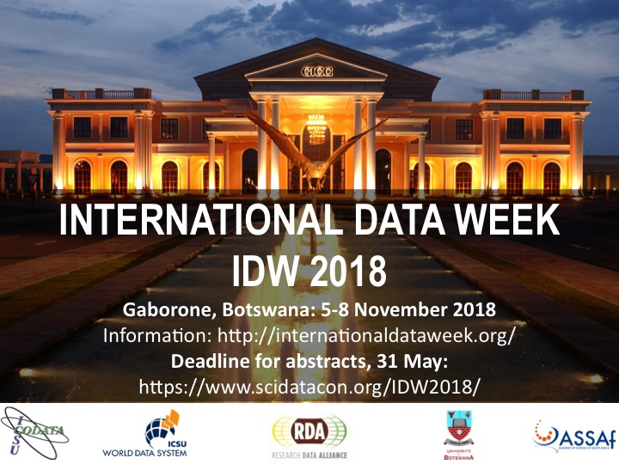
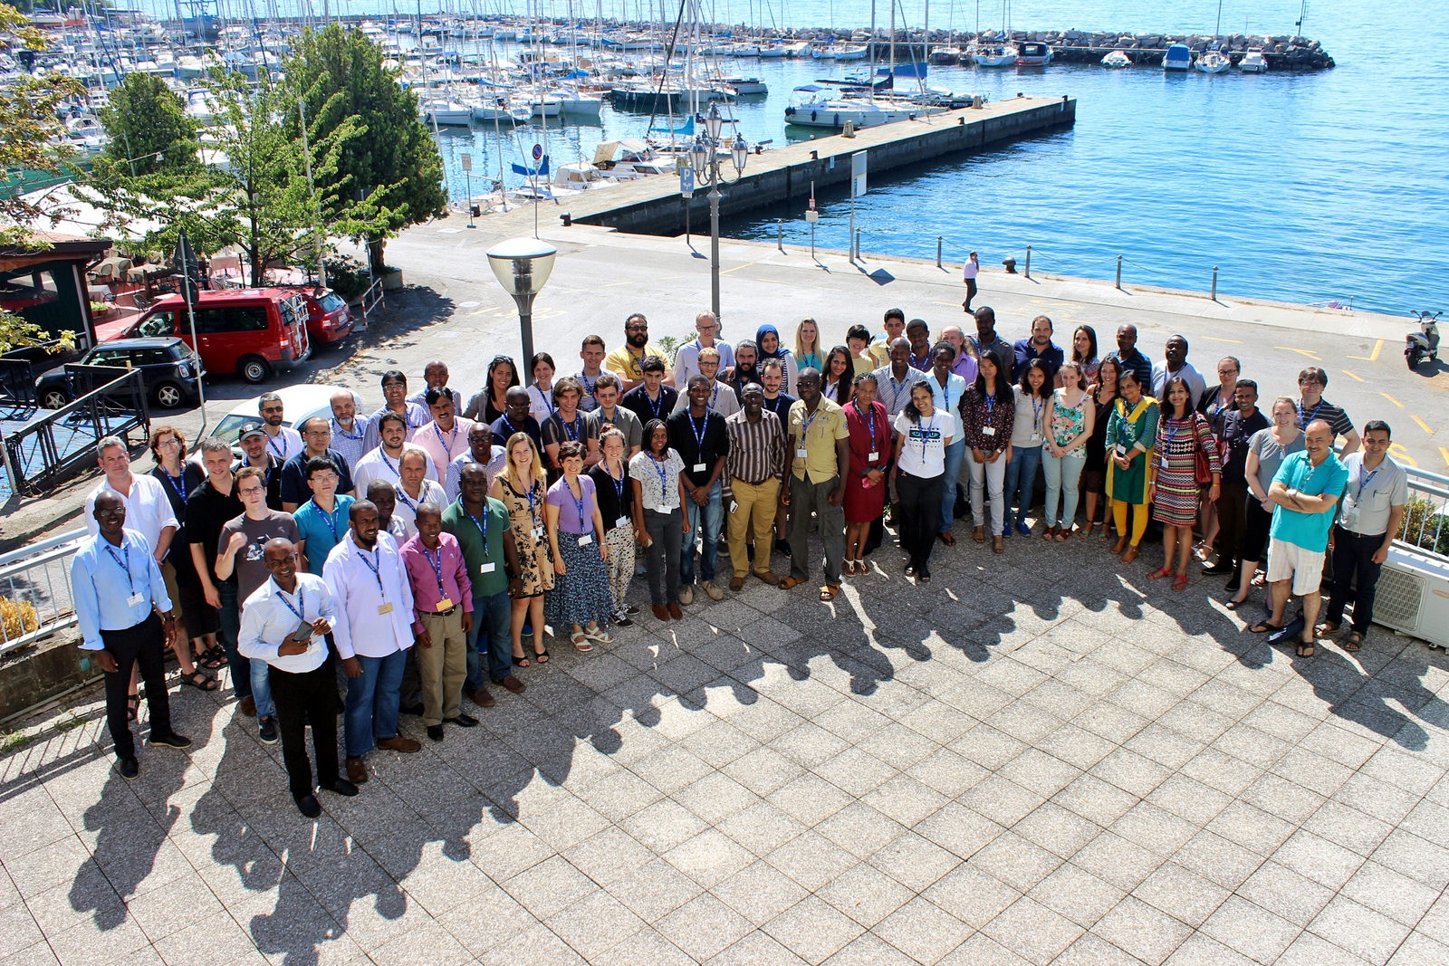
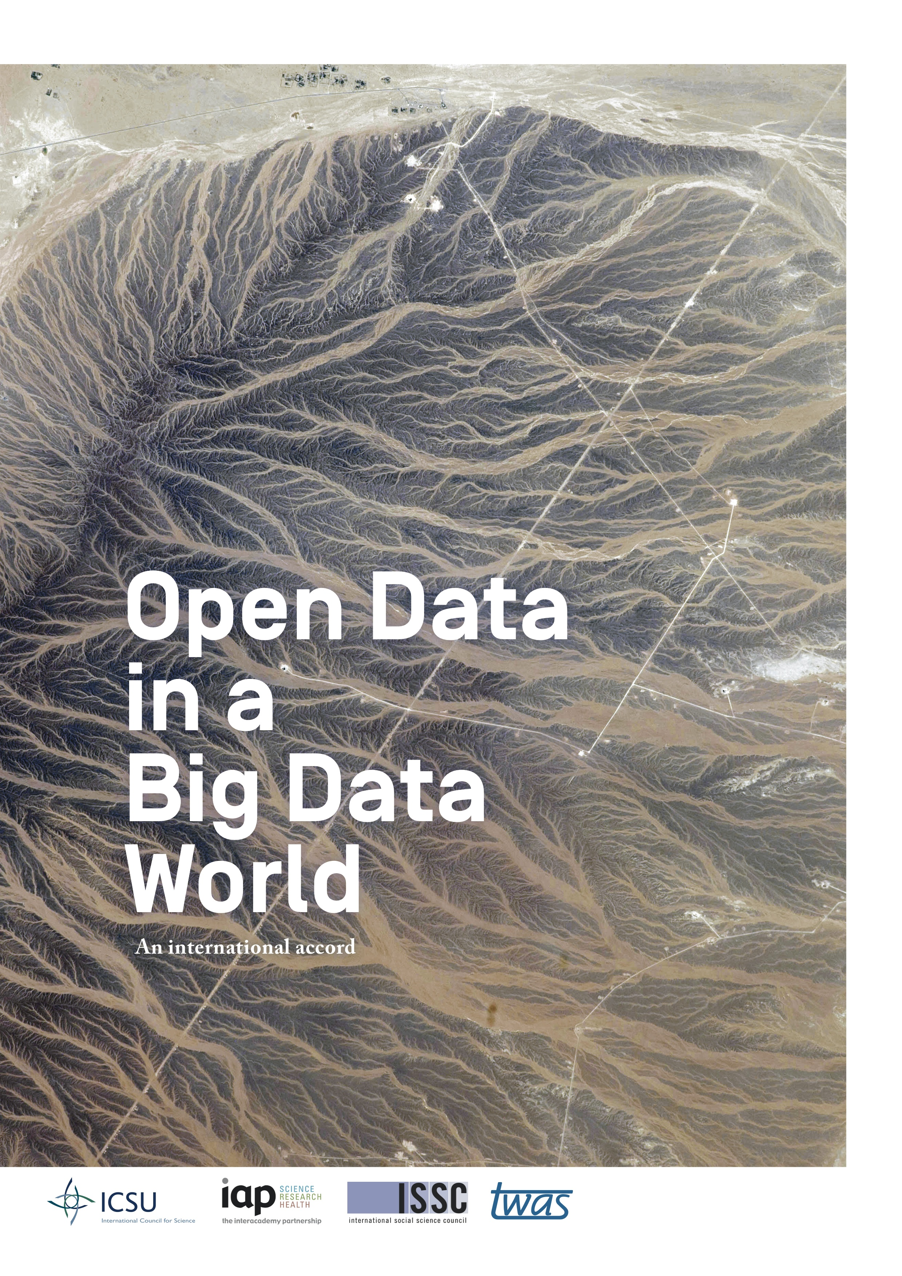
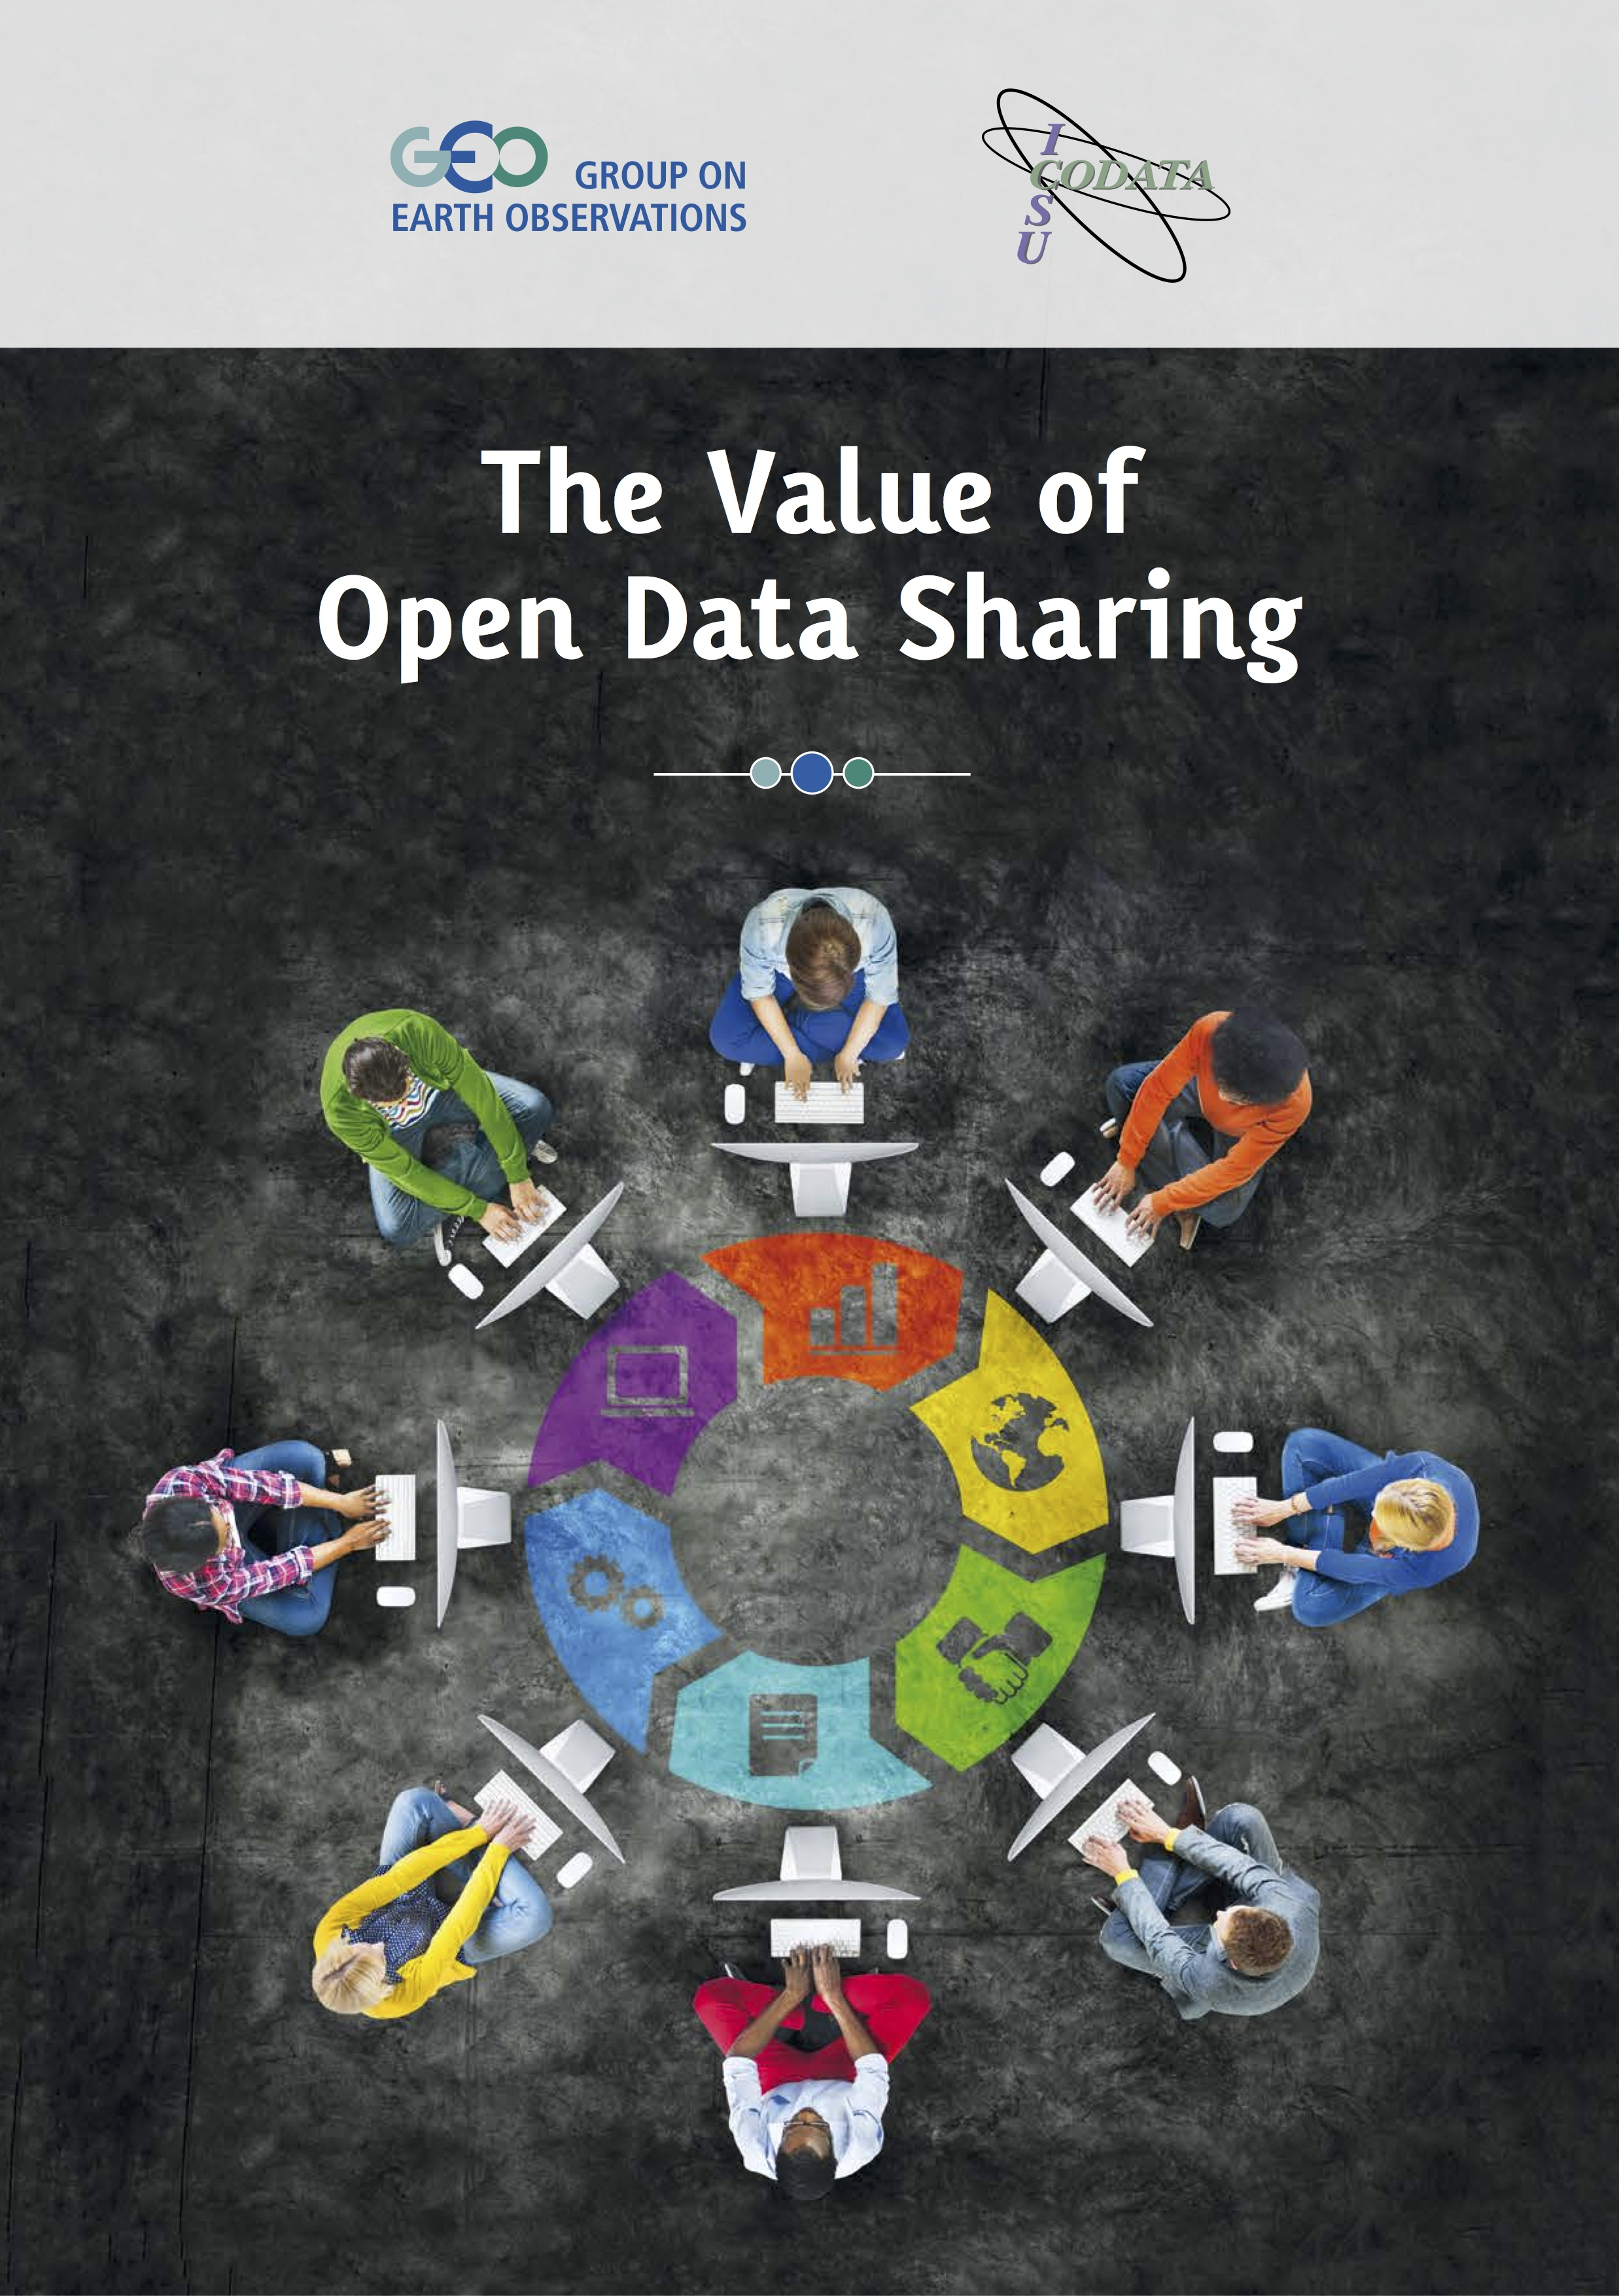
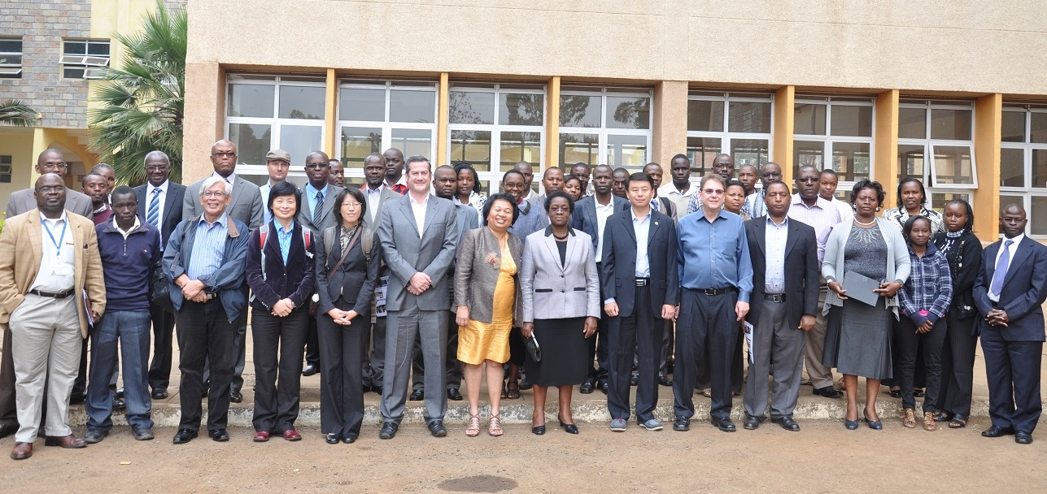
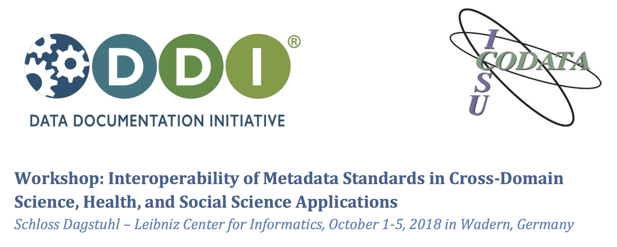
Data Policies
Data Science
Data Skills
Data Good Practices
CODATA Data Policy Committee http://bit.ly/data-policy-committee;
One major policy report per year.
20-Year Review of GBIF currently underway.
New Centre of Excellence in Data for Society being set up at University of Arizona.
CODATA-RDA School of Research Data Science.
CODATA China, PASTD and other training activities.
#terms4FAIRskills and FAIRsFAIR Competence Centres.
Data Science Journal: https://datascience.codata.org/
International Data Week and CODATA Conference series.
Task Groups and Working Groups.
Regional Open Science Platforms
Data Interoperability for Multi-Disciplinary Research.
Survey and recommendation of good practices.

Slide 3
Formed by a merger of the International Council for Science and the International Social Science Council.
Explicit mission for ALL the sciences and for interdisciplinary and transdisciplinary research.

Slide 4
Global Grand Challenges:
Tackling Complexity: Data-Driven Interdisciplinarity
The major, pressing global scientific and human issues of the 21st century can ONLY be addressed through research that works across disciplines to understand complex systems, and which uses a transdisciplinary approach to turn data into knowledge and then into action.
Require the ability to gather data from multiple varies sources and extract information from those complex and heterogeneous data.
The digital and data revolution presents us with huge opportunities and significant challenges.
Better exploitation of data resources for research is the epochal challenge of the 21st century.
With the merger of ICSU and ISSC to form the International Science Council, addressing the data revolution and global challenges is a priority.

Slide 5
CODATA and ISC Data Integration Pilot
The initiative addresses data interoperability for pressing, 21st century global challenges, initially through three closely-allied interdisciplinary research areas:
Infectious Diseases (IDDO)
Disaster Risk Reduction (CODATA TG, PHE, IRDR)
Resilient Cities (Resilience Brokers)
With global collaboration within and across domains and disciplines, the overall activities are designed to:
have practical outputs of value to policymakers and users;
to develop technical approaches and methods that have generic value; and
to be persuasive demonstrators to the broader scientific community of the value of the approach.
Support from CAST and ISC
WIDER STAKEHOLDERS
Domestic and International Policymakers / Users
PROJECT DOMAINS
STAGES
Stage 3) High-level
integration
Stage 2) Full project
Stage 1) Pilot project
TIME
Infectious Disease
(A)
Disaster
Risk R.
(B)
Resilient Cities
(C)
DOMAIN SCIENTISTS
DATA PROVIDERS
DATA SCIENTISTS
COLLABORATORS
Data science groups
Data services
Other programmes
FUNDERS SPONSORS

Slide 6
CODATA Data Interoperability Pilot: Methodology and Approach
Intelligence Support for Data Science and Data Integration
Provides generic support for an expanding series of pilots.
Problem Definition:
Interdisciplinary or transdisciplinary research on topics where there is a need for data integration.
Domains include:
Infectious Diseases
Disaster Risk Reduction (DRR)
Resilient Cities
Data Integration Intelligence Methodology:
Phase 1:
Understanding the pilot
Phase 2:
Understanding the data
Phase 3:
Identifying opportunities for data integration
Phase 4:
Identifying recommendations and requirements
Data integration recommendations
Phase 5: Implementation of Data Integration Intelligence
Interoperability and data integration solutions
Pilot A:
Infectious
Diseases
Pilot B:
Disaster
Risk
Reduction
(DRR)
Pilot C:
Resilient Cities
Pilots D,E ...
TBD
Phase 6:
Enhanced
Research
Innovative research outcomes and recommendations
Phase 7:
Distilling Generic Lessons for Data Integration and Enhanced Research
Recommendations for interdisciplinary research; recommendations for societal actors.

Slide 7
Interoperability of Metadata Standards in Cross-Domain Science
Pilot Case Studies Prepared Data Audits
What is the overarching question or challenge that is being addressed?
What are the data sets which, ideally, need to be accessed, assembled in order to address these questions?
Who ‘owns’ the data? What is the licensing and use regime?
Where are the data stored? What are the access requirements?
What is the data format?
What is the metadata format used? What provenance information is provided? Can fitness for use be assessed?
How are the variables defined? What semantics, controlled vocabularies or ontologies are used to define these qualities, values?
Is code associated with processing/analyzing the data available?
Dagstuhl Workshop in partnership with DDI
Detailed examination of the requirements and the challenges of the pilot case studies.
Recommendations on how to address issues of interoperability and integration: what standards can and should be used; how implementing those standards may assist the pilots; what work is necessary on the standards to assist interoperability in these use cases.
Documents and reflections contributed to the ongoing process.
Proposal prepared for the ISC Science Action Plan.

Slide 8
Tackling Complexity: Data-Driven Interdisciplinarity
Project 2.1 of ISC Science Action Plan
Decadal Initiative to Advance the Science and Practice of Data Documentation and Semantics. Mobilisation of expertise in the science of data, terminologies and metadata specifications, including engagement with organisations that curate specifications and standards.
Good data practices: perhaps building on ‘matrix’ work by GO FAIR, identifying, documenting and recommending good practices, ‘core resources’ and data specifications.
Programmatic Data ‘Integration’. Enabling machine assisted, programmatic discovery, integration and analysis of relevant data is a priority. Ensuring data is Fully AI Ready (FAIR…)
Interdisciplinary Case Studies.
Increase the number of case studies
Apply and refine methodology: apply FAIR principles, align data specifications, machine learning and data science to assist interoperability, distributed data integration and the extraction of meaning from interdisciplinary data.
Projects with International Scientific Unions and Associations and other community domain bodies.
Promoting good data practices and specifications and projects to implement them.
Discussions with IUPAC, IUCr, IUBS, IUGG, IUGS (Deep Time Digital Earth initiative), ISSSP.

Slide 9
Data-Driven Interdisciplinarity
Proposal to ISC Science Action Plan
Approved as part of the ISC Science Action Plan: http://bit.ly/ISC-Science-Action-Plan
100K euros dedicated by ISC to prepare the initiative: design, plan, raise funds, build partnerships.
Exploring opportunities for additional funds…
Aim to launch at ISC GA in Oman, October 2021 (TWO YEARS!)
This Dagstuhl Workshop should contribute to the design of the programme and the further development of an approach and methodology.

Slide 10
Data-Driven Interdisciplinarity
Designing the Programme
Partnerships:
Building partnerships with: international data and science organisations; cross-domain initiatives; research groups and centres; domain organisations etc.
Delivery Mechanisms
Fund raising;
Distributed programme offices;
CODATA (and other partners) Centres of Excellence;
Joint projects with partners;
Contribution of effort (in kind) from partners.

Slide 11
What next?
Outputs and recommendations from this workshop.
An expanding set of case studies keen to be part of the programme.
An expanding community of interest of metadata and semantic experts keen to be part of the programme.
Suggestions, advice and partners for the programme.

Slide 12
Follow CODATA!
CODATA Website: http://www.codata.org/
CODATA Blog: http://codata.org/blog/
CODATA International News and Discussion List: http://bit.ly/CODATA-International-List
CODATA Data Science and Data Stewardship Careers List: http://bit.ly/CODATA_Careers_List
CODATA on Twitter: @CODATANews and @simonhodson99

Slide 13
Thank you for your attention Simon Hodson, CODATA www.codata.org simon@codata.org @simonhodson99 ; @CODATAnews

Slide 14
Slide Credit: Fernando Gouveia Reis and Laura Merson, IDDO
Infectious Diseases Data Observatory, Oxford.
IDDO collects and integrates clinical, laboratory and epidemiological data relating to a number of infectious diseases.
Analysis of combined datasets increases the power to determine optimal treatments, identify the most effective intervention in outbreaks.

Slide 15
Slide Credit: Laura Merson, IDDO
West African Ebola Outbreak, 2014-2016.

Slide 16
Slide Credit: Laura Merson, IDDO
West African Ebola Outbreak, 2014-2016.
Pisani et al. 2018 Estimate 65% of study data not available, not shared.

Slide 17
Data aggregation is essential for research and action.
Barriers to data aggregation impede research and action.
65% of data was not shared, made available (finding in E. Pisani et al. Data sharing in public health emergencies. Wellcome Trust, 2018.)
Most data cannot be accessed directly at the record level (e.g. summarised in studies and not shared).
Most clinical records from the outbreak are pdf scans.
Lack of metadata (data / information about the data which allows the data to be discovered, aggregated, integrated).
Lack of a data dictionary (a set of definitions that allows the variables in the data to be understood).
Technically challenging to integrate and analyse trials data and clinical data; and other relevant data (e.g. genomic data, vector data, transport and environmental data etc).
Slide Credit: Fernando Gouveia Reis and Laura Merson, IDDO

Slide 18
Data that characterise many of the factors influencing the progression of an outbreak are available, but remain isolated in siloes within the various domain- specific communities, often with their own domain-specific formats, vocabularies and ontologies.
Availability of datasets from industry, the research community, national public health surveillance, climate and environmental monitoring systems, health systems administration, social media feeds, and animal health services will then be sought in order to understand how their integration can fill critical knowledge gaps across disciplines. Reports and lessons learned from previous infectious disease outbreaks have identified clinical, genomic, demographic, pathogen and vector surveillance, communications, land-use, health administration, and environmental data as powerful inputs to support planning and operationalising outbreak response. We can anticipate data in numerous formats such as tabular data in spreadsheets, CSV, TSV, and/or plain text, geospatial point-wise data, geographic data, and a variety of XML and JSON dialects. For the domains of interest, available ontologies will be sourced and compared to determine methods for integration and interchange.
Slide Credit: Fernando Gouveia Reis and Laura Merson, IDDO

Slide 19
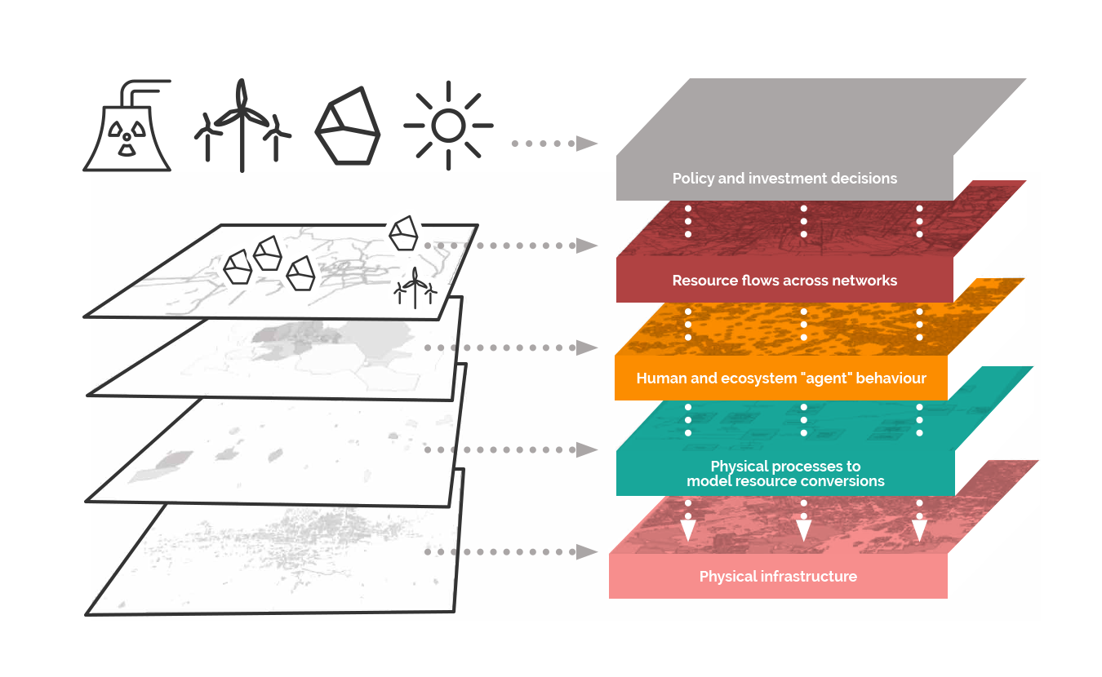
Resilience Brokers – resilience.io
New Science of Cities: test case par excellence of ability to integrate heterogeneous data and to model complex systems.
Resilience.io: An integrated-systems modelling platform that combines a suite of interlinking modules, including:
an agent-based model (ABM) simulates the population of the entire city-region, their choices, consumption patterns and behaviours.
a growing library of input-output process blocks (resource conversions) for process optimisation that describe all of the energy and materials flows of a city-region system. These processes are geo-located to build up an integrated systems network based on the actual functions of a city or other geography.
Case studies with Accra, Ghana (water resources); and, with Medellîn, Colombia (on pollution, health outcomes and economic impact).
Slide Credit: Stephen Passmore and Andrew Simmons, Resilience Brokers

Slide 20
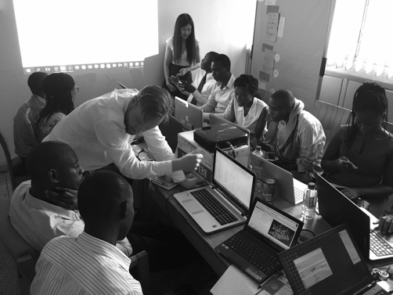
Resilient Cities Findings and Recommendations
Greater Accra Metropolitan Areas water modelling initiative, required major collaborative co-design effort to create the system and to prepare and integrate the datasets.
Allowed modelling of water needs, by district; costing of solutions (desalination plants etc); consideration of impacts and modelling of economic outcomes.
Effective approach and demonstrates the utility of the resilience.io platform.
Challenges of data quality and metadata quality.
Improved data stewardship; application of FAIR principles; improved semantics and metadata would greatly assist.
Demonstrates how data collection, processing and disseminating can be used for municipal decision-making lead to enhanced urban resilience.
Population socio-economics
Water access
Tariffs
Water and sanitation infrastructure in place
Infrastructure investment and operation cost
Water quality data
Water use per person
Water flow data and estimates,
Treatment capacity values
Rainfall data.
Datasets: https://africaopendata.org/dataset/greater-accra-population-socio-economics-and-water-access

Slide 21
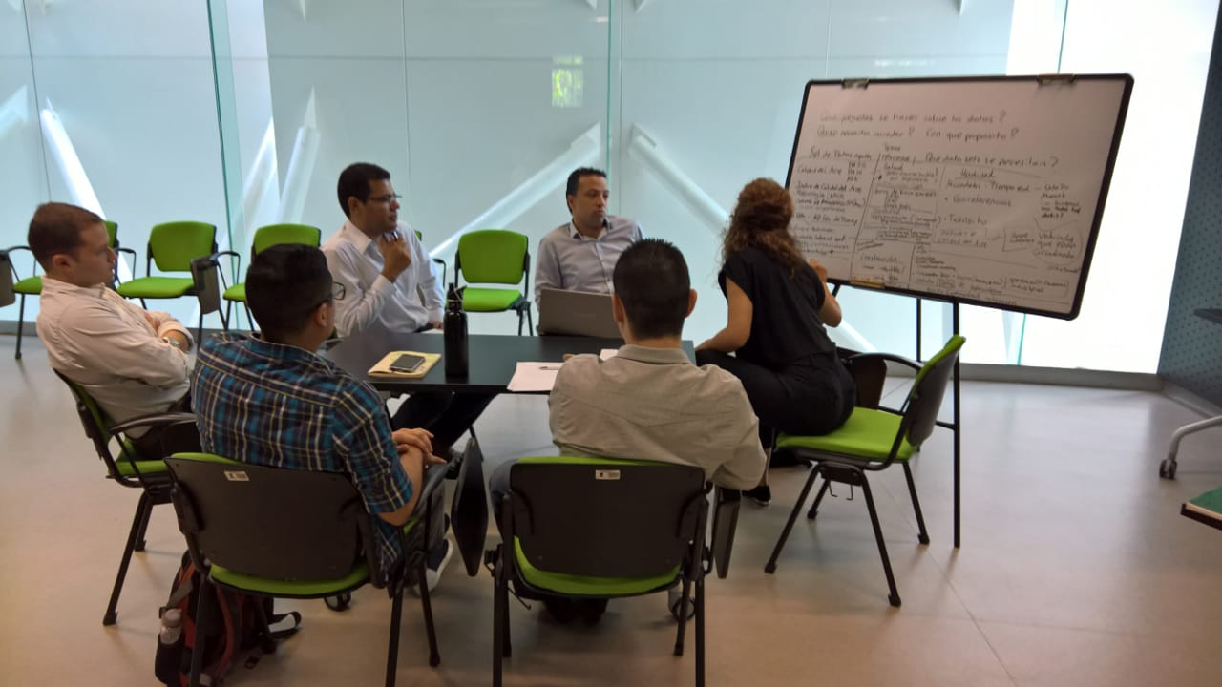
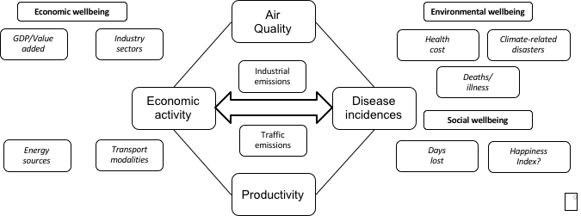
Resilient Cities Findings and Recommendations
Medellín has had a major push to enhance availability of open data: good quality in terms of coverage of sectors, detail and completeness.
Significant interoperability challenges in spatial and temporal parameters measured (e.g. air pollution recorded at daily or hourly intervals vs. hospital visit records that are aggregated annually).
Valuable to enhance standards and definitions for metadata, research approaches and methodologies for the measurement of city- and region-level indicators.
FAIR principles, discovery / collection level metadata and alignment of variable specifications can play a role.
Slide Credit: Stephen Passmore and Andrew Simmons, Resilience Brokers

Slide 22
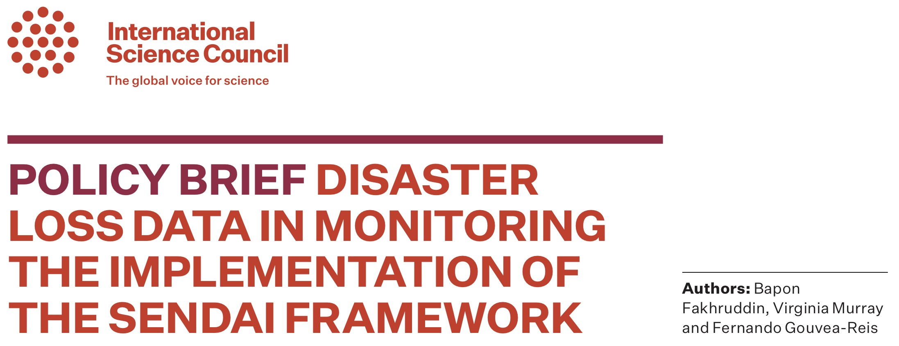
Disaster Risk Reduction
Pilot case study engaged with UNDRR, IRDR, ISC and others on challenges of Sendai reporting.
Focussed on specific challenges with mortality reporting: uncovered major challenges of data quality, inconsistent definitions, demonstrable under estimating of mortality.
Lack of data: not enough data are reported by those already reporting, and the need to support countries who have yet to start reporting;
Concerns on data quality: within individual country reports, there is a concern that the data reported appears to underestimate the impacts caused by different hazards.
Lack of agreement of hazards to be identified and their related definitions.
Recommendations
The absence of standardised hazards definitions is a critical issue that affects the identification, assessment, and analysis of hazards. A UNDRR-ISC technical working group on the review of Sendai Hazard Terminology and Classification has been established and will report in November 2019.
Recommendations on the contribution of data science to the Sendai process. Adoption of FAIR principles, in particular metadata for discovery and community specifications to ensure commensurability of data.
Develop standard protocols for exchanging data and metadata, and standard services for querying, retrieving, and performing other common functions.
Slide Credit: Virginia Murray, PHE and CODATA

