Slide 1
FAIR scientific data Alejandra Gonzalez-Beltran
Workshop on Interoperability of Metadata Standards in Cross-Domain Science, Health, and Social Science Applications II
Schloss Dagstuhl – Leibniz Center for Informatics Wadern, Germany, October 7-11, 2019
Notes:
We are happy that you will give a presentation on technologies, standards, or platforms to the workshop.
We have you listed on the agenda speaking on the first day, on the topic of “Biomed/Science”.
3 use cases: cancer data, biomedical data, large science facilities data

Slide 2
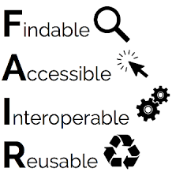
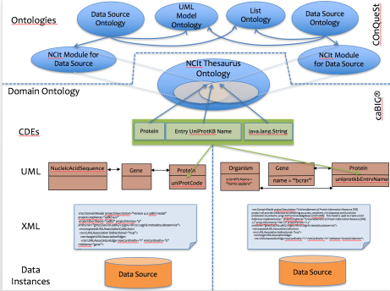
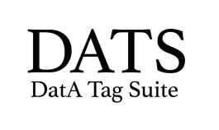
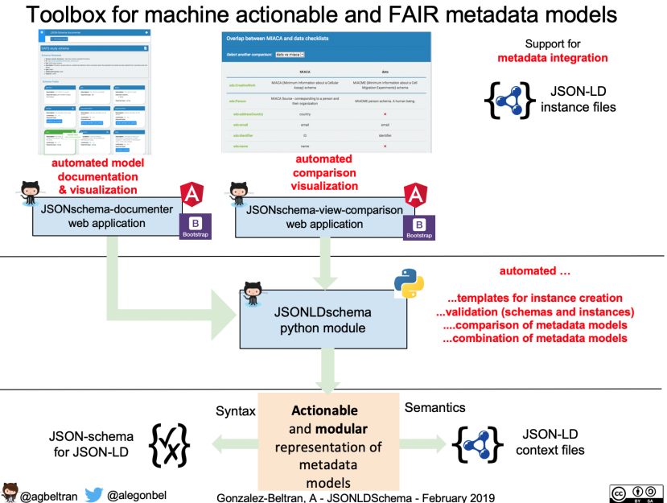
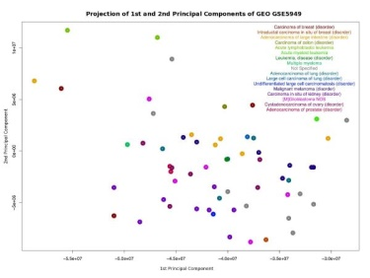
conquest
(cancer ontology
querying system)
FAIR data for the photon
and neutron communities
Next generation data management system for the large data produced at the facilities
Assessment of current infrastructure
In terms of FAIRness but also scalability
Principal component analysis
after integrating data from
GEO and caTissue

Slide 3
Cross-domain Issues
Distributed “big” data (but also “small” data)
All data deserves FAIRness
Need for common vocabularies enabling cross-domain interoperability
Datasets , Software, Analysis Workflows, Standards, Repositories
cataloguing, publication, archival
Funding, People/Organisations, Publications, Licenses
Policies
Openness driving FAIRness, but it could be the other way around
Need for software tools to support making data FAIR (and open)
Cultural changes in the communities; need of training

Slide 4
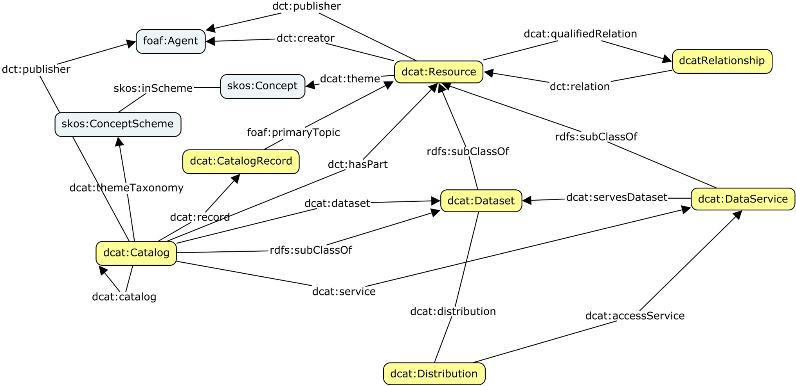
W3 Data Catalog Vocabulary v2 Purpose
A domain agnostic RDF vocabulary for representing catalogs related to data (e.g. datasets, data services
https://www.w3.org/TR/vocab-dcat-2/

Slide 5
Main changes in DCAT 2
Addition of dcat:Resource to support cataloguing other entities in addition to datasets
Addition of dcat:DataService representing a collection of operations that provide access to one or more datasets or data processing functions
More properties for better describing the temporal and spatial characteristics of resources
Better guidance on identifiers and licensing/rights considerations
Some domain/range constraints for properties were relaxed to allow for more flexible descriptions

Slide 6
DCAT Status
New charter for the group to maintain and revise the Data Catalog Vocabulary taking into account feature requests from the user community - W3C ever green standards
Many requirements still to be addressed:
Versioning
Dataset series
Profiles: research data, citation
https://www.w3.org/wiki/Evergreen_Standards
Notes:
https://www.w3.org/wiki/Evergreen_Standards

