Slide 1
Programme Launch October 2021
ISC General Assembly, Muscat, Oman
Aim is to launch the programme at the ISC GA and associated events ‘Global Knowledge Forum’ in Oman, 10-14 October 2021.

Slide 2
Decadal Programme
Data for the Planet: making data work for cross domain challenges
1: Making Data Work
Programme of technical and consensus building activities for interoperability
2: Advancing Interoperability through Cross Domain Case Studies
3: Mobilising Domains and Breaking Down Silos

Slide 3
1: Making Data Work
What?
Develop consensus and work to facilitate the implementation of enabling technologies and convergence towards common good practice such that data interoperates across disciplines.
Engagement with related initiatives such as DDI 4 Core, GO FAIR Data Object model and Matrix.
Continuation of work on terminologies, core concepts, alignment of metadata specifications.
…
How?
Consensus building workshops
Intensive Dagstuhl and Dagstuhl-style workshops
Projects, working groups etc.
Collaboration with GO FAIR INs, RDA WGs and IGs, etc.
…

Slide 4
2: Advancing Interoperability Through Cross-Domain Case Studies
What?
advancing interoperability through cross-domain case studies: the programme will work with a number of cross domain case studies (including, but not limited to the Sustainable Development Goals, disaster risk reduction and reporting, urban health and resilience and infectious diseases)
testing generic solutions with cross-domain initiatives
identification of challenges and development of reapplicable solutions for cross-domain projects
…
How?
Joint projects and WGs with cross domain case studies
Urban Health in LAC (urban health programme, SALURBAL, Resilience Brokers)
Alpha++
Collaboration with CASEarth on SDG 11, integration of EO and other data
Projects on SDG and DRR data
Other cross-domain areas?
…

Slide 5
3: Mobilising Domains and Breaking Down Silos
What?
engage with international scientific unions and associations in programmes of work designed to promote progress across the disciplines of science that will enable interdisciplinary data interoperability.
collaboration with international scientific unions and their initiatives
activities to encourage domain specifications to think about cross-domain reuse
…
How?
Joint activities with IUSSP, IUTAM, IUPAC, IUCr, IUGG, IUBS and others
Joint project or WG with Deep Time Digital Earth (IUGS)
‘Ambassadors’ programme suggested by IUPAC
…

Slide 6
Resourcing and Delivering
European Commission: discussions underway for resourcing related to EOSC.
NIST, Bob Hanisch, possibly in collaboration with RDA.
Other options with support of ISC and ISC funders (to be discussed).
Other options for supporting activities…?
Proposal to Montréal International for support for coordinating programme office (meetings to be arranged for March 2020, proposal by June 2020).
Setting up CODATA programme offices (Kenya and China, possibly others).
Call for EOI to host programme offices, release in June 2020.
Invitation for contributions of effort in kind to particular activities (from interested institutions, research projects, Research Infrastructures etc) – ongoing, for particular activities.
Through CODATA, the Decadal Programme could be a party to funding proposals concerned with interoperability. Funded projects could contribute to the programme.
Related project invited to coordinate with the programme.

Slide 7
Making Data Work: POs, community of expertise
WG on Terminology Resources
Alpha++
Resilient and Healthy Cities in LAC
Dagstuhl or other WG; pilot case study
The Making Data Work POs and community of expertise, engages with WGs, projects, pilot case studies that come out of activities or wish to engage…

Slide 8
Decadal Programme
Data for the Planet: making data work for cross domain challenges
Central or distributed secretariat
Programme Offices / CODATA CoEs
Projects and Working Groups
Regular programme meetings and intensive workshops

Slide 9
What next?
Finalise outputs from this workshop.
Project management and communications support from CODATA
Further meetings around RDA in Australia
Planning for another Dagstuhl Workshop next year
Funding proposals for programmatic aspects and for activities coming out of this workshop.
Possibly, ISC global programmes conference in Sept 2020, Beijing.
CODATA Conference or Workshop in Oct-Dec next year.
…

Slide 10
What’s in a name?
Data Integration Programme
Interoperability for Cross-Domain Areas
Data for the Planet: driving solutions for cross-domain research and policy areas
Data-Driven Interdisciplinarity
Barend doesn’t like ‘integration’; ISC doesn’t like ‘interoperability’…
…

Slide 11
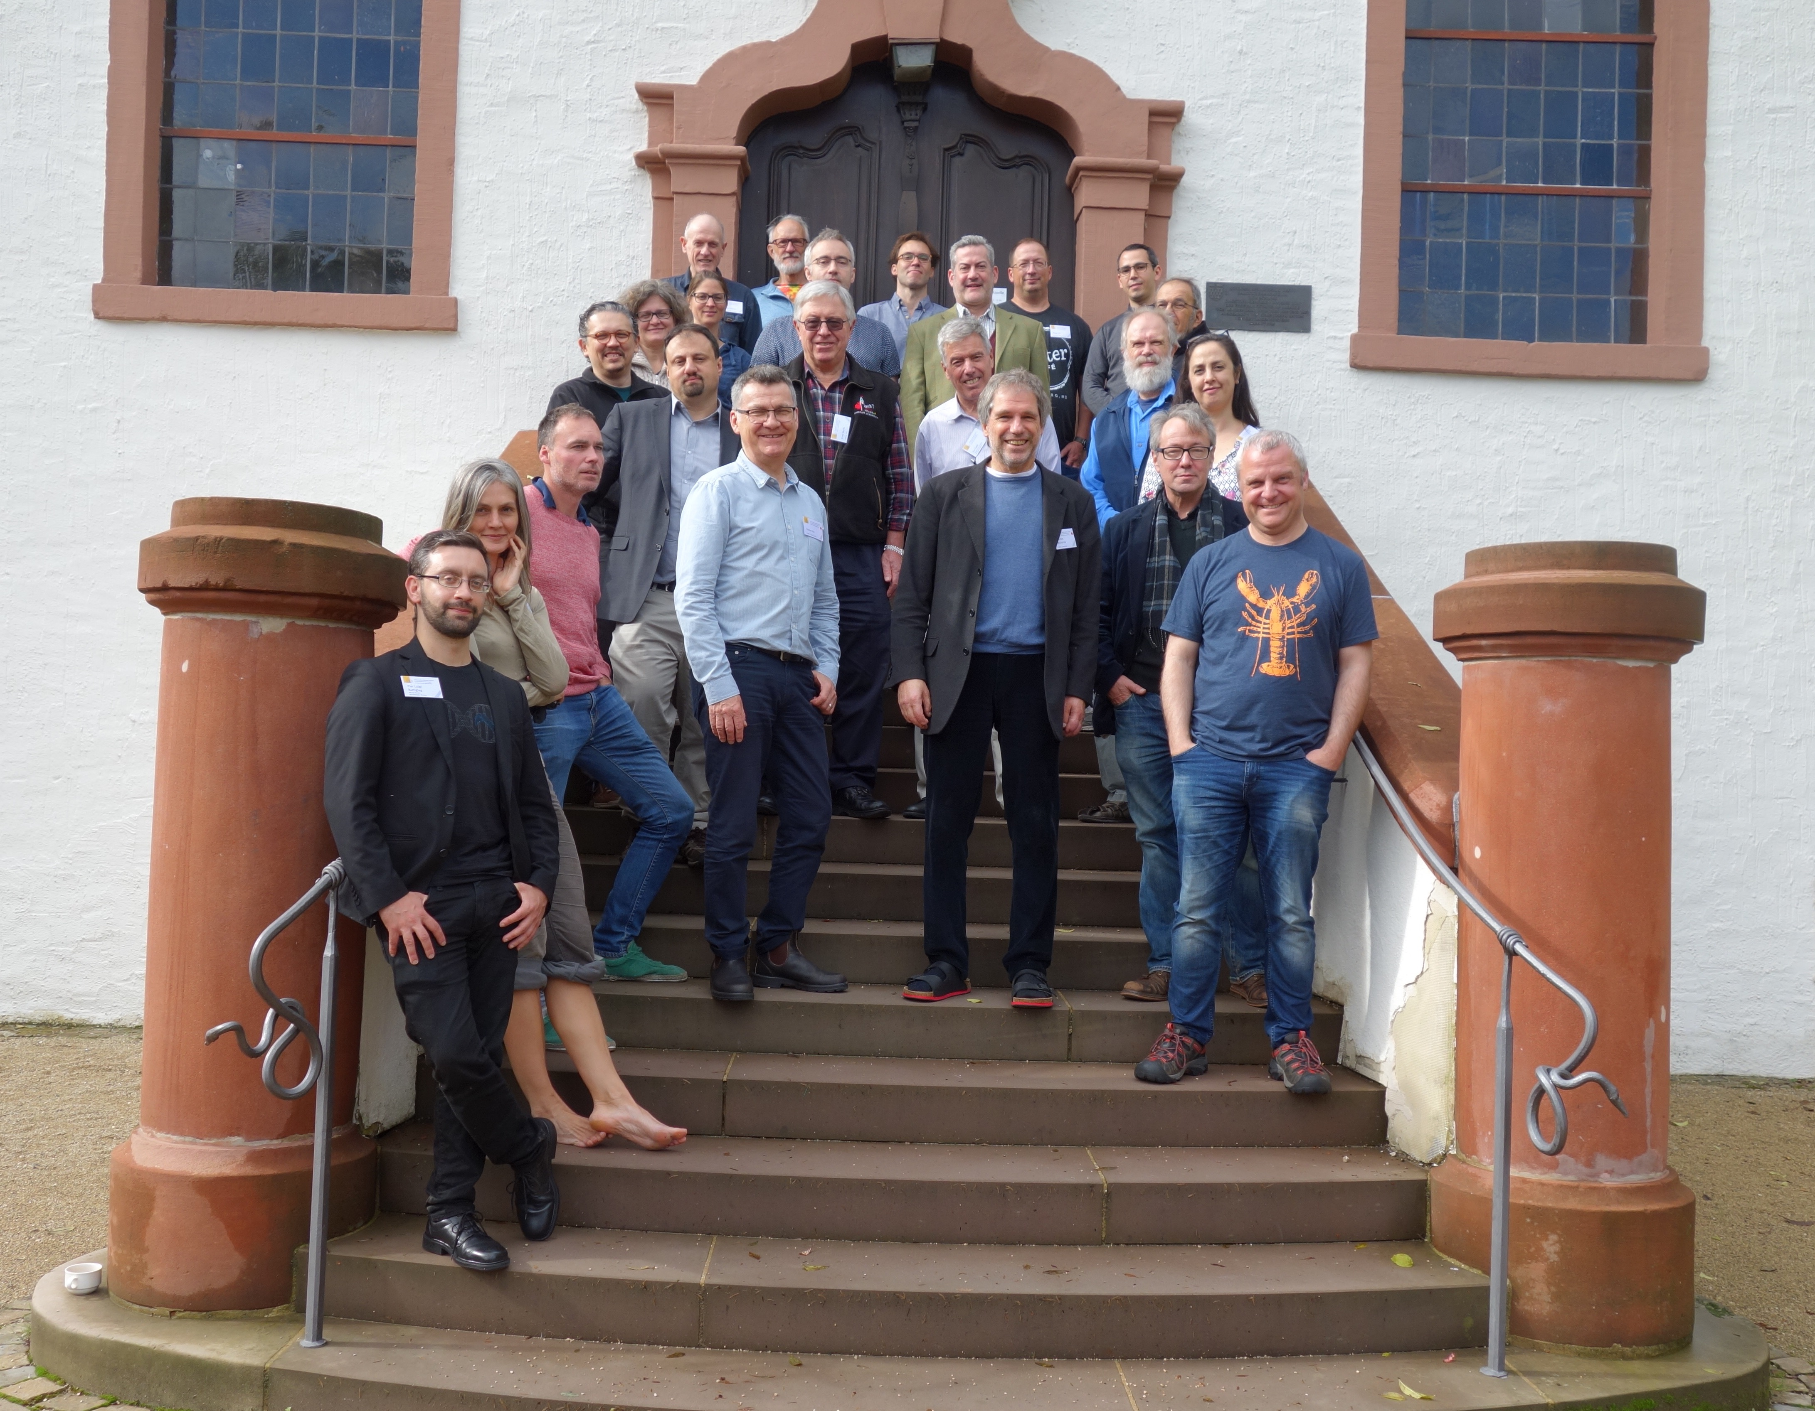
Please be part of this!

