Slide 1
Predicting HIV Status using social and behavioral factors in Eastern and Southern Africa
Case Study 4: Infectious Diseases
FACULTY OF MEDICINE
Institute of Global Health

Slide 2
90-90-90
  WHO and UNAIDS targets by 2020: 90-90-90
  90% of people living with HIV know their status (PLHIV)
  90% of people who know their HIV-positive status are on antiretroviral therapy
  90% of people on antiretroviral therapy are virally suppressed
  First step is to reach the 90% of PLHIV
  According to UNAIDS, as of today, 79% of PLHIV know their status
  Develop new high yield (precision) testing strategy
FACULTY OF MEDICINE
Institute of Global Health

Slide 3
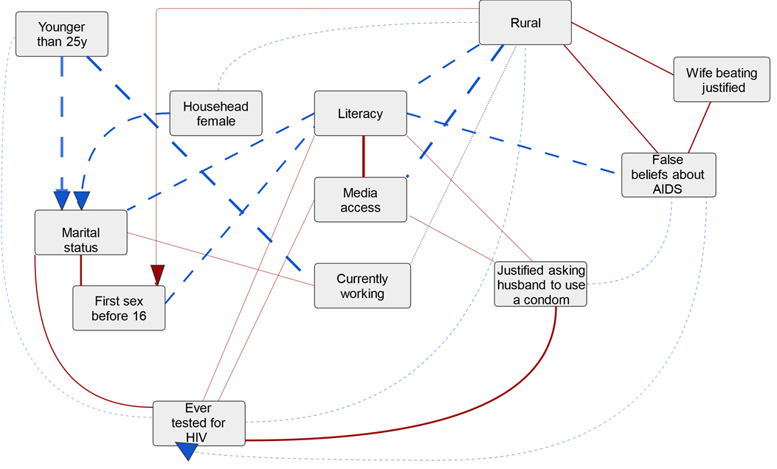
Background of the project
Country-level HIV incidence with similar social and behavioral characteristics
Relevant factors for HIV status at individual level in Malawi
FACULTY OF MEDICINE
Institute of Global Health

Slide 4
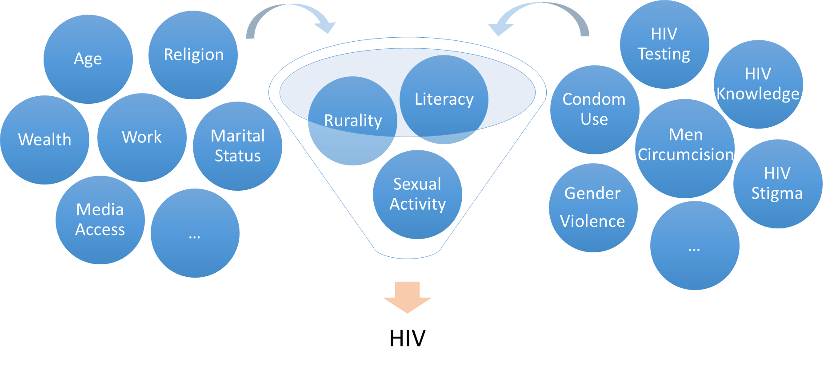
Goal of the project
Individual-level HIV status prediction
Generalized HIV epidemic countries
Use of machine-learning classifier
Define relevant factors
HIV status prediction
Targeting specific interventions
FACULTY OF MEDICINE
Institute of Global Health

Slide 5
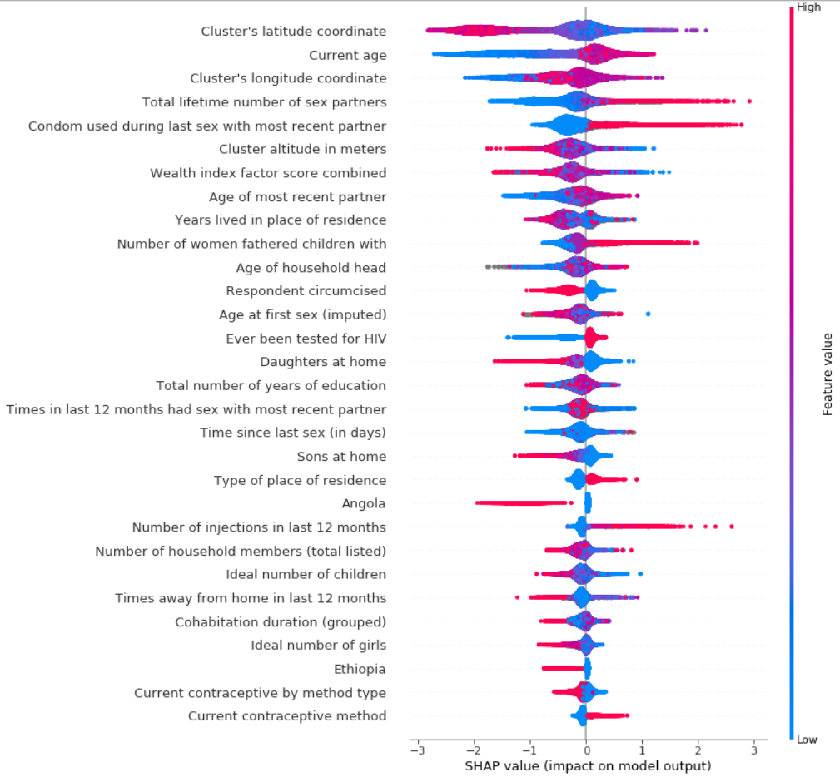
Key results
FACULTY OF MEDICINE
Institute of Global Health

Slide 6

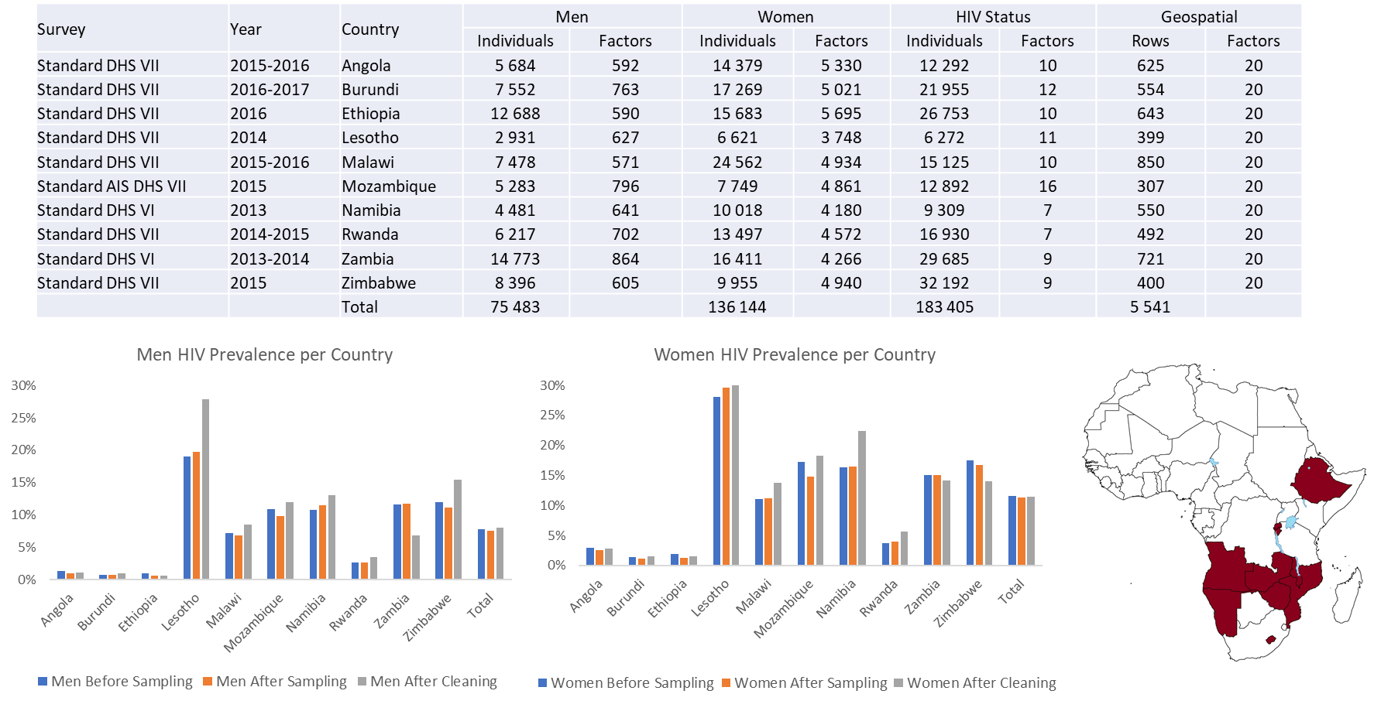
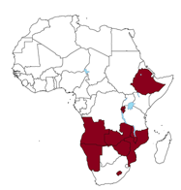
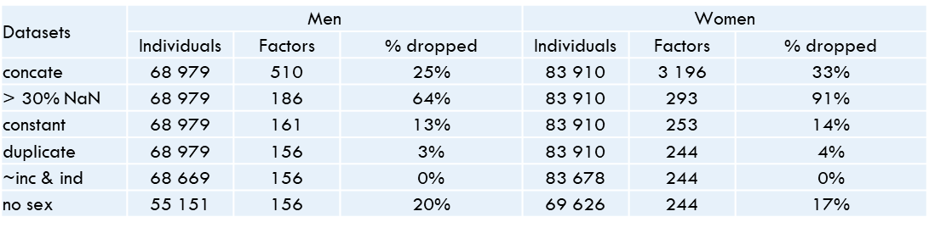
Data from tototo
FACULTY OF MEDICINE
Institute of Global Health

Slide 7
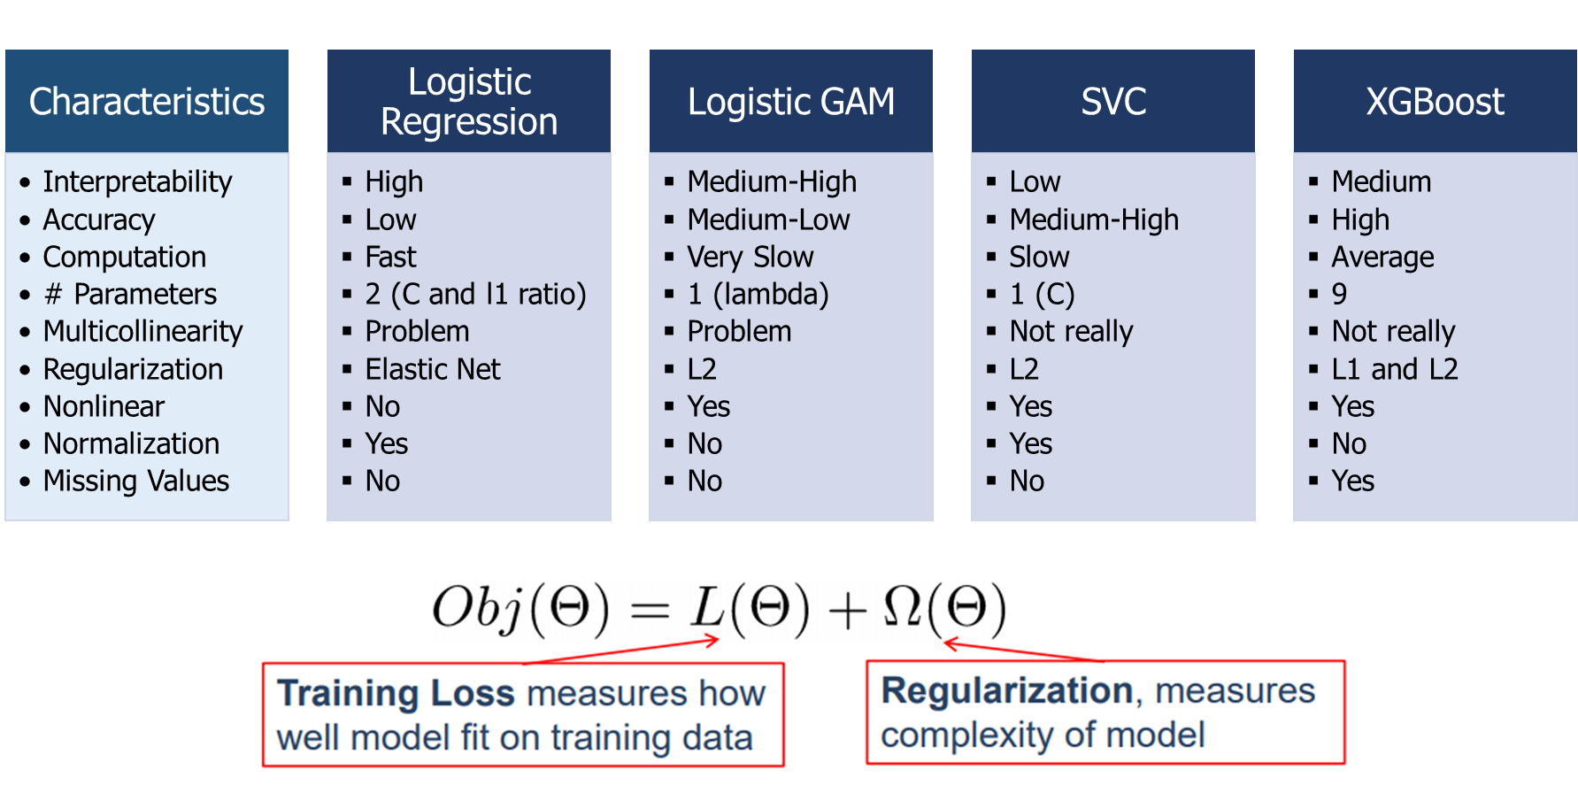
Feeding algorithms with curated data
FACULTY OF MEDICINE
Institute of Global Health

Slide 8
DHS data interoperability
  DHS data availability: Flat ASCII, Stata, SAS and SPSS
  Import into Python:
  If flat ASCII used, lost of information about already encoded factors (e.g. ordinal ones)
  Python libraries for importing Stata, SAS and SPSS exists but
    When imported into Python, very often importation problems arise (try-except needed)
    Many classifier algorithms can only accept numerical data (and not factors)
      Needs recoding anyway
  Need for uniformity in numerical data coding and storing format
FACULTY OF MEDICINE
Institute of Global Health

Slide 9
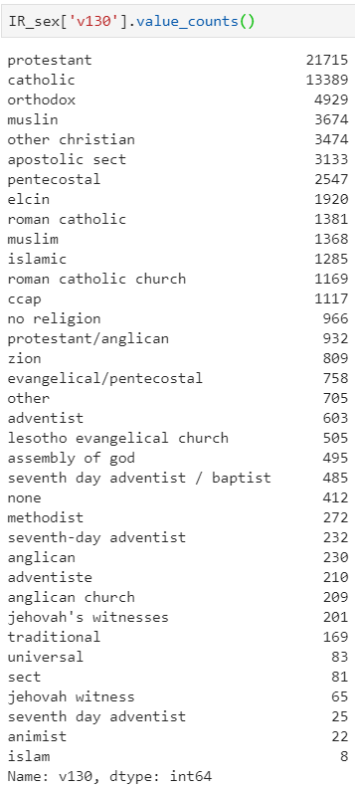
Challenges: Part I: Features engineering
  Example with encoding nominal factors: OneHot encoding
  Create n (or n-1) dummy variables (0 or 1)
    One new variable for each category
    Problem: Curse of dimensionality
    Needs more specification for missing value imputation
  Ideal world: data entry automation
    Saves enormous time
    Makes data entry effortless
    Eliminates human errors
  Already some libraries available but:
    Depends mainly on the data quality: garbage in…
FACULTY OF MEDICINE
Institute of Global Health

Slide 10


Challenges: Part II: Merging surveys
  Example with and surveys:
  Ideally would increase the samples size and add information (e.g. additional biomarkers)
    Both population based surveys
    Similar countries: Ethiopia, Lesotho, Malawi, Mozambique, Namibia, Rwanda, Zambia, Zimbabwe
  Challenges:
    The adult age bands may differ between surveys or one may only include a sub-sample of adult
    HIV tests performed using different techniques
    No unique individual identification keys: duplicates may arise
    Socio-behavioural questions may have (even slightly) different definitions
  Potential biases and necessity of imputation process for non-similar factors
FACULTY OF MEDICINE
Institute of Global Health

