Slide 1
Workshop on Interoperability of Metadata Standards in Cross-Domain Science, Health, and Social Science Applications II
Introduction
Schloss Dagstuhl – Leibniz Center for Informatics Wadern, Germany, October 7-11, 2019

Slide 2
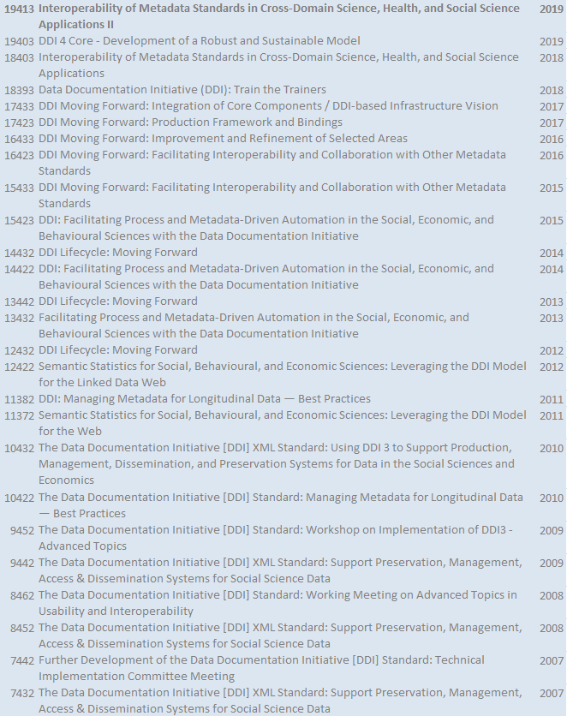
14th Workshop in this Series
DDI/Metadata Workshop series started in 2007 in Dagstuhl
Two 5-day workshops in each year
Topics
DDI development, DDI usage, DDI training
Development of semantic statistics (RDF vocabularies)
Interoperability of metadata standards, including:
Workshops in 2018 and 2019 on Interoperability of Metadata Standards in Cross-Domain Science, Health, and Social Science Applications

Slide 3
Organizers and Sponsors
Organizers:
Simon Cox, CSIRO Australia and W3C Dataset Exchange Working Group
Arofan Gregory, Consultant and DDI Alliance
Simon Hodson, CODATA - Committee on Data of the International Science Council (ISC)
Steven McEachern, Australian National University and DDI Alliance
Joachim Wackerow, GESIS - Leibniz Institute for the Social Sciences and DDI Alliance
Facilitator:
Catharina Wasner, ZBW - Leibniz Information Centre for Economics
Sponsored by:
CODATA (the Committee on Data of the International Science Council)
Data Documentation Initiative Alliance (DDI)
Subsidized by
Schloss Dagstuhl – Leibniz Center for Informatics

Slide 4
DDI Alliance
The Data Documentation Initiative (DDI) is an international standard for describing the data produced by surveys and other observational methods in the social, behavioral, economic, and health sciences. DDI can document and manage different stages in the research data lifecycle, such as conceptualization, collection, processing, distribution, discovery, and archiving.
Use DDI to Document, Discover, and Interoperate!
Aristotle Cloud Services
Australian Bureau of Statistics (ABS)
Australian Data Archive (ADA)
Blaise - Statistics Netherlands
Centre for Longitudinal Studies, Institute of Education, University College London
Centro De Investigaciones Sociologicas (CIS), Spain
Colectica
Consortium of Social Science Data Archives (CESSDA)
Cornell University (CISER)
Danish Data Archive
Data Archiving and Networked Services (DANS), The Netherlands
Eurostat
Finnish Social Science Data Archive
GESIS - Leibniz Institute for the Social Sciences
German Socio-Economic Panel Study (SOEP)
Institute for the Study of Labor (IZA)
Inter-university Consortium for Political and Social Research (ICPSR)
Massachusetts Institute of Technology (MIT)
National Institute of Statistics and Economic Studies (INSEE)
Nooro Online Research
Norwegian Social Science Data Service (NSD)
Open Data Foundation
Research Data Centre of the German Federal Employment Agency, Institute for Employment Research (IAB)
Roper Center for Public Opinion Research
Stanford University
Statistics Canada
Statistics Estonia
Statistics New Zealand
Survey Research Operations, University of Michigan
Swedish National Data Service (SND)
Swiss Foundation for Research in Social Sciences (FORS)
TBA21 Group
U.S. Bureau of Labor Statistics
University of Alberta, Canada
University of Applied Sciences HTW Chur
University of California, Berkeley -- Computer-Assisted Survey Methods Program and UCDATA
University of Essex
University of Guelph
University of Kansas, Institute for Policy and Social Research (IPSR)
University of Minnesota, Minnesota Population Center
University of Toronto Scholars Portal
University of Wisconsin Institute on Aging – MIDUS study
World Bank, Development Data Group (DECDG)
mStats DS – Data Science and Statistical Software

Slide 5
News in Wadern - Wildlife Accidents

Slide 6
Practical Information
ID badges
Honour system
Place cards at lunch/dinner table
Wireless Internet access: wlan.dagstuhl.de
Facilities, our rooms: Kaiserslautern, S003, S005, and S104
Dinner excursion on Thursday evening
Final plenary on Friday late morning or early afternoon
Daily schedule

Slide 7
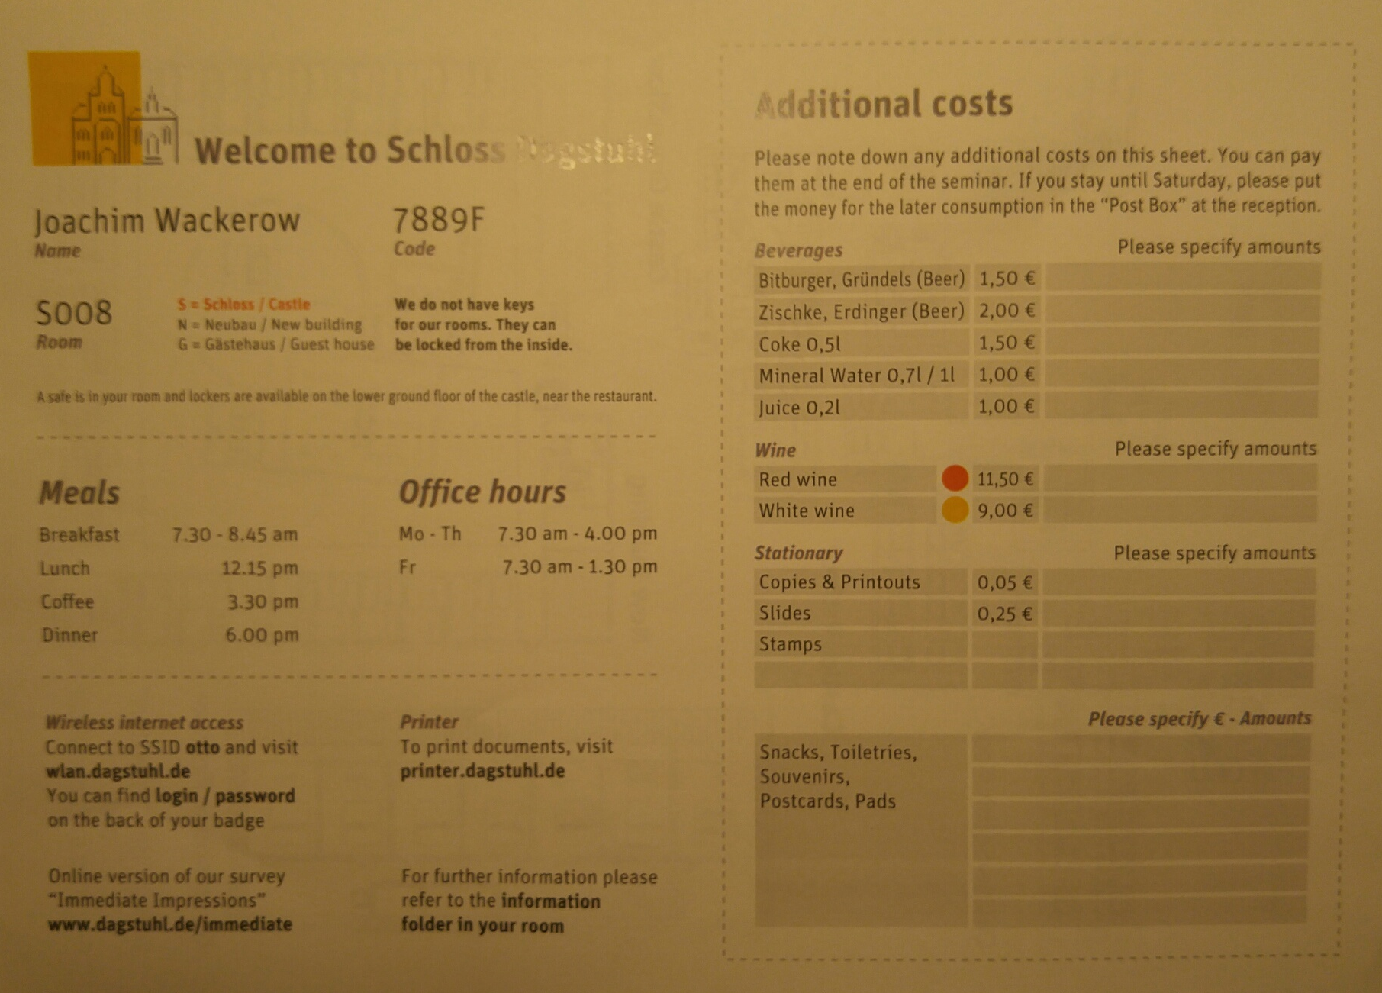

Slide 8
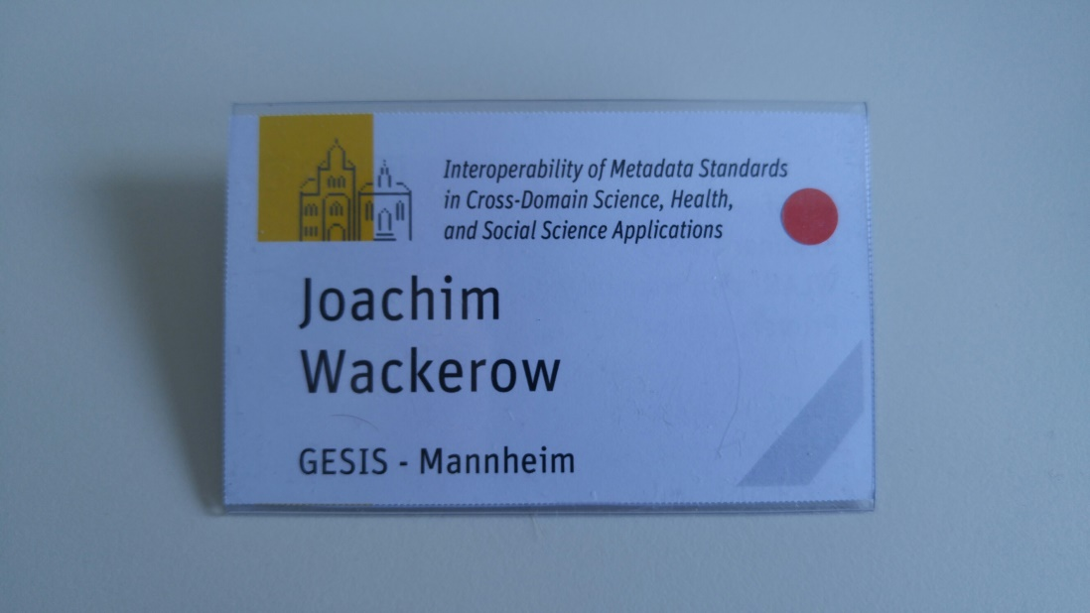
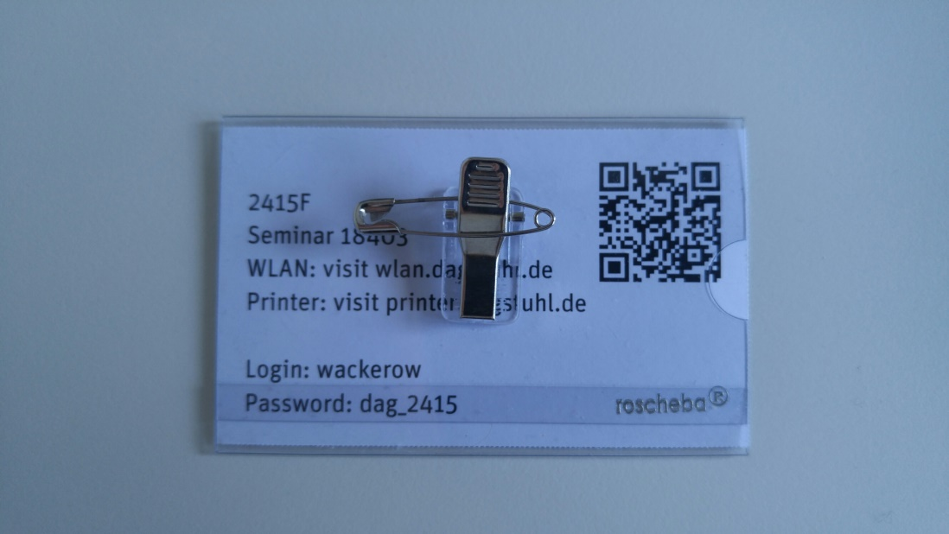

Slide 9
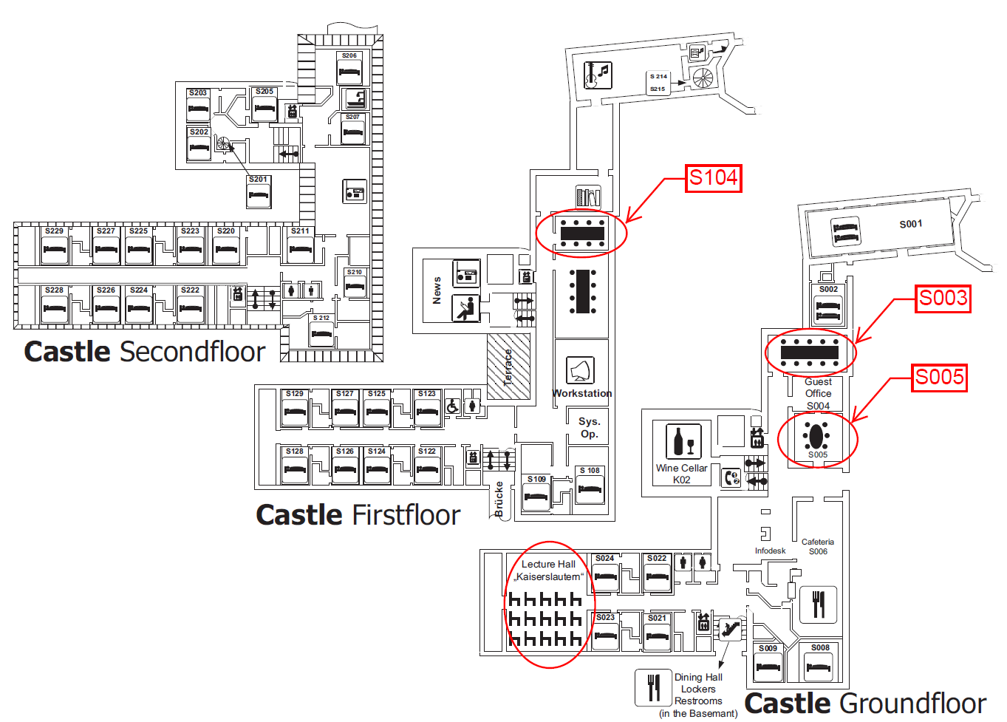

Slide 10
Daily Schedule
Time
07:30 - 08:45 | Breakfast
09:00 - 10:30 | Session 1
10:30 - 10:45 | Coffee/Tea
10:45 - 12:15 | Session 2
12:15 - 13:00 | Lunch
13:00 - 13:45 | Walk
13:45 - 15:15 | Session 3
15:15 - 15:30 | Cake and Coffee/Tea
15:30 - 17:00 | Session 4
17:00 - 17:30 | Organizers Meeting
18:00 - 19:00 | Dinner
19:00 - 20:00 | Possible evening session
Evening | Informal discussion (with drinks on own expense)
20:00 | Cheese platter at wine cellar

Slide 11
Practical Information II
Departure day (staying until Saturday is possible)
Information will be collected while the week
Payment at Dagstuhl office prior to departure (morning on the day of departure)
Time will be announced
Taxi booking at Dagstuhl office
They organize shared taxis

Slide 12
Wiki
Confluence system, workshop tiny link: https://ddi-alliance.atlassian.net/wiki/x/FwDIK
All participants have write access
Simoulteanous editing of documents possible if logged in

Slide 13
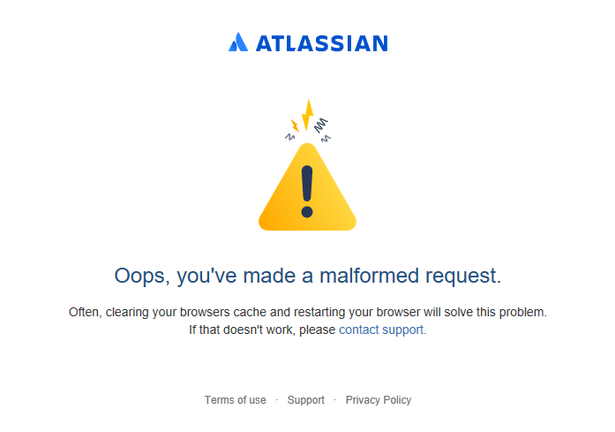
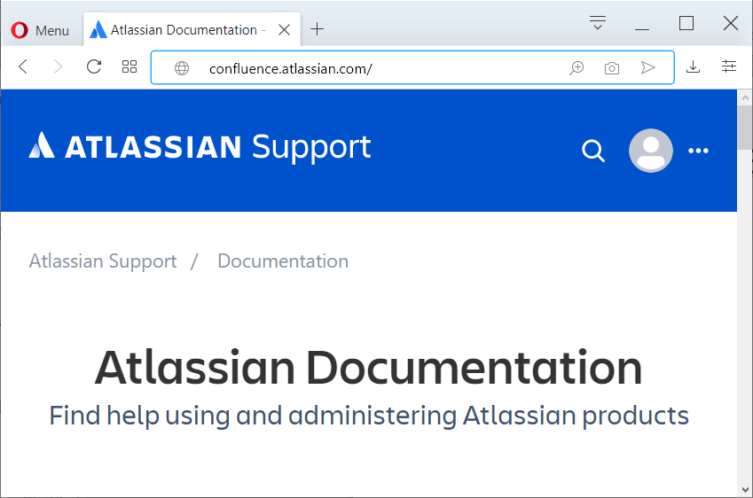
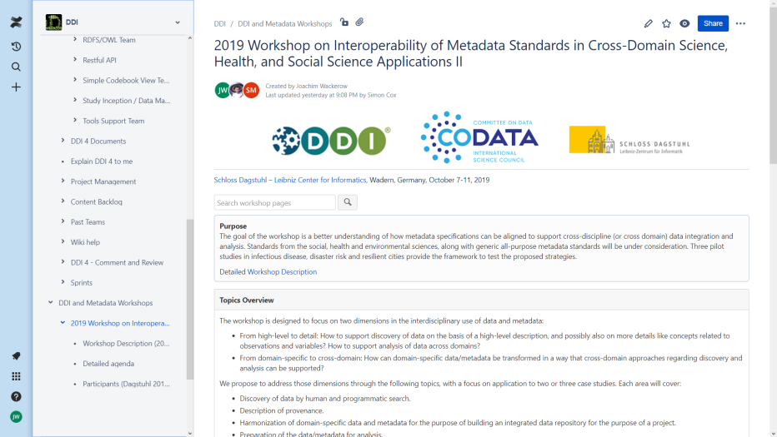
Confluence Login Issues
Instructions to work around this:
Go to the Confluence page https://confluence.atlassian.com/
Click login. Enter your credentials.
Go to the page workshop page at https://ddi-alliance.atlassian.net/wiki/x/FwDIK

Slide 14
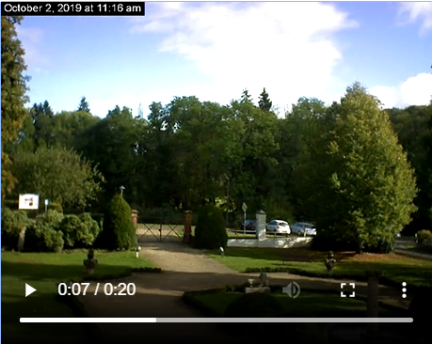

Slide 15
Agile Process
Plenary and dynamic working groups in four 90-minutes blocks per day
Daily adapting in plenary
Daily organizers meeting in the evenings
Possible evening sessions (19:00) with special focus on Tuesday and Wednesday

Slide 16
Icebreaker Round
Introduce yourself:
Do you see yourself as researcher, data expert, infrastructure expert or disseminator?
What do you bring to this workshop?
What do you want to take away from this workshop?

