Slide 1
Analysing Longitudinal Population-based HIV/AIDS data on Africa: The ALPHA Network http://alpha.lshtm.ac.uk/
Applied demographic, health research in Africa

Slide 2
ALPHA network aims (2005)
Perform epidemiological and demographic analyses of population-based HIV surveillance data
Harmonise longitudinal HIV data from different cohorts to make comparative cross-country analyses
Disseminate results to policy makers & implementers
Build data analysis and data management capability in African partner institutions
All based on data from existing, African, longitudinal, population-based cohorts with HIV data.
Notes:
The ALPHA network started from the perspective of African, longitudinal, population-based cohorts with HIV data. What could be done to bring these together to answer questions about the HIV epidemic which was already in its third decade by the time ALPHA started.
The ALPHA project was conceived:
To develop new, innovative analyse of these HIV data.
To harmonise the data from different cohorts to provide comparative analyses.
To make the results available and useful to policy makers.
To build the capacity of staff within the partner institutions to undertake their own analyses.
All similar to other research projects and programmes. But this is rooted within the theoretic demographic analyses from HDSS with strong links to the INDEPTH network.

Slide 3
ALPHA partner studies
Independent institutions
Managed by ten independent African research institutions
Surveillance studies pre-date the network formation
Facilitated by LSHTM secretariat
Data
Household residency episodes
HIV care and ART clinical records
Deaths and verbal autopsy
HIV test dates and results
Notes:
The different datasets are brought together by the ALPHA team.
Each of these boxes represents a harmonised data specification within the ALPHA network.
All of the African partners who collect the primary data have the longitudinal, population data from households on births, death and migration (at the centre). But other data obtained from as many partners with the data.

Slide 4
Population cohort data
Demographic sentinel surveillance (DSS) provides data on households and individuals
Fertility, Mortality (including Cause of Death), Migration
Population representative over time (observational cohorts)
HIV data from nested health surveys with DSS
Estimates HIV prevalence (size of the problem)
Longitudinal population cohorts allow
Estimation of HIV incidence estimates
Assessment of outcomes in treated and untreated patients.
Platforms for special surveys and qualitative research
A complement to Civil Registration & Vital Statistics (CRVS)
Notes:
A quick review of the health and demographic sentinel surveillance in Africa giving credit and recognition to the INDEPTH network.
These observational cohorts provide the best up-to-date information on fertility, mortality, and migration in sub-Saharan Africa.
The addition of regular HIV data allows estimation of prevalence of HIV at the time of the surveys, and the incidence of HIV over time.
These cohorts can assess outcomes and the impact of interventions through the observation of real-world implementation. They also provide the population platform for other surveys, including SES, and for qualitative research.
As an aside in the demography world (and perhaps elsewhere):
Some feel that HDSS are only relevant where there is limited Civil Vital Registration data, but we see HDSS as important platforms for collection of longitudinal population-based data. And there are plenty of others who also see the value of HDSS beyond civil registration and vital statistics.

Slide 5
ALPHA Hub with analyses
ALPHA data hub receives little dedicated funding
Funding for secondary data analyses used to support Hub.
Independent Partners contribute data from existing HDSS
Data hub
data harmonised and documented
HIV analyses
NCD analyses
New Partners & networks contribute data and processes to enhance FIND data availability
Health systems analyses
New analyses
Primary motivation
Need improve data access and to share data beyond ALPHA
Other possible drivers
Internal, central gateway for data and related resources
Funders and publishers policies requiring data sharing
Credit for producing data through data citation.
Notes:
In the beginning, the ALPHA network has started with one spoke - the analyses of HIV – and no hub. In 2005 there were important questions that needed answers, and funding was available to answer these questions. The funding was used not only to do the analyses, but also to develop the pooled databases needed to bring the data together from the diverse HDSS. This was only possible because the same people who did the analyses, devoted their time to data issues as well.
As the number of analyses increased, and the spokes increased, then the role of the data hub becomes more important, and more distinct from the analysis. This diagram shows the independent partners contributing data, to an organised and harmonised data hub, which in turn allows in-depth analysis of key questions on a multitude of different health conditions. and spokes is new.
The urgent need now is to develop the process within the data hub, to improve the quality of the data, enhance the data documentation, and to credit the partners producing the primary data

Slide 6
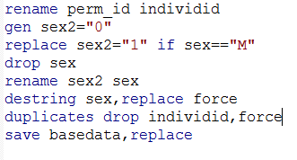
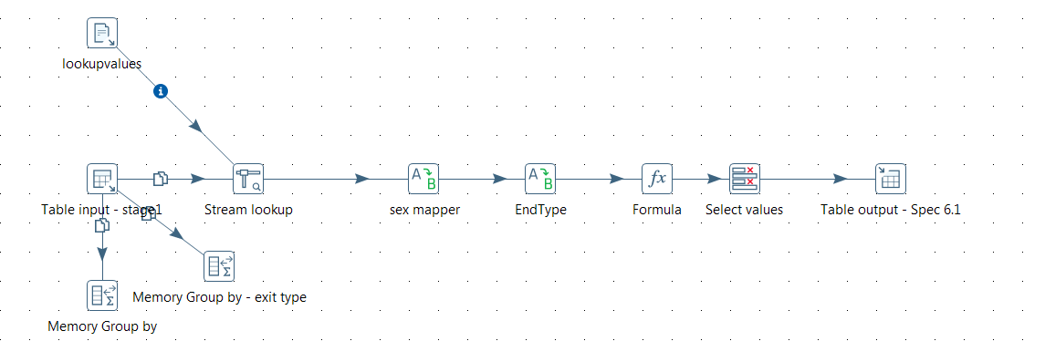
Preparation of ALPHA datasets
Source data from HDSS
ALPHA harmonised data
Transformation routines
Traditionally done in Stata
Now migrating to Pentaho
Extract, Transform and Load (ETL)
Accompanied by documentation using DDI compliant standards
Automated update of ALPHA documentation from site meta-data.
Notes:
Complex transformations of longitudinal population data, repeated cross sectional surveys and health records
Different data managers/ researchers producing the ALPHA data
Pentaho
Powerful extraction, transformation and loading tool
Support data in a wide variety of input formats
Can output data in a wide variety of formats
Can manipulate data in various ways
Research data management can be automated and standardised
Standard data manipulation recipes can be shared
These processes can incorporate the data documentation needed for the ultimate use of the ALPHA harmonised data – which is analysing health conditions which affect populations in African countries.

Slide 7
ALPHA Data specs
Pregnancy and Births
Parent/child links
Changing individual SES
Deaths and Verbal autopsy
ALPHA harmonised data
Longitudinal population surveuillance in 10 HDSS
Demographic data:
Household residence episodes
Entry information: birth, aging in, in migration
Exit information: death, out migration
ALPHA harmonised data-spec
Household Socio-demographic data
Sexual and other risk behaviours
Linked clinic data.
Research test dates and results (for HIV and other conditions
Linked clinical records on HIV care & ART
Non-communicable disease risks and outcomes
Self-report of diagnosis and treatment history
Notes:
This slide shows the different datasets that are brought together by the ALPHA team. Each of these boxes represents a harmonised data specification within the ALPHA network.
All of the African partners who collect the primary data have the longitudinal, population data from households on births, death and migration (at the centre). Which forms the central core of the ALPHA harmonised data specs.
But other data obtained from as many partners with the data.
Extraction, transformation and documentation by ALPHA into common data specification anonymises the data, but preserves the links between the datasets.

Slide 8
Key Questions
How do HDSS adopt DDI standard for primary data documentation? (essential first step)
What does a metadata standards-based model look like?
Will ALPHA data harmonisation fit a standard metadata model
How can ALPHA data transformations and the transformations of documentation languages fit together?
What metadata are required for aggregated outputs from ALPHA data harmonisation?
What data provenance features are required by end-users of ALPHA data?
How can data harmonisation be politically and economically sustainable in LMIC settings?
Is the model capable of scaling up to multiple morbidities?

