Slide 1
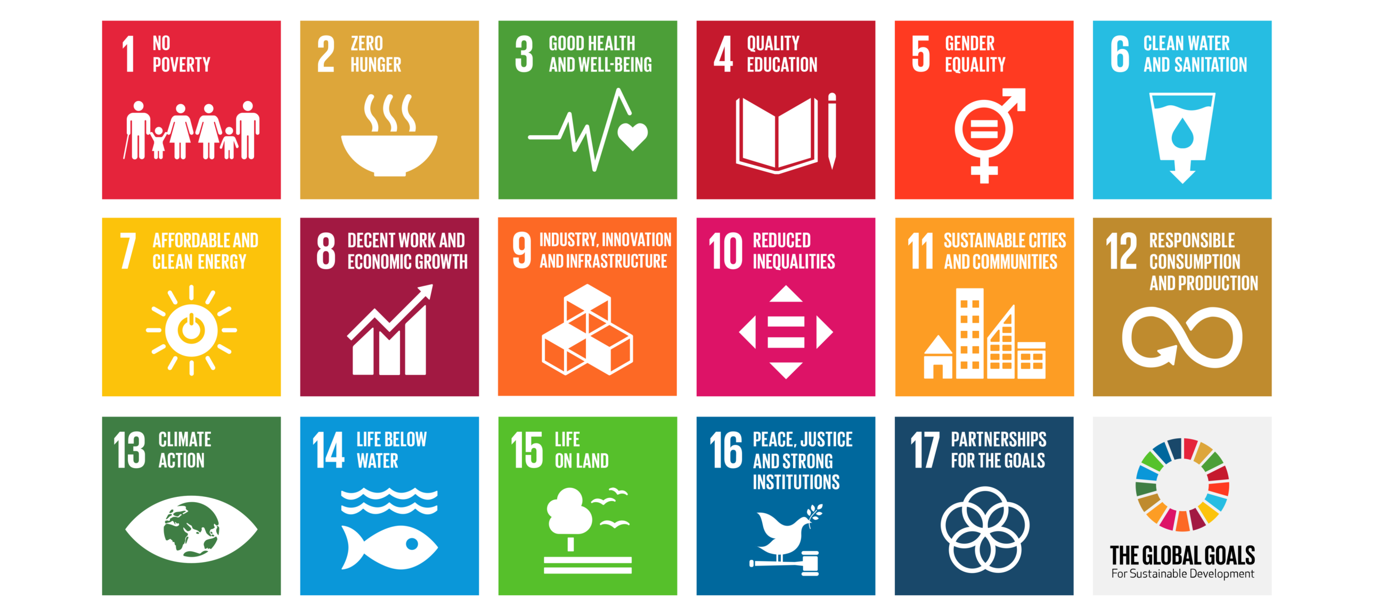
2019 Workshop on Interoperability of Metadata Standards in Cross-Domain Science, Health, and Social Science Applications II
Case Study: Sustainable Development Goals
Schloss Dagstuhl – Leibniz Center for Informatics, Wadern, Germany, October 7-11, 2019

Slide 2
Background
2030 Agenda for Sustainable Development demands high-quality, timely, and reliable data for policy and decision making, disaggregated and supplemented with necessary contextual information.
The challenge is not only to fill data gaps, but also to integrate and make existing SDG-related data and information easily accessible to users in a meaningful way

Slide 3
Data interoperability for the SDGs
There are many unrealized opportunities to extract value from data that already exists to meet information needs of the 2030 Agenda
Investing time and resources in the development and deployment of data interoperability solutions will help us make better use of the data that currently sits in sectoral and institutional silos to implement and monitor the SDGs
Notes:
Particularly in the sustainable development field, there is an unrealized opportunity to extract far more value from the vast quantities of data that already exist
Interoperability simplifies everyone's ability to access, share, manipulate, and use complex data with much less effort.
Investing time and resources in the development and deployment of sector-wide interoperability solutions give everyone the opportunity to make better use of the data that currently sits in sectoral and institutional silos.
It is vital that not only statisticians and IT staff, but also senior management and operational staff within government ministries, departments and agencies, recognize and understand the role that interoperability plays, in order to make the right decisions about how data for the SDGs is collected, made available and used, and so that integration and comparability challenges are not left until after information systems have already been designed and deployed.
It is also important to help avoid duplication of efforts and the prevention of the same, or very similar, data being collected multiple times by different institutions because there is little or no coordination between them.

Slide 4
Vision
Integrating and joining up data from multiple sources, and across systems, to realize the data revolution for sustainable development, where more and better data is open, accessible, and used to the fullest extent possible in improving people’s lives

Slide 5
Pathway to data interoperability
Getting the governance and institutional framework right
Designing data structures with users in mind
Standardizing the data content
Providing standard interfaces to access and work with data
Disseminating linked open data for knowledge creation

Slide 6
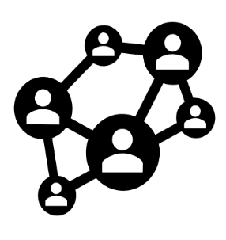
Bringing the SDGs to the semantic web
Documents
Data
Data
UN Institutional Knowledge
Other vocabularies
Documents
Statistical Data
2030 Agenda
UN BIS
SDG Indicator Framework
VNRs
SDG Ontology

Slide 7
High-level objectives
Facilitate discovery of SDG-related data and information by humans and machines
Ensure documentation and traceability of SDG data provenance to build trust in high-quality, authoritative sources
Enable interoperability, contextualization and integration of SDG information from multiple sources
Demonstrate how to publish and use SDG-related data and information on the semantic web

Slide 8
SDG Metadata: a working definition
“Data about the nature and characteristics of digital SDG information resources published on the web…
structured according to standardized schemas, and …
encoded following commonly agreed rules and vocabularies
that enhances their findability, searchability, integrability and usability”

Slide 9
Deliverables
Express and utilize metadata about existing SDG datasets following linked-data standards (e.g., schema.org and the DCAT)
Develop and maintain authoritative SDG knowledge organization systems for the semantic web
Enrich metadata about existing SDG datasets with references to external KOS (e.g., using skos:exactMatch)
Map traditional SDG datasets (e.g., in SDMX format) to their representation using the Data Cube Vocabulary
Publish SDG datasets on RDF-enabled data stores
Develop tools and applications that consume rich, structured data and metadata on the semantic web

Slide 10
Challenges
The survival and adoption of particular SDG data and metadata standards depends on how easy/costly they are to implement by practitioners
The value of a specific metadata collection is increased when users are able to establish and exploit links with other metadata collections
References to external knowledge organization systems require mechanisms to keep those references up-to-date
Data producers need to learn how to easily and effectively “skosify” their traditional vocabularies and classifications
Build on existing data standards (e.g. SDMX) instead of starting from scratch when publishing SDG data as linked data

Slide 11
Current status of the SDG linked-data project
The UN, in collaboration with linked-data experts, has developed a proposal for an SDG Knowledge Organization System, to be hosted on the metadata.un.org subdomain, which also hosts the UN Bibliographic Information System (UN BIS) at the UN Library. It consists of:
A basic schema of the SDG goal-target-indicator-series hierarchy
An SDG taxonomy describing all instances of the goal-target-indicator-series hierarchy, with mappings to external vocabularies:
UNBIS and EuroVoc
SDG Interface Ontology
SDG Goals in Wikidata

Slide 12
SDG Knowledge Organization System
https://github.com/UNStats/LOD4Stats/wiki/SDG-knowledge-organization-system

Slide 13
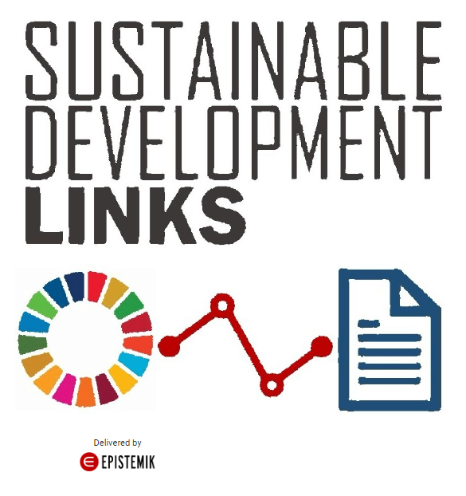
Demo app
Automatically extract key concepts related to sustainable development from text documents
Establish links the most relevant Goals, Targets, Indicators and Series.

Slide 14
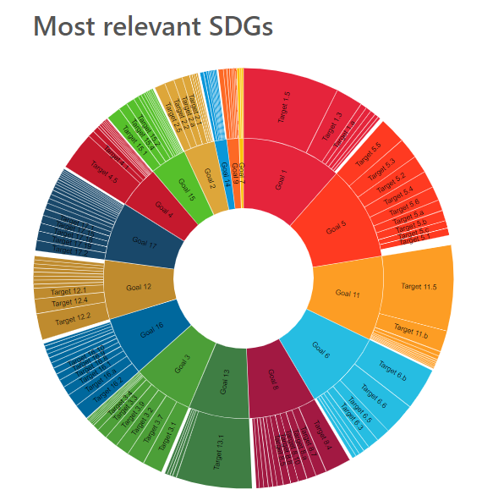
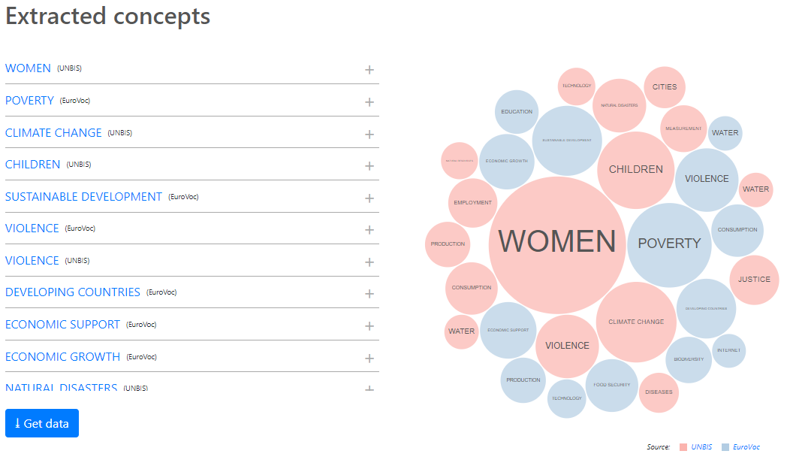
How it works…
Upload a document (PDF, DOC, DOCX, HTML) related to SDGs or paste its URL
Extract concepts
Link to Sustainable Development Goals, targets, indicators, and statistical data series

Slide 15
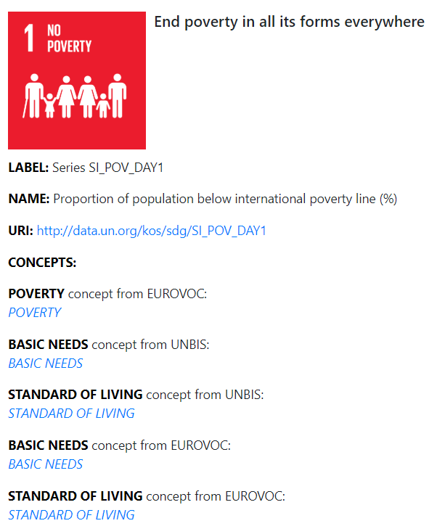
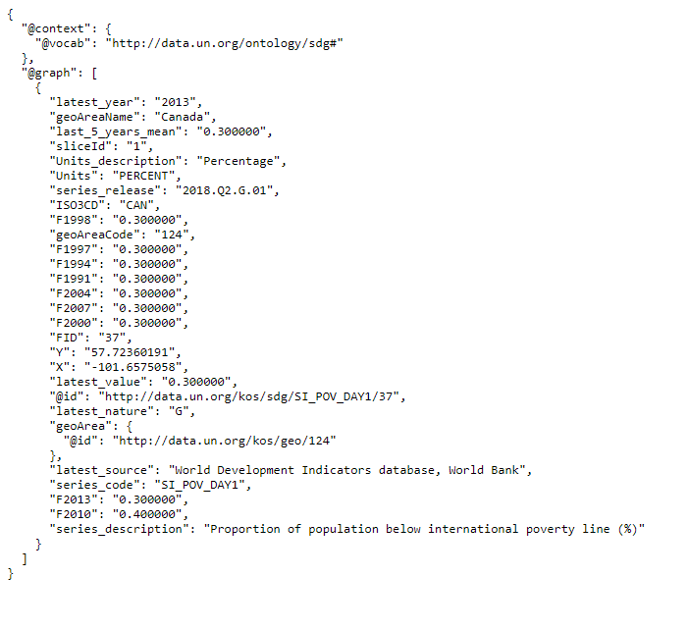
Drill-down to get relevant statistical data from Global SDG database

Slide 16
The big task ahead
Develop capacity of national and international statistical organizations to publish and maintain SDG data as linked data
Develop capacity of users to develop new SDG data products and services leveraging semantic-web technologies

Slide 17
Thank you.
Questions or inquiries?
gonzalezmorales@un.org

