Slide 1
Spatial metadata Stephen M. Richard US Geoscience Information Network NSF Earth Cube Tucson, AZ USA
Workshop on Interoperability of Metadata Standards in Cross-Domain Science, Health, and Social Science Applications II
Schloss Dagstuhl – Leibniz Center for Informatics Wadern, Germany, October 7-11, 2019

Slide 2
Purpose
Data integration requires an integration basis
Same individual
Same location
Same time…
Location as the basis for integration
Notes:
For data to be FAIR, documentation==metadata is required

Slide 3
Approach
Clearly define WHAT is being located
Decide on the frame of reference
Relative to adjacent features – shoreline, delta, north side of mountain
Relative to some fixed reference frame
How will the location be encoded for computation
Notes:
Gibb R G, Raichev A and Speth M 2013 The rHEALPix Discrete Global Grid System URL http://dx.doi.org/10.7931/J2D21VHM [https://datastore.landcareresearch.co.nz/dataset/f0c488fe-ab25-4737-9d20-eb7777806a41/resource/f6e5726d-07be-460f-89be-bf1c84310972/download/gibbrhealpixdggs.pdf]
Geohash https://en.wikipedia.org/wiki/Geohash
What3Words https://en.wikipedia.org/wiki/What3words
PlusCode https://en.wikipedia.org/wiki/Open_Location_Code
See https://en.wikipedia.org/wiki/Discrete_global_grid

Slide 4
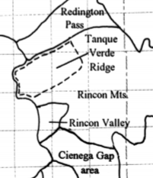
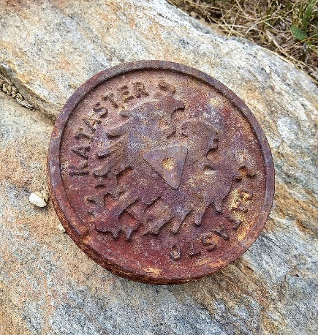
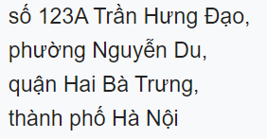
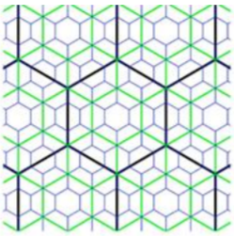
Approach for location
Place names
Street Addressing
Cadastral survey
Global grid systems
Coordinate reference systems
By Bartleby08 - CC BY-SA 4.0,
Notes:
Global Grid systems
Preserve area
Global coverage
Hierarchical
Each cell has identifier
Globe is not a sphere
Lots of existing systems in place
DGGS https://docs.opengeospatial.org/as/15-104r5/15-104r5.html
Gibb R G, Raichev A and Speth M 2013 The rHEALPix Discrete Global Grid System URL http://dx.doi.org/10.7931/J2D21VHM [https://datastore.landcareresearch.co.nz/dataset/f0c488fe-ab25-4737-9d20-eb7777806a41/resource/f6e5726d-07be-460f-89be-bf1c84310972/download/gibbrhealpixdggs.pdf]
Geohash https://en.wikipedia.org/wiki/Geohash
What3Words https://en.wikipedia.org/wiki/What3words
PlusCode https://en.wikipedia.org/wiki/Open_Location_Code
See https://en.wikipedia.org/wiki/Discrete_global_grid

Slide 5
Key information
Where– Extent
Precision -- Resolution
Accuracy
https://www.w3.org/TR/vocab-dcat-2/#time-and-space

Slide 6
Challenges
Documentation for location reference
Matching between different systems
Different precision, accuracy

Slide 7
Benefits
Integrate data by location
Status
Lots of different approaches
Lots of tools

Slide 9
More General Challenges
Getting good metadata content
Maintaining metadata content
Integrating metadata from different sources
Machine-actionable metadata
Semantics
Data description
Links

Slide 10
Goals
Finding:
Text for indexing
Location information for spatial search
Accessing:
How to get
Access controls
Interoperable:
Information model
Format
Schema
Reusable:
Provenance,
Quality
Notes:
find data based on the information provided by their metadata, even without the data’s identifier.

Slide 11
Approach
Communities define sets of metadata elements they consider important
MANY different schemes are in use
Focus has been on discovery/find, emphasis is changing…
Cross domain aggregation for discovery
– harvest and index on a set of elements that are common
Notes:
Gibb R G, Raichev A and Speth M 2013 The rHEALPix Discrete Global Grid System URL http://dx.doi.org/10.7931/J2D21VHM [https://datastore.landcareresearch.co.nz/dataset/f0c488fe-ab25-4737-9d20-eb7777806a41/resource/f6e5726d-07be-460f-89be-bf1c84310972/download/gibbrhealpixdggs.pdf]
Geohash https://en.wikipedia.org/wiki/Geohash
What3Words https://en.wikipedia.org/wiki/What3words
PlusCode https://en.wikipedia.org/wiki/Open_Location_Code
See https://en.wikipedia.org/wiki/Discrete_global_grid

Slide 12
Metadata schemes
DDI, CSDGM, EML, ISO, DCAT, Schema.org, STAC…..
All include various text fields that can be indexed
Solves first order discovery problem
Cross domain issues:
Shared vocabulary
Location
Notes:
STAC https://stacspec.org/

Slide 13
Status
Emergence of schema.org and sitemap approach
Move towards Open world descriptions
Improving text analytics to extract information
Semantic integration
Location
Notes:
Datasets: DCAT
Spatial data: CSDGM, ISO19115
Ontologies: MOD, WIDICO
Statistical data: DDI
Web pages: schema.org
What is the status of the standard/technology/platform? Is it well-adopted? Among what audiences/domains? Are there production tools?

