Slide 1
Beyond interoperation inception: realising cross-domain semantics Pier Luigi Buttigieg & Barbara Magagna
Workshop on Interoperability of Metadata Standards in Cross-Domain Science, Health, and Social Science Applications II
Schloss Dagstuhl – Leibniz Center for Informatics Wadern, Germany, October 7-11, 2019

Slide 2
Purpose
What is the standard/technology/platform in general terms? (Be concise.)
A family of knowledge representation (KR) languages, standards, and conventions* which translate human knowledge into machine-actionable form
* RDF, SKOS, OWL, etc
The core goal is to enable distributed machine intelligences to broker between (meta)data stores through common (enough) knowledge representations

Slide 3
Ontologies
A rough illustration of the semantic gradient
Stronger semantics
Taxonomies
Reality check: we’re in an all-hands-on-deck situation, and need resources across the whole gradient, however, these resources should be moving towards ever closer alignment and co-development models to be sustainable
Controlled
vocabularies
Data models
Thesauri
Glossaries
Weaker semantics
Modified from McCreary D (2006)
Patterns of Semantic Integration. CC 2.5

Slide 4
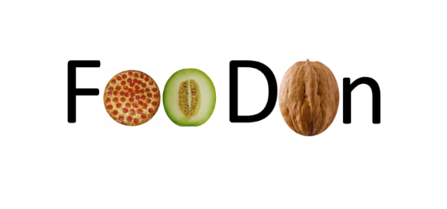
OBO Foundry
Links to SDG Agenda
Biological processes
Chemicals
Environmental and ecological entities
Food and agriculture
AgrO

Slide 5
Goals
What is the feature or capability that you are presenting supposed to do? What problem does it solve?
We have impressive technologies, resources, and consortia all over the place: we need more instances of social technology to make them work together at scale

Slide 6
An example …
InteroperAble Descriptions of Observable Property Terminology WG (I-ADOPT RDA WG)
WG goal:
Develop a community framework to represent observable properties in environmental research
Allowing new and established resources across the semantic gradient to start interoperating sustainably

Slide 7
Approach
Surveying existing, formalized representations of observable properties
Analyzing the overlaps and gaps between these representations
Develop a common framework to represent observable properties for the environmental domain but can serve as blueprint reusable for other domains
Testing interoperability of terminologies aligned via use cases collected from the involved parties

Slide 8
Benefits
who: domain scientists, vocab/thesauri/ontology engineers, data providers, data centers
how:
a community basis to align semantic products
guidance in identifying and adapting relevant observation representations
recommendations on how to encode complex semantic descriptions of observable properties such that other resources „get it“
Identification of terminologies pushing for greater inter-alignment for the annotation of datasets

Slide 9
Status
I-ADOPT WG is getting officially RDA endorsed within VSSIG
around 60 members, half of them actively involved, 20 RIs/Intiatives (eLTER, NERC, LifeWatch, PANGAEA, OBO-Foundry, GoFAIR,...)
Kick-Off 25 October, Helsinki (18 months)

