Slide 1
ENVRI Provenance Service
ENVRI Provenance template registry and expansion service
Dagstuhl, October 2019
Barbara Magagna – EAA/Austria

Slide 2
Data Provenance
Who participated in the creation of dataset X?
Which data processing steps were applied?
What were the original sources for this dataset?
What processes where involved in their creation?
PROV-DM
https://www.w3.org/tr/prov-dm/

Slide 3
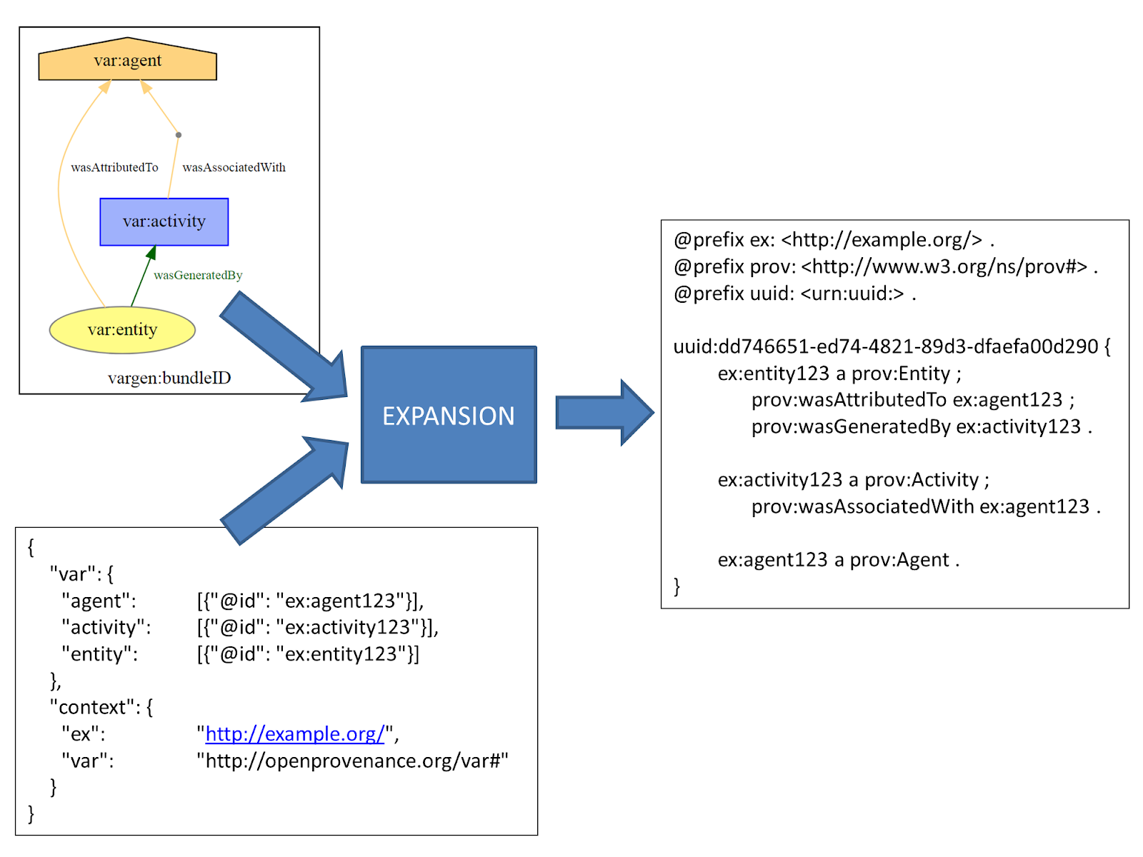
PROV-Template https://provenance.ecs.soton.ac.uk/prov-template/
Template
Binding
PROV Document

Slide 4
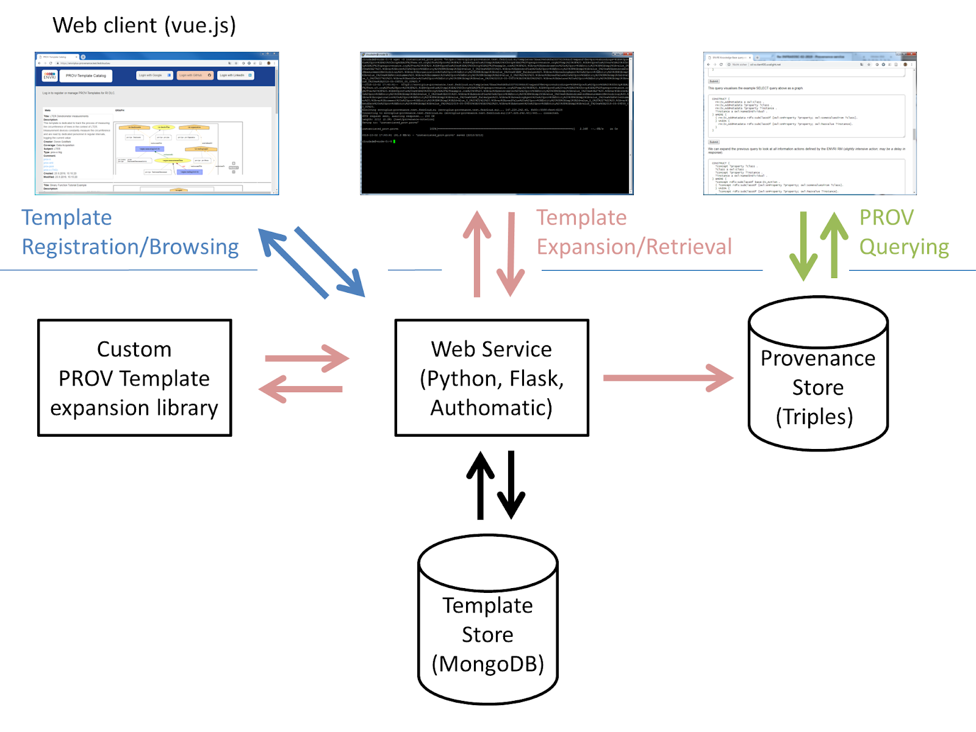
ENVRI Provenance template registry and expansion service

Slide 5
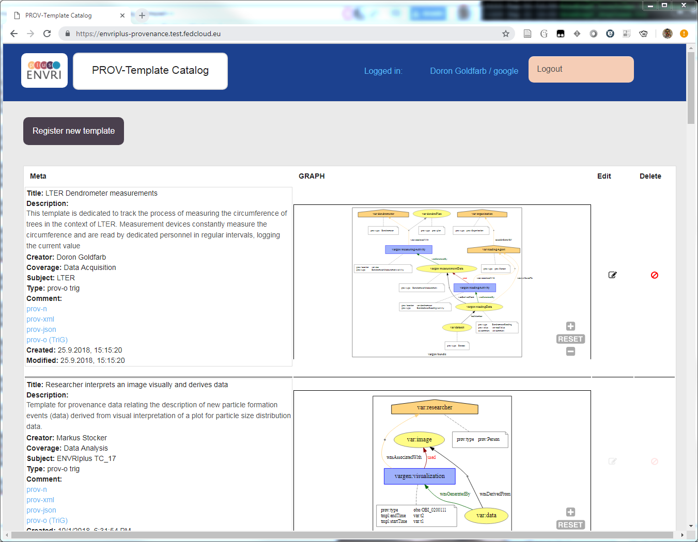
PROV Template catalog
https://www.envri.eu/provenancetemplates

