Slide 1
Federated Information System for the SDGs
A platform for the sharing of national and global statistical and geospatial data for the 2030 Agenda

Slide 2
Global SDG Indicator Framework
17 goals, 169 targets, 232 indicators
Tracking progress on SDGs requires an unprecedented amount of high-quality, open, timely and disaggregated data and statistics!
Notes:
Tracking progress on SDGs requires an unprecedented amount of high-quality, open, timely and disaggregated data and statistics
At subnational, national, regional and global levels
From official statistical systems and from new and innovative data sources

Slide 3
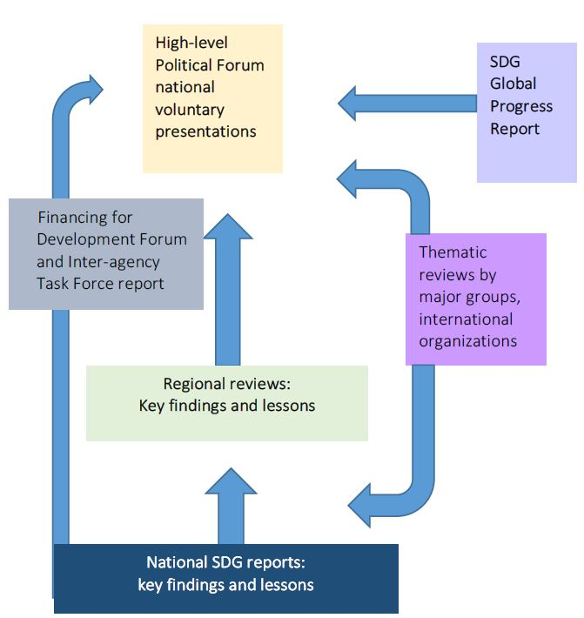
SDG data reporting
National and subnational reporting are the most significant levels of the SDG review process
The global SDG monitoring system should build on national data reporting
Data derived from national sources is the foundation for SDG reviews at all levels
It is crucial to create opportunities for countries to directly contribute to global reporting
Notes:
Aggregate data on global SDG indicators often mask or confuse national and subnational realities
There is a need for a multi-level SDG reporting system that would work from the subnational level up to the national and global levels.

Slide 4
Why a Federated Information System for the SDGs?
Implement the 2030 Agenda through the effective dissemination and use of integrated statistical and geospatial data, supported by technologies that facilitate data sharing and interoperability and collaboration to report on the SDGs across local, national and global data hubs.

Slide 5
Federated Architecture
An approach for the coordinated interchange of information among independent data hubs that allows for data sharing while maintaining control over own data resources:
Autonomy: Each hub is free to join or leave the federated system, sharing new data and withdrawing access to previously shared data
Equality: No data hub has authority over another
Access control: Each hub decides what content to share, who can access that content, and how can that content be accessed
Traceability: Data assets remain at the source, but references to them may be passed to other hubs
Notes:
The basic elements of the federated architecture are “hubs” representing individual information systems of organizations that wish to share and exchange information.
A hub may be seen as an autonomous database
Each hub will have certain objects that it is willing to share with every other hub
It will also have other elements that it is willing to share only with some specified subset of hubs

Slide 6
The FIS4SDG challenge
Build a global network of autonomous, authoritative national SDG data hubs that invites participation and creates significant value for all participating countries
Provide tools and services that make it easy for SDG data producers and consumers to interact with each other in mutually rewarding ways
Design and maintain a technological infrastructure capable of scaling rapidly, encouraging positive network effects while minimizing negative ones

Slide 7
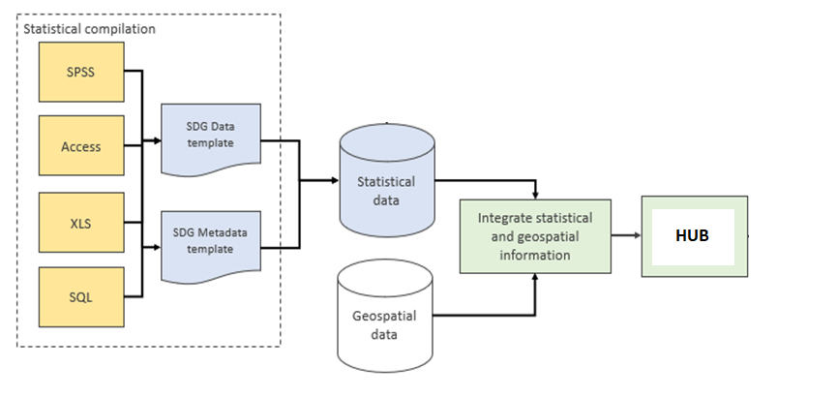
SDG compilation process

Slide 8
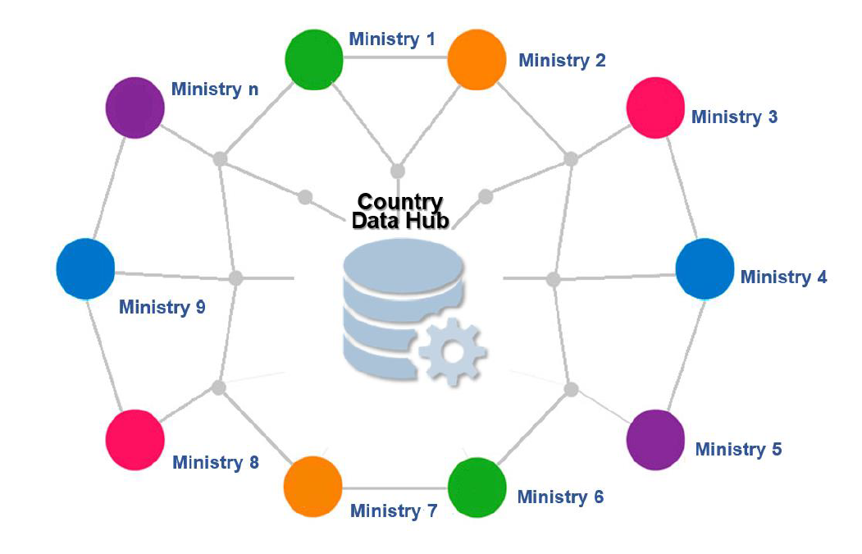
Country data hub
Source: INEGI

Slide 9
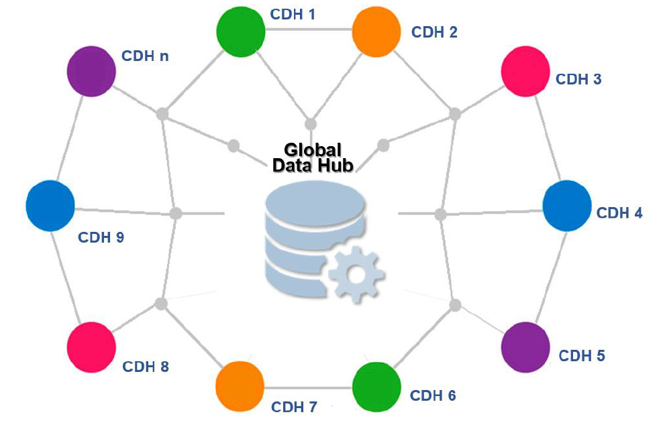
Global data hub
Source: INEGI

Slide 10
Technology as enabler
The FIS4SDGs is enabled by digital technology and software and web-based tools that allow data producers and data users to connect more precisely, speedily and easily

Slide 11
Leadership of national statistical organizations and geospatial information authorities
Engagement with all SDG data stakeholders
Data ecosystem governance
Curation of open and participatory data hubs
Orchestration and management of data value creation

Slide 12
Role of the National Statistical System
SDG Review process has to draw on the entire National Statistical System, involving all relevant ministries and government agencies that regularly collect data
The National Statistical Office has a crucial role to play
Coordinating the NSS and improving cooperation between data producers
Supporting statistical work of line ministries and other entities
Validating data from different sources for consistency, accuracy and reliability (in line with Fundamental Principles of Official Statistics)

Slide 13
Data Hub curation
Curation: Process of validating and selecting:
the type of content a data hub can share or access, and
the connections hubs can form with one another
Effective curation helps decision makers find useful, high-quality data

Slide 14
National data hub
Provides and manages the technological infrastructure within which valuable data content and data services can be exchanged
Fosters quality control, encouraging national data producers to share content and services that are accurate, useful, relevant and interesting to data users
Creates filters designed to help users find high-value data

Slide 15
Linking data producers with data users
A data hub
Connects data producers with data consumers
Allows them to engage in mutually rewarding exchange of valuable data and information assets
Every item exchanged among users of the FIS4SDGs platform is a “value unit”
Data users find the information they need
Data producers become more visible and build reputation through source attribution

Slide 16
How does the FIS4SDGs work?
Country ownership: Owned, led and managed by each participating country
Standards driven: Publication and sharing of SDG data following open standards and principles for data interoperability
Human-centered: Tools for collaboration, story-telling and user engagement

Slide 17
Capacity building objectives
Support…
Enable…
Empower…
… NSOs in managing statistical and geospatial data for sustainable development
…national and local decision makers to access, understand, and use data for SDG implementation
… Member States to directly contribute to global SDG reporting through innovative data applications

Slide 18
Federated data governance model
National Statistical Office coordinates the implementation at the country level
Common data models, data definitions and data flows allow for data interoperability
Each hub independently when and how to publish and share authoritative data with other hubs
Users can access the data they need while the traceability and accountability of the originating data sources is ensured
01
02
03
04
Notes:
National Statistical Systems coordinate the implementation of a multi-layered set of policies, standards and procedures around the production, dissemination and use of data from local to national to global levels
Common data models, data definitions and data flows allow for data interoperability and integration across multiple systems into a network of federated data hubs
Each hub independently publishes and shares authoritative data, contributing to a global catalog of standardized open SDG data and information
Users can access the data they need while the traceability and accountability of the originating data sources is ensured.

Slide 19
Decisions by UN Statistical Commission
At its 49th session in March 2018, the Statistical Commission welcomed the efforts to establish a federated system of national and global data hubs for the SDGs to:
facilitate integration of different data sources,
promote data interoperability
foster collaboration among partners from different stakeholder groups, including the geospatial community and other data providers,
improve data flows and global reporting of the SDGs.

Slide 20
Decisions by UN Statistical Commission
At its 50th session in March 2019, the Statistical Commission welcomed the progress in the implementation of the Federated Information System of national and global data hubs to
facilitate integration of different data sources
promote data interoperability and
foster collaboration among partners from different stakeholder groups
and stressed the need to mobilize resources and provide the necessary technical support to all countries wishing to join the Federated System

Slide 21
Key activities
Establish internal teams and dedicated infrastructure
Determine roles and levels of access granted to internal and external stakeholders and partners
Create small teams to facilitate sharing of experiences and lessons learned
Document standard procedures and best practices
Share data and statistics on a selected number of indicators

Slide 22
Deliverables
1
2
3
4
National SDG Data Hubs that transform local and national statistical data and geospatial information into accessible web services
A comprehensive architecture that allows the integration of metadata-driven SDG Data Hubs
Information products and applications that respond to the needs of policy and decision makers at the local, national and global levels
Improved capacity of local institutional and human resources to implement, operate and further develop national SDG data platforms

Slide 24
Esri Support
Esri has a program to support SDG Hubs and has committed to the donation of software to participating National Statistical Offices from developing countries. This donation includes:
Perpetual use licensing
Some subscription-based services at a $0 cost for three years
At the end of the three-year period, if the country wishes to continue using these licenses and subscriptions, it can do so at an 85% discount until 2030.
Annual costs will be based on the number of users and could range from an estimated $1,000 to $10,000 USD.

