Slide 1
Metadata standards
Using DDI to Inform, Organize, and Drive
Survey Data Production

Slide 2
Overview
What Metadata standards try to achieve
DDI – the metadata standard for social science
Barriers to adoption
Implementing metadata in a complex environment
Use Cases:
MIDUS portal
CLOSER portal
Takeaway

Slide 3
Barriers to sharing data and metadata
Different agencies and clients have different systems
Taking over a survey from another agency often requires re-inputting everything
Questionnaire specification quality and format differences
Different clients have different requirements
Barriers are also internal within organisations
Different disciplines have different attitudes to what is most important
Different departments speak different languages
Communication is always an issue
Difficulties are also intra-personal
“the person with the information you want is yourself, 6 months ago, and he or she don’t respond to emails.”
Manual processes
reduce transparency within and between organisations
Survey Metadata: Barriers and Opportunities” Meeting June 26, 2014,

Slide 4
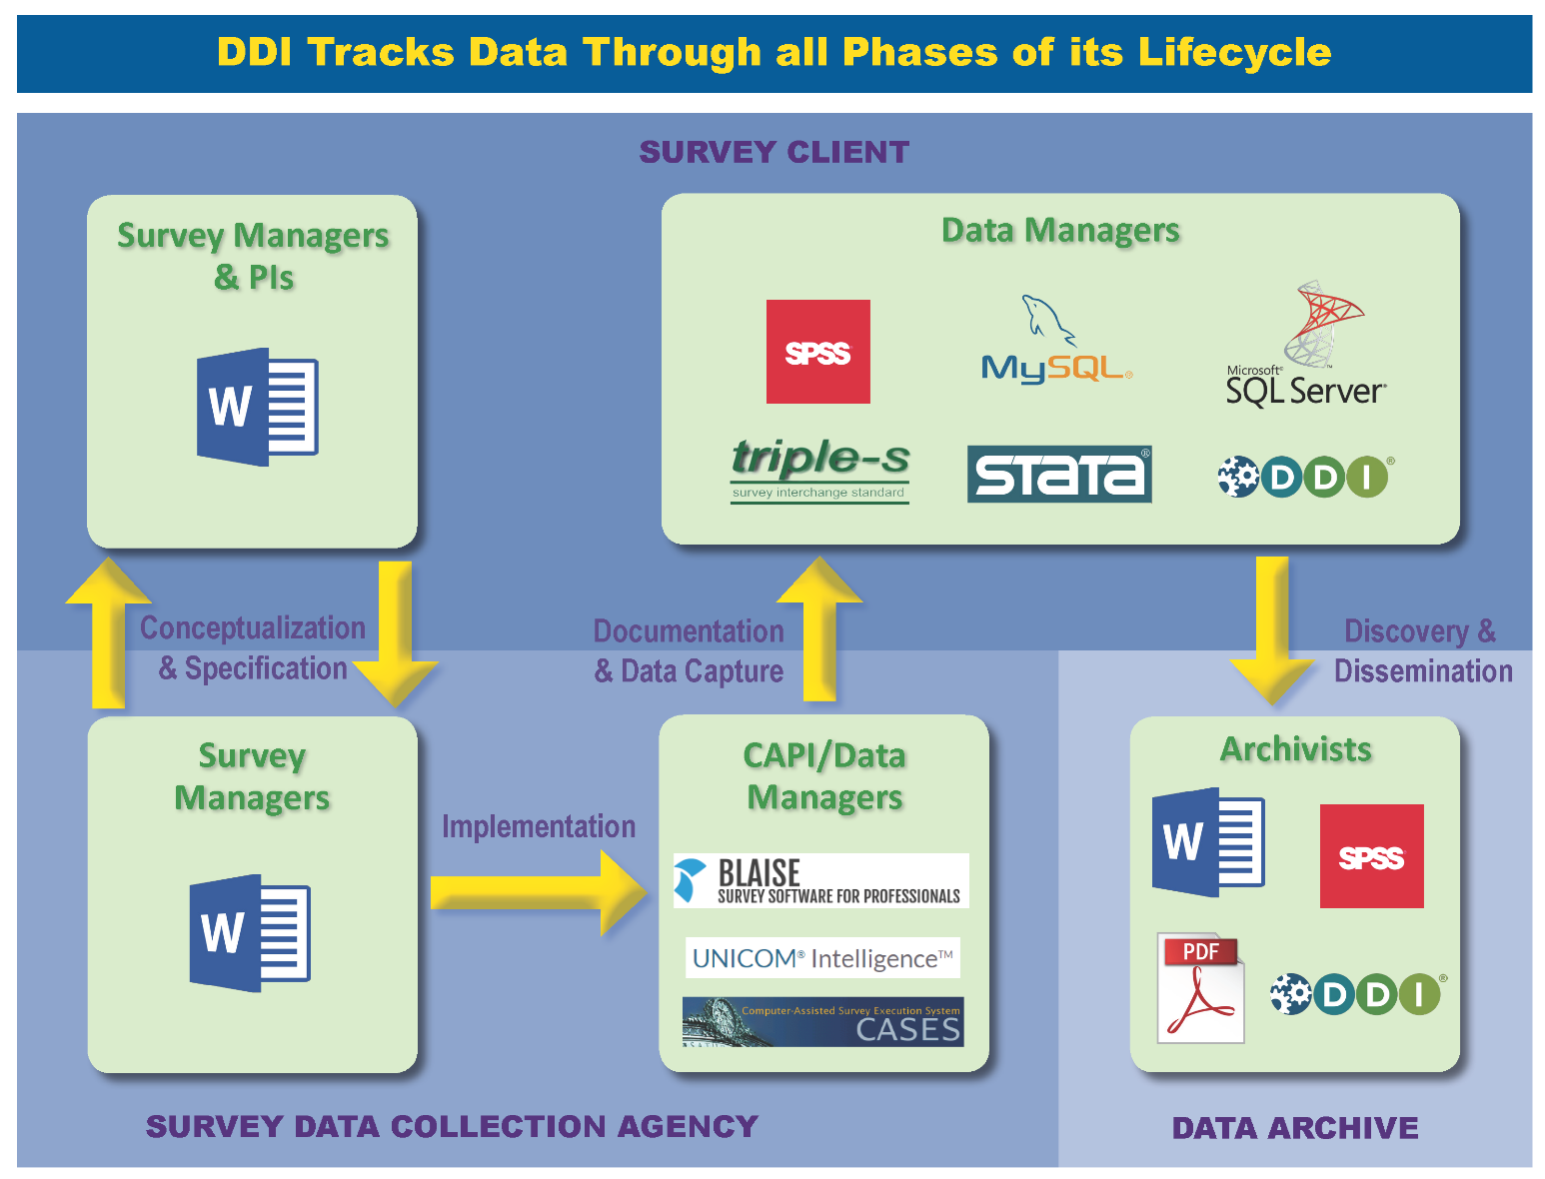
Tackling diversity in the Survey Process
Notes:
The survey process, especially on large scale longitudinal studies, involves many actors / organizations, reducing information loss between them is critical to increasing quality and reducing costs

Slide 5
What are survey questions trying to achieve
Accurate Communication & Accurate Response
Most important considerations are:
Language used
Frame of reference
Arrangement of questions
Length of the questionnaire
Form of the response
Dichotomous
Multiple choice
Check lists
Open Ended
Pictorial
From Young, Pauline (1956) “Scientific Social Surveys & Research”, 3rd Edition. Prentice Hall

Slide 6
What we are trying to capture with DDI
How the survey was communicated & how participants responded
Most important considerations are:
Language used in the questions
Frame of reference
Arrangement of questions
Length of the questionnaire
Form of the response
Dichotomous
Multiple choice
Check lists
Open Ended
Pictorial
Who was asked
Who responded
Is the question asked related to another question
Who was responsible for the collection
Notes:
Highlighted in blue are other information additional to the questionnaire itself that are essential to understanding it

Slide 7
What DDI provides
Capture what was intended
What, where it came from and why
Capture exactly what was used in the survey implementation
How, the logic employed and under what conditions
To specify what the data output will be
That is mirrors what was captured and its source
To keep the connection between the survey implementation through to the data received -> data management at a study -> to archiving
Generalised solution
So that is can be actioned efficiently and is self-describing
So that it can be rendered in different forms for different purposes
Notes:
To do something with this, we need ……

Slide 8
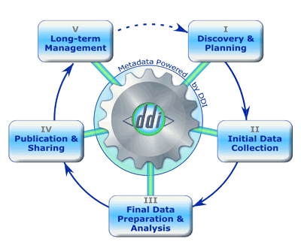
And a framework to do this
Methodology and
Instrument Design
Instrument Fielding and
Data Collection
Documentation, READMEs,
Descriptions (non-dataset
or variable)
Data Cleaning, Labeling,
And Transformations

Slide 9
Data production
Questionnaire development
Colectica (DDI to Blaise / CASES etc)
Questionnaire metadata and data export
Blaise (well used add on)
Unicom Intelligence (Colectica export)
CASES (SDAtoDDI, and Colectica)
RedCap (API and Colectica)
Data production
StatTransfer
SledgeHammer
Colectica
Notes:
DDI is supported to a lesser or greater extent across many CAI software packages

Slide 10
Discovery and dissemination
Archives
Australian Data Archive (2 million variables)
ICPSR (4.5 million variables)
CESSDA (14 European social science data archives)
Research Portals
MIDUS (25,000 variables)
CLOSER (45,000 variables, 18,000 questions)
Notes:
Widescale usage of DDI for discovery and research, the catalogues of the majority of Archives and emerging research portals are based on DDI

Slide 11
Choosing the right flavor
Codebook
Cross-sectional data (codebook)
Easy to implement
Lifecycle
Longitudinal data
Harmonization
Re-use of data and questions
Support process description e.g. questions

Slide 12
DDI in practice

Slide 13
Use Case: MIDUS
Key strength of MIDUS:
Multiple longitudinal samples
Multidisciplinary design
Products:
N<13,000
25,000 variables
20 datasets
Wide secondary usage – Open Data philosophy
Top data download at ICPSR
68k data downloads; 30k users
700+ publications
Survey data collection with CASES (DDI friendly)

Slide 14
Use Case: MIDUS
Metadata capture is crucial for:
Harmonization
Discovery
Data download capabilities

Slide 15
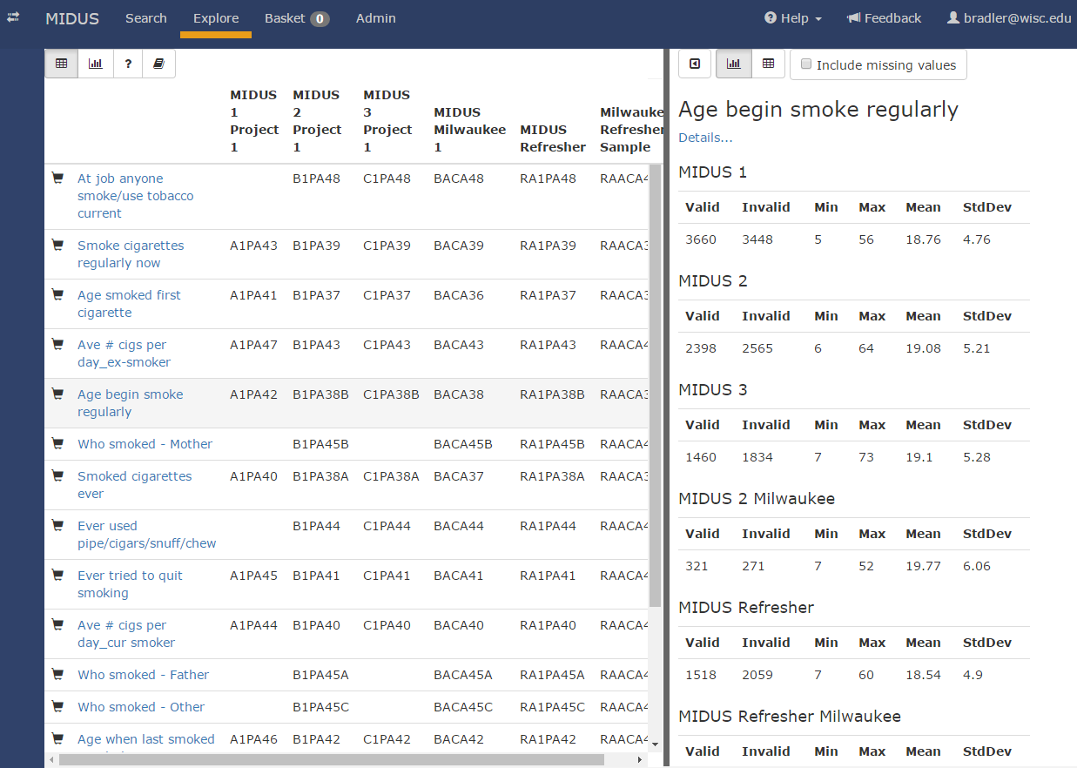
Use Case: MIDUS - Harmonization

Slide 16
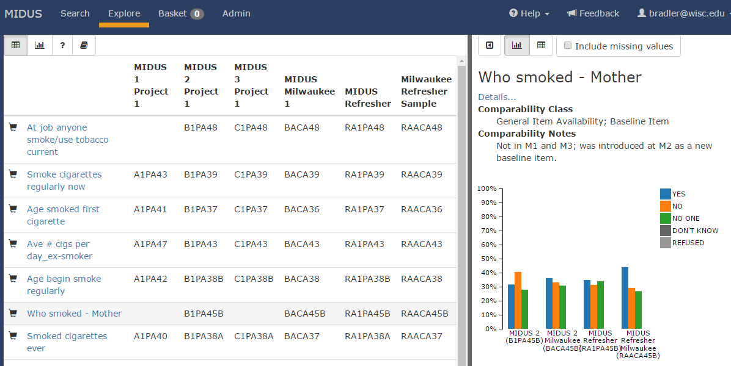
Use Case: MIDUS - Discovery

Slide 17
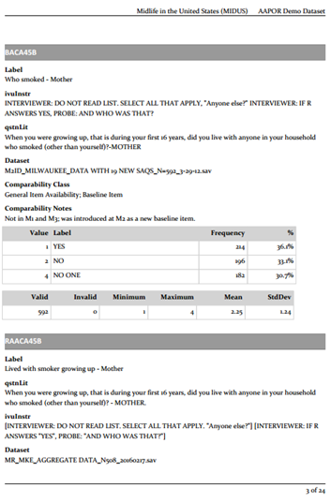
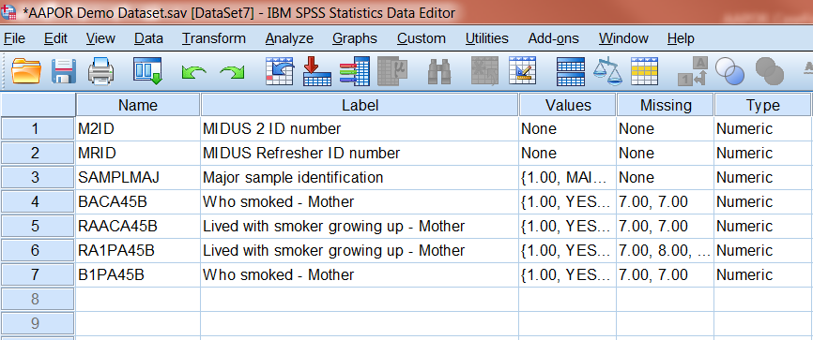
Use Case: MIDUS - Download
Codebook
Dataset

Slide 18
Use Case: CLOSER
Key strength of CLOSER
Multiple longitudinal samples
Multiple cohorts (1930 – present)
Biomedical & Social Science
Products:
N ~ 150,000
~ 250,000 variables
~ 300 datasets
Metadata only platform
Full Questionnaire flow and contents
Cross-cohort comparison

Slide 19
Millennium Cohort Study
Data Extraction
Dimensions MDD + DDF
Dimensions MDD + DDF
QA
Clean and Edit
Export to SPSS
Colectica Designer
SPSS (Edited)
DDI XML
Notes:
IPSOS worked with Centre for Longitudinal Studies, and Colectica to improve the extraction of high quality metadata from IBM DC, this is the only CAI software currently in use in the UK

Slide 20
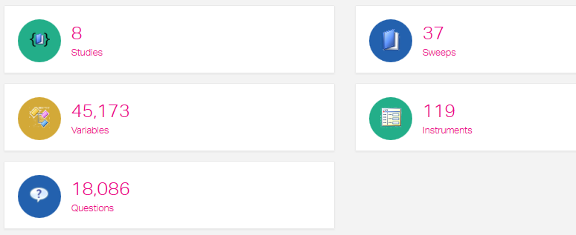
Use Case: CLOSER - Scope

Slide 21
Use Case: CLOSER - Questions

Slide 22
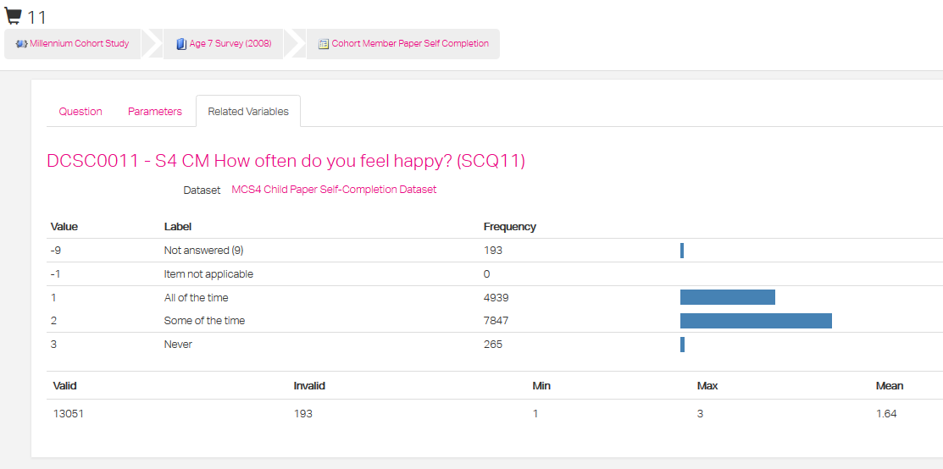
Use Case: CLOSER - Data

Slide 23
A Common mechanism for communication
Capture what was intended
What, where it came from and why
Capture exactly what was used in the survey implementation
How, the logic was employed and under what conditions
To specify what the data output will be
Mirrors what was captured and its source
To keep the connection between the survey implementation through to the data received -> data management -> to the archive
Generalised solution
So that is can be actioned efficiently and is self-describing
So that it can be rendered in different forms for different purposes

Slide 24
Some final thoughts
Reduction in manual processes
More accurate, cheaper and quicker
One DDI document → multiple uses
Enables distributed data collection
Across different platforms and organizations
Enables distributed research
Increased quality of documentation of data collection
Raises visibility of needs
Encourages users to better understand
the data and
the data collection process
New tools to think in more interesting ways can be built

Slide 25
Another perspective
Dan Gillman: Information Scientist, Bureau of Labor Statistics

