Slide 1
DDI Marketing and Partnerships Group
Report and Plan 2018
Team:
Barry Radler
Kelly Chatain
Jared Lyle
Steve McEachern
Ron Nakao
Dan Smith
Wendy Thomas

Slide 2
Mission Statement
Coordinate marketing activities, establish DDI brand, ensure consistent messaging
Interface with other standards bodies (Partnerships)
Goal: Increase the DDI user community and DDI Alliance membership

Slide 3
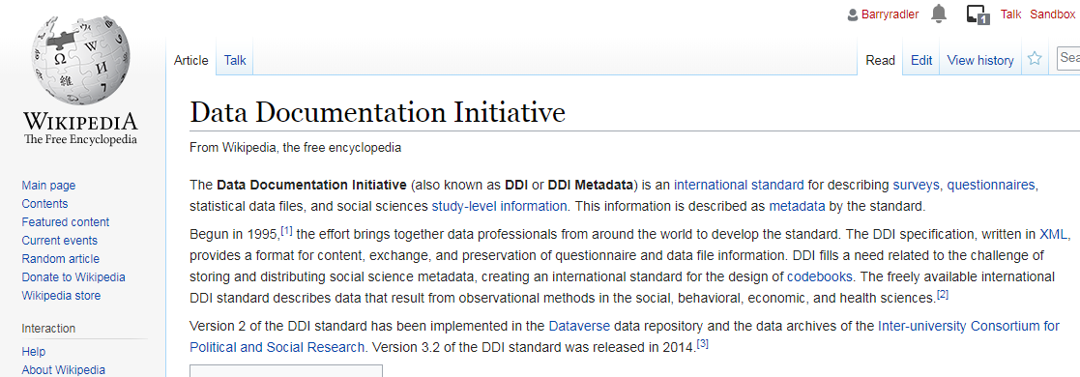
What worked during the past year?
Promotional activities
APDU webinar
Response to OMB and NSF Request For Information
Opened PRNewswire account for distributing press releases
Promoted NADDI
Opportunities to expand use?
Online presence
Update time-sensitive content on website
Twitter account: @DDIAlliance
Updated Wikipedia page
Monitoring website traffic with Google Analytics
Notes:
Conducted a webinar with APDU group; Jon Johnson, Jared, and I presented an introduction to DDI and demonstrated its benefits for data archives and research.
Importantly, we submitted responses to 2 RFIs the past 6 months. Jared submitted these responses to research data infrOpenedastructures and how to support reproducible and shareable research data.
Opened a PRNewswire account in order to help promote the NADDI conference.
Importantly, we could expand its use to help distribute press releases and news about DDI
Continued to work on maintaining and improving out online presence.
We’ve become much better at updating time-sensitive content on the website (most of our Marketing materials are available thru there).
Opened a Twitter account (Jared has been conscientiously updating)
Started managing an existing Wikipedia page
Also began monitoring DDI Alliance website traffic using Google Analytics.

Slide 4
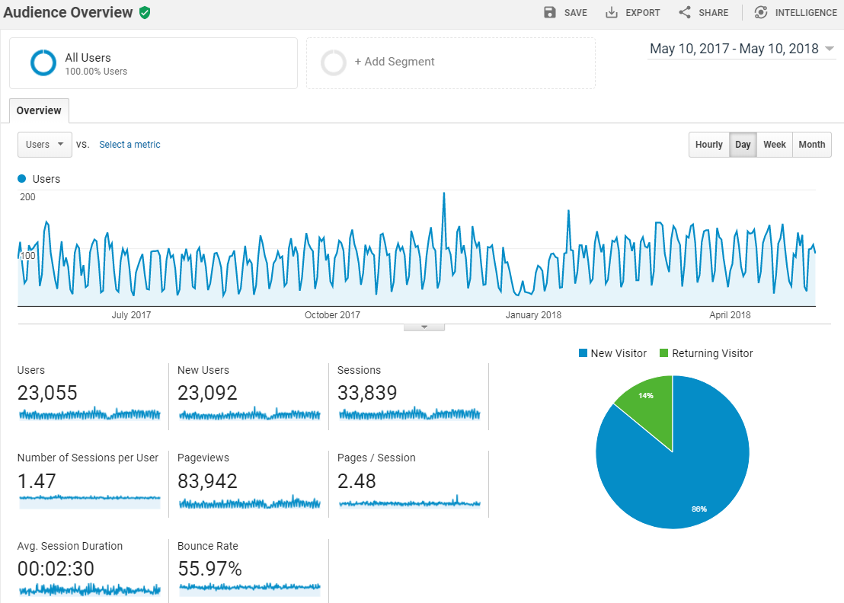
Notes:
Using Google Analytics allows us some insight into our users and potential users, at least the ones who are using the website.
The following few slides show some metrics and statistics about DDI Alliance website in the past 12 months.
23,000 users, the vast majority of which are new and not returning visitors
Generally the traffic shows a consistent pattern, but there was a big spike on November 21, 2017.
Bounce rate: the percentage of visitors to a website who navigate away from the site after viewing only one page.

Slide 5
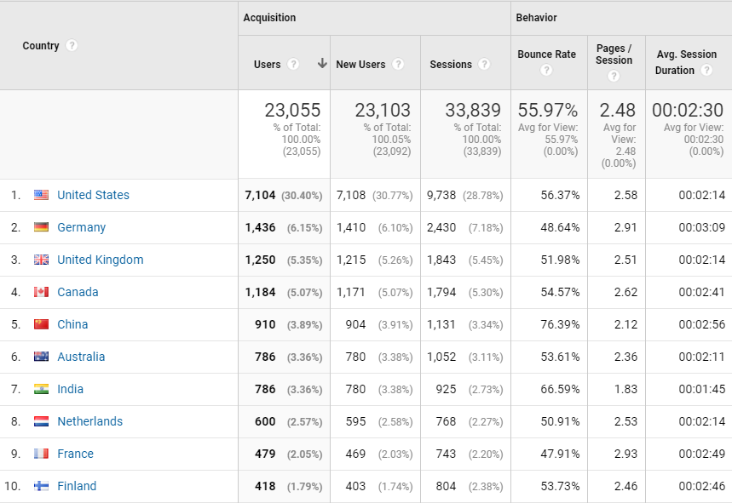
Notes:
We can get a handle on who these website visitors are:
Nearly a third are US users, followed by Germany, UK, and Canada.
The Germans and French have slightly lower bounce rates and look at more pages than others.

Slide 6
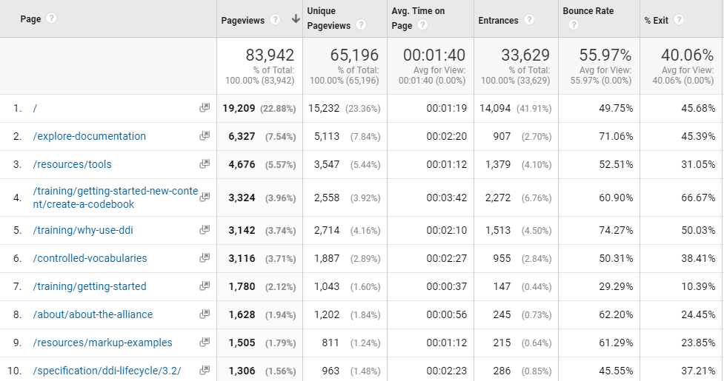
Notes:
One of the most useful metrics, IMHO, are the behavior stats:
The top pages used are:
Documentation and Tools page – this speaks volumes
“Entrances” is the number of times visitors entered the site through a specified page.
The top ones were “Getting Started – How to create a codebook” and “Why use DDI?”
Finally the bounce rate for the “Getting Started” page had the lowest bounce rate by far.
Just a few brief insights from the DDI Alliance webpage.

Slide 7
What worked during the past year?
Promotional activities
Conference attendance
Ongoing use of promotional printed and electronic materials, conference schwag
Continued promotion to communities/conferences
Sponsorships, exhibitions, and ads at IASSIST, AAPOR, ESRA, APDU, EDDI, NADDI
Notes:
Continued to have a presence at of targeted conferences;
Continued using the promotional materials, include multiple brochures, a rolling PP presentation on a screen; and new conference schwag or tchatchis, including things like the USB drive slap bracelets which have proved popular. These are all available at booths that the DDI Alliance is tending at these conferences.
Have been sponsors, exhibitors, or advertisers at a number of conferences and have been trying to expand this list.
We track these and potential conference targets on the Marketing Wiki page.

Slide 8
What worked during the past year?
Promotional activities
Conference attendance
Coordination with other DDI groups
Increased user community (Partnerships)
Four new DDI Alliance members since May, 2017
AAPOR Transparency Initiative – webinar in August, 2018
Some followup last week at AAPOR
Notes:
Third, we continue to improve coordination with other DDI working groups, primarily training and the TC. This is particularly important to promotional and marketing communication concerns so that different members of the DDI Alliance and community are all singing from the same hymnal – still have a ways to go to instill some rigor in message discipline thought.
Also we’ve increased the user community with four new DDI Alliance members since this time last year – not all Marketing’s doing, but it is one of our goals and metrics.
As for other Partnerships, we’ve made overtures to the AAPOR TI and see some really good opportunities to realize some synergies, and being associated with AAPOR would be a boon.
Conducted a webinar for AAPOR last summer, while contact has dropped off, we (really the Roper Center, one of our new members) recently conducted some followup with them at AAPOR last week.

Slide 9
Challenges looking forward
Establishing relationships with other standards bodies
Refining process of promotion among working groups
Steps: Attention → Interest → Education → Training, documentation, tools
How to improve hand-off among groups/steps?
How to engage new community members?
Maintain email list of users, conference attendees/invitees
Identifying customers? Users vs. active individuals?
Identifying metrics for success of promotions:
“Half the money I spend on advertising is wasted; the trouble is I don't know which half.” - John Wanamaker (1838-1922), considered a "pioneer in marketing”
Notes:
While we’ve reached out to a few examples like the TI, the Marketing and Partnerships groups is definitely more focused on the Marketing piece of things. I’m not sure we have enough capacity to do both, and there seem to be a number of partnerships that are pursued between the Alliance and other standards groups that aren’t organized through this group.
As a volunteer organization, it is a challenge to operate like for-profit business in which the process of promotion would be better coordinated.
If we think of how to move increase membership and use, there might be 4 steps. Marketing is mainly focused on the earlier steps; garnering awareness and generating interest, some education. But we still need a good way to engage potential users.
Another challenge with DDI as an open standard is how do we identify current users? They don’t have to buy anything, get permission from us, anything. We could have more users than we know.
Related to that, and this a concern that Jared and I have talked about: how do we know we’re moving the needle with our communication efforts? We could use some more and better metrics.
But doing nothing isn’t an option. The problem with advertising is that the causal sequence is often not clear.
but we are establishing some relationships – successfully reached out in just the past 2 weeks to AAPOR TI
Also continue to refine the division of labor among the DDI working groups

Slide 10
Plans for next 12 months
Promote:
Prototype review
Updates to DDI 3.3 and XKOS
Coordinate with TC
Improve website
Develop email list (list-serves, conference attendees, invitees)
Continue/expand conference presence and attendance
Consider more sponsorships, “getting in the program” is ideal
Begin feedback and input process from members
Consider sit-down interviews with each DDI Alliance member
Notes:
Promote:
Prototype
Review of 3.3 and release of XKOS
We’ll coordinate with TC on this and other releases.
Improve website:
As I demonstrated with the Google Analytics, the website is one promotional vehicle for which we can identify our user audience and provide some metrics of success in promotion. Therefore we need to prioritize and dedicate resources towards improving and fixing it.
Continue conference presence, attendance, and outreach (like webinars).
Getting in the program is ideal for these, but that takes either a canned presentation, or individual initiative.
Latest idea, begin formal feedback and input process with membership
Surveys haven’t worked well
Give members the white glove treatment and full attention with in-person or conference calls whereby we can ask some standard questions but also get rich unedited feedback about DDI’s performance and direction.

Slide 11
Resources required next 12 months
2018 budget ($17k)
Ongoing - marketing materials, printing brochures, conference schwag,
PRNewswire?
Website development?
Ongoing - conference sponsorships, advertising, attendance/travel
2019+: Outsource tasks not being accomplished by volunteer contributions
Dedicated Marketing and Promotion position:
Website design and maintenance
Updating Wiki, social media
Press releases, promoting user conferences
Conference attendance and active outreach
Grant writing
Notes:
Looking forward, we’re slightly increasing our budget this next year, but we didn’t spend the entire budget last year.
This money will go towards continued promotion and marketing materials
Possibly expand use of the PRNewswire?
Also prioritize work on the website.
From a longer term perspective, I continue to believe the Alliance should dedicate funds to a marketing and promotion professional who can dedicate themselves to things the volunteers just can’t get done.
The right person could be a website designer, manage other vehicles, produce press releases, make the conference circuit, and possibly even help with acquiring other sources of revenue such as grant-writing.
As a free and open standard, the DDI spec is reliant on something akin to crowdsourcing: to identify problems and solutions to the standard, and to help with the work of sustaining, improving, and developing the standard. Because of this, DDI directly benefits to the extent more people use it. Following that line of thought--and this is where I’m editorializing--promoting our current line of DDI products in order to grow our user base is key to the success of the standard. And our budget and strategic directions should reflect that.
If we want to bring more resources to bear on developing DDI4, then increase the number of people currently using DDI. To do that, you have to communicate persuasively the benefits of DDI to potential audiences.

