Slide 1
DDI Marketing and Partnerships Group
Report and Plan 2019
Team:
Barry Radler
Kelly Chatain
Jared Lyle
Steve McEachern
Ron Nakao
Dan Smith
Wendy Thomas

Slide 2
Mission Statement
Coordinate marketing activities, establish DDI brand, ensure consistent messaging
Interface with other standards bodies (Partnerships)
Goal: Increase the DDI user community and DDI Alliance membership

Slide 3
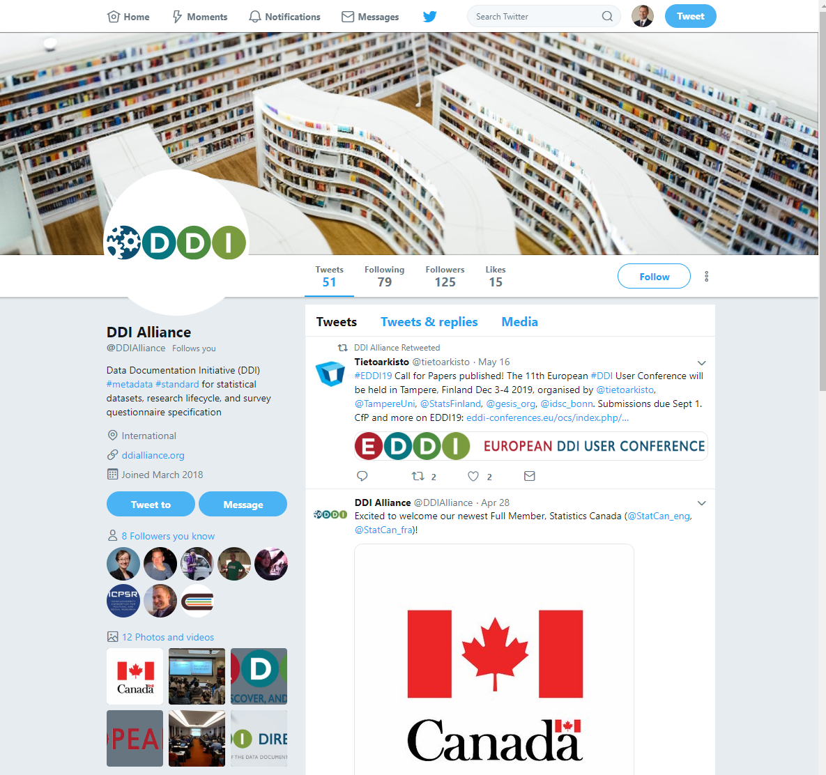
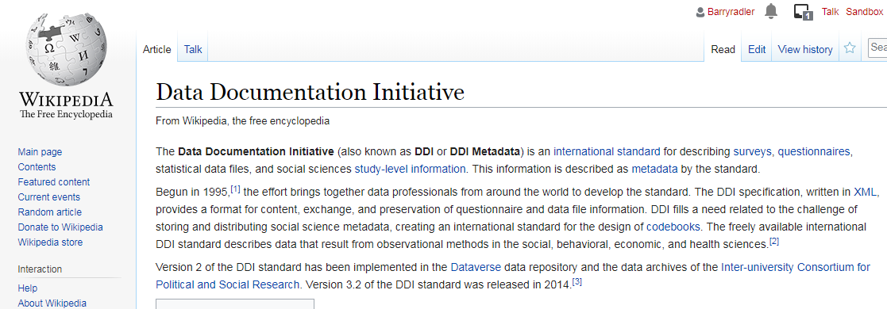
Activities during the past year
Promotional activities
Relatively quiet year of marketing activity
Maintenance of ongoing efforts
Wiki - Jared
Twitter
Monitoring website with Google Analytics

Slide 4
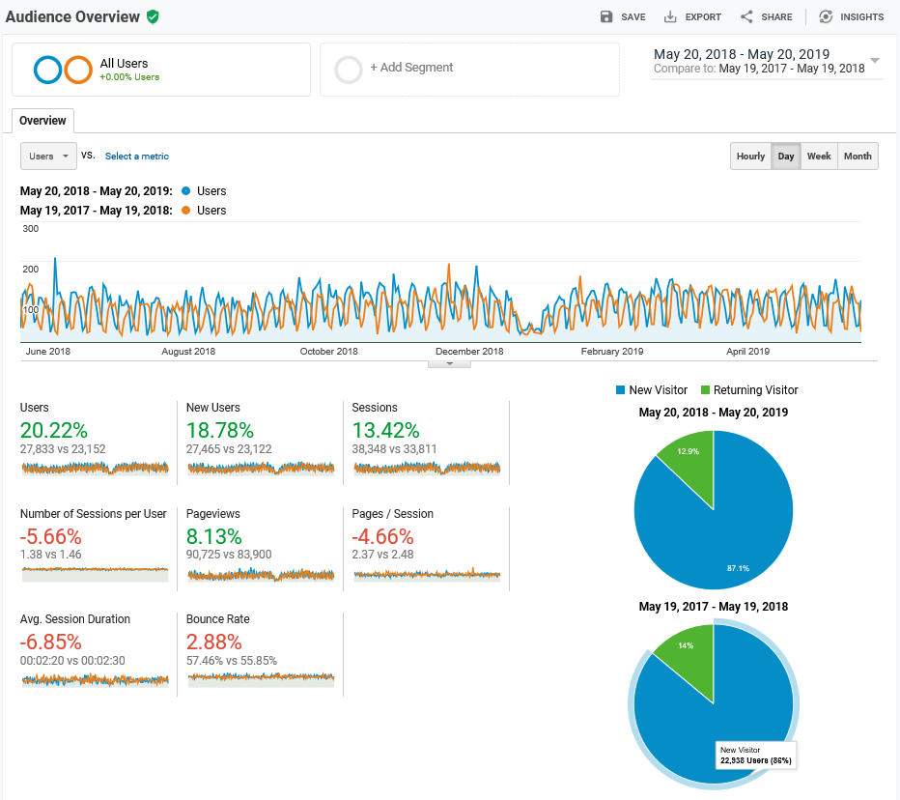
Notes:
Big spike on Monday June 4, 2018.
Other spikes in November and December, both years.
Overall, 20% increase in # of users and new users
But decreases in stickiness of site – can’t keep them for long.
Bounce rate: the percentage of visitors to a website who navigate away from the site after viewing only one page.
Only 13% of visitors return to the site after one view.

Slide 5
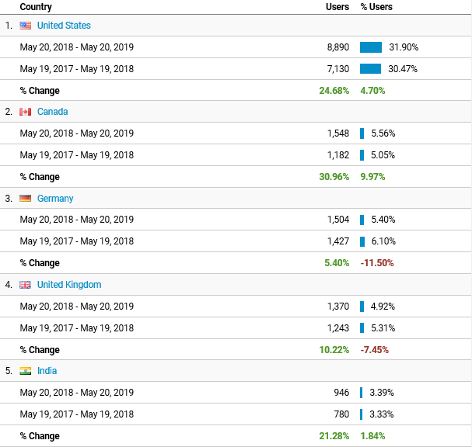
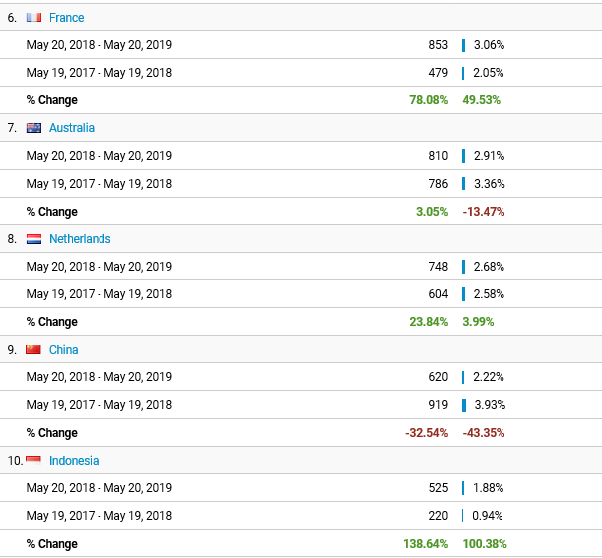
Audience by country
Notes:
We can get a handle on who these website visitors are:
Nearly a third are US users, followed by Canada, Germany, and UK.

Slide 6
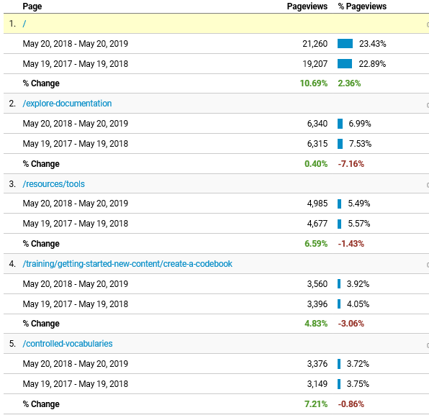
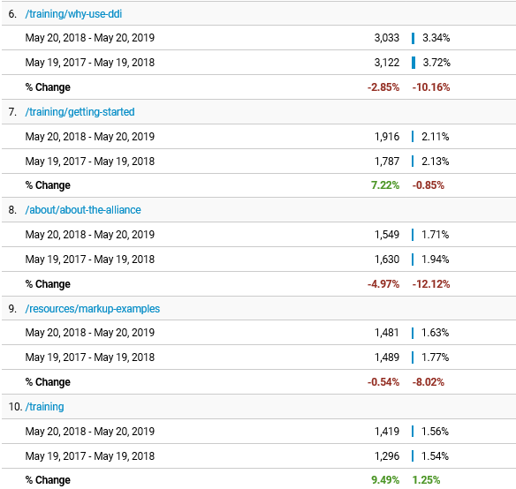
Behavior by pages viewed
Notes:
One of the most useful metrics, IMHO, are the behavior stats:
The top pages used are:
Documentation and Tools page – this speaks volumes
“Entrances” is the number of times visitors entered the site through a specified page.
Similar to 2018, the top ones were “Getting Started – How to create a codebook” (6.6%) and “Tools” (3.8%), also “Why use DDI?” (3.4%)
Finally the bounce rate for the “Getting Started” page had the lowest bounce rate by far.
Just a few brief insights from the DDI Alliance webpage.

Slide 7
What worked during the past year?
Promotional activities
Conference attendance
Ongoing use of promotional printed and electronic materials, conference schwag
Continued promotion to communities/conferences
Sponsorships, exhibitions, and ads at IASSIST, AAPOR, ESRA, APDU, ESS, EDDI, NADDI
Branch out: RDA, others?
Notes:
Continued to have a presence at of targeted conferences;
Continued using the promotional materials, include multiple brochures, a rolling PP presentation on a screen; and new conference schwag or tchatchis.
Have been sponsors, exhibitors, or advertisers at a number of conferences and have been trying to expand this list.
We track these and potential conference targets on the Marketing Wiki page.

Slide 8
What worked during the past year?
Promotional activities
Conference attendance
DDI Alliance membership treading water
Notes:
New: Stats Canada
Lost: Roper, ABS, ITMO (France)

Slide 9
Plans for next 12 months
Promote
Continue/expand conference presence and attendance
Gather feedback and input from Alliance members and user community
Proposed formal assessment
Requires money, effort, and time

Slide 10
Longer term DDI Marketing goals
Dedicated DDI Alliance position (50-100%):
Website design and maintenance
Updating Wiki, social media
Membership maintenance
Press releases, promoting user conferences
Conference attendance and active outreach
Revenue generation, grant writing
Notes:
I believe the Allliance would benefit from a dedicated position to actively promote the standard, maintain promotional resources, conduct outreach to members and more conferences, and increase the revenue stream.
The Alliance has regularly hired consultants for development work; I believe that increasing membership and user base will speed future development, not the other way around. And a re-allocation of resources and effort is needed.

