Slide 1
Introduction to…

Slide 3
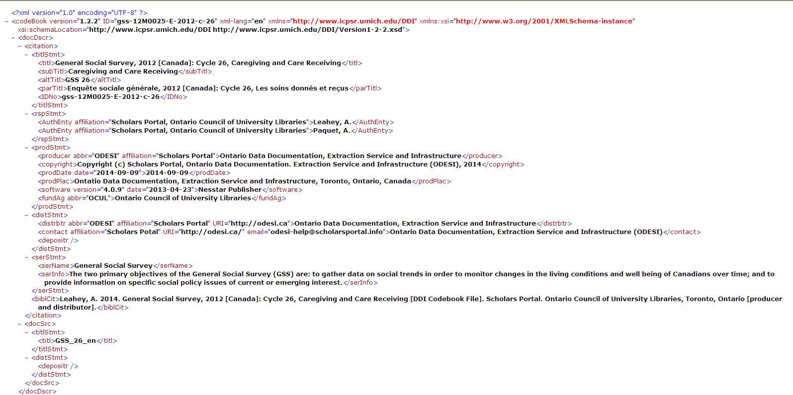
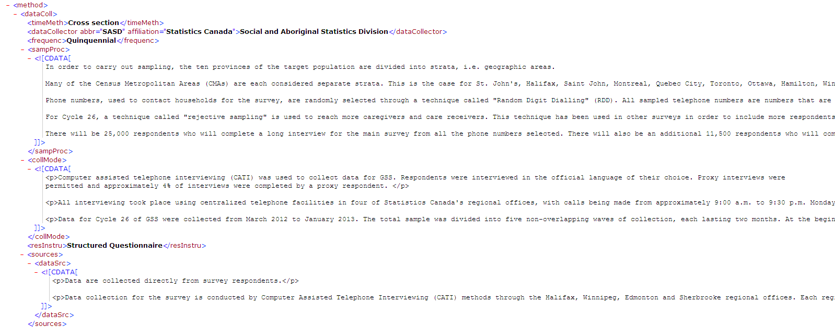

Slide 7
DDI Lifecycle

Slide 8
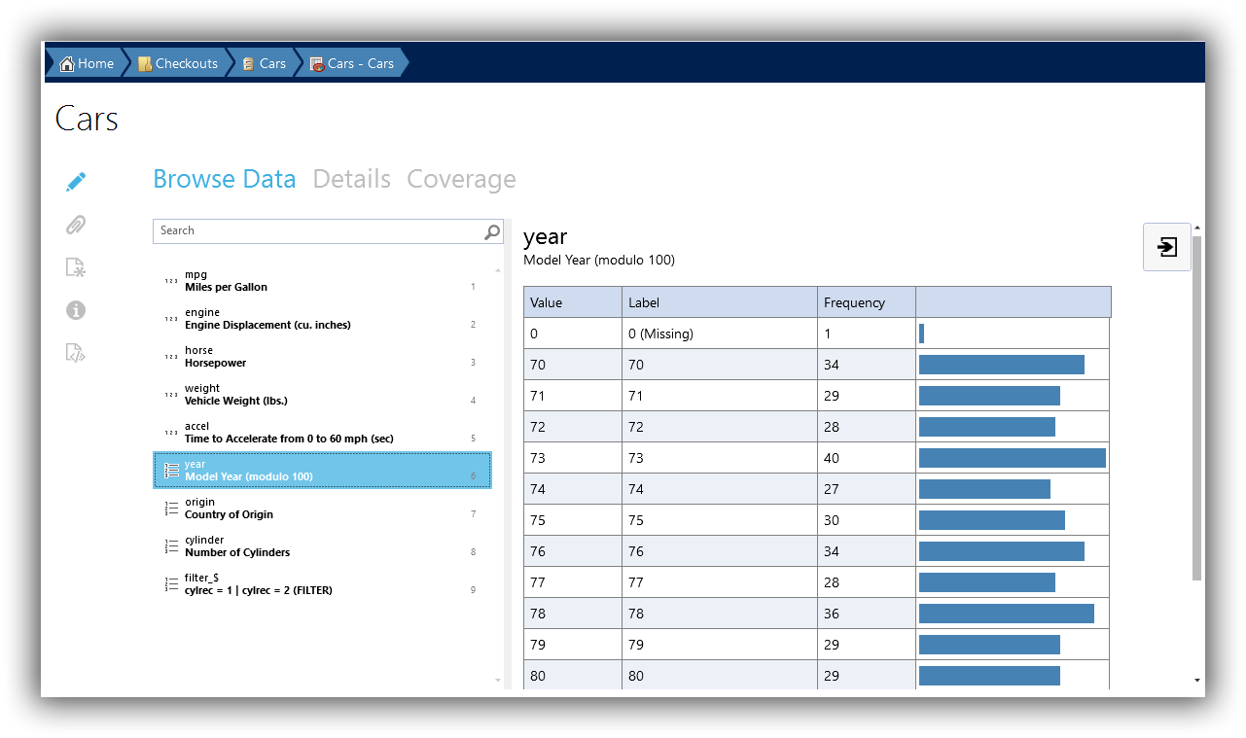
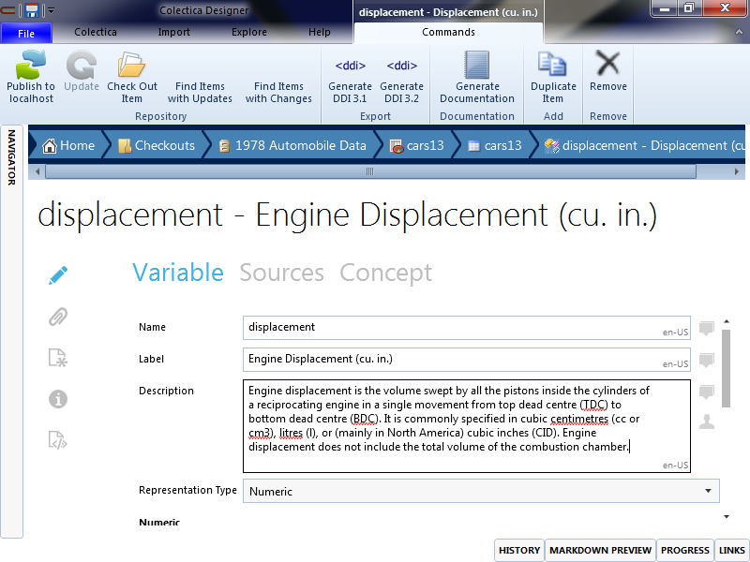
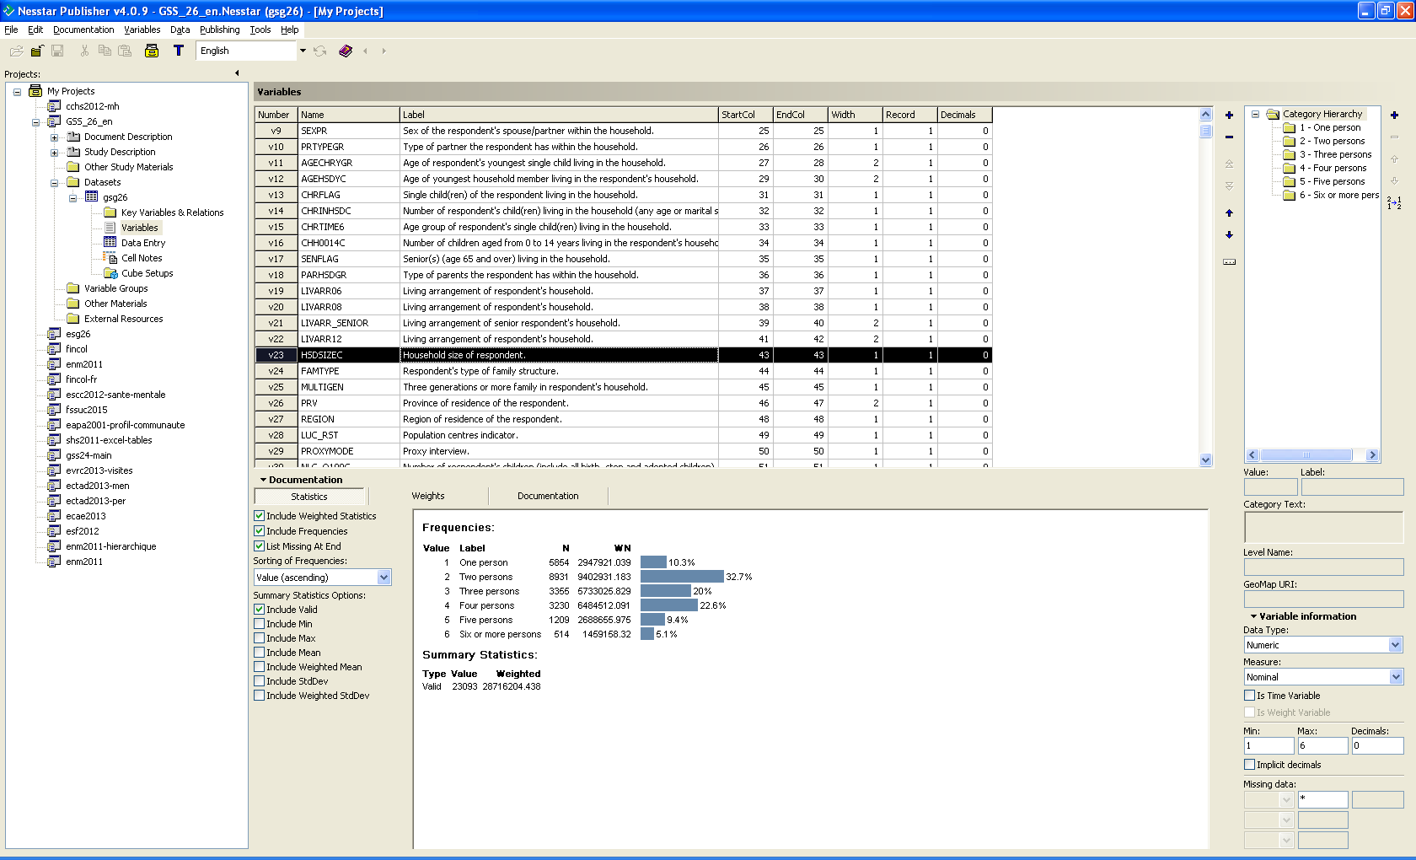

Slide 10
The DDI Alliance
University of Alberta, Canada
Australian Bureau of Statistics (ABS)
Australian Data Archive (ADA)
University of California, Berkeley -- Computer-Assisted Survey Methods Program and UCDATA
Centre for Longitudinal Studies, Institute of Education, University of London (Associate Member)
Centro De Investigaciones Sociologicas (CIS), Spain
Colectica (Associate Member)
Cornell University (CISER)
Danish Data Archive
Data Archiving and Networked Services (DANS), The Netherlands
Epidemiology France, Aviesan - ITMO Santé Publique
Eurostat
Finnish Social Science Data Archive
Food and Agriculture Organization (FAO)
German Institute for International Educational Research (DIPF)
German Socio-Economic Panel Study (SOEP)
GESIS - Leibniz Institute for the Social Sciences
University of Guelph
Institute for Quantitative Social Science (IQSS) at Harvard University
Institute for Social and Economic Research (ISER)
Institute for the Study of Labor (IZA)

Slide 11
The DDI Alliance
Inter-university Consortium for Political and Social Research (ICPSR)
University of Kansas, Institute for Policy and Social Research (IPSR) (Associate Member)
Massachusetts Institute of Technology (MIT)
University of Minnesota, Minnesota Population Center
National Institute of Statistics and Economic Studies (INSEE)
Norwegian Social Science Data Service (NSD)
Open Data Foundation (Associate Member)
Research Data Centre of the German Federal Employment Agency, Institute for Employment Research (IAB)
Roper Center
Stanford University
Statistics New Zealand
Survey Research Operations, University of Michigan
Swedish National Data Service (SND)
Swiss Foundation for Research in Social Sciences (FORS)
United Kingdom Data Archive
University of Toronto Libraries
University of Toronto Scholars Portal
University of Washington, Center for Studies in Demography & Ecology (CSDE)
U.S. Bureau of Labor Statistics (Associate Member)
World Bank, Development Data Group (DECDG)

