Slide 1
FAIR Data Sharing and DDI
DDI Training Library
Version 1.0
DDI Alliance, DDI Train the Trainers Workshop, DDI Training Working Group
This work is licensed under Creative Commons Attribution 4.0 International License.

Slide 2
Overview
What is FAIR?
Where is the Metadata?
The FAIR Ecosystem
How DDI Supports FAIR

Slide 3
What is DDI?
The Data Documentation Initiative (DDI) is a suite of metadata specifications for the Social Behavioral and Economic (SBE) sciences
It is granular, machine-actionable (XML), and platform-independent
Used by many data archives and producers throughout the globe

Slide 4
What is FAIR?

Slide 5
QUIZ: What is “FAIR”?
An elaborate contemporary folk dance involving the energetic flapping of the jaws and waving of hands, followed by a prolonged period of inactivity
A specific set of universally agreed practices for sharing research data, implemented by adhering to well-defined specifications applying equally across all domains
A compelling article published in Nature in 2016, describing the basic principles which should be followed for sharing research data in sciences of all kinds

Slide 6
QUIZ: What is “FAIR”?
An elaborate contemporary folk dance involving the energetic flapping of the jaws and waving of hands, followed by a prolonged period of inactivity
A specific set of universally agreed practices for sharing research data, implemented by adhering to well-defined specifications applying equally across all domains
A compelling article published in Nature in 2016, describing the basic principles which should be followed for sharing research data in sciences of all kinds

Slide 7
QUIZ: What is “FAIR”?
An elaborate contemporary folk dance involving the energetic flapping of the jaws and waving of hands, followed by a prolonged period of inactivity
A specific set of universally agreed practices for sharing research data, implemented by adhering to well-defined specifications applying equally across all domains
A compelling article published in Nature in 2016, describing the basic principles which should be followed for sharing research data in sciences of all kinds

Slide 8
QUIZ: What is “FAIR”?
An elaborate contemporary folk dance involving the energetic flapping of the jaws and waving of hands, followed by a prolonged period of inactivity
A specific set of universally agreed practices for sharing research data, implemented by adhering to well-defined specifications applying equally across all domains
A compelling article published in Nature in 2016, describing the basic principles which should be followed for sharing research data in sciences of all kinds

Slide 9
FAIR Is a (Simple) Idea
Findable, Accessible, Interoperable, Re-usable
Embodied in a set of principles (“The FAIR Guiding Principles”)*
Promote data-sharing and reuse
Within and between domains
Not a new idea!
DDI has been focused on data sharing and reuse for decades
The archival community is in the business of data-sharing and reuse
Complex topic, not always clearly articulated
Important ideas whose time has come
Demand for more data (large projects, new technologies)
More cross-cutting, multi-domain research (i.e., UN Sustainable Development Goals)
Demand for data coming from more different sources
Broader acceptance of data-sharing as important
The key to FAIR data is metadata
* Wilkinson MD, Dumontier M, Aalbersberg IJJ, Appleton G, Axton M, Baak A et al. The FAIR Guiding Principles for scientific data management and stewardship. Scientific Data. 2016;3. 160018. https://doi.org/10.1038/sdata.2016.18

Slide 10
Where is the Metadata?

Slide 11
FINDABLE
F1 – (Meta)data are assigned a globally unique and eternally persistent identifier
F2 – Data are described with rich metadata
F3 – (Meta)data are registered or indexed in a searchable resource
F4 – Metadata specify the data identifier

Slide 12
ACCESSIBLE
A1 – (Meta)data are retrievable by their identifier using a standardized communications protocol
A1.1 – The protocol is open, free, and universally implementable
A1.2 – The protocol allows for an authentication and authorization procedure, where necessary
A2 – Metadata are accessible, even when the data are no longer available

Slide 13
INTEROPERABLE
I1 – (Meta)data use a formal, accessible, shared, and broadly applicable language for knowledge representation
I2 – (Meta)data use vocabularies that follow FAIR principles
I3 – (Meta)data include qualified references to other (meta)data

Slide 14
RE-USABLE
R1 – (Meta)data have a plurality of accurate and relevant attributes
R1.1 – (Meta)data are released with a clear and accessible data usage license
R1.2 – (Meta)data are associated with their provenance
R1.3 – (Meta)data meet domain-relevant community standards

Slide 15
Some Things to Note
All of the top-level principles mention “metadata” (at least once)
Many things described are, in fact, metadata
Identifiers (F1)
Licensing (R1.1)
Provenance (R1.2)
Vocabularies (I2)
Standards are important
Persistent identification schemes require standards (F1)
“Protocols” are a (technical) type of standard (A1)
“Knowledge representation” hints at many popular standards (I1)
“Community standards” are directly mentioned (R1.3)
“Qualified references” implicitly require standards (I3)

Slide 16
The FAIR Ecosystem

Slide 17
The FAIR Ecosystem
There is no single set of specifications for implementing FAIR data sharing
There are organizations (and collaborative projects) which proactively support FAIR:
GO FAIR
Research Data Alliance (RDA)
CODATA
FAIRsFAIR Project
European Open Science Cloud (EOSC) – Including SSHOC/CESSDA
Many, many others
There is an emerging set of standards, protocols and approaches around FAIR
FAIR Implementation Profiles (FIPs)
FAIR Digital Objects (FDOs)
FAIR Data Points (FDPs)

Slide 18
FAIR Implementation Profiles (FIPS)
Description of what is being used by which FAIR communities
Community-driven description of how FAIR is implemented
Useful as an indication of what standards and vocabularies are likely to be found
Helpful in locating significant repositories of data and metadata
Meant to be machine-readable, may be machine-actionable
Still under discussion
Uses a standardized form to collect information from projects/communities
Notionally, FIPS are the contents of a “catalogue of catalogues” highlighting relevant resources
https://www.go-fair.org/how-to-go-fair/fair-implementation-profile/

Slide 19
FAIR Digital Objects (FDOs)
A way of packaging all the needed information for a data resource together
A universal protocol for navigating the FAIR ecosystem
Very high-level: each domain will define its own part of the overall picture
Similar to TCP/IP for Internet addresses (universal protocol)
FDOs may contain a minimal set of high-level metadata
This is not fully specified yet – work is ongoing
Always includes a globally unique persistent and resolvable identifier
Enough to support use (and references to more)
Data and metadata should “travel” together
FAIR Digital Object Forum: https://fairdo.org/

Slide 20
FAIR Data Points (FDPs)
A location on the Internet where data (and metadata) is made available according to the FAIR principles
Can be narrowly defined as a SPARQL end-point
Very popular way of implementing FDOs
Not everyone uses RDF
A well-run repository is an FDP
If it embodies the FAIR principles
The technical requirements here may become stricter moving forward
Currently under development
https://www.fairdatapoint.org/

Slide 21
How Do These Things Fit Together?
While recognizing that there are different types of data, metadata, and other information which are important, there also need to be technical implementations
FAIR is technology agnostic
The technology will change
The FAIR principles will not change
The RDF technologies from the W3C are a popular approach
They are not the only option
Domains have their own cultures of technology implementation

Slide 22
Registry of Catalogues
FAIR Data Point
PIDs
(By Domain)
FIPs
DATA
(By Domain)
FAIR Digital Object
STRUCTURAL
METADATA
PROVENANCE/
PROCESS
METADATA
(META)METADATA
RESOURCES
SEMANTICS/
CLASSIFICATIONS

Slide 23
Implementation of FAIR Constructs
Different infrastructure approaches are looking at how FAIR fits in with their real-world requirements
One good example is the European Open Science Cloud (EOSC) Interoperability Framework
They have a conceptual frame for thinking about a broad range of information related to FAIR
They have a specific set of metadata objects where they see DDI (“semantic business objects”)
This is only one example! (There are many different implementations)
Following diagrams from: EOSC Interoperability Framework, pp40, 41 - https://op.europa.eu/en/publication-detail/-/publication/d787ea54-6a87-11eb-aeb5-01aa75ed71a1/language-en/format-PDF/source-190308283

Slide 25
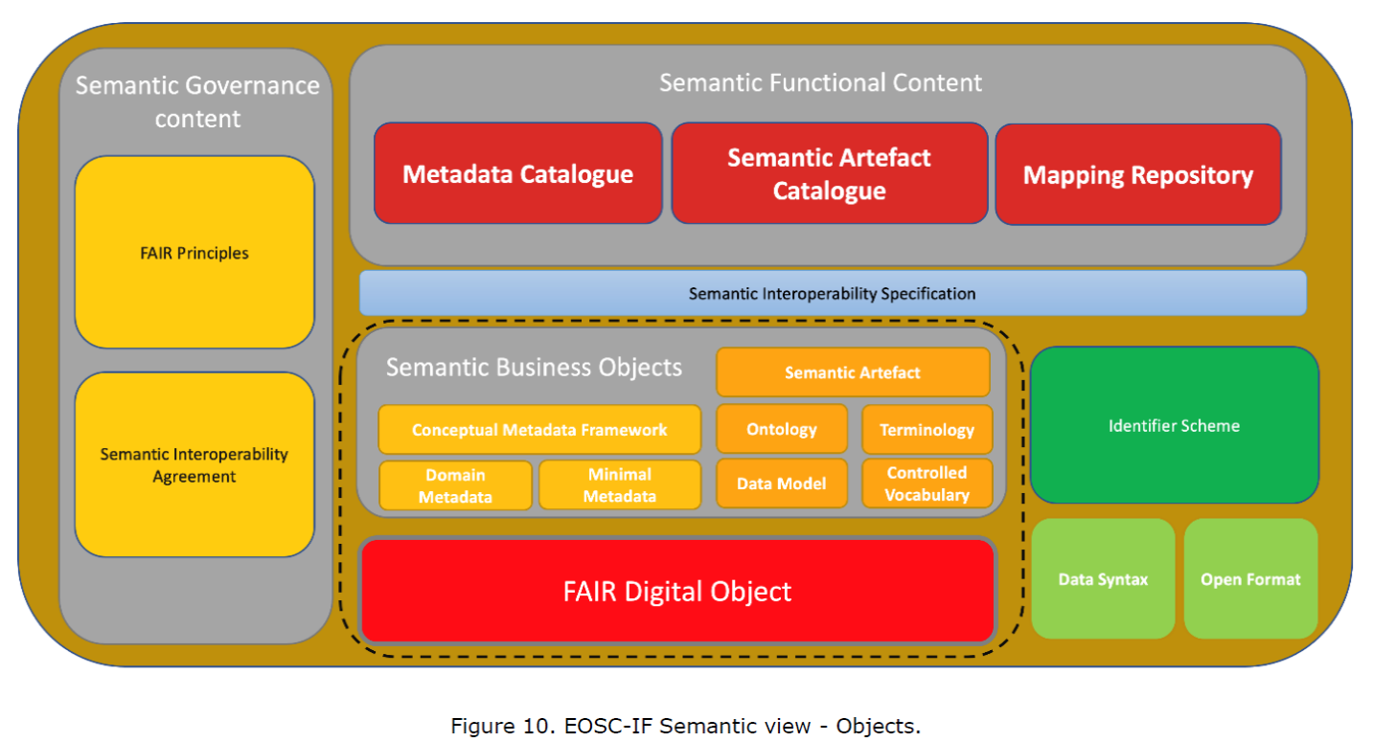

Slide 26
Domain A
Data User
(3) Retrieve Needed
Metadata Resources
FDP 1
FDP 2
FDP 3
(2) Query/Retrieve the FDO
(1) Discover the FDP
Domain B
Register of FDPs/Data Portals/Data Catalogues (by Domain)
Metadata
Resource
FDP 4
FDP 5
FDP 6
Metadata
Resource
Metadata
Resource
Provision of FIPs

Slide 27
How DDI Supports FAIR

Slide 28
An Observation
Many people talk about FAIR but focus only on Findability and Accessibility
This isn’t “FAIR”, it’s “FA”
(You can be mistaken for someone trying to perform The Sound of Music)
These are actually the easy parts
FAIR include the Interoperability and Reusability parts as well!
This has been the primary focus of DDI for a long time
The hard, expensive part…
DDI is for people who want to be serious about FAIR!
DDI provides the rich metadata which is required

Slide 29
DDI: Major Specifications
DDI Codebook (aka “DDI 1.0”, “DDI 1.2”, “DDI 2.5”, etc.)
DDI Lifecycle (aka “DDI 3.0”, “DDI 3.1”, “DDI 3.3”, etc.)
DDI Cross Domain Integration (aka “DDI-CDI”)
Public review draft, expected release summer 2021

Slide 30
DDI Codebook
An XML description of a “codebook” (a data dictionary)
Rectangular files
No concept of metadata reuse
Based on models in existing analysis tools (Stata, SPSS, SAS, etc.)
Included Dublin Core and descriptive “study-level” metadata
Machine-readable (slightly machine-actionable…)
Described data for a single study (one point in time)
After-the-fact description to support archiving and reuse

Slide 31
FAIR Support: DDI Codebook (DDI-C)
A “domain” standard (Social, Behavioral, Economic sciences)
Encoded using XML
But also (to some extent) in RDF – the Disco Vocabulary for discovery
Includes Dublin Core which has many representations
Study- and Data Set-level metadata is good for Findability
Investigators, Funders, etc.
Coverage and Scope
Access and holdings
Methodology
Good support in catalogues
IHSN NADA Catalogue
CESSDA (currently using Nesstar Server)
Variable-level metadata is good for Interoperability and Reusability
Supports external vocabularies of many types

Slide 32
DDI Lifecycle
Major expansion
Describe multiple waves for longitudinal/repeat data collection
Describe comparison and harmonization
Describe data collection and survey instruments
Describe the entire data lifecycle
Reuse of metadata was central to these functions
Support for centralized metadata management
Focus still primarily on rectangular data
XML encoding
Machine-readable
Machine-actionable

Slide 33
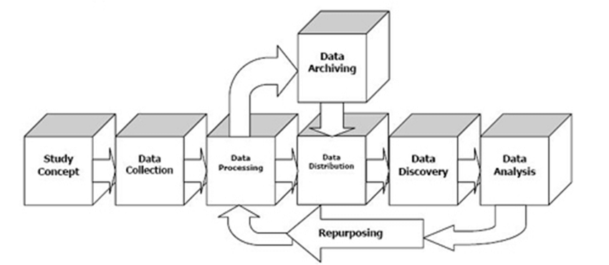
The DDI Lifecycle Diagram (Original Version)

Slide 34
An Important Change…
DDI Codebook allowed you to reference Concepts from variable descriptions
DDI Lifecycle provided full-blown support for describing Concepts and reusing them
Referenced by Variables
Referenced by Categories in Classifications/Codelists
Referenced by Units/Populations/Universes
With the popular “semantic” technologies, Concepts become central
SKOS is the most-used vocabulary in the RDF world
Basis of sematic mapping between organizations/domains

Slide 35
FAIR Support: DDI Lifecycle (DDI-L)
Like DDI Codebook, an XML-based “domain” standard for SBE
FAIR takes a “data-centric” view: DDI Lifecycle has a more holistic view
Much richer information on provenance and processing (Interoperability, Reusability)
Detailed description of data collection (especially questionnaires)
Can associate processing information to many aspects of the data lifecycle (e.g., cleaning, aggregation, anonymization)
Supports use of process description standards such as SDTL
Can be used to describe reusable metadata (Interoperability, Reusability)
Vocabularies are first-order objects
Comparison and harmonization of data is well-supported at a granular “variable” level
Supports external controlled vocabularies and references
Very rich in describing concepts to support sematic integration
Provides support for exchange protocols of many types with “packaging” features
Excellent tool to support data Interoperability and Reusability

Slide 36
DDI Cross-Domain Integration (DDI-CDI)
An extension of the metadata set found in DDI-C and DDI-L
Not a replacement!
Will be released Summer 2021
Provides support for additional types of data
Long data/sensor data/event data
Multi-dimensional data/data “cubes”
Key-Value data/No SQL data/”big” data
Provides support for describing process and provenance across data sets as data is reused/harmonized/integrated
Very Concept-rich
Focus is on individual “Datums”
Model-based (UML), not just XML
Emphasis on machine-actionable metadata!

Slide 37
FAIR Support: DDI Cross-Domain Integration (DDI-CDI)
A cross-domain “conceptual” standard focused on Interoperability and Reusability
Also touches on Findability
Model-based (UML) to support other representations in addition to standard XML
Describes a wide range of data formats used in a variety of domains
Detailed and flexible description for process and provenance
Rich “core” metadata
Concepts
Variables
Vocabularies
Designed to complement/reference other standards
Cataloguing
Vocabularies
Domain semantics
Process and provenance

Slide 38
Credits: DDI Training Working Group
Florio Orocio Arguillas
Alina Danciu
Adrian Dusa
Jane Fry
Martine Gagnon
Dan Gillman
Arofan Gregory
Taras Günther
Lea Sztuk Haahr
Simon Hodson
Chifundo Kanjala
Kaia Kulla
Kathryn Lavender
Amber Leahey
Marta Limmert
Jared Lyle
Alexandre Mairot
Lucie Marie
Hayley Mills
Laura Molloy
Hilde Orten
Anja Perry
Barry Radler
Knut Wenzig

