Slide 1
DDI-CDI Overview, Status, and Implementation
DDI Training Group
DDI Alliance
This work is licensed under Creative Commons Attribution 4.0 International License.

Slide 2
Outline
Introduction
History and Background
Scope and Design
Foundational Metadata
Data Structures
Process
Summary

Slide 3
Introduction

Slide 4
DDI-CDI and FAIR
Many people talk about Findability and Access
Not so much about Interoperability and Reuse
DDI-CDI focuses on these aspects of FAIR data
It is also quite useful for data discovery
Interoperability and reuse of data are metadata-intensive
Historically, these aspects of data management are expensive and have not been fully incentivized by research funders
Today’s focus on FAIR data demands that we do more!

Slide 5
COMMENT
Slide about Shareable metadata = standard and reusable = heightened interoperability

Slide 6
Real-World Trends and Requirements
Several changes have taken place in recent years which impact the requirements for DDI-CDI
Larger research projects using data sometimes coming from external domains
More data, coming from a wider range of sources
Increased ability to compute with data (Machine Learning, etc.)
These changes result in requirements for data/metadata management
More complete, machine-actionable metadata is needed
Improved “context” for data is needed (provenance, semantics)
New data formats/structures must be described and integrated
A broader range of technology platforms require support

Slide 7
Why DDI-CDI?
DDI-CDI is designed to meet these challenges
Standard “lingua franca” for describing data of many types
DDI-CDI is designed to fill the gaps among existing standards and models
Alignment and integration
Complements existing metadata specifications
Provides detailed metadata about the data and processes by which it is reused
Supports an exact understanding of what is required for data reuse
Automate the structural transformations
Connects structural elements with concepts/vocabularies
Support semantic crosswalks between domain ontologies

Slide 8
DDI – CDI as a New Type of Work Product
Earlier DDI standards - DDI Codebook and DDI Lifecycle - are metadata specifications for the Social, Behavioral, and Economic (SBE) Sciences
They are generic enough to be used in similar domains (official statistics, public health)
They still use terms and models familiar to SBE sciences
DDI – CDI is different: it is intended to be used across a wider range of domains
Different types of data and models
More abstract/general terminology
DDI – CDI is a new type of specification, meant to be used with many other standards, in SBE and outside it

Slide 9
History and Background

Slide 10
History: MRT and DDI Developments
DDI was working on a “model-driven” version of the standard for many years – “DDI 4” or “DDI Moving Forward”
This work is the basis of DDI-CDI
This work has also informed developments in DDI Lifecycle
In the margins of the 2018 European DDI User Conference (Berlin) it was agreed that a “core” of the next-generation/model based DDI work should be brought to market
A 1-year timeframe was proposed but as usual it took basically forever – thanks COVID! (Qualify w/ first public review version)
The Modelling, Representation and Testing (MRT) group was formed in early 2019
The working process was to base models on implementations, tested against real-world use cases
ALPHA Network
DDI R Libraries (references: 1, 2)
Others (U.S. Bureau of Labor Statistics for time series, etc.)

Slide 11
Group and Events
Confluence Sprints Page lists the events in the development of DDI 4 (and CDI)
MRT: small group (9 members) meeting weekly (and more) for over a year
No turn-over – members have been extremely focused and disciplined
Ottawa Sprint in margins of NADDI 2019
Dagstuhl Sprint in October 2019
Public Review Release April 2020
MRT has done 7 webinars to reach out to users in different areas (250+ people)
In collaboration with CODATA
More are planned
Communications with management, technical committee work, marketing, and training groups within the DDI Alliance have been emphasized

Slide 12
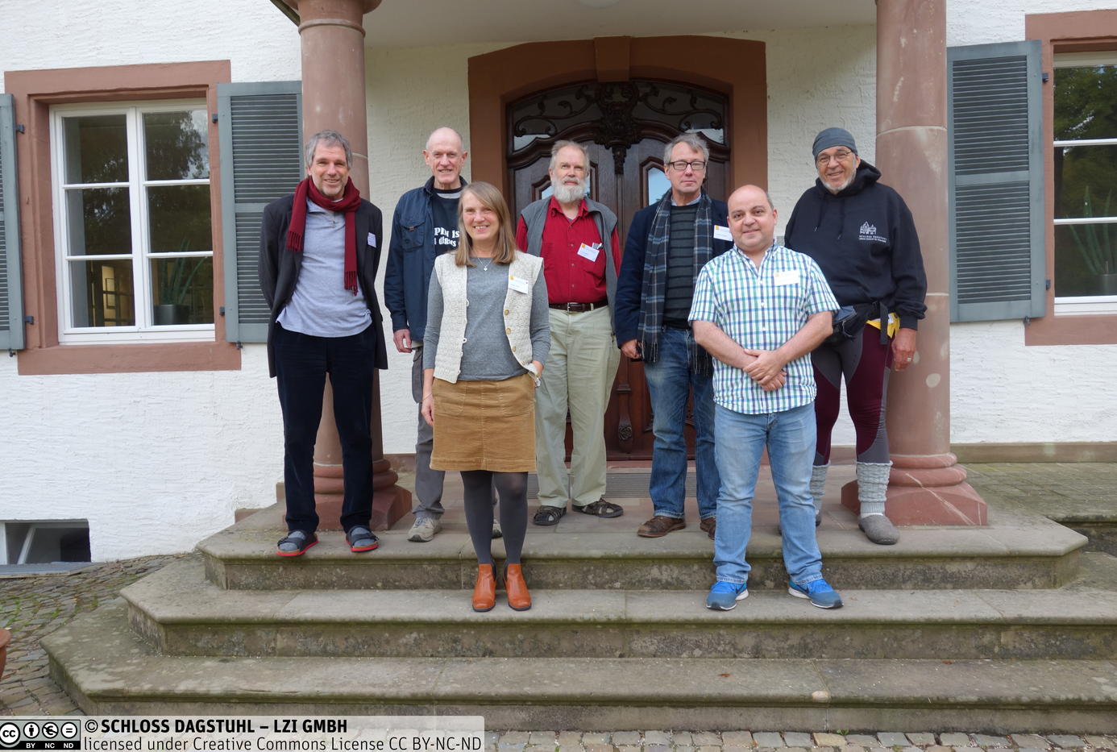
MRT Members
Back row, from left: Joachim Wackerow Dan Gillman Larry Hoyle Arofan Gregory Jay Greenfield
Front row, from left: Hilde Orten Flavio Rizzolo
Not in picture:
Oliver Hopt Wendy Thomas
https://ddi-alliance.atlassian.net/wiki/spaces/DDI4/pages/707624961/Dagstuhl+Sprint+October+2019
Notes:
Back row, from left: Joachim Wackerow, Dan Gillman, Larry Hoyle, Arofan Gregory, Jay Greenfield
In front, from left: Hilde Orten, Flavio Rizzolo
Not on the picture: Oliver Hopt, Wendy Thomas

Slide 13
Evolution in Purpose
DDI-CDI was expected to be the “core” of a model-driven DDI
A “next generation” after DDI-Lifecycle
Implementation cases showed that something else was needed: a focus on data provenance and data integration
DDI-CDI has emerged as a companion to DDI-Codebook and DDI-Lifecycle, not a replacement for them
The Social, Behavioral, and Economic (SBE) community needs better data integration tools
So do other domains!

Slide 14
Scope and Design

Slide 15
DDI-CDI within the Realm of Metadata Standards
DDI-CDI does not replace existing domain metadata standards
DDI-Codebook or DDI-Lifecycle for SBE sciences
Other fine-grained standards according to domain use (EML for ecology, OMOP CDM for clinical records, etc.)
It functions as a complement
It adds support for understanding diverse types of data across domain boundaries
It expands the ability to describe process (provenance)
It provides a detailed description of integration between disparate types of data

Slide 16
The Model is the Main Thing!
A formal UML class model
Based on a subset of UML features
Expressed as Canonical XMI
XMI is an XML language for describing/exchanging UML models
Canonical XMI is well-supported by a broad range of UML tools
Representations in specific tools/syntaxes can be generated automatically from the UML (even by users)
An XML representation is provided, others may be in future
UML “future-proofs” the standards
Against changes in technology tools
By being extensible

Slide 17
DDI – CDI Scope (Example)
“Microdata”/Unit Record Data
Aggregate Data/ Data “Cube”
Raw Data
Indicators
DDI – CDI describes the data at each stage, indicating the roles played by each atomic bit of data (“datum”)
This includes describing classifications, variables, concepts, etc. (“Foundational Metadata”)
New types of data can be described
DDI – CDI tracks the processing between each stage (implements PROV), reflecting the relationships between atomic datums (uses other standards for describing specific processes - SDTL)

Slide 18
Foundational Metadata

Slide 19
Foundational Metadata (from DDI 4)
Concepts and Concept Systems
Variables (of many types!)
Classifications, Codelists, Categories (etc.)
Includes classification management
Populations, Units, and Universes

Slide 20
Foundational Metadata: The Variable Cascade
Understanding the roles played by variables is critical in integration of data
Variables do many, many different things
Not all variables are the same!
We have three levels of variables in our model:
Conceptual Variables
Represented Variables
Instance Variables
Notes:
The Variable Cascade was developed as part of the DDI-CDI (DDI4) development. It is also taken on board in DDI-Lifecycle

Slide 21
Variable Cascade – Conceptual Variable
Variable descriptions at a high level. Early in designing data collection, broad searches. Broadly reusable.
Notes:
The ConceptualVariable holds information at a very general level.

Slide 22
Variable Cascade - RepresentedVariable
More specificity about value domain, units of measurement. Still reusable.
Notes:
RepresentedVariable: A ConceptualVariable with a substantive value domain specified.

Slide 23
Variable Cascade - InstanceVariable
Describing collected data. Physical datatype and platform. Invariant role of the variable (e.g. a weight)
Notes:
InstanceVariables are for collected data. Represents the use of a RepresentedVariable within a data set.
The InstanceVariable class inherits all of the properties and relationships of the RepresentedVariable class and, in turn, the ConceptualVariable class.
This means that an InstanceVariable can be completely populated without the need to create an associated RepresentedVariable or ConceptualVariable.

Slide 24
Application: Documenting Comparability among Variables (Simple Example)
Legalmaritalstatus (conceptual variable)
Conceptual variable Common variable specification without a representation
1 | Married
2 | Separated
3 | Divorced
4 | Widowed
5 | Never married
MARITAL (represented variable)
MARITALB (represented variable)
Represented variable
Common variable specification with a code representation
1 | Legally married
2 | In a legally registered civil union
3 | Legally separated
4 | Legally divorced/civil union dissolved
5 | Widowed/civil partner died
6 | None of these (NEVER married or in legally registered civil union)
MARITAL
2004 (variable)
MARITALB
2008 (variable)
MARITALB
2018 (variable)
Variable
Variable specification within a dataset context
Notes:
The example, European Social Survey 2004, 2008 and 2018:
Three Different (distinct) sets of data with a different variables all measuring legal marriage status.
Represented variables link variables which are directly comparable and have the same representation of the value domain. It doesn’t care about the question asked- only the value domain.
The represented variable is a way to measure marriage and so links to the marriage conceptual variable.
(Value domain = Variable representation in DDI-Lifecycle)

Slide 25
Application: Recognizing Similar variables in Difficult Cases
Two variables in different data sets might:
Measure the same concept differently
Measure the same concept in the same way with different physical representations
Exist identically in two data sets, but with no formal link
In all of these cases, understanding the variables at each level (conceptual, representational, and actual) provides a strong basis for programmatically identifying them as potential points for joining data sets

Slide 26
Notes on the Variable Cascade
The variable cascade separates the logical construct from its physical organization
A variable can be expressed in different ways, but is logically the same
It is not always a column in a table
The variable cascade separates substantive and sentinel values
Sentinel values may be platform or software specific (i.e., missing value codes)
Substantive values will remain consistent
Reference is ISO 114h04 Data Types specification
The Conceptual Variable may also contain Categories (although not codes) if this level of refinement is needed to inform reuse

Slide 27
Data Structures

Slide 28
Data Structures
DDI-CDI currently can describe four different data structures
Wide – as with unit records
Long - as with event or stream data
Key value – as in a key-value store
Dimensional - as with aggregate data
We’ll now show some examples of data and their representations in the different structure types.
Notes:
Wide Data
Traditional rectangular unit record data sets. Each record has a unit identifier and a set of measures for the same unit
Long Data
Each record has a unit identifier and a set of measures but there may be multiple records for any given unit. The structure is used for many different data types, for example event data and spell data
Multi-Dimensional Data
Data in which observations are identified using a set of dimensions. Examples are multi-dimensional cubes and time series
Key-Value Data
Set of measures, each paired with an identifier

Slide 29
Roles: The COVID example- Wide structure
(Unit)
Identifier
Component
Measure
Component
Attribute
Component
entry | datetime | systolic | diastolic | position | weight | temp | pctO2 | pulse | away | exposed
101 | 2020-07-14T13:54 | 114 | 70 | 2 | 83914.6 | 36.44 | 98 | 70 | n | n
132 | 2020-07-14T14:03 | 125 | 86 | 3 | 68038.9 | 37.5 | 85 | 92 | y | n

Slide 30
Roles: The COVID example- Long structure
VariableDescriptorComponent
AttributeComponent
VariableValueComponent
Identifiers
Entry | DateTime | Position | Measure | Value
101 | 2020-07-14T13:54 | 2 | systolic | 114
101 | 2020-07-14T13:54 | 2 | diastolic | 70
101 | 2020-07-14T13:54 | 2 | weight | 83914.60
101 | 2020-07-14T13:54 | 2 | temp | 36.44
101 | 2020-07-14T13:54 | 2 | pctO2 | 98
101 | 2020-07-14T13:54 | 2 | pulse | 70
101 | 2020-07-14T13:54 | 2 | away | n
101 | 2020-07-14T13:54 | 2 | exposed | n
132 | 2020-07-14T14:03 | 3 | systolic | 125
132 | 2020-07-14T14:03 | 3 | diastolic | 86
132 | 2020-07-14T14:03 | 3 | weight | 68038.90
132 | 2020-07-14T14:03 | 3 | temp | 37.5
132 | 2020-07-14T14:03 | 3 | pctO2 | 85
132 | 2020-07-14T14:03 | 3 | pulse | 92
132 | 2020-07-14T14:03 | 3 | away | y
132 | 2020-07-14T14:03 | 3 | exposed | n
The Variable Descriptor Component has values
taken from the list of non-Unit Identifiers
in the wide data set.
(This can be programmatically known.)
The “key” for each value is composed from
the identifiers plus the Variable Descriptor.
Notes:
COVID example: DDI-CDI builds up compound keys from components. For Long structures there are identifier, measure and attribute components.
Here Position is intended as an attribute of the blood pressure measurement. More on that in the next slide. A long structure has a column that is problematic for describing this as a traditional record. The
Value column does not have a single concept or datatype, instead there is another column that has a code that indicates what the measure is. This is a common type of structure for event or stream data. Here, the value column is associated with a VariableValueComponent and the Measure column is associated with the VariableDescriptorComponent.
* IdentifierComponent – one of possibly several components that together identify the Unit associated with the measures and attributes.
* AttributeComponent – an attribute that annotates the associated measure values.
* VariableDescriptorComponent – an indicator of the InstanceVariable in each associated VariableValueComponent.
* VariableValueComponent – defines a column that has a value associated with the value in the VariableDescriptorComponent. A character datatype for the associated RepresentedVariable would be required.
NB: In many statistical platforms there are tools to reshape data between wide and long format. Many have restrictions that would force all of the measure values to have the same datatype (e.g. all numeric).
* MeasureComponent (not in the example) – a measure just like in the wide layout. This allows a hybrid wide-tall layout. There is no such column in the example above.

Slide 31
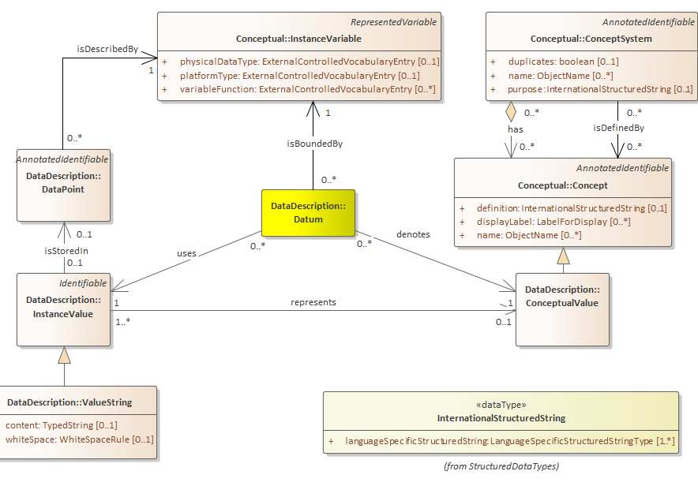
The Datum Approach
Notes:
All of the preceding structures are built up as sets of DataPoints.
It might be worth describing this one model diagram in detail, The Datum ties together the InstanceVariable, the InstanceValue and the ConceptualValue. Contained in a DataPoint, the InstanceValue is the physical representation of the person’s systolic BP at that point in time. In this case it is a string. The InstanceVariable carries the metadata described earlier.
There could be many InstanceValues representing the same ConceptualValue.
The model does not require the use of Datum and ConceptualValue though. Data can be described with InstanceValue and DataPoint if explicitly tracking measurements is not needed.

Slide 32
Cross Domain – Content and Structure
Integrating data across domains involves both dealing with different kinds of discipline’s structures and vocabularies
Sensor data streams in tall structures
Survey data in wide structures
Administrative summary data in cubes
A standard also needs to be discipline agnostic.
Vocabularies need to be referenced, not built in
(e.g. “question”)
A standard needs to be able to at least reference metadata in other disciplines standards.
This, of course, presents challenges for machine actionability.
Notes:
Different domains not only deal with different concepts, but also may have different expectations for data structure. A cross – domain standard needs to be able to deal with, and transform among the differences.
No standard is going to be able to include all of the details needed to thoroughly document and integrate data across disciplines. Referencing metadata in other standards can help, but software using the referenced information faces the same dilemma – it must be able to understand the structure of anything it needs to use.

Slide 33
Dimensional Example
Aggregate fisheries statistics, Year 2019 – Norwegian boats – Round weight in tons
 | Fishing equipment, main group
Species, main group | Purse seine | Conventional | Trawl | Other
Pelagic fish | 587465 | 1371 | 712873 | 359
Cod and cod species | 33554 | 397254 | 237496 | 11
etc.
Multi-dimensional “keys” are identifiers formed from the set of dimension values (variables in long table).
Long table (micro-data set)
Boat name | Nationality of boat | Landing date | Spieces | Round weight in ton | Fishing equipment
Lønningen | NO | 07.04.2019 | Blue whiting | 2917,75 | Trawl
Ligrunn | NO | 29.08.2019 | Herring | 23034,41 | Trawl
Ligrunn | NO | 29.08.2019 | Pollock | 307,1 | Trawl
Ligrunn | NO | 25.09.2019 | Mackerel | 1621,68 | Seine net
Vikingbank | NO | 05.11.2019 | Norwegian spring breeding herring | 2932,16 | Net equipment
Notes:
Adapted from source: https://www.fiskeridir.no/Yrkesfiske/Tall-og-analyse/Fangst-og-kvoter/Fangst/Fangst-fordelt-paa-art

Slide 34
Key-Value example
Semantic Sensor Network Ontology (SSN) example
Wide
SensorID | Property | Time | ResultingValue
sensor/35-207306-844818-0/BMP282 | atmosphericPressurehPa | 2017-06-06T12:36:12Z | 1021.45
Key-Value
Key | Time | ResultingValue
sensor/35-207306-844818-0/BMP28/atmosphericPressurehPa | 2017-06-06T12:36:12Z | 1021.45
Notes:
Streaming data may involve a flexible set of measures arriving at unpredictable times. Structures that may be useful for streaming data include the long structure (like for event data) or a key value store.
With a long structure measure variables, may be associated with identifier variables (such as a sensor identifier) and attribute variables (such as time of measurement, time of receipt, location of measurement).
An example sensor observation from the W3C Semantic Sensor Network Ontology (SSN) (https://www.w3.org/TR/vocab-ssn/#iphone_barometer-sosa) is of a barometric pressure taken by an iPhone.
Upper table: Long format:
The value atmosphericPressurehPa is a code that points to a variable that links to the Concept “earthAtmosphere” in units of hectoPascal (hPa).
Lower table: Key Value Store format:
The SensorID and Property are concatenated into a single Key. The Key could be decomposed into the SensorID and Property components as needed.
Measures may involve datatypes not currently described in DDI (images, sound recording, etc.) but envisioned for future updates such as for Qualitative data.

Slide 35
Tracking across structures
Entry | DateTime | Position | Measure | Value
101 | 2020-07-14T13:54 | 2 | systolic | 114
101 | 2020-07-14T13:54 | 2 | diastolic | 70
101 | 2020-07-14T13:54 | 2 | weight | 83914.60
101 | 2020-07-14T13:54 | 2 | temp | 36.44
101 | 2020-07-14T13:54 | 2 | pctO2 | 98
101 | 2020-07-14T13:54 | 2 | pulse | 70
101 | 2020-07-14T13:54 | 2 | away | n
101 | 2020-07-14T13:54 | 2 | exposed | n
132 | 2020-07-14T14:03 | 3 | systolic | 125
132 | 2020-07-14T14:03 | 3 | diastolic | 86
132 | 2020-07-14T14:03 | 3 | weight | 68038.90
132 | 2020-07-14T14:03 | 3 | temp | 37.5
132 | 2020-07-14T14:03 | 3 | pctO2 | 85
132 | 2020-07-14T14:03 | 3 | pulse | 92
132 | 2020-07-14T14:03 | 3 | away | y
132 | 2020-07-14T14:03 | 3 | exposed | n
The example contains three Instance Values relating to the same ConceptualValue
DDI-CDI can tie all three together!
And through the use of keys map the transformations between the long structure at right and the wide structures below.
For Europe
entry datetime systolic diastolic position weight temp pctO2 pulse away exposed
101 2020-07-14T13:54 114 70 2 83.914,6 36,44 98 70 n n
132 2020-07-14T14:03 125 86 3 68.038,9 37,50 85 92 y n
For US
entry datetime systolic diastolic position weight temp pctO2 pulse away exposed
101 2020-07-14T13:54 114 70 2 83,914.6 36.44 98 70 n n
132 2020-07-14T14:03 125 86 3 68,038.9 37.50 85 92 y n
Notes:
Previous versions of DDI would have difficulty in documenting these three representations (Instance values) of the weight of entry 101 at 2020-07-14T13:54 as representing the same thing.
DDI-CDI allows for identifying DataPoints through the use of keys.

Slide 36
Application: Automating Data Integration
If I understand the role played by any given data point in its data set of origin, I can predict what role it must play in the data set I need to transform it into for integration purposes
The DDI-CDI model shows us how these relate, and can avoid manual intervention in performing the needed structural transformations
Reduces the (up to 80%) resource burden on projects for preparing data for analysis

Slide 37
SERL: Granular Metadata for Cross-Domain Sharing
Smart Energy Research Laboratory (SERL)
Several partners, UKDA is managing and processing the data
Currently, and example of a pre-integrated data coming from different domains
Temperature readings from Copernicus
Meter readings from energy suppliers
Survey responses from a customer sample
We looked at how DDI-CDI could be used to support such an integration in an automated fashion (e.g., a “run-time” discovery and use scenario)
DDI-CDI descriptions of inputs could provide the basis for automated creation of integration/linking information

Slide 38
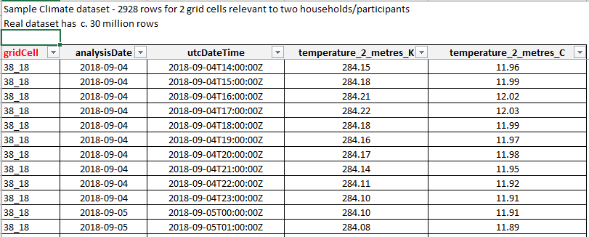
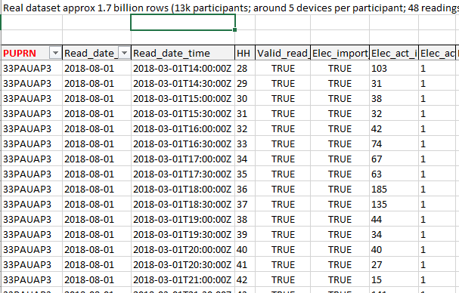
Temperature Data
(by Region “grid cell”)
Utility Meter Data
(by Customer ID)
Linking Data
(grid cells mapped
to customer IDs)
Customer Questionnaire
Data
(by Customer ID)

Slide 39
Process

Slide 40
The DDI-CDI Process Model
Describes the use of individual processes, and how they fit together
Supports standard descriptions (SDTL, VTL) and specific languages (SQL, R, STATA, SPSS, Python, SAS, etc.)
Three “modes”:
Procedural: Step-wise, with decision points
Declarative: “Black box” multi-threaded, uses a “playbook” and configurations
Hybrid approaches of the two

Slide 41
Simple Diagram
Parameters
Process
Engine
Playbook
(Functions)
Activity
Control Logic
Step
Inputs
Outputs
Inputs
DECLARATIVE PROCESS
Outputs
Sub-Step
PROCEDURAL PROCESS

Slide 42
Process Example: Data Cleaning Activity
Step 1: Inspect data and generate a report with:
Impossible cases (e.g., 3-year-olds giving birth; people marrying themselves)
Improbable cases (e.g., 12-year-olds with an earned income of 250,000 EUR per annum)
Step 2: Evaluate quality
Accept: Data has low percentage of impossible/improbable cases - continue
Reject: Data has high percentage of impossible/improbable cases – exit process with errors
Step 3: Produce cleaned data set
Trim out impossible/improbable cases

Slide 43
Procedural Process
Input
Data
INSPECT DATA
Report of Errors
PRODUCE CLEAN DATA
Cleaned
Data
Input
Metadata
EVALUATE DATA
Cleaned
Metadata
ACCEPT
PROCESS CONTROL (FLOW LOGIC)
REJECT

Slide 44
Declarative Process
Input
Data
Cleaned
Data
PROCESS “BLACK BOX”
Input
Metadata
OR
Cleaned
Metadata
Completion Criteria
PROCESS CONTROL
Playbook (Functions)

Slide 45
Application: A Provenance Browser
One question researchers often ask is: “Where did this number come from? What is it really?”
Typically, the answer is unsatisfying and/or non-existent.
The following examples are drawn from an application being developed using the DDI-CDI model to bring together processes and data sets, and the metadata attached to them, to give researchers a useful way to look at any portion of the provenance chain, and to answer this question.

Slide 46
Application: A Provenance Browser (cont.)
This is an application was one of the test cases for DDI-CDI specification development
Provenance metadata (the processes) are mined programmatically from the ETL platform, Pentaho
These are often “chains” which leverage STATA scripts to perform the processing itself
Variable descriptions are taken from DDI Codebook XML
Human-readable “Purpose” statements are added manually
The “browser” brings this together in an easy-to-use form, from the viewpoint of a specific process step or data set

Slide 47
COMMENTS
ADD EXPLICATION OF SCREEN-SHOT SLIDES
STRESS AUTOMATED CAPTURE OF PROCESS METADATA
NEED TO DEVELOP TOOLS FOR PACKAGES USED BY EACH DOMAIN
CONSIDER SDTL AND C2METADATA TOOLS

Slide 48
SCREEN DESIGN: VIEW DATA INPUTS/OUTPUTS BY PROCESS JOB
[NAME OF PROCESS]
JOB: [NAME OF JOB]
[TASK]
[TASK]
[TASK]
JOB: [NAME OF JOB]
[TASK]
[TASK]
[TASK]
DATASETS
[DATASET NAME]
[DATASET NAME]
[DATASET NAME]
[INPUT DATASET]
[OUTPUT DATASET]
[NAME OF JOB]
Overview
Purpose
Algorithm
[INPUT DATASET]
[OUTPUT DATASET]

Slide 49
SCREEN DESIGN: VIEW PROCESS JOBS BY DATA SET
[NAME OF PROCESS]
JOB: [NAME OF JOB]
[TASK]
[TASK]
[TASK]
JOB: [NAME OF JOB]
[TASK]
[TASK]
[TASK]
DATASETS
[DATASET NAME]
[DATASET NAME]
[DATASET NAME]
[CONSUMING
JOB]
[NAME OF DATASET]
Overview
Purpose
Algorithm
[CREATINGJOB]
[CONSUMING
JOB]

Slide 50
SCREEN DESIGN: VIEW CODE FOR A SPECIFIC TASK WITHIN A PROCESS JOB
[NAME OF PROCESS]
JOB: [NAME OF JOB]
[TASK]
[TASK]
[TASK]
JOB: [NAME OF JOB]
[TASK]
[TASK]
[TASK]
DATASETS
[DATASET NAME]
[DATASET NAME]
[DATASET NAME]
[NAME OF TASK FILE]
use hsb2, clear
* get values for boxplot
summarize write, d
gen f=43 /* set value a little larger than bin with highest frequency */
gen pmin=r(min)
gen p25=r(p25)
gen p50=r(p50)
gen p75=r(p75)
gen pmax=r(max)
gen pmean=r(mean)
* graph histogram and boxplot on same axes
two (histogram write, start(30) width(5) freq) ///
(rcap pmin pmax f in 1, hor bcolor(dknavy)) ///
(rbar p25 p75 f in 1, hor bcolor(dknavy)) ///
(rcap p50 p50 f in 1, hor bcolor(white)) ///
(rcapsym pmean pmean f in 1, hor msym(plus) mcolor(white)), ///
legend(off) xtitle("Writing Score") ytitle("Frequency")
* drop variables created for boxplot values
drop f-pmean

Slide 51
EXAMPLE: DESCRIPTIVE METADATA ABOUT A PROCESS JOB
ALPHA Data Pipeline Spec. 6.1
Business Processes:
[02] Core ETL for Raw Input
Overview
Purpose
Steps:
[2.1] Generate Anonymized IDs
[2.2] Map original IDs to
Anonymized IDs
[2.3] Store ID Mapping
[2.4] Create 6.1 Data from Raw
Data
[03] 6.1 Data Quality Metrics
Overview
Purpose
Steps:
[3.1] Compile Quality Metrics
[3.2] Compile Residency Starting
Events
[3.3] Compile Residency Ending
Events
[3.4] Compile Legal and Illegal
Starting Events
02 Core ETL for Raw Input - Purpose
Creates staging tables from member-centre-specific data. The staging tables are then transformed further to create the ALPHA specification 6.1.

Slide 52
EXAMPLE: CONCEPTUAL METADATA ABOUT A DATA SET
ALPHA Data Pipeline Spec. 6.1
Business Processes:
[02] Core ETL for Raw Input
Overview
Purpose
Steps:
[2.1] Generate Anonymized IDs
[2.2] Map original IDs to
Anonymized IDs
[2.3] Store ID Mapping
[2.4] Create 6.1 Data from Raw
Data
[03] 6.1 Data Quality Metrics
Overview
Purpose
Steps:
[3.1] Compile Quality Metrics
[3.2] Compile Residency Starting
Events
[3.3] Compile Residency Ending
Events
[3.4] Compile Legal and Illegal
Starting Events
[3.2] Compile Residency Starting Events
Description:
Identify in the data, events that start a residency episode (birth, external-immigration, enumeration, becoming eligible for a study, found after being lost to follow-up).
Concepts:
This algorithm step references the following study concepts: residency
birth
migration
The change of residence by a registered individual or social group (e.g., a household). There are two types of migration that occur among the registered population. These are internal and external migration.

Slide 53
EXAMPLE: STRUCTURAL/CODEBOOK METADATA ABOUT A DATA SET
ALPHA Data Pipeline Spec. 6.1
Business Processes:
[03] 6.1 Data Quality Metrics
Overview
Purpose
Steps:
[3.1] Compile Quality Metrics
[3.2] Compile Residency Starting
Events
[3.3] Compile Residency Ending
Events
[3.4] Compile Legal and Illegal
Starting Events
Data Sets:
[1] Raw 6.1 Event Format
[2] DoB Quality Metrics
[3] Illegal Transitions
recnr [INT] study_name [VARCHAR(15)] idno [VARCHAR(32)] hhold_id [VARCHAR(32)] hhold_id_extra [VARCHAR(32)] sex [INT] dob [DATETIME] residence [VARCHAR(5)] eventnr [INT] event [INT] event_date [DATETIME] type_of_date [INT] obs_date [DATETIME] obs_round [VARCHAR(2)]
CONSUMING PROCESS
CREATING PROCESS
[03] 6.1 Data Quality Metrics
[1]
Raw 6.1 Event Format
[01] Site-Specific ETL
CONSUMING PROCESS
[04] Clean 6.1 Data
View Dataset Structure

Slide 54
Benefits of DDI-CDI
Data and process/provenance can be tied together into a coherent chain
The process metadata can be captured programmatically off of processing platforms
Other standards and syntaxes can be embedded
Structured Data Transformation Language (SDTL)
Validation and Transformation Language (VTL)
Proprietary/package syntaxes /Stata, R, etc.)

Slide 55
Application: Transparency - Replication/Reproduction of Findings
With rich provenance metadata, it is much easier for humans to reproduce findings
With a complete machine-actionable record of data provenance, reproducibility of findings can be performed by machines – computational replication’
Transparency requires this ability, but…
Problems of scale will demand that these processes be more efficient!

Slide 56
Summary

Slide 57
DDI-CDI Promotes FAIR Data Sharing
By supporting the interoperability and reuse of data across domains
Differences in structure
Differences in process
By providing a concept-rich, detailed descriptions of data
Supports mapping of domain ontologies/semantics
Designed to provide machine-actionable metadata for leveraging sophisticated data integration processing

Slide 58
Where Are We?
Engagement with external domains and reviewers has been high
Webinars on specific topics/domains
EOSC Project to Recommend Applications of DDI-CDI
International FAIR Convergence Symposium/GO FAIR/CODATA
Next Steps
Focus on examples (UOM, Process)
Look at external data cases (e.g, NetCDF)
Example with DCAT
Consider “upper model” work
Integration with FAIR FIPs/FDOs
Release of final specification in summer of 2021

Slide 59
Credits: DDI Training Working Group
Florio Orocio Arguillas
Alina Danciu
Adrian Dusa
Jane Fry
Martine Gagnon
Dan Gillman
Arofan Gregory
Taras Günther
Lea Sztuk Haahr
Simon Hodson
Chifundo Kanjala
Kaia Kulla
Kathryn Lavender
Amber Leahey
Marta Limmert
Jared Lyle
Alexandre Mairot
Lucie Marie
Hayley Mills
Laura Molloy
Hilde Orten
Anja Perry
Knut Wenzig

